Slide 1
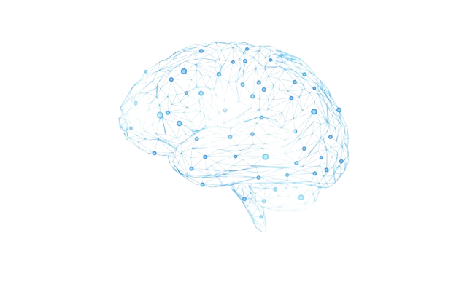
Memento -Human Touch with Automation -

Slide 2
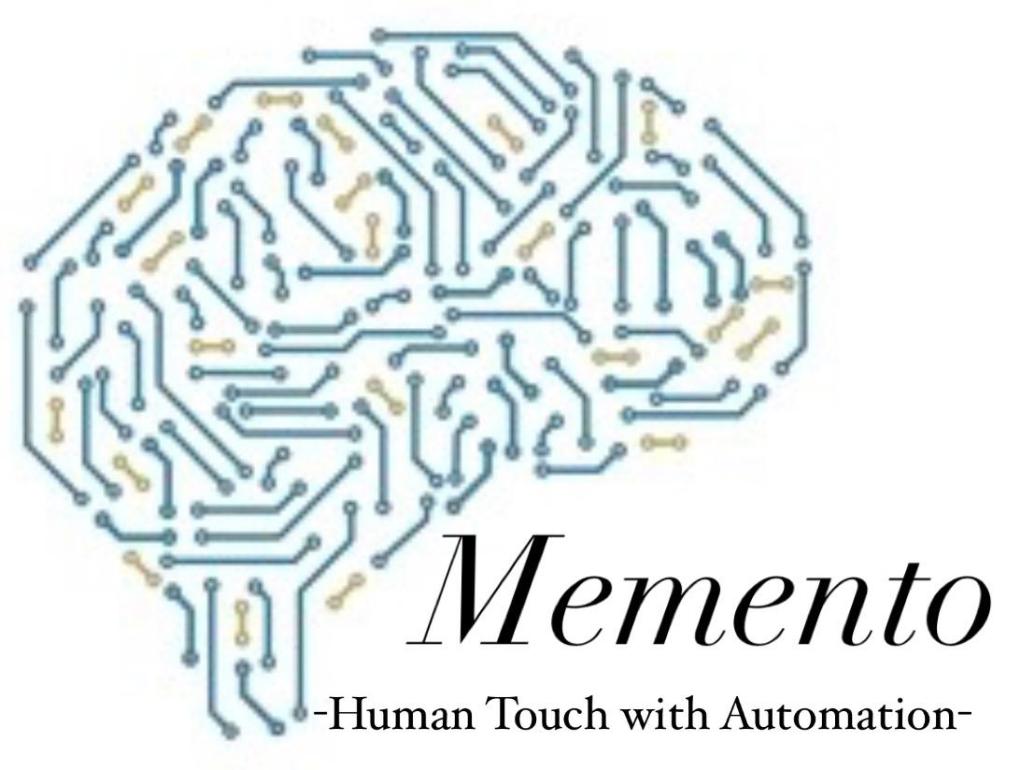
Problem Statement
Caregivers for Alzheimer’s and Parkinson’s patients face burnout due to the demanding nature of providing consistent, personalized support. Our AI-powered solution delivers logical assistance, reducing caregiver stress, optimizing care efficiency, and enhancing patient quality of life through smart technology.
About Memento AI
At Memento AI, we believe that person-centered care is the cornerstone of quality care.
Our approach emphasizes understanding each individual living with Alzheimer’s and Parkinson’s—embracing their values, beliefs, interests, abilities, and preferences from both past and present.
By prioritizing these unique needs, we ensure that caregivers and health professionals are equipped to make informed decisions that truly reflect the individual's circumstances.
Memento AI is committed to enhancing the care experience by placing the person at the forefront of all interactions, ultimately improving the quality of life for both patients and their caregivers.

Slide 3
Patient with Alzheimer's/Parkinson
Human Caregiver
Memento AI
Daily Tasks
Health Monitoring & Management
Task Automation
Data Analysis
Support and Help from Family
Medication Reminders
Scheduling & Follow up
Alerts & Reports
Communication with Health Care Providers
Feedback Loop
Health Outcomes
Emotional Support

Slide 4
Block Diagram
Providing Instructions
Guiding the instructions
User (Family/Caregiver)
Memento (AI assistance)
Subject (Patient)
Shares updates with family members and caregiver
Observing the response and recording it
Analysis and decision making

Slide 5
Thank you!

