Slide 1
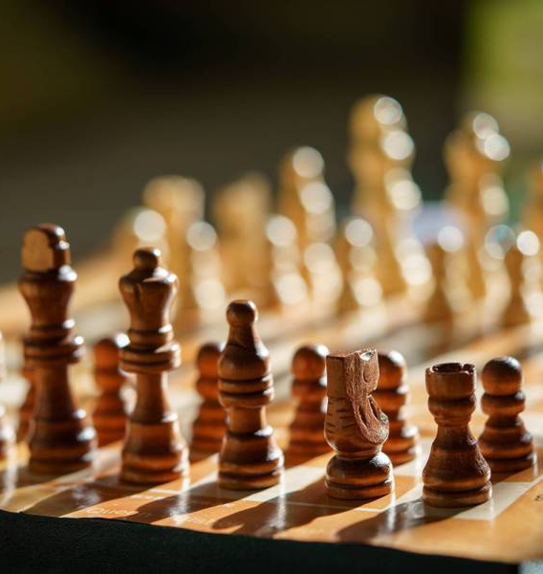
Game of chess guided by Prof Priyanka Rukesh
USN | Name
ENG22CA0017 | Blessto Gods Feareth D
ENG22CA0024 | Harshith S
ENG22CA0031 | Kishore A
ENG22CA0057 | Bala Vinay

Slide 2
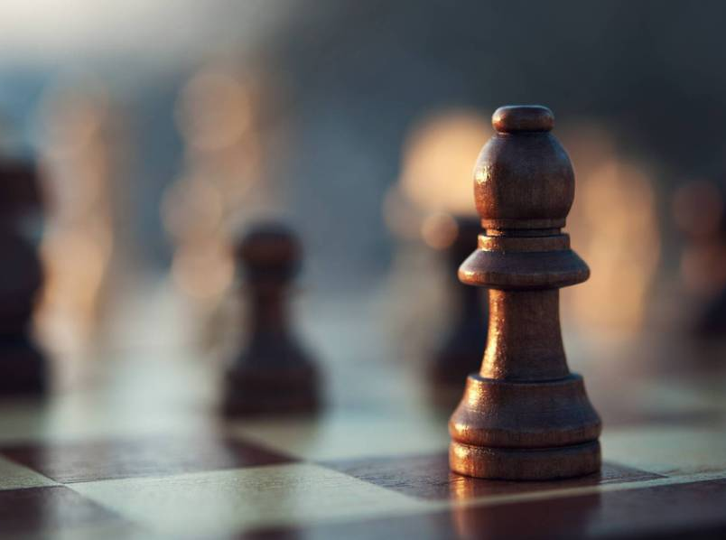
Introduction
Chess is a two-player strategy board game played on a checkered board with 64 squares. The goal is to checkmate your opponent's king, or put it in a position where it cannot escape capture on the next move . History Chess originated in India around the 6th century CE, and spread to Europe and the Middle East by the 10th century. It evolved into what we know as chess around the 16th century . Pieces Each player has 16 pieces, including one king, one queen, two rooks, two bishops, two knights, and eight pawns . Rules Chess is a complex game with many rules and scenarios. For example, white always has the first move, and one player is usually responsible for hiding a white and black pawn in each hand to decide who gets white and who gets black.

Slide 3
Scope of creating a game of chess using Python
Board Representation: Decide how you will represent the chessboard in your code. This could be a 2D array, a list of lists, or even a more complex object-oriented approach.
Piece Representation: You'll need to represent each chess piece and its properties such as type, color, position, and legal moves.
Move Generation: Implement the logic for generating legal moves for each piece. This involves considering the rules of chess regarding piece movement, capturing, castling, and en passant.
Game Logic: Implement the overall game logic, including checking for checkmate, stalemate, and other game-ending conditions.
User Interface: Decide whether you want a simple text-based interface or a more complex graphical one using libraries like Pygame or Tkinter.
AI: Optionally, you might want to implement an AI opponent using techniques like minimax with alpha-beta pruning, reinforcement learning, or neural networks.
Testing: Develop a suite of tests to ensure that your game functions correctly under various conditions.
Documentation: Document your code thoroughly, especially if you plan to share it with others or revisit it later.
Extras: Consider adding features like saving/loading games, tracking game history, implementing different variants of chess (e.g., chess960), or adding a multiplayer mode.

Slide 4
Requirement of hardware and software
Hardware
Software
Storage : 1TB
CPU : Intel i5 or above
RAM : 2 GB
MONITOR : 17 Inches with any resolution.
An average PC with basic specifications for smooth gaming experience.
VS Code : For writing code
Github : To storage/share fields
Python 3.x, Pygame library and an integrated development environment (IDE).

Slide 5
Process To Create Human vs Human game
Steps | Tasks
1 | Install Pygame, Chess and simpleGUI library
2 | Set development environment to work with python and pygame
3 | Create a GUI window using pygame where users can interact with game
4 | Display menu for the game, the menu contain human vs human or human vs AI
5 | Based users selection initialize the game with appropriate setup
6 | Implement Human vs Human Gameplay: Allow player to input via the GUI Validate the move and update the GUI accordingly Check for game ending condition after each move
7 | Continue the game until a checkmate, stalemate, or user choose to quite
8 | Display the results of the game (Win or Lose) and GUI should pop-up a menu asking the player to continue or quite

Slide 6
Division for Human vs Human
Blessto Gods Feareth D | Harshith S | Kishore A | Bala Vinay M
Basic Pygame Setup | Handling Player Piece Options | Calculate Valid Pawn Moves | Drawing the Board
Importing Chess Piece Images and Setting up Lists | Check Valid Piece Options | Draw Valid Moves Onto the Screen | Drawing Chess Pieces Onto Board
Calculate Valid Rook Moves | Draw Captured Pieces onto the Screen | Calculate Valid King Moves | Calculate Valid Bishop Moves
Calculate Valid Knight Moves | Checking for Winners and Game Over handling | Check if King in Check and Flash on Screen | Calculate Valid Queen Moves

Slide 7
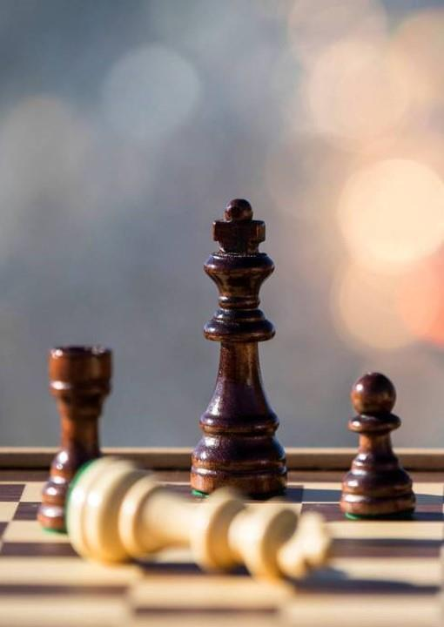
Thank You

