Slide 1
Azure Container registry
Build, store, secure, scan, replicate, and manage container images and artifacts
Automate container image builds and maintenance with ACR Tasks

Slide 2
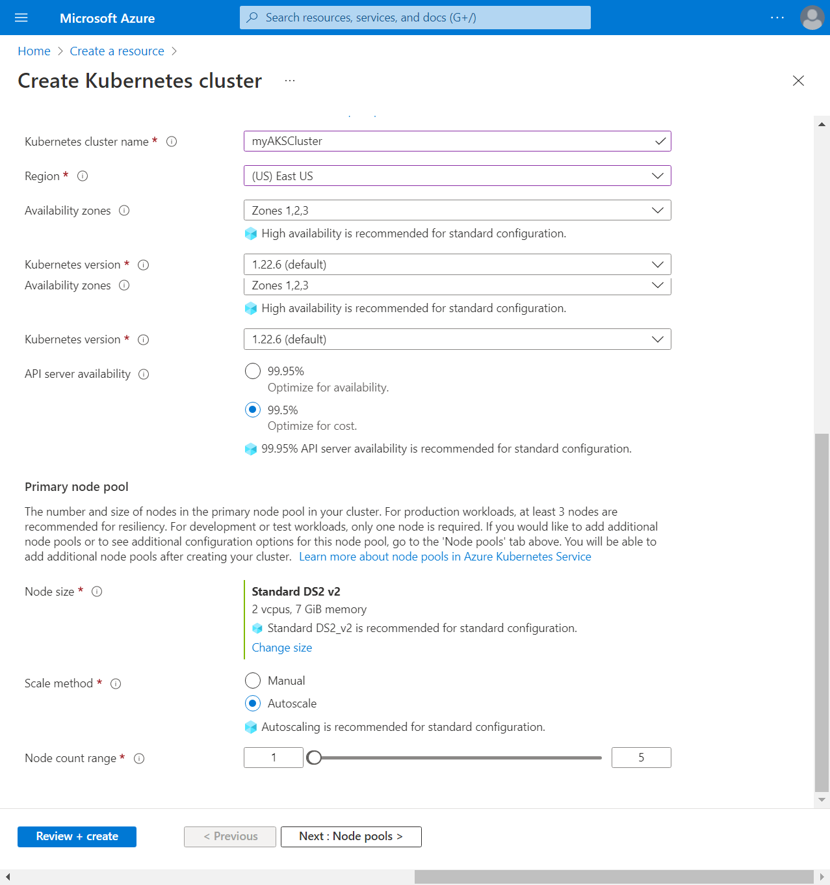
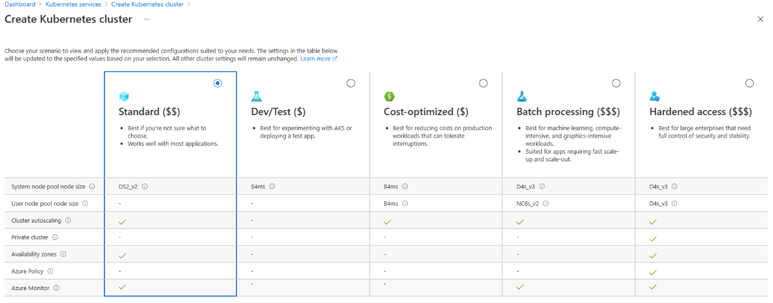
ClUSter Creation
Sign in to the Azure portal.
On the Azure portal menu or from the Home page, select Create a resource.
Project details: Select an Azure Subscription.
Select or create an Azure Resource group, such as myResourceGroup

Slide 3
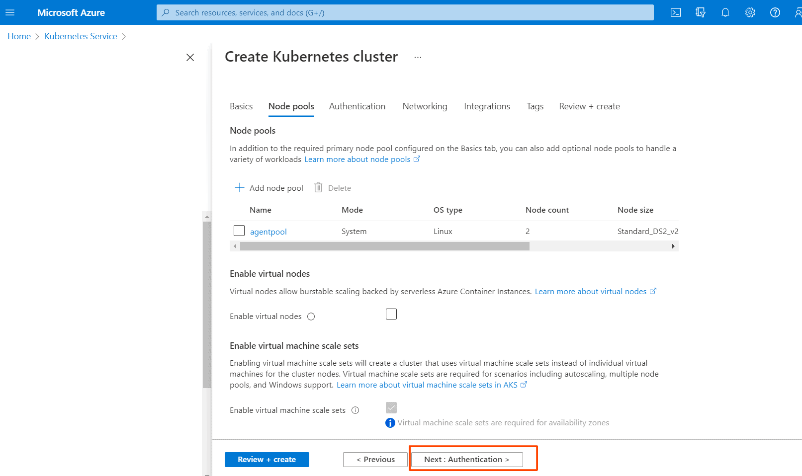
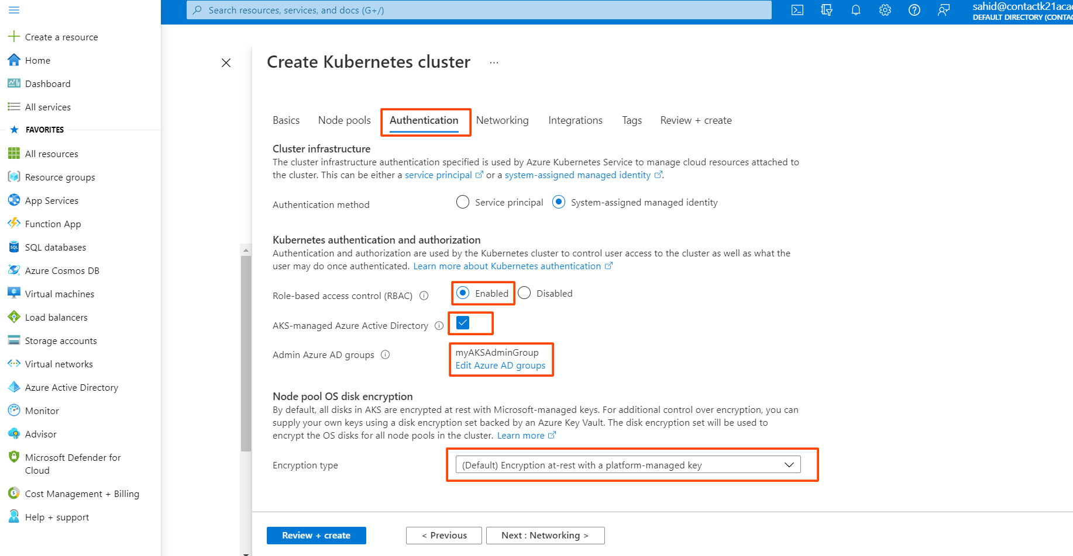
Continues…

Slide 4
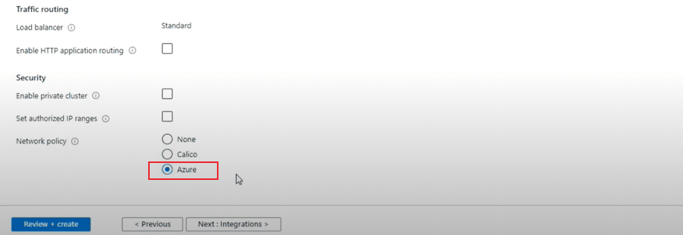
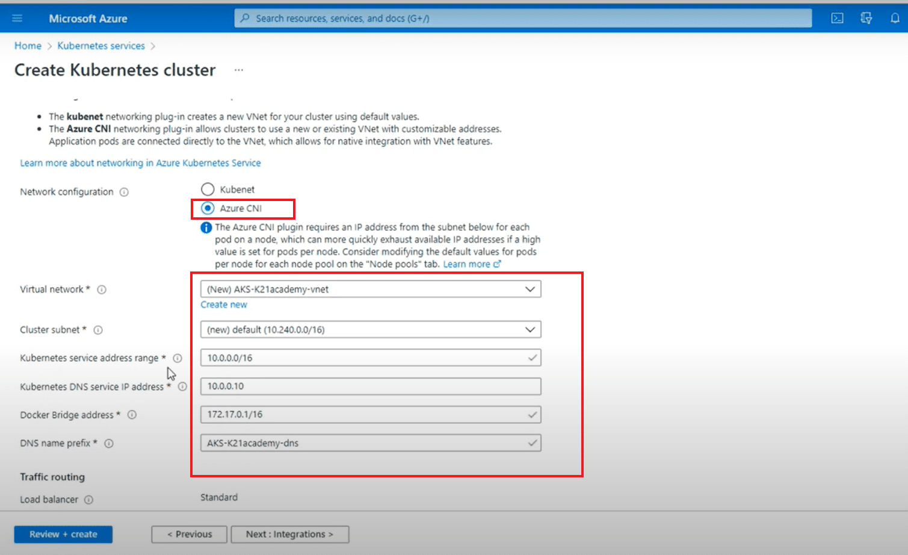
Continues…

Slide 5
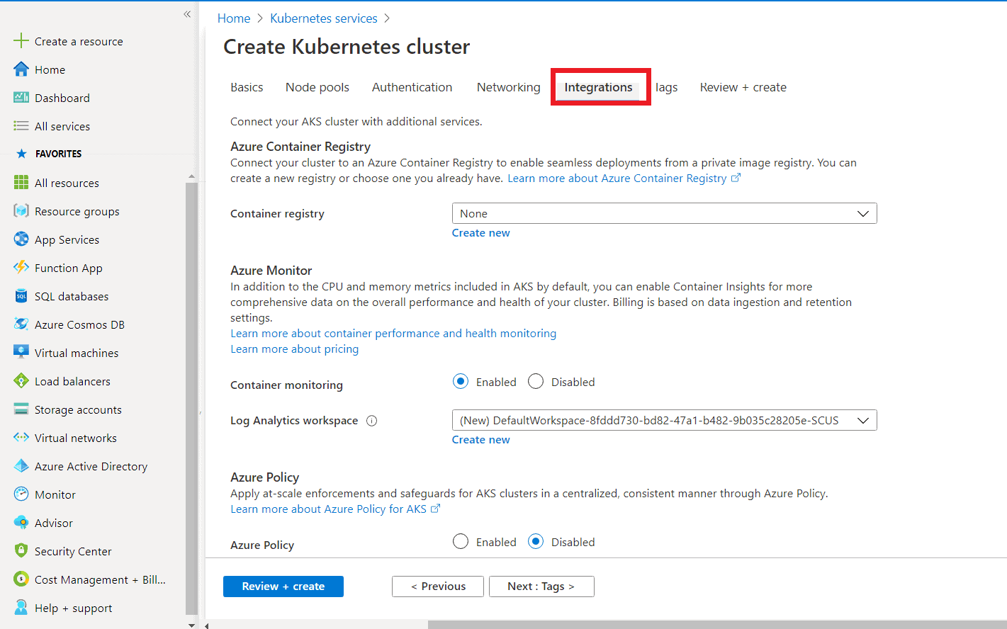
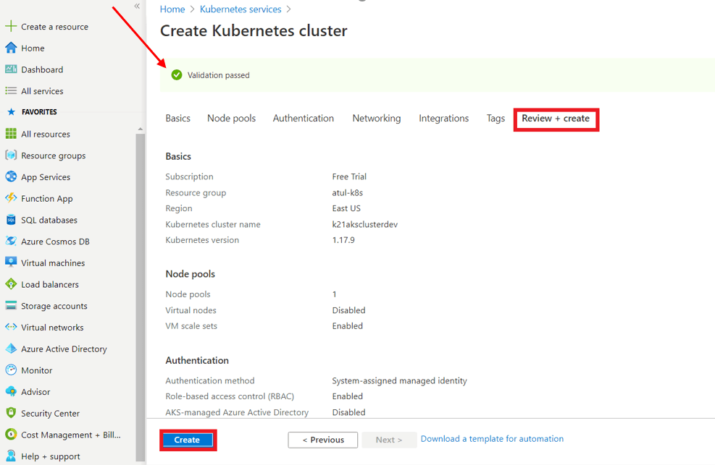
Continues…

Slide 6
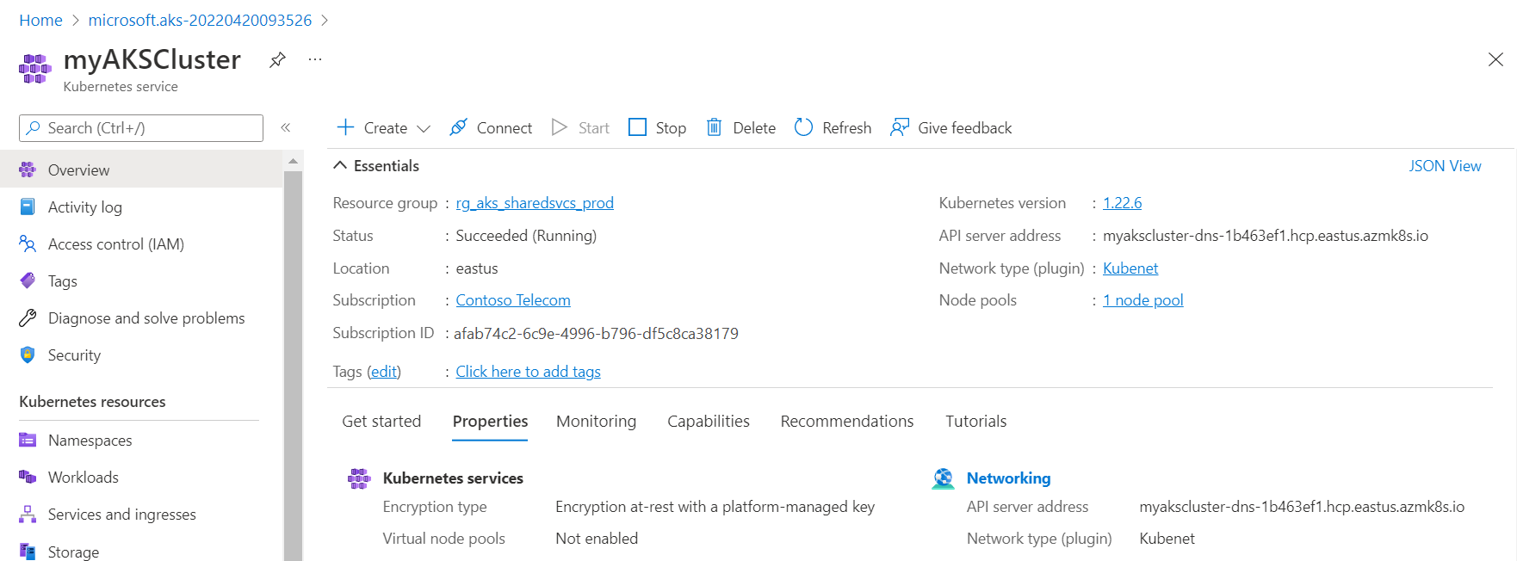
Continues…

Slide 7
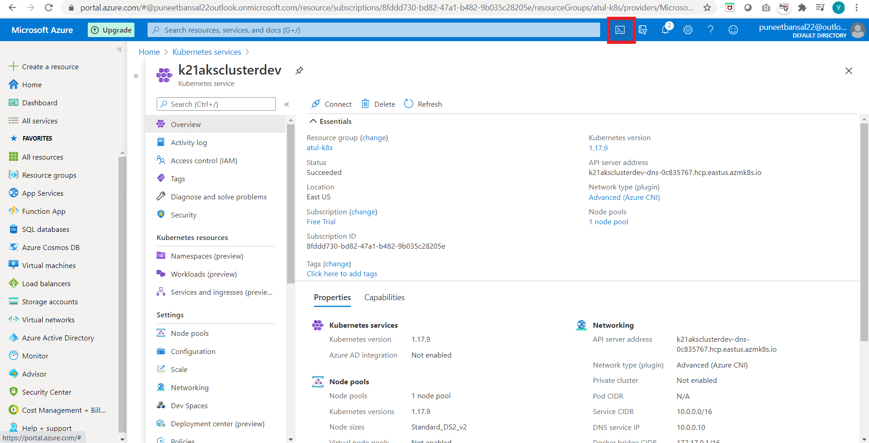
Connect to the Azure Kubernetes Cluster
Using Cloud Shell
Using Azure CLI
Install kubectl locally using the az aks install-cli command.
Configure kubectl to connect to your Kubernetes cluster using the az aks get-credentials command.
az aks get-credentials --resource-group myResourceGroup --name myAKSCluster
To get the list of Nodes
kubectl get nodes

Slide 8
NODE Pools
az aks nodepool add --resource-group myResourceGroup --cluster-name myAKSCluster --name mynodepool --node-count 3
System and User node pools. System node pools primary purpose is hosting critical system pods like CoreDNS and tunnelfront. User node pools are designed for you to host your application pods.
Note: The name of a node pool must start with a lowercase letter and can only contain alphanumeric characters. For Linux node pools the length must be between 1 and 12 characters, for Windows node pools the length must be between 1 and 6 characters.

Slide 9
Networking
The Kubernetes network model provides the foundation for understanding how containers, pods, and services within Kubernetes communicate with each other.
The Kubernetes network model specifies:
- Every pod gets its own IP address
- Containers within a pod share the pod IP address and can communicate freely with each other
- Pods can communicate with all other pods in the cluster using pod IP addresses
- Isolation (restricting what each pod can communicate with) is defined using network policies
Networking Model Commonly used – Calico, Flannel, Weave Net

Slide 10
Network plugin
Azure CNI - With Azure Container Networking Interface (CNI), every pod gets an IP address from the subnet and can be accessed directly. These IP addresses must be unique across your network space, and must be planned in advance. Each node has a configuration parameter for the maximum number of pods that it supports. The equivalent number of IP addresses per node are then reserved up front for that node. This approach requires more planning, and often leads to IP address exhaustion or the need to rebuild clusters in a larger subnet as your application demands grow
Kubenet - By default, AKS clusters use kubenet, and a virtual network and subnet are created for you. With kubenet, nodes get an IP address from a virtual network subnet. Network address translation (NAT) is then configured on the nodes, and pods receive an IP address "hidden" behind the node IP. This approach reduces the number of IP addresses that you need to reserve in your network space for pods to use
Note: AKS clusters may not use 169.254.0.0/16, 172.30.0.0/16, 172.31.0.0/16, or 192.0.2.0/24 for the Kubernetes service address range, pod address range, or cluster virtual network address range.
The cluster identity used by the AKS cluster must have at least Network Contributor permissions on the subnet within your virtual network.
If you wish to define a custom role instead of using the built-in Network Contributor role, the following permissions are required:Microsoft.Network/virtualNetworks/subnets/join/action
Microsoft.Network/virtualNetworks/subnets/read

Slide 11
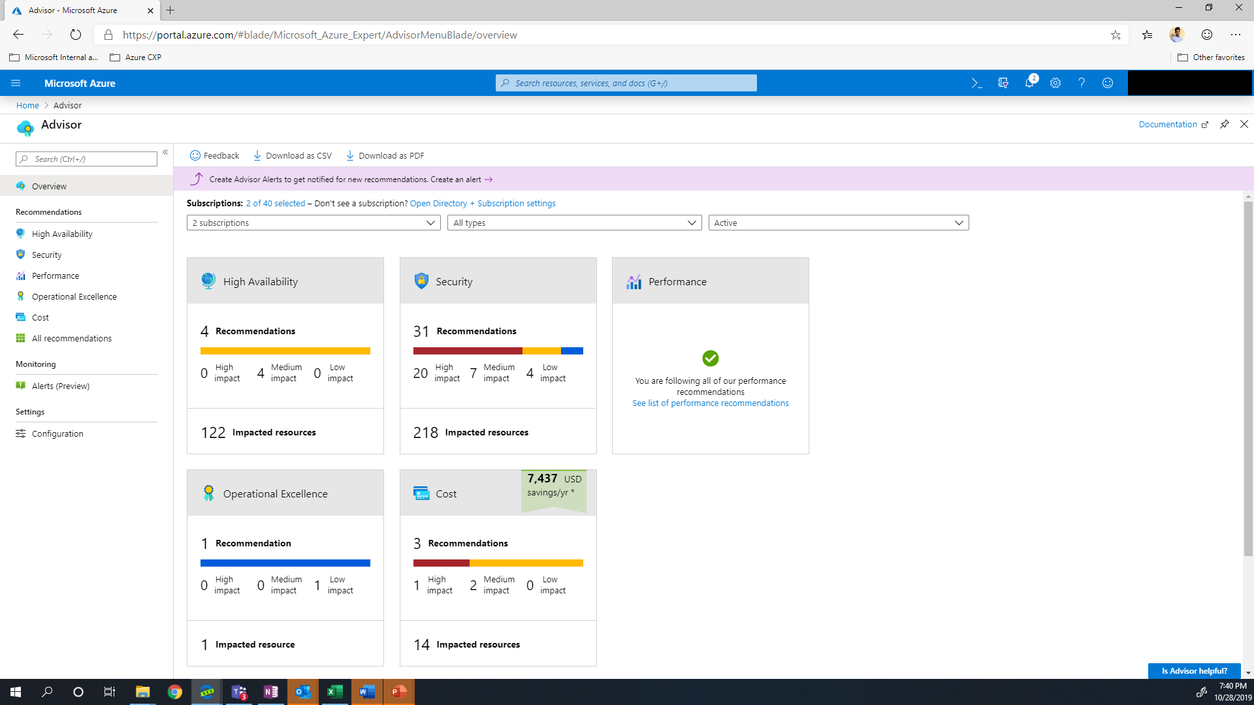
Azure advisory
Analyzes your resource configuration and usage telemetry and then recommends solutions that can help you improve the cost effectiveness, performance, Reliability (formerly called High availability), and security of your Azure resources
The recommendations are divided into five categories:
  Reliability
  Security
  Performance
  Cost
  Operational Excellence

Slide 12
Azure Storages
The Azure Storage platform is Microsoft's cloud storage solution for modern data storage scenarios. Azure Storage offers highly available, massively scalable, durable, and secure storage for a variety of data objects in the cloud. Azure Storage data objects are accessible from anywhere in the world over HTTP or HTTPS via a REST API
The Azure Storage platform includes the following data services:
Azure Blobs: A massively scalable object store for text and binary data. Also includes support for big data analytics through Data Lake Storage Gen2.
Azure Files: Managed file shares for cloud or on-premises deployments.
Azure Queues: A messaging store for reliable messaging between application components.
Azure Tables: A NoSQL store for schemaless storage of structured data.
Azure Disks: Block-level storage volumes for Azure VMs.

Slide 13
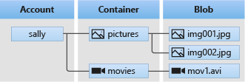
AZURE Blob storage
Azure Blob storage is Microsoft's object storage solution for the cloud. Blob storage is optimized for storing massive amounts of unstructured data.
Blob storage offers three types of resources:
- The storage account
- A container in the storage account
- A blob in a container
To Move Data to Blob Storage
AzCopy is an easy-to-use command-line tool for Windows and Linux that copies data to and from Blob storage, across containers, or across storage accounts.
Azure Data Factory supports copying data to and from Blob storage by using the account key, a shared access signature, a service principal, or managed identities for Azure resources.
The Azure Import/Export service provides a way to import or export large amounts of data to and from your storage account using hard drives that you provide.

Slide 14
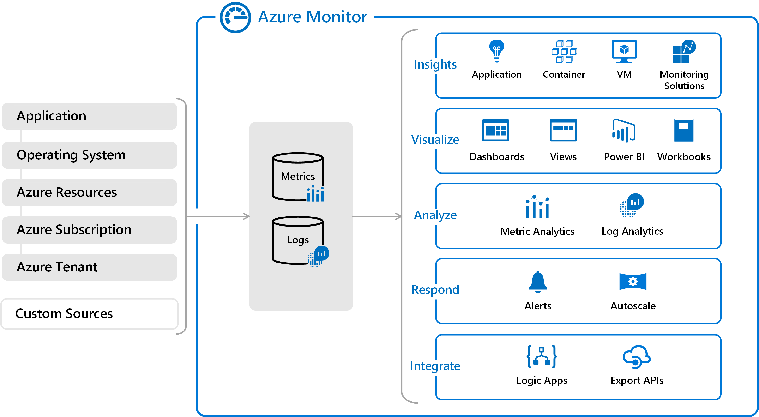
Azure monitor
Azure Monitor helps you maximize the availability and performance of your applications and services.
Helps you understand how your applications are performing and proactively identify issues that affect them and the resources they depend on
Data Collection rules in Azure Monitor
  Data Collection Rules (DCRs) define the date collection process in Azure Monitor. DCRs specify what data should be collected, how to transform that data, and where to send that data.

Slide 15
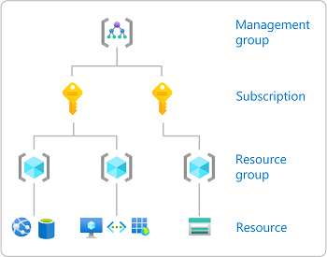
Azure role based access control (rbac)
Authorization system you use to manage access to Azure resources. To grant access, you assign roles to users, groups, service principals, or managed identities at a particular scope.
  Identify the scope
  Steps:
  Sign into the Azure Portal
  Select the Resource group

Slide 16
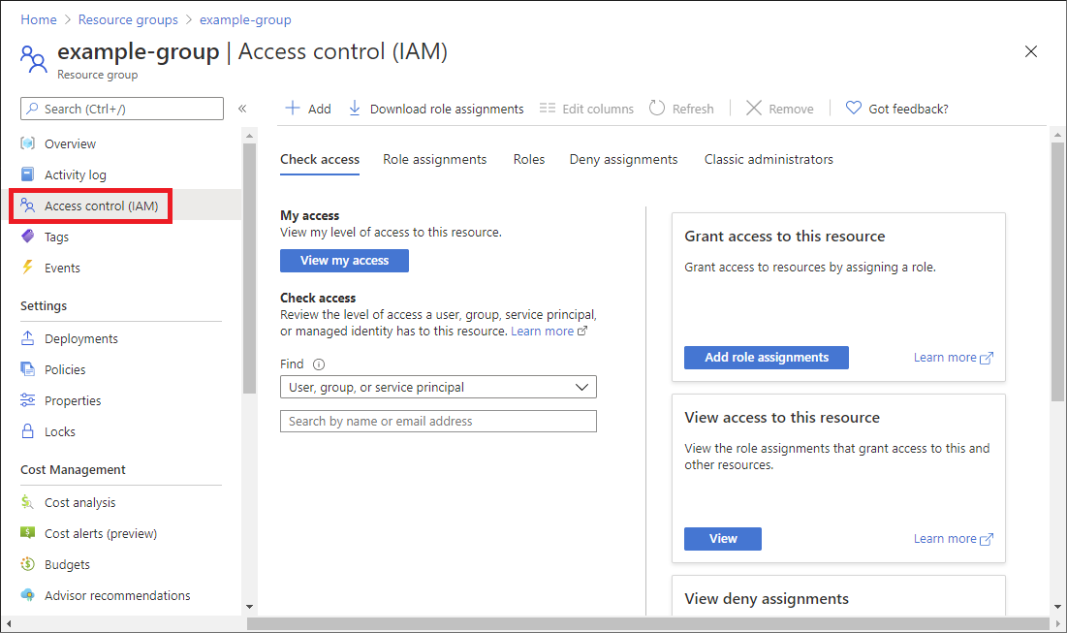
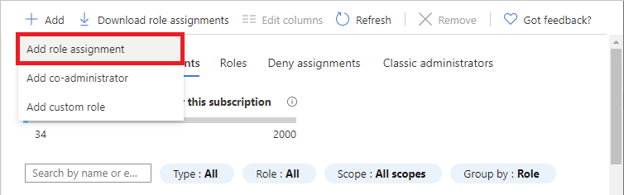
Continues…
Step 2: Open the Add role assignment page
Access control (IAM) is the page that you typically use to assign roles to grant access to Azure resources. It's also known as identity and access management (IAM) and appears in several locations in the Azure portal.
Click Access control (IAM).
2. Click the Role assignments tab to view the role assignments at this scope.
3. Click Add > Add role assignment.

Slide 17
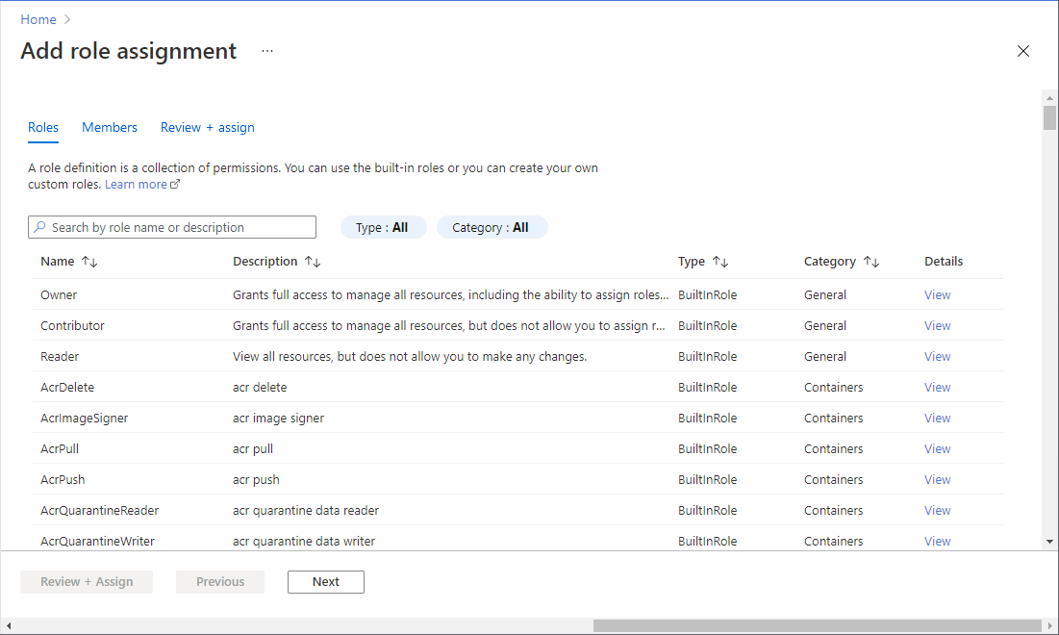
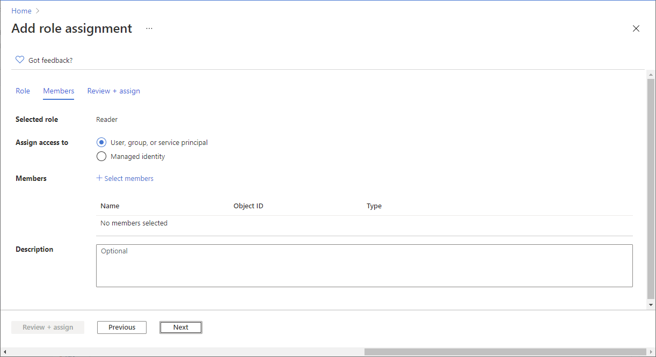
continues
Step 3: Select the appropriate role
Step 4: Select who needs access
On the Members tab, select User, group, or service principal to assign the selected role to one or more Azure AD users, groups, or service principals (applications).
Find and select the users, groups, or service principals.

Slide 18
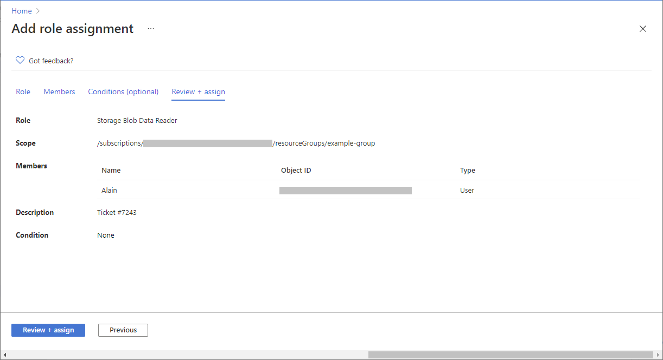
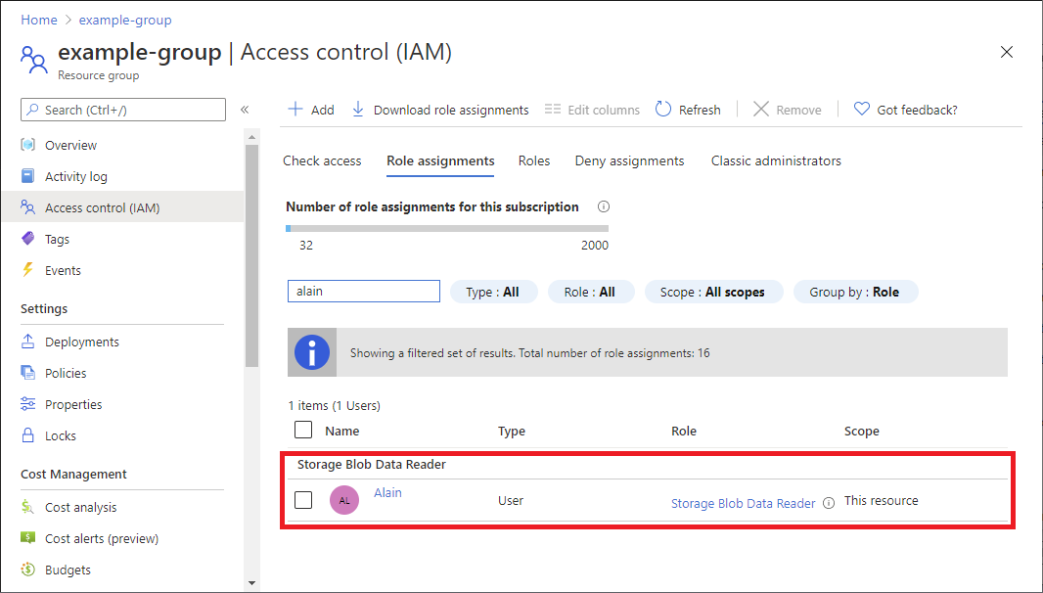
Continues
Step5: Assign the Role.

Slide 19
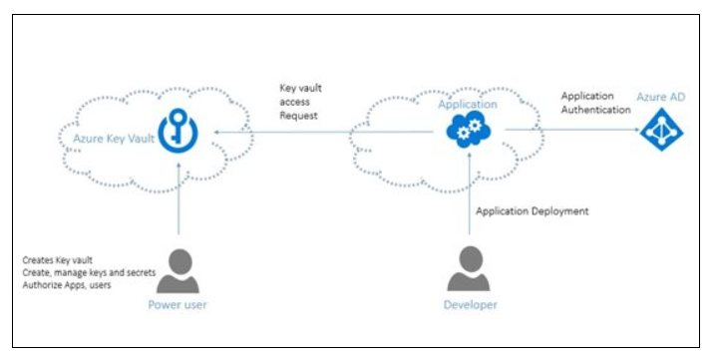
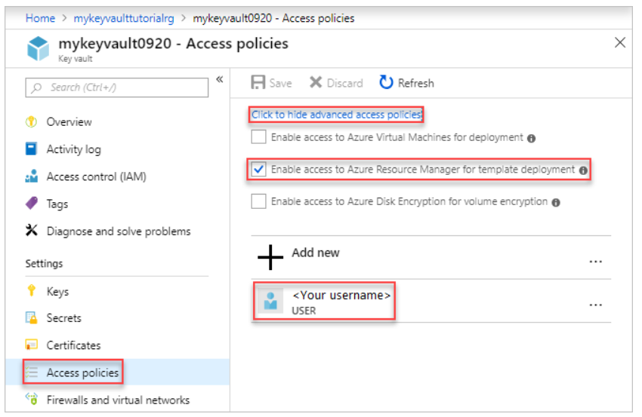
Azure KeyVault
Azure Key Vault is a cloud service for securely storing and accessing secrets. A secret is anything that you want to tightly control access to, such as API keys, passwords, certificates.

Slide 20
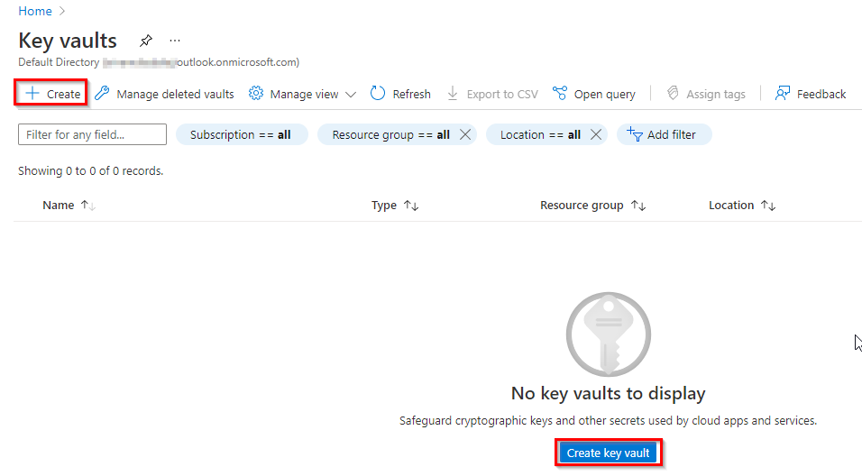
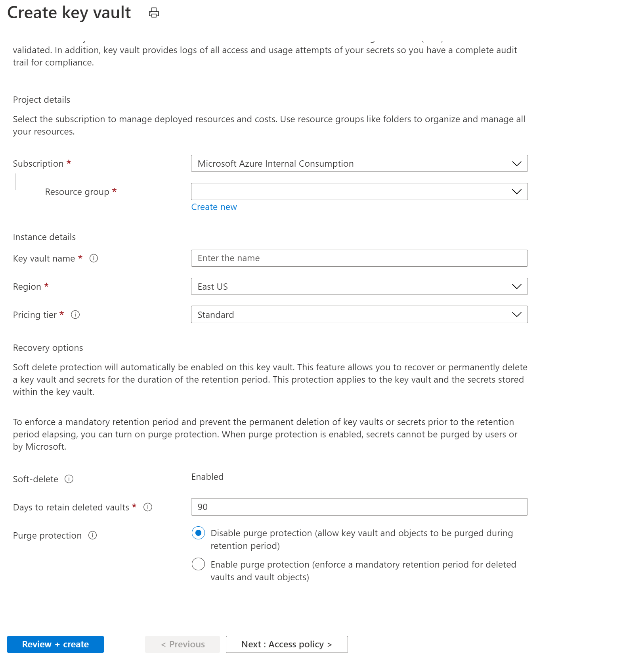
Azure key vault create

Slide 21
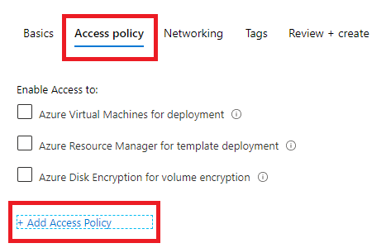
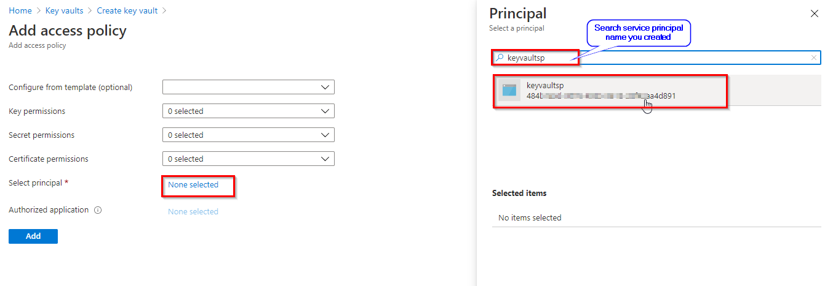
Continues

Slide 22
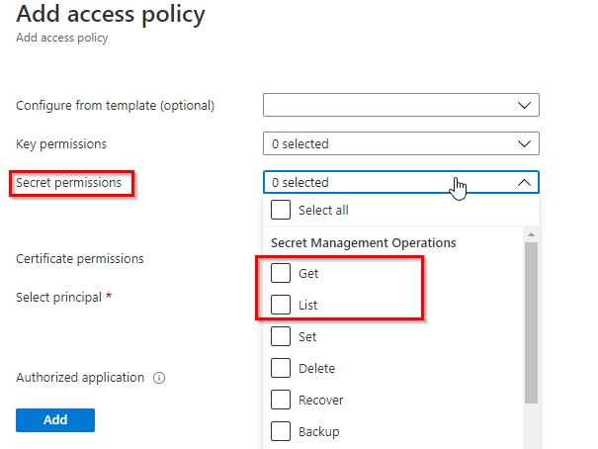
Continues
Click Review + create to close the open blades and select Create to create the vault

Slide 23
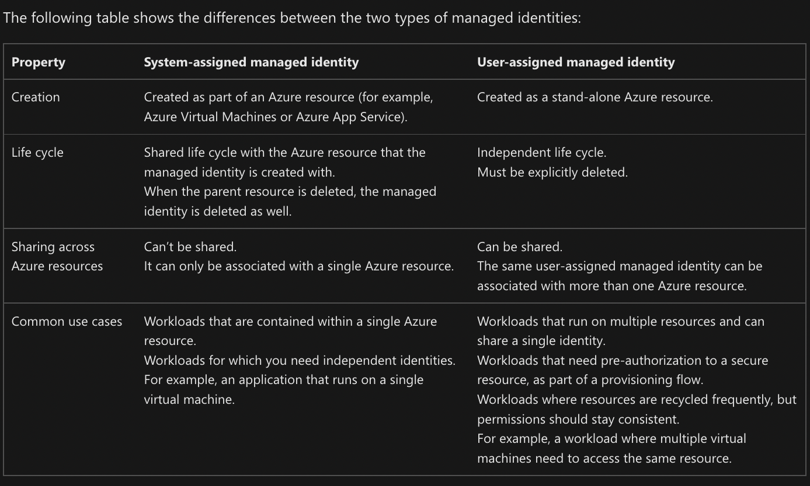
Managed Identity
Managed identities provide an automatically managed identity in Azure Active Directory for applications to use when connecting to resources that support Azure Active Directory (Azure AD) authentication. Applications can use managed identities to obtain Azure AD tokens without having to manage any credentials.
Two types of managed identities:

Slide 24
Azure backup
Azure Backup is Microsoft’s solution to back up files, folders, physical machines, virtual machines (VMs), and applications stored on-premises or in the cloud. Azure Backup uses the pay-as-you-use model.
Azure Backup service consists of three main components
- Azure backup agent
- Agent cache
- Recovery services vault (RSV)
Azure Backup Limitations includes:
- The minimum period between SQL server backups is 15 minutes. For other workloads it is 1 hour.
- The maximum recovery points for file servers is 64. For application servers it is 448.
- There is no support for tape backup and Ephemeral OS disk type.
- The maximum recovery services vaults per region are 25.
- Granular file recovery for Linux is not fully supported.
- An Azure VM can be backed-up only if it has not more than 16 data disks.

Slide 25
.
Thank You!

