Slide 1
VastraCo
Production Grade 3-Tier E-Commerce Architecture
on Amazon Web Services (AWS)
HTTPS / TLS
Multi-AZ HA
Route53 DNS
ACM SSL
RDS PostgreSQL
Auto Scaling
VPC ID: vpc-00982eb886dd14616

Slide 2
AGENDA
01
Problem Statement
07
SSL / ACM
Traditional arch pain points
TLS termination, wildcard cert
02
Solution Overview
08
Route53 & DNS
3-tier AWS architecture
Hosted zones, DNS validation
03
VPC & Networking
09
RDS PostgreSQL
Subnets, IGW, NAT, Multi-AZ
Managed, private, multi-DB
04
Load Balancing
10
Security
Public ALB + Internal ALB
SG, bastion, least-privilege
05
Path-Based Routing
11
High Availability
/api/auth → /api/products → /api/orders
Multi-AZ, auto scaling
06
Host-Based Routing
12
Live Outputs & Conclusion
vastraco.online + api.vastraco.online
Real screenshots & summary

Slide 3
PROBLEM STATEMENT
⚡
Scaling Nightmare
🔓
Poor Security Posture
Traditional monoliths can't handle traffic spikes. Manual vertical scaling is slow, costly, and unreliable.
Flat network topology exposes all services. No isolation between tiers. Databases publicly accessible.
💀
Single Point of Failure
🔧
Deployment Complexity
One AZ deployment means any hardware failure = complete outage. No redundancy, no failover.
Manual deployments, no SSL, no DNS management. HTTP-only traffic vulnerable to interception.

Slide 4
SOLUTION OVERVIEW
PRESENTATION TIER
APPLICATION TIER
DATA TIER
🌐
⚙️
🗄️
React Frontend on EC2
Public Subnet | HTTPS
Node.js Microservices
Private Subnet | HTTP internal
RDS PostgreSQL
Private Isolated Subnet
▸ HTTPS / SSL termination
▸ Path-based routing
▸ 3 separate databases
▸ Public ALB routing
▸ Internal ALB
▸ Multi-AZ standby
▸ Route53 DNS
▸ 3 microservices
▸ Encrypted at rest
VPC ID: vpc-00982eb886dd14616 | Region: us-east-1 | Domain: vastraco.online | SSL: *.vastraco.online (ACM Wildcard)

Slide 5
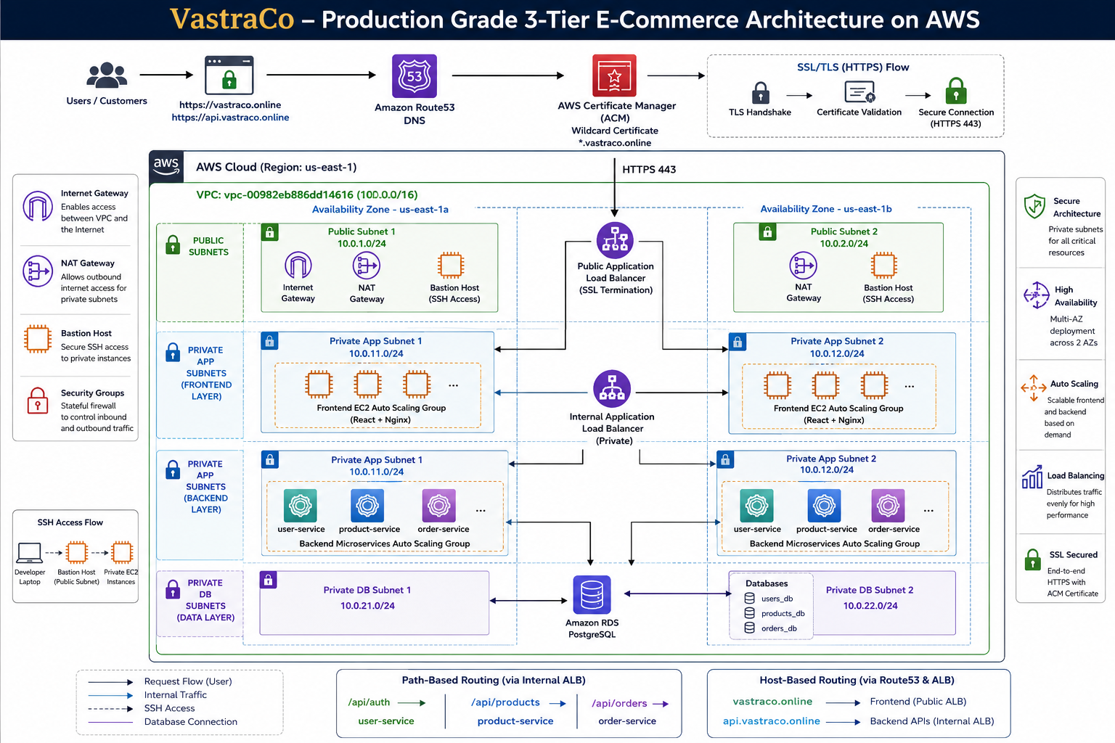

Slide 6
VPC & NETWORKING
VPC
IGW
🏠
VPC
vpc-00982eb886dd14616
AZ-1a
AZ-1b
Isolated virtual network, ap-south-1
Public
Subnet
Public
Subnet
🌍
Internet Gateway
igw-*
Entry point for public internet traffic
Private
Subnet
Private
Subnet
🔒
NAT Gateway
NAT
Public Subnet
Allows private EC2 outbound internet (no inbound)
📡
Public Subnet (x2)
AZ-1a + AZ-1b
ALB, Frontend EC2, Bastion, NAT GW
🔐
Private Subnet (x2)
AZ-1a + AZ-1b
Backend EC2, RDS — no direct internet

Slide 7
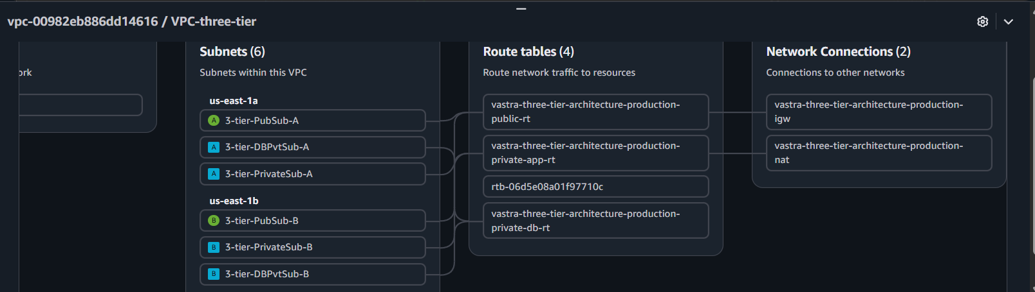
NETWORKING CONSOLE EVIDENCE
🏠 VPC Console
📡 Subnets (Public + Private)
[ 2.1 ]
[ 2.1 ]
🗺 Route Tables
🔁 NAT Gateway
[ 2.25 ]
[ 2.25 ]

Slide 8
BASTION HOST — SECURE SSH ARCHITECTURE
🔒 Never expose private EC2 to internet
Backend services stay in private subnets, unreachable directly from public internet
🛡 Single hardened entry point
Bastion is the ONLY SSH entry. Small attack surface, monitored, key-pair only.
💻 Local
Machine
🛡 Bastion
Host
(Public Subnet)
🖥 Private
EC2 Instance
SSH :22
Port 22
SSH :22
Private IP
📋 Audit trail
All SSH sessions go through bastion, enabling centralized access logging
🔑 SSH key: vastraco-key.pem
🔐 Principle of least privilege
Security groups allow port 22 only from bastion SG, not from 0.0.0.0/0

Slide 9
LOAD BALANCERS — PUBLIC ALB + INTERNAL ALB
⚖️ Public
ALB
HTTPS:443
⚖️ Internal
ALB
HTTP:80
🌐 Browser
(Client)
🖥 Frontend
EC2
⚙️ Backend
Services
Feature
Public ALB
Internal ALB
Listener
HTTPS :443
HTTP :80
Scheme
internet-facing
internal
Subnet
Public Subnet
Private Subnet
SSL
ACM Certificate
None needed
Target
Frontend EC2
Backend Services
Health Check
/health → 200
/api/*/health → 200
[ Insert ALB Listener Rules screenshot ]
[ Insert Target Group screenshot ]

Slide 10
PATH-BASED ROUTING — Internal ALB
⚖️ Internal ALB
api.vastraco.online
/api/auth/*
⚙️ user-service :3001
Register / Login / JWT tokens
/api/products/*
⚙️ product-service :3002
Product catalog & inventory
/api/orders/*
⚙️ order-service :3003
Orders & transactions
🔴 LIVE DEMO ENDPOINTS
https://api.vastraco.online/api/auth/health https://api.vastraco.online/api/products https://api.vastraco.online/api/orders/health

Slide 11
HOST-BASED ROUTING — Route53 + Public ALB
🌐 vastraco.online
🔀 Route53
A / CNAME
⚖️ Public ALB
HTTPS:443
🖥
Frontend
→ ALB DNS → Public Subnet EC2
🌐 api.vastraco.online
🔀 Route53
A / CNAME
⚖️ Public ALB
HTTPS:443
⚙️
Backend
→ ALB DNS → Internal ALB → Services
🔴 LIVE DEMO LINKS
https://vastraco.online https://api.vastraco.online

Slide 12
AMAZON RDS — PostgreSQL
⚙️ user-service
⚙️ product-service
⚙️ order-service
🗄 users_db
🗄 products_db
🗄 orders_db
Users, auth tokens, sessions
Products, categories, inventory
Orders, transactions, status
🔒 Private Subnet
🌍 Multi-AZ Standby
💾 Automated Backups
RDS lives in isolated private subnet. Zero public internet access.
Synchronous replication to standby in another AZ for instant failover.
Daily snapshots with point-in-time recovery up to 35 days.
🔐 Encryption at Rest
📊 Managed Service
🚀 Read Replicas
All data encrypted using AWS KMS. Storage-level encryption enabled.
AWS handles patching, maintenance, hardware failures automatically.
Scale read traffic with PostgreSQL read replicas when needed.

Slide 13
🔒 SSL TERMINATION USING AWS ACM
🌐
Browser
🔀
Route53
🔒
ACM Cert
Validation
⚖️
Public ALB
HTTPS:443
🖥
Frontend
EC2
⚙️
Backend
Services
🔐
🔐
🔐
🔐
🔓
HTTPS
Request
DNS
Resolve
*.vastraco
.online
TLS
Terminate
HTTP
:80 internal
HTTP
:3001+
🔐 What is SSL/TLS?
🌐 What is HTTPS?
📜 What is ACM?
⚖️ SSL Termination at ALB
Cryptographic protocol that encrypts data in transit. TLS 1.2/1.3 used. Creates encrypted tunnel between client and server.
HTTP over TLS. Port 443. Browser shows 🔒 padlock. Certificate validates server identity. Prevents MITM attacks.
AWS Certificate Manager. FREE SSL certificates. Automatic renewal. Deep integration with ALB, CloudFront.
ALB decrypts HTTPS at the edge. Internal traffic uses HTTP. Offloads crypto from backend. Centralized certificate management.
✳️ Wildcard Certificate
🔀 DNS Validation
🛡 Browser Trust Flow
🤝 TLS Handshake
*.vastraco.online covers ALL subdomains: vastraco.online, api.vastraco.online, admin.vastraco.online etc.
ACM adds CNAME record in Route53 to prove domain ownership. Automatic validation. No email needed.
Browser checks cert → CA validates → certificate chain verified → padlock shown → encrypted channel established.
Client hello → Server sends cert → Client verifies CA → Session keys exchanged → Encrypted communication begins.

Slide 14
ROUTE53 & DNS MANAGEMENT
🔀 Route53 Hosted Zone
vastraco.online
1. 🌐 Browser types
vastraco.online
A (Alias)
vastraco.online
→ Public ALB DNS
2. 🔀 Route53
DNS Lookup
A (Alias)
api.vastraco.online
→ Public ALB DNS
3. 📍 ALB DNS
Resolved
NS
@
ns-XXX.awsdns-XX.com
SOA
@
4. ⚖️ Public ALB
HTTPS:443
Hosted Zone Authority
CNAME
_acm-validation
→ ACM DNS validate
5. 🖥 Frontend
EC2 Response
[ Insert Route53 Hosted Zone screenshot ]

Slide 15
SECURITY IMPLEMENTATION — Defense in Depth
Layer 1: Network
Layer 2: Transport
Layer 3: Access Control
Layer 4: Data
VPC Isolation
HTTPS / TLS 1.2+
Security Groups
RDS Private Subnet
Public/Private Subnets
ACM SSL Certificate
Bastion-only SSH
Encryption at rest
Internet Gateway controlled
SSL termination at ALB
Least privilege SGs
No public endpoint
No direct private access
Encrypted in transit
Port 22 restricted
KMS key management

Slide 16
HIGH AVAILABILITY ARCHITECTURE — Multi-AZ Design
🏙 Availability Zone: ap-south-1a
🏙 Availability Zone: ap-south-1b
Public ALB Node (Primary)
Public ALB Node (Standby)
Frontend EC2 (Primary)
Frontend EC2 (Standby)
Internal ALB Node (Primary)
Internal ALB Node (Standby)
Backend EC2 (Primary)
Backend EC2 (Standby)
RDS Primary (Primary)
RDS Primary (Standby)
⚡ Automatic failover < 60 seconds

Slide 17
FINAL RESULTS — Production-Grade Deployment
✅
🌐
⚖️
🗄
HTTPS
Route53
ALB x2
RDS x3
Fully Encrypted
DNS Managed
Load Balanced
Databases Live
TLS 1.2/1.3 via ACM wildcard cert on Public ALB
vastraco.online & api.vastraco.online live
Public ALB + Internal ALB routing all traffic
users_db / products_db / orders_db on PostgreSQL
🔀
🌍
🛡
🔐
3 Services
Multi-AZ
Bastion
Private
Path Routing
High Availability
Secure SSH
Zero Public DB
/api/auth → /api/products → /api/orders
ap-south-1a + 1b failover in < 60 seconds
Private EC2 accessible only via bastion host
RDS in isolated private subnet, no internet exposure
VPC: vpc-00982eb886dd14616 | vastraco.online | ap-south-1 | AWS Production Architecture

Slide 18
CONCLUSION — What Was Achieved
🏗 3-Tier Architecture
🛡 Defense in Depth
Complete separation of presentation, application, and data tiers for clean, scalable design.
VPC isolation + private subnets + security groups + bastion host + HTTPS encryption.
🔒 Production-Grade SSL
🗄 Managed Database
ACM wildcard certificate with automated DNS validation, TLS termination at ALB edge.
Three isolated PostgreSQL databases on RDS with encryption, backups, and Multi-AZ.
🔀 Smart Routing
🔐 Least Privilege
Host-based routing for domains + path-based routing for microservices via two ALBs.
Each layer can only communicate with the next — zero unnecessary exposure.
🌍 High Availability
⚡ Cloud Native
Multi-AZ deployment across ap-south-1a and 1b with automatic RDS and EC2 failover.
Leverages AWS Route53, ACM, ALB, RDS, EC2, VPC — all managed AWS services.
Built with: Amazon EC2 · RDS PostgreSQL · ALB · Route53 · ACM · VPC · NAT Gateway · Security Groups

Slide 19
Thank You
VastraCo — Production Grade AWS Architecture
vastraco.online
api.vastraco.online
vpc-00982eb886dd14616
Route53
ACM
ALB
RDS
EC2
VPC
NAT GW

