Slide 1


CMR TECHNICAL CAMPUS UGC (Autonomous) Kandlakoya, Medchal Road, Hyd-501401 Department of Computer Science and Engineering
ESTD: 2009
A
Major Project On
ELECTRICITY THEFT DETECTION IN SMART GRIDS BASED ON DEEP NEURAL NETWORK
BATCH NO: 08
GROUP MEMBERS :
207R1A0587 K.Harshitha
207R5A05B0 P.Karthik
207R1A0598 Mohammed Mokhim
UNDER THE GUIDANCE OF:
A.Uday Kiran
(Assistant Professor)

Slide 2
CONTENTS
Abstract
Existing System
Disadvantages in Existing System
Proposed System
Advantages of Proposed System
Hardware and Software Requirements
Novelty
Architecture
Modules
UML Diagrams
Sample Code
Results
Conclusion
Future Scope
References
Github Link

Slide 3
ABSTRACT
Electricity theft is a global problem that negatively affects both utility companies and electricity users. It destabilizes the economic development of utility companies, causes electric hazards and impacts the high cost of energy for users.
We address dataset weaknesses such as missing data and class imbalance problems through data interpolation and synthetic data generation processes.
We analyze and compare the contribution of features from both time and frequency domains, run experiments in combined and reduced feature space using principal component analysis and finally incorporate minimum redundancy maximum relevance scheme for validating the most important features.
Lastly, we show the competitiveness of our method in comparison with other methods evaluated on the same dataset.

Slide 4
EXISTING SYSTEM
The data related to electricity consumption, power flow, and other relevant parameters is collected in the current system. Mention the sources of data, such as smart meters, sensors, and monitoring devices.
The collected data is processed in the current system. This may involve data aggregation, filtering, and analysis to identify patterns and anomalies.
For variables used in the current system for detecting electricity theft. This could include parameters like energy consumption patterns, voltage levels, and current flows.
Summarizing the performance of the current system in terms of its accuracy, reliability, and efficiency in detecting electricity theft.

Slide 5
DISADVANTAGES IN EXISTING SYSTEM
Less Accuracy
Low Efficiency
Time consuming

Slide 6
PROPOSED SYSTEM
As one of the major factors of the nontechnical losses in distribution networks, the electricity theft causes significant harm to power grids, which influences power supply quality and reduces operating profits.
In order to help utility companies solve the problems of inefficient electricity inspection and irregular power consumption, a novel hybrid convolutional neural network-random forest (CNN-RF) model for automatic electricity theft detection is presented in this project.
In this model, a convolutional neural network (CNN) firstly is designed to learn the features between different hours of the day and different days from massive and varying smart meter data by the operations of convolution and downsampling.
In addition, a dropout layer is added to retard the risk of overfitting, and the backpropagation algorithm is applied to update network parameters in the training phase. And then, the random forest (RF) is trained based on the obtained features to detect whether the consumer steals electricity. To build the RF in the hybrid model, the grid search algorithm is adopted to determine optimal parameters.
Finally, experiments are conducted based on real energy consumption data, and the results show that the proposed detection model outperforms other methods in terms of accuracy and efficiency.

Slide 7
ADVANTAGES OF PROPOSED SYSTEM
High Accuracy
High Efficiency
Less Time consumption

Slide 8
Hardware and Software Requirements
Hardware Requirements:
Processor : Pentium –IV
RAM : 4 GB (min)
Hard Disk : 20 GB
Key Board : Standard Windows Keyboard
Mouse : Two or Three Button Mouse
Monitor : SVGA
Software Requirements:
Operating system : Windows 7 Ultimate
Coding Language : Python
Front-End : HTML
Back-End : Django-ORM
Designing : Html, css, javascript
Data Base : MySQL (WAMP Server)

Slide 9
NOVELTY
The novelty of your project lies in the application of deep neural networks (DNNs) for electricity theft detection in a smart grid. This approach offers several unique advantages over traditional methods:
Advanced Pattern Recognition: DNNs can effectively learn complex patterns and relationships from large-scale data, enabling them to detect subtle anomalies indicative of electricity theft. This ability surpasses the capabilities of traditional statistical or rule-based methods.
Efficiency: Once trained, DNN models can process data rapidly, allowing for real-time or near-real-time detection of theft incidents. This can lead to quicker response times and reduced losses for utility companies.
Improved Accuracy: The inherent learning capabilities of DNNs can lead to more accurate detection of theft incidents while minimizing false alarms, improving the overall efficiency of theft detection systems.

Slide 10
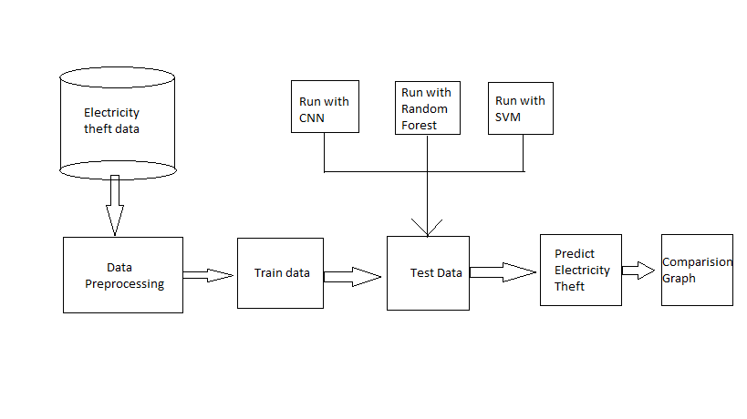
ARCHITECTURE

Slide 11
MODULES
For this project on electricity theft detection in a smart grid using deep neural networks, you can break down the implementation into several modules:
Data Collection: Module for collecting data from smart meters, sensors, and other sources in the smart grid. This could involve setting up data acquisition systems and protocols for retrieving data.
Data Preprocessing: Module for preprocessing the collected data to clean and transform it into a suitable format for input to the neural network. This may include data cleaning, normalization, and feature extraction.
Model Evaluation: Module for evaluating the performance of the trained neural network model. This may involve testing the model on a separate dataset and calculating metrics such as accuracy, precision, recall, and F1-score.

Slide 12
UML DIAGRAMS
Use Case Diagram

Slide 13
Class Diagram

Slide 14
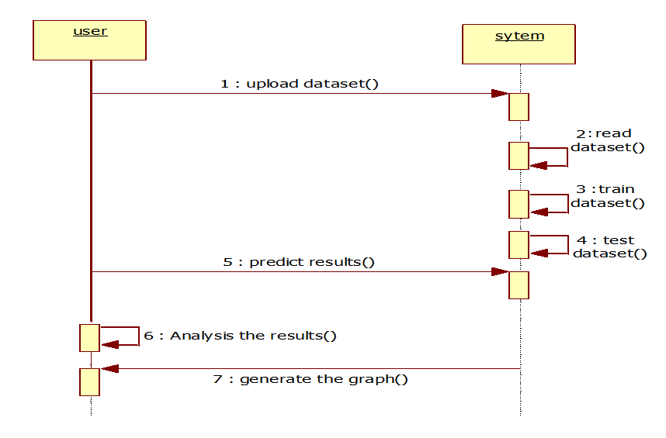
Sequence Diagram

Slide 15
Activity Diagram

Slide 16
SAMPLE CODE
import pandas as pd
import numpy as np
from sklearn.preprocessing import LabelEncoder
from sklearn.preprocessing import normalize
from keras.models import Sequential, Model
from keras.layers import Dense, Dropout, Activation
from keras.utils.np_utils import to_categorical
from keras.models import model_from_json
from sklearn.ensemble import RandomForestClassifier
le = LabelEncoder() dataset = pd.read_csv('Dataset/ElectricityTheft.csv')
dataset.fillna(0, inplace = True) dataset['client_id'] = pd.Series(le.fit_transform(dataset['client_id'].astype(str)))
dataset['label'] = dataset['label'].astype('uint8')
print(dataset.info())
dataset.drop(['creation_date'], axis = 1,inplace=True)
dataset = dataset.values
X = dataset[:,0:dataset.shape[1]-1]
Y = dataset[:,dataset.shape[1]-1]
Y = Y.astype('uint8')

Slide 17
print(X)
print(Y) unique, frequency = np.unique(Y, return_counts = True)
print(str(unique)+" "+str(frequency)) #X = normalize(X)
print(X.shape)
indices = np.arange(X.shape[0])
np.random.shuffle(indices)
X = X[indices]
Y = Y[indices]
Y = Y.astype('uint8') Y = to_categorical(Y)
print(Y)
Y = Y.astype('uint8')
counts = np.bincount(Y[:, 0])
weight_for_0 = 1.0 / counts[0]
weight_for_1 = 1.0 / counts[1]
test = extract.predict(test)
print(test.shape)
print(X.shape)
predict = rfc.predict(test)
print(predict)

Slide 18
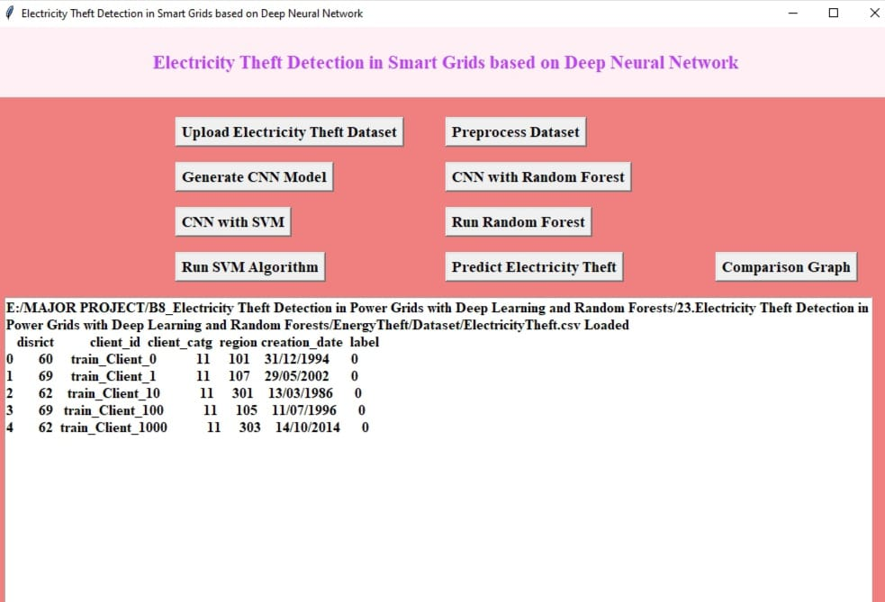
RESULTS

Slide 19
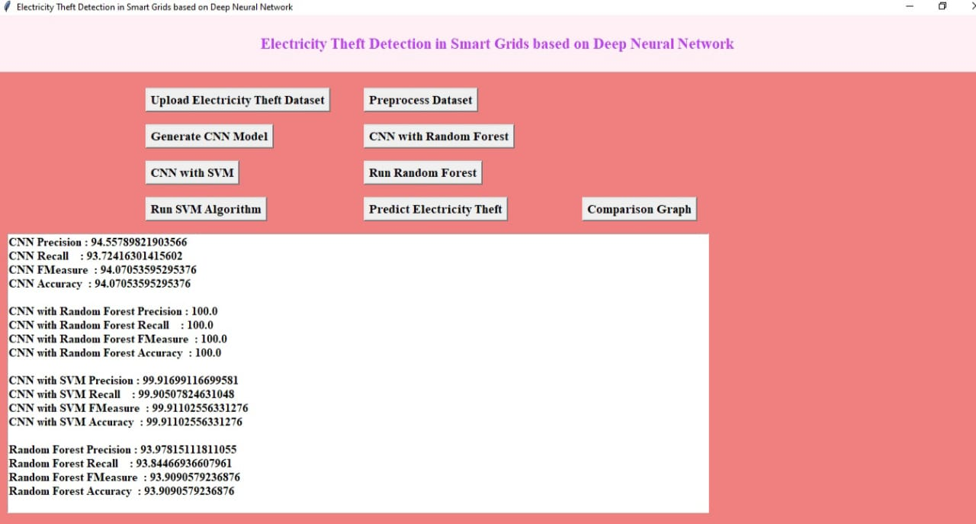

Slide 20
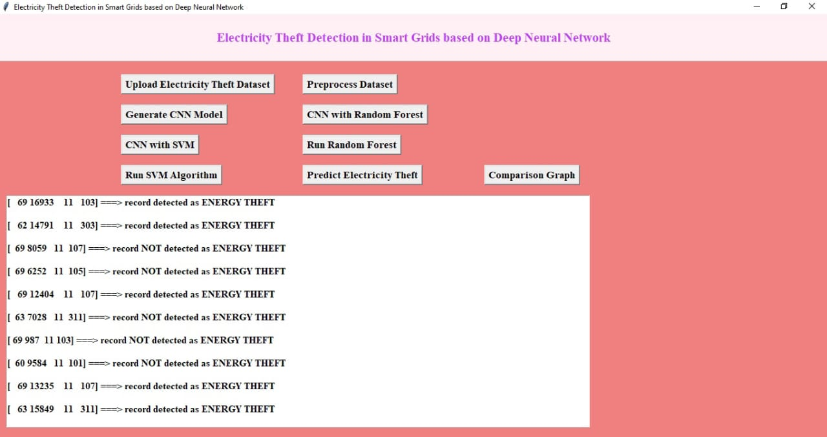

Slide 21
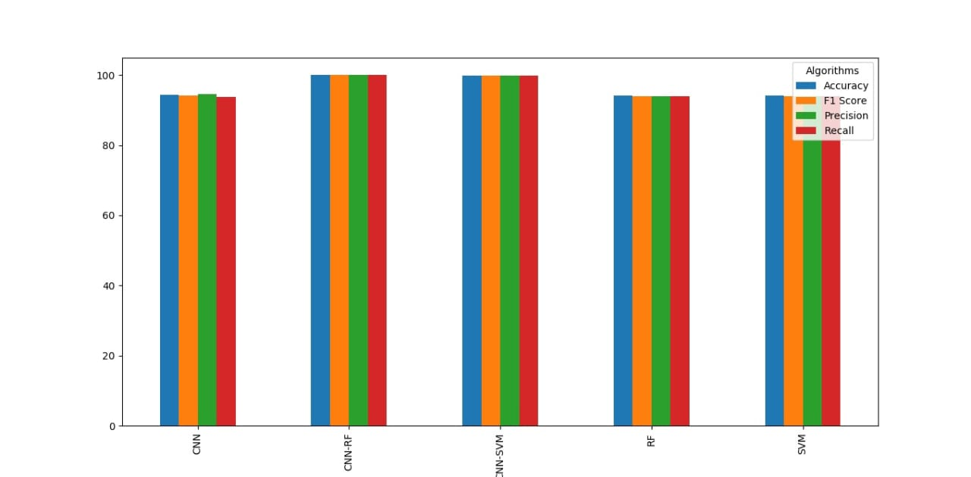

Slide 22
CONCLUSION
In conclusion, the application of deep neural networks for electricity theft detection in smart grids represents a promising and effective approach. This technology has the potential to revolutionize the way utilities and grid operators identify and mitigate unauthorized consumption, ultimately improving the reliability and sustainability of our energy infrastructure.
By analyzing vast amounts of data from smart meters and other grid sensors, deep neural networks can accurately pinpoint irregularities and anomalies in power consumption patterns, facilitating early detection of electricity theft. The advantages include their ability to adapt to complex and evolving patterns of theft, their high accuracy rates, and their potential for real-time monitoring and response. Additionally, they can reduce operational costs and revenue losses for utilities, benefiting both providers and consume.

Slide 23
FUTURE SCOPE
In the future, a project on detecting electricity theft in smart grids using deep neural networks could grow in several ways. Firstly, the accuracy of the detection system could be improved by using more advanced algorithms and tweaking the settings to make it more precise. Secondly, the system could be made faster to detect theft as it happens, by optimizing how it processes data from smart meters and other sensors. Thirdly, it could be expanded to look for unusual patterns in electricity use that might suggest theft, even in cases where traditional methods might not spot it. Fourthly, the system could be made to work efficiently in very large smart grid networks with millions of users.
Additionally, it could be integrated more closely with other parts of the smart grid, like smart meters and control systems, to make monitoring and control easier. Data privacy and security would also be a big focus, making sure that sensitive information is kept safe. Finally, the system would need to follow all the rules and standards for detecting electricity theft and protecting data, which can vary depending on where it's being used.

Slide 24
REFERENCES
S. Foster. (Nov. 2, 2021). Non-Technical Losses: A $96 Billion Global Opportunity for Electrical Utilities. [Online]. Available: https://energycentral.com/c/pip/ non-technical-losses-96-billion-globalopportunity-electrical-utilities
Q. Louw and P. Bokoro, ‘‘An alternative technique for the detection and mitigation of electricity theft in South Africa,’’ SAIEE Afr. Res. J., vol. 110, no. 4, pp. 209–216, Dec. 2019.
M. Anwar, N. Javaid, A. Khalid, M. Imran, and M. Shoaib, ‘‘Electricity theft detection using pipeline in machine learning,’’ in Proc. Int. Wireless Commun. Mobile Comput. (IWCMC), Jun. 2020, pp. 2138–2142.
Z. Zheng, Y. Yang, X. Niu, H.-N. Dai, and Y. Zhou, ‘‘Wide and deep convolutional neural networks for electricity-theft detection to secure smart grids,’’ IEEE Trans. Ind. Informat., vol. 14, no. 4, pp. 1606–1615, Apr. 2018.
P. Pickering. (Nov. 1, 2021). E-Meters Offer Multiple Ways to Combat Electricity Theft and Tampering. [Online]. Available: https://www.electronicdesign.com/technologies/meters
X. Fang, S. Misra, G. Xue, and D. Yang, ‘‘Smart grid—The new and improved power grid: A survey,’’ IEEE Commun. Surveys Tuts., vol. 14, no. 4, pp. 944–980, 4th Quart., 2012.

Slide 25
GITHUB LINK
https://github.com/Harshitha-31/Electricity-theft-detection-in-smart-grids-based-on-deep-neural-network

Slide 26
Thank You

