Slide 1


Slide 2
Overview
Project Introduction
System Architecture
A modular security scanner that identifies open ports, maps vulnerabilities, analyzes threats, and generates risk scores with actionable remediation recommendations.
Three-tier architecture with data collection, analysis engine, and visualization dashboard for complete security assessment.
Technical Stack and Modules
Working Process and Features
Built with Python backend, PostgreSQL database, and React frontend. Includes port scanner, CVE matcher, threat analyzer, and reporting engine.
Automated scanning workflow from host discovery through vulnerability mapping to risk scoring and recommendation generation.

Slide 3
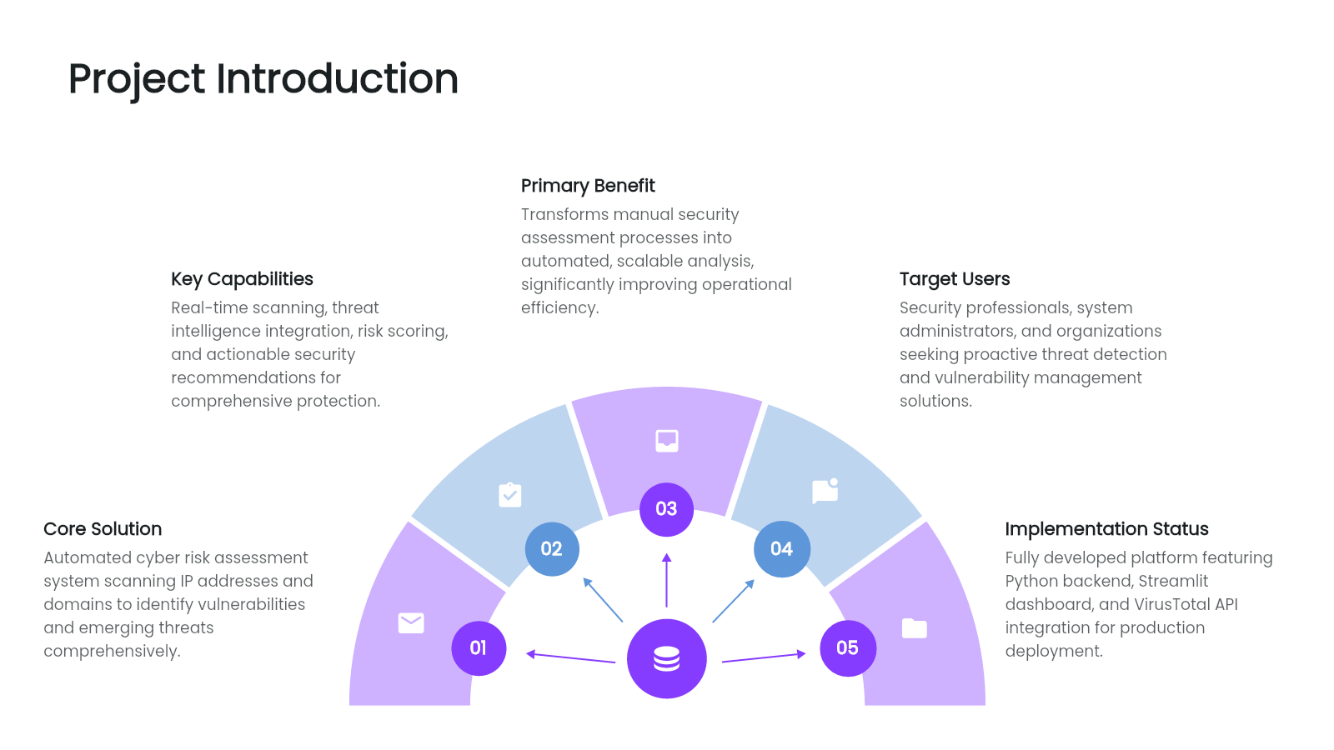

Slide 4
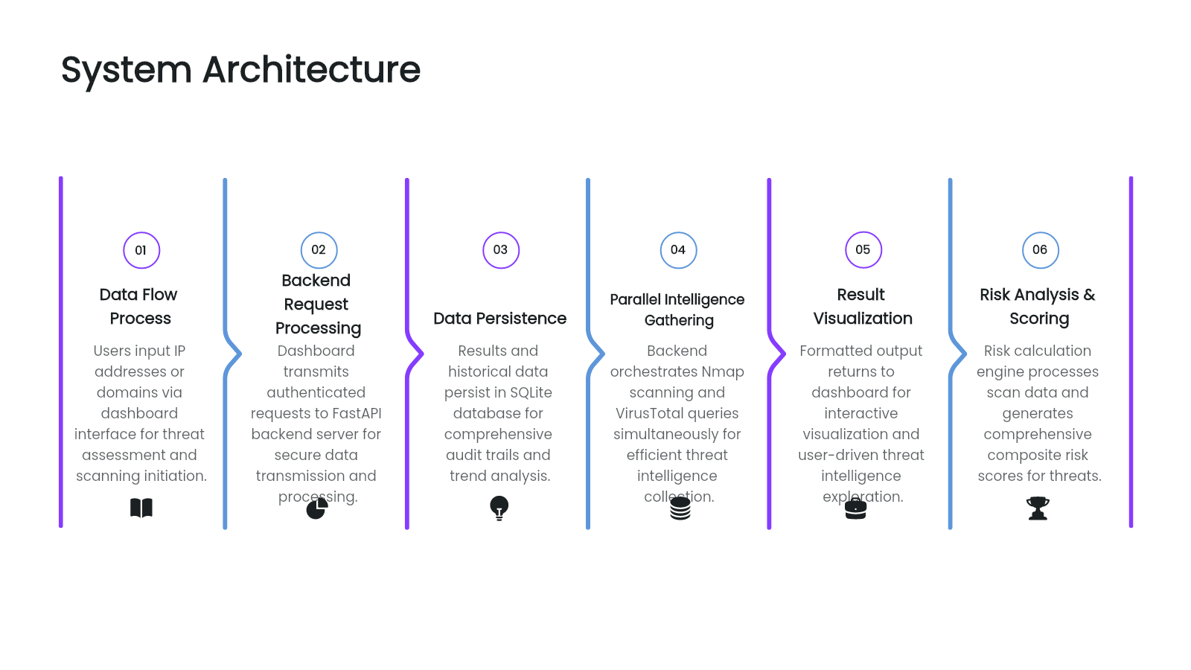

Slide 5
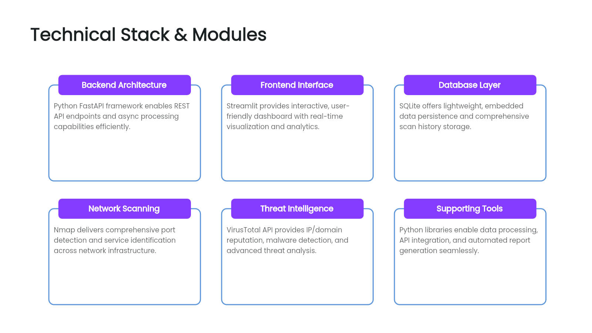

Slide 6
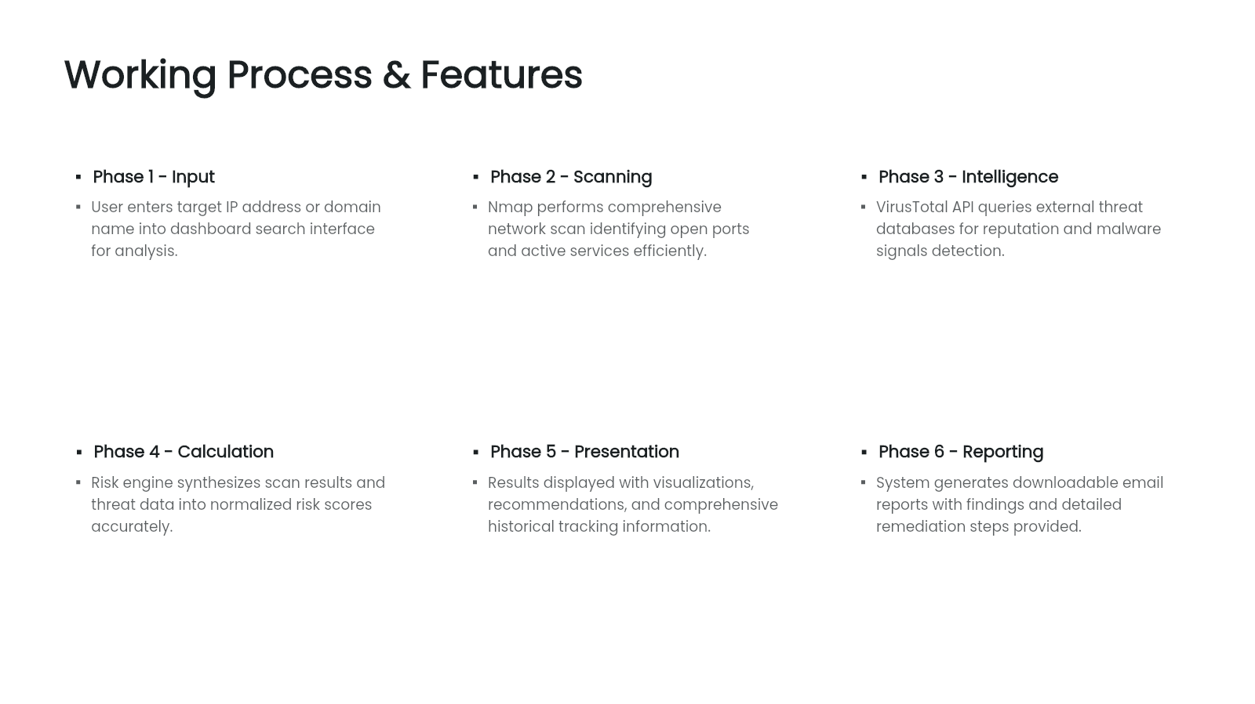

Slide 7
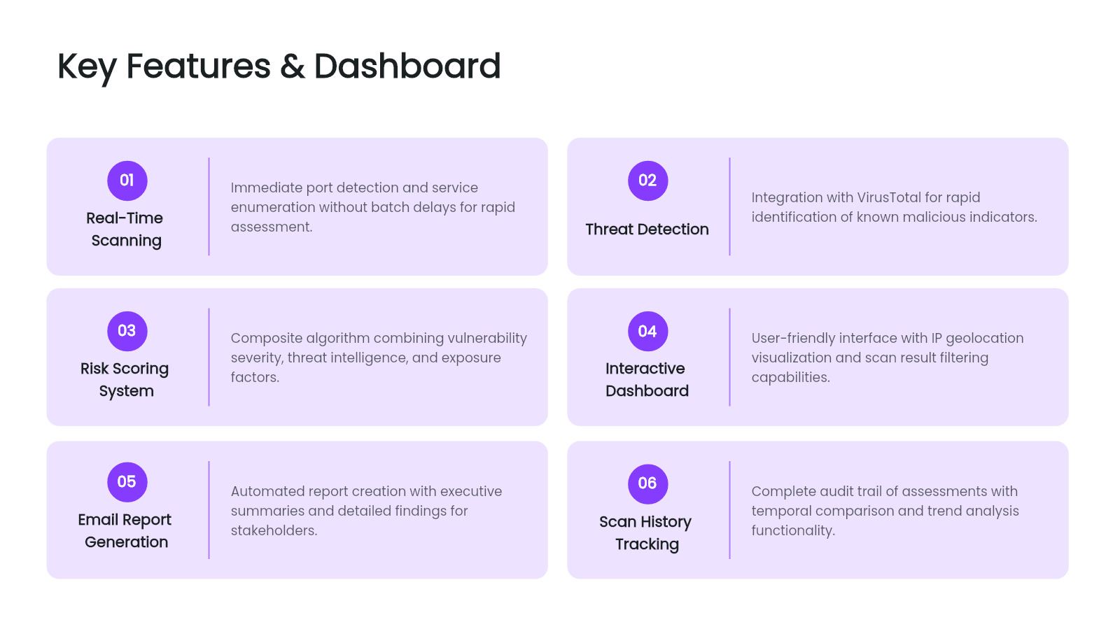

Slide 8
Results and Security Insights
Open Ports Identified
Vulnerabilities Detected
Threat Analysis Completed
Comprehensive inventory of all detected open ports, including associated services, versions, and exposure levels. This helps identify potential entry points and assess network visibility.
Mapped CVEs and known weaknesses categorized by severity. Enables prioritization of remediation efforts based on risk level and exploitability.
Detailed analysis of potential threats using reputation data, malware indicators, and attack pattern correlations to understand attacker behavior and overall threat landscape.
Risk Score Generated
Security Suggestions
A normalized risk score (0–100) with confidence levels and tier classification. Provides a clear, quantifiable view of the system's security posture for decision-making.
Actionable and prioritized remediation recommendations aligned with identified vulnerabilities and threats, helping optimize risk mitigation and resource allocation.

