Slide 1

Email Spam Classification

Slide 2

Abstract:
  Email is an information stored on a computer that is exchanged between two
  users over telecommunication.
  Spam is one of the major threats posed to email users. Spam refers to the
  electronic messaging system to send out unrequested or unwanted messages in
  bulk.
  The privacy and security of large amount of sensitive data are thread by malicious spam.
  Data mining has many approaches and algorithms for email filtering. A classifier is a supervised function
  where the learned attribute is categorical.
  The cyberpunks use emails to obtain valuable credentials.
  So, it is needed to identify those spam mails which are fraud. This project will identify those spam by using techniques of machine learning, this project will discuss the machine learning algorithms and apply all those methods on our data sets
  Using the type of methods on dataset which are the collection of the mails that the user received, we can predict whether the mail is spam or not.

Slide 3

Introduction:
  Email is one of the crucial aspects of web data communication.
  Spam emails are the emails that the receiver does not wish to receive. Spam messages not only increases the network communication and memory space but can also be used for some attack.
  Spamming is actually done by sending unsolicited bulk messages to indiscriminate set of recipients for advertising purpose.
  A large number of identical messages are sent to several recipients of email. Increasing volume of such spam emails is causing serious problems for internet users, Internet Service Providers, and the whole Internet backbone network.

Slide 4
  Dealing with spam and classifying it is very difficult task. Moreover a single model cannot tackle the problem since new spams are constantly evolving and these spams are often actively tailored so that they are not detected adding further impediment to accurate detection
  So here we are classifying the spam detected dataset to find the accuracy of classifying spam and not spam mails.
  There are several existing systems to classify the emails but to overcome the drawbacks of those systems we are using Logistic Regression model for classification of emails with high accuracy.

Slide 5
Motivation towards project:
By developing effective spam detection algorithms, you can contribute to improving the user experience for email
users.
By reducing the amount of spam that reaches people’s inboxes, you can help ensure that they have a more streamlined and enjoyable email experience.

Slide 6
Objectives:
  To compare the accuracy of the classifiers and introduces the best classifier for detecting mails.
  We use different data mining techniques classifiers like Naive Bayes, KNN, DecisionTree, Logistic Regression to categorize a mail into spam or legitimate.
  Here we are going to use Logestic Regression to predict our accuracy score.

Slide 7
Logistic Regression(Algorithm):
  Logistic regression is a statistical method used to demonstrate if a binary response variable Y independent on one or more independent variables X = (X1,··· ,Xn).
  It links the probability of an email being spam (πi) to the prediction variables (x1i,··· ,xij) through
  a framework very similar to that of multiple regression.
  It is another way to determine a class label, depending on the features. Logistic regression takes features that can be continuous and translate them to discrete values.

Slide 8

Data and Analysis:
  We took a dataset called ”mail_data.csv”, which contains 2 columns namely Category and Messages and 5572 rows of data.
  Here the Message column defines the text that present in the mails which we generally called it as subject and body of the mails.
  Whereas the Category column defines whether the message is spam or ham. Ham is nothing but Non-spam.
  Further we replace the null values in the message column will be replaced with empty string for better training. We classify the Spam and Ham as 0 and 1. Where 0 is for spam and 1 is for ham.
  Later we divide the dataset for training and testing using train test split method which is importing from sklearn library.
  Here we used a technique called Logistic Regression on
  our dataset.

Slide 9
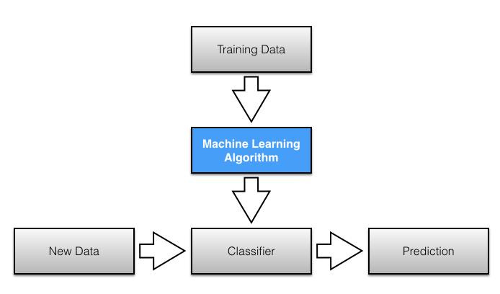

Slide 10


Conclusion
  Spam is considered as one of the main attacks in launching various attacks like stealing user identities and spreading malware.
  Spam mails area unit used for spreading virus or malicious code, for fraud in banking, for phishing and for advertising.
  To avoid spam/irrelevant mails we'd like effective spam filtering strategies.
  Applying the integrated approach over the traditional approach may increase the accuracy with respect to the real world data set. It basically helps internet users to avoid spam mails.
  In this way Machine Learning techniques are helpful to overcome from fraud happening in our devices.

Slide 11



Thank You
Harshitha Chandaka [S190987]
CSE-2E
Kavya Varanasi [S190406]
CSE-2D

