Slide 1
Travel AGENT
IBM CAPSTONE PROJECT
Presented By:
Student name : HARSHITHA NUKA
College Name & Department : KAKATIYA UNIVERSITY, MASTER OF COMPUTER APPLICATIONS

Slide 2
OUTLINE
Problem Statement
Technology used
Wow factor
End users
Result
Conclusion
Git-hub Link
Future scope
IBM Certifications

Slide 3
Problem Statement
Design and develop an AI - powered Travel Agent that:
Plans trips based on user preferences
Suggest destinations , builds itineraries
Recommends transport and accommodations
Uses real-time data(weather , maps ,events)
Manages bookings and alerts
Optimizes schedules dynamically

Slide 4
Technology used
IBM cloud lite services
Natural Language Processing (NLP)
Large Language Models(LLM)
IBM Granite model

Slide 5
IBM cloud services used
IBM Cloud Watsonx AI Studio
IBM Cloud Watsonx AI runtime
IBM Cloud Agent Lab
IBM Granite foundation model
IBM Cloud Object Storage

Slide 6
Wow factors
Real-time itinerary adjustment based on live weather and travel updates
Natural language understanding using IBM Granite for personalized suggestions
Tailored recommendations based on user interests, budget, and trip duration
Smart integration of maps, weather, and booking data for seamless planning
Chat-based interactive experience powered by Watson Assistant
Serverless backend logic using IBM Cloud Functions for efficiency

Slide 7
End users
Individual Travellers
Travel bloggers and influencers
Business executives planning multi-city trips
Academic or research-based travelers

Slide 8
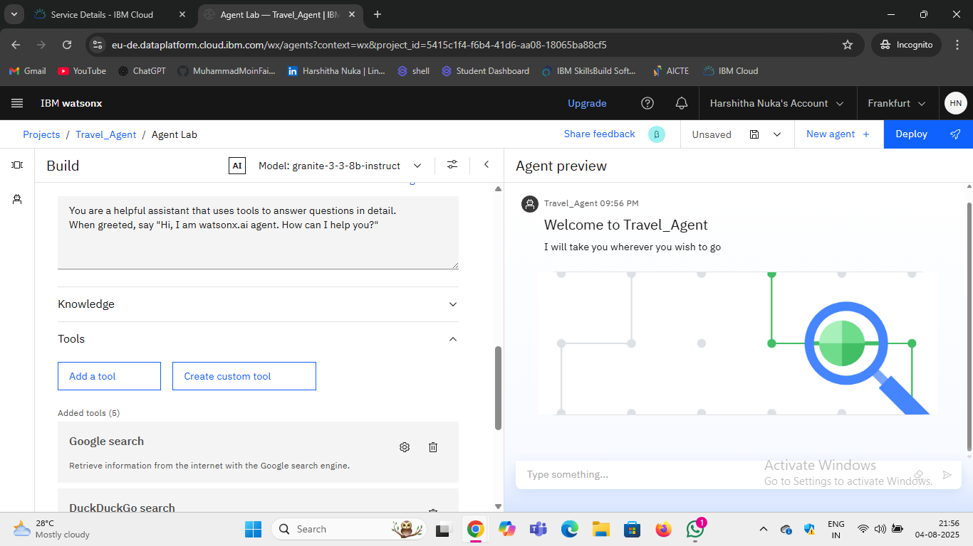
Results

Slide 9
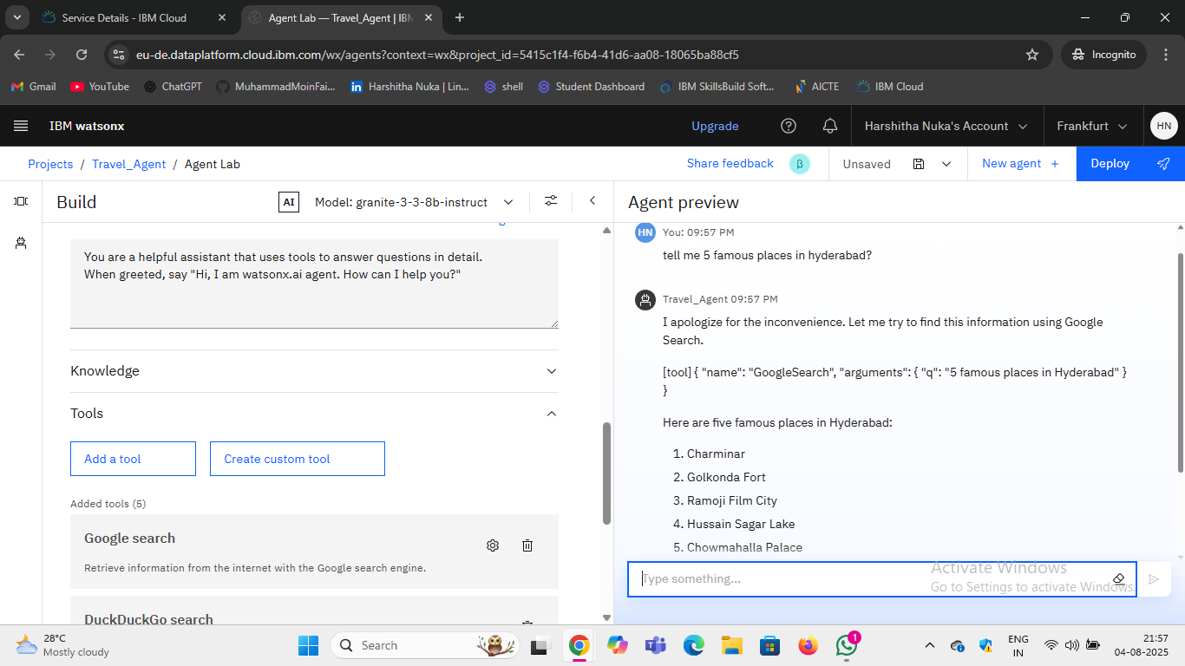
Results

Slide 10
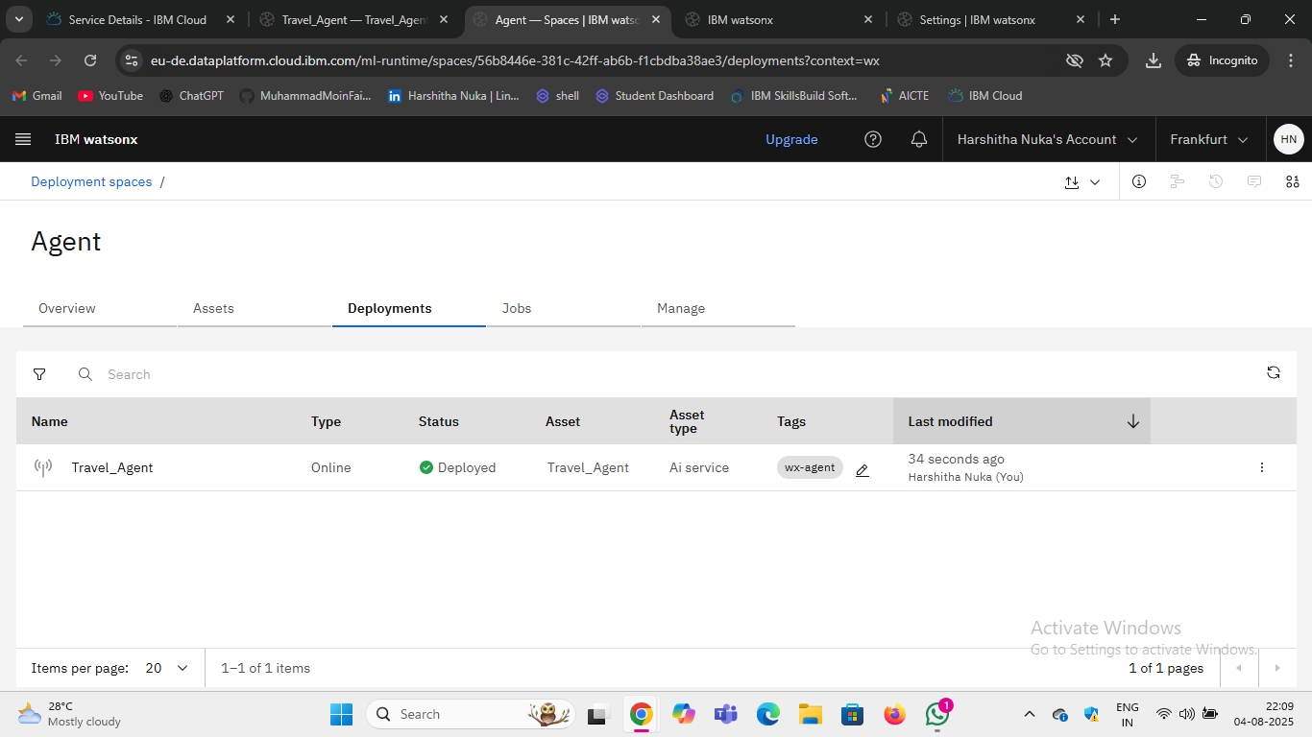
Results
DEPLOYMENT

Slide 11
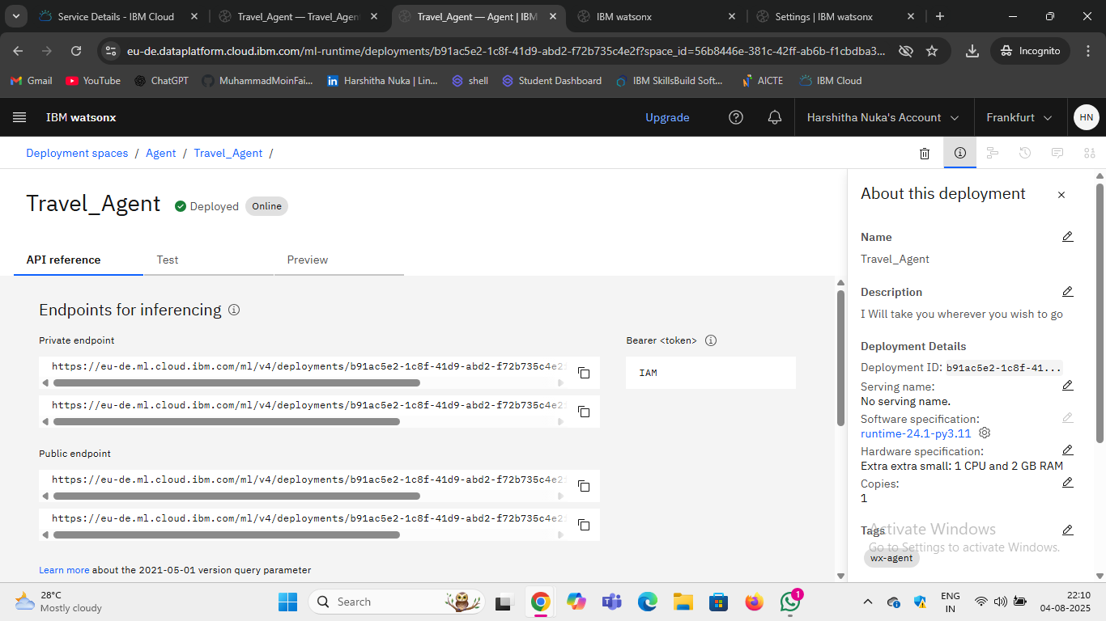
Results
API REFERENCE LINKS

Slide 12
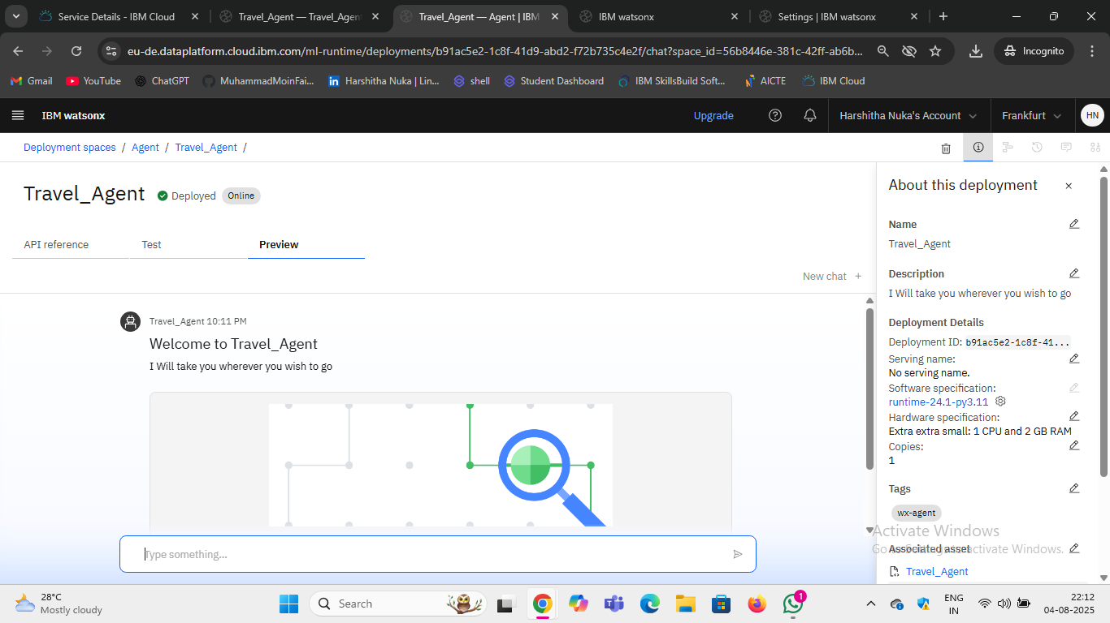
Results
PREVIEW

Slide 13
Conclusion
The Travel Agent significantly reduces the complexity of planning a trip.
By leveraging IBM Cloud Al services, the agent delivers real-time, personalized, and adaptive travel solutions, helping users enjoy a well-organized journey.
It shows the practical application of Al in solving real-life logistical challenges while keeping the experience user-friendly and efficient.

Slide 14
Voice Assistant Integration
Multilingual Travel Support
Integration with Booking Platforms
Emergency Support Services
Travel Community Features - recommendations from other users
Future scope

Slide 15
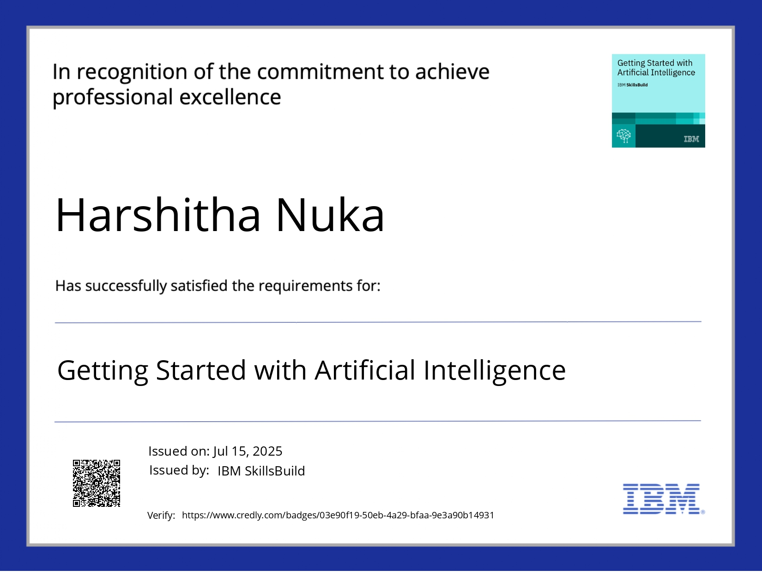
IBM Certifications

Slide 16
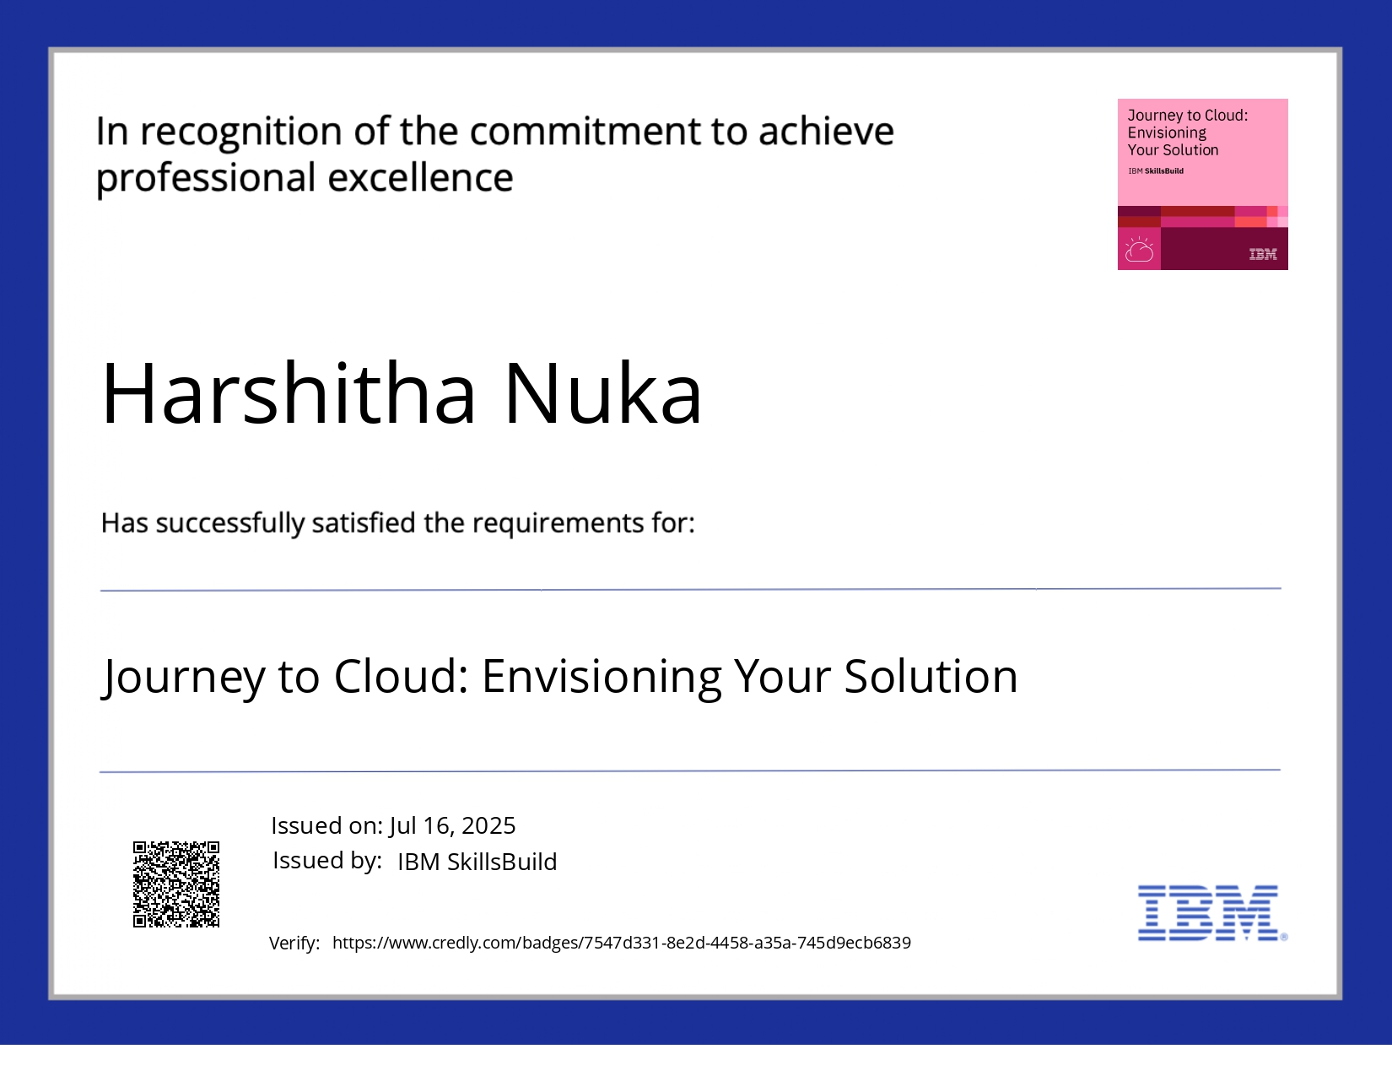
IBM Certifications

Slide 17
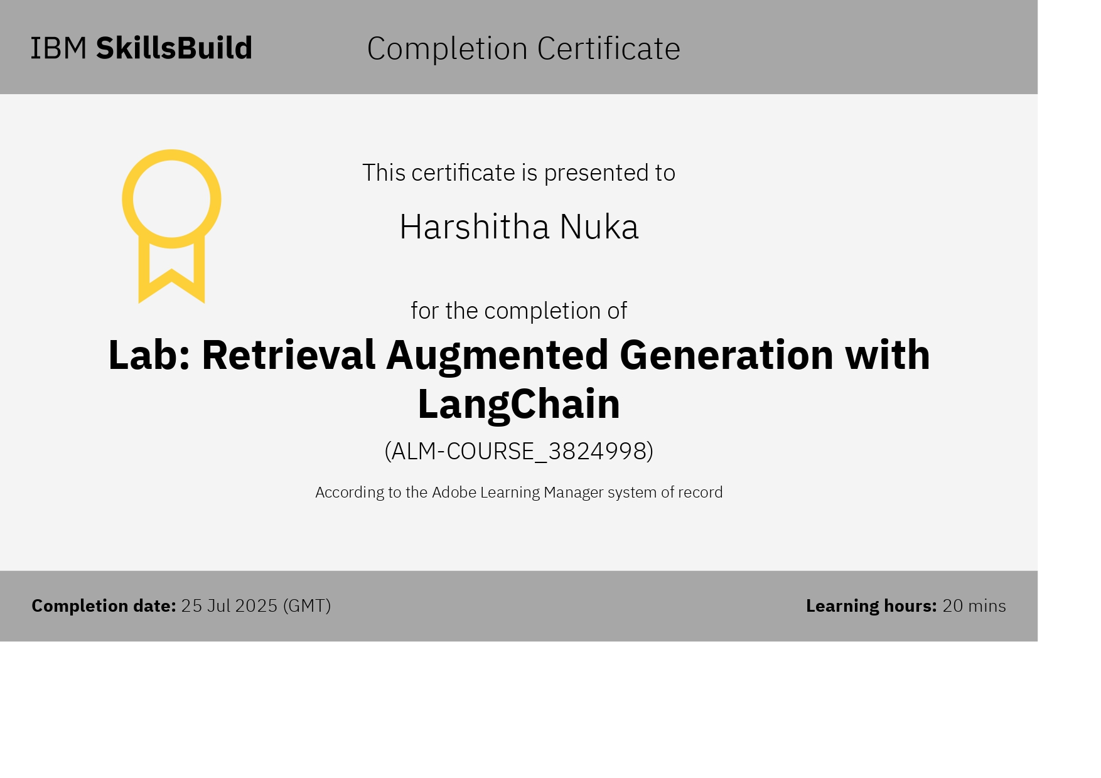

Slide 18
GitHub Link
https://github.com/Harshitha-Nuka/Travel_Agent_IBM_Project.git

Slide 19
THANK YOU

