Slide 1


K.RAMAKRISHNAN COLLEGE OF TECHNOLOGY
(AUTONOMOUS), TRICHY.
EXPENSE TRACKER APPLICATION
PRESENTED BY
HARSHITHA R
2303811710422062
SUPERVISOR
Mr. M. Saravanan, M.E.,
AP/CSE.

Slide 2
PRESENTATION OVERVIEW
Objective
Project Introduction
Problem Statement
Methodologies (Programming concepts relevant to problem statement)
Architecture of the proposed system
List of Modules
Merits
Results and Discussion
Queries

Slide 3
OBJECTIVE
The Objective of Expense Tracker GUI is a Java Swing-based application that helps users manage their personal finances by setting budgets, recording expenses by category and date, and tracking total expenses. It provides warnings when expenses exceed the budget, displays a breakdown of expenses by category, and allows users to check their budget status. With a user-friendly interface and essential features, it ensures effective financial management.

Slide 4
PROJECT INTRODUCTION
The Expense Tracker GUI is a Java-based application designed to help users manage their
personal finances by setting budgets, tracking expenses by category and date, and monitoring spending. It features a user-friendly interface and tools for staying within budget and analyzing expenses effectively.

Slide 5
PROBLEM STATEMENT
Tracking personal expenses and staying within a budget can be challenging without an organized tool. Many individuals struggle to monitor their spending, leading to overspending or poor financial decisions. There is a need for an efficient solution to set budgets, record expenses, and track financial status in real-time to help users maintain financial control.

Slide 6
METHODOLOGIES
1. Object-Oriented Programming (OOP):The Expense class encapsulates expense-related data (amount, category, and date) and provides a structured way to manage expense records.
2.Event-Driven Programming:The program uses event listeners to handle user interactions, such as button clicks and dropdown selections, ensuring responsive and interactive behavior.
3.Data Categorization:Expenses are categorized by types (e.g., Food, Transportation) to provide users with organized insights and summaries.
4.Validation and Error Handling:User inputs, such as budget and expense amounts, are validated to prevent invalid or negative entries.

Slide 7
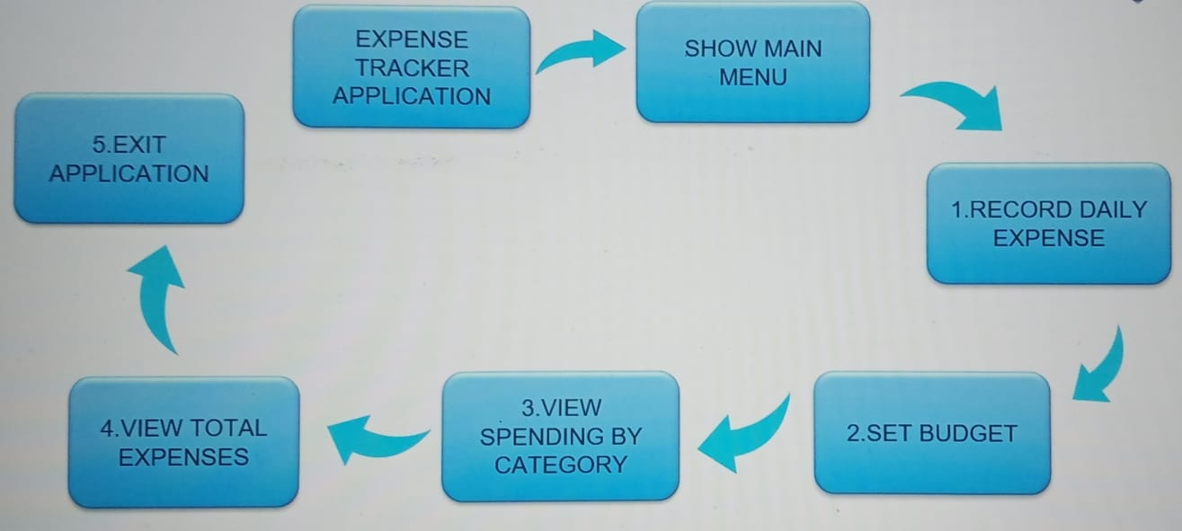
ARCHITECTURE OF THE PROPOSED SYSTEM

Slide 8
LIST OF MODULES
1.Expense Management Module:
Manages and organizes expenses using the Expense class, storing them in an ArrayList for easy retrieval and manipulation.
2. Budget Monitoring Module:
Tracks total expenses against the set budget, updating the display and alerting users when the budget is exceeded.
3. Categorization and Reporting Module:
Categorizes expenses into predefined groups (e.g., Food, Transportation) using a HashMap, and generates reports to help users analyze spending patterns.
4. Event Handling Module:
Handles user interactions (e.g., button clicks) using ActionListener, ensuring the application responds dynamically to actions like adding expenses or setting budgets.

Slide 9
MERITS
User-Friendly Interface: Intuitive design makes it accessible to all users.
Budget Tracking: Enables users to set and monitor budgets effectively.
Expense Categorization: Organizes expenses into predefined categories.
Date-Based Tracking: Allows precise recording of expenses by date.
Alerts and Notifications: Warns users when expenses exceed the budget
Data Validation: Ensures accurate and valid inputs for budget and expenses.
Exit Confirmation: Prevents accidental closure by prompting confirmation.

Slide 10
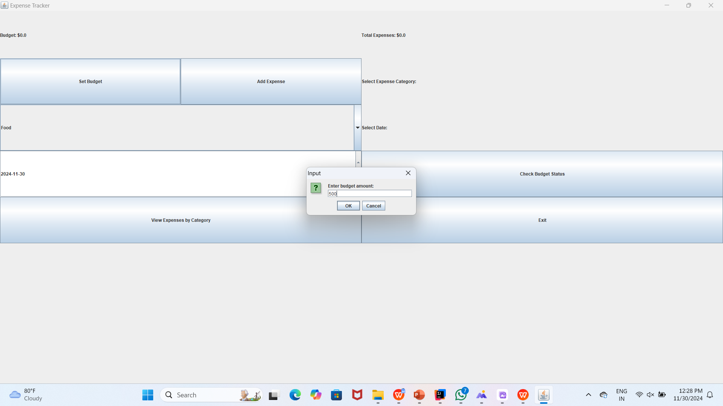
RESULTS AND DISCUSSION
1.SET BUDGET

Slide 11
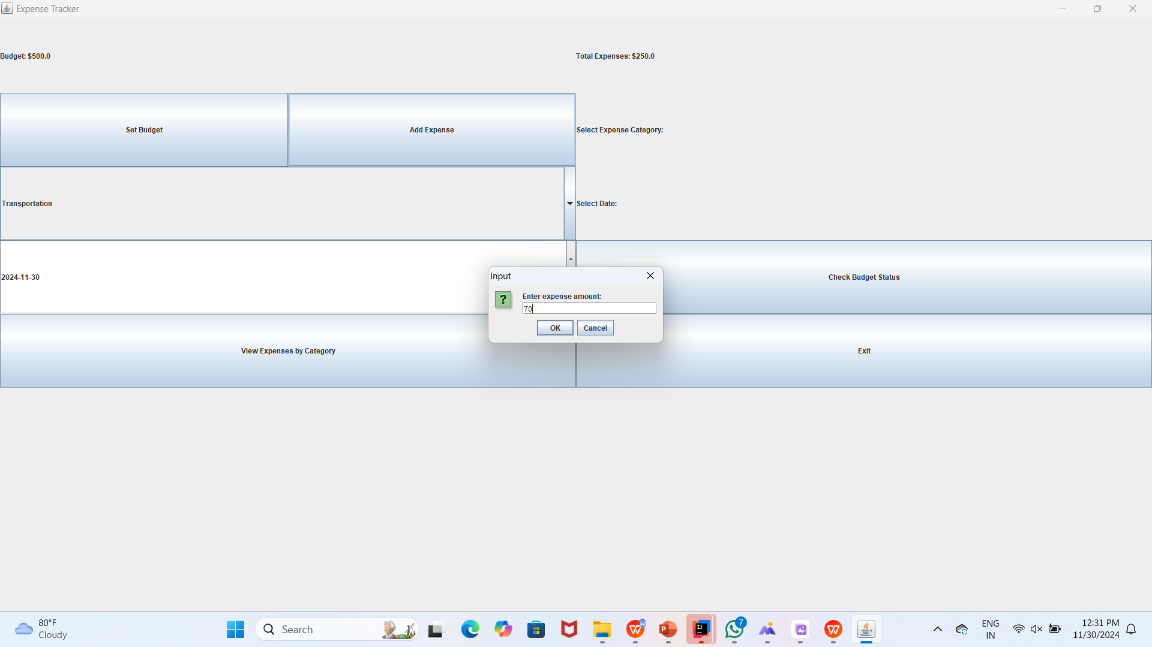
2.ADD EXPENSES

Slide 12
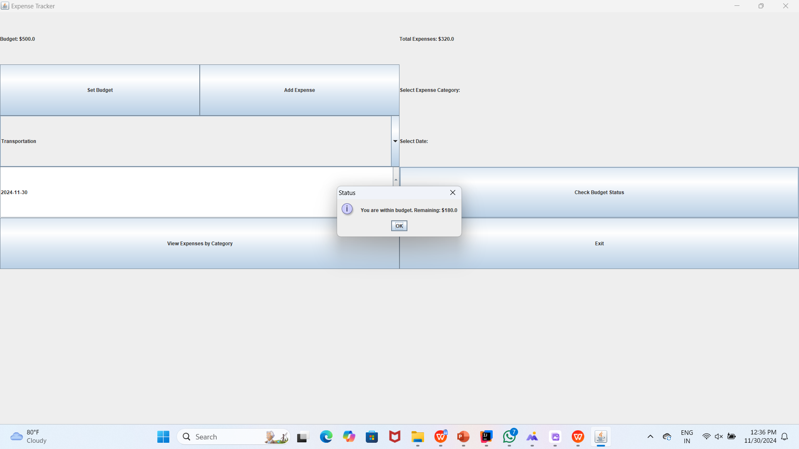
3.CHECK BUDGET STATUS

Slide 13

4.VIEW EXPENSE BY CATEGORY

Slide 14
QUERIES ?

