Slide 1
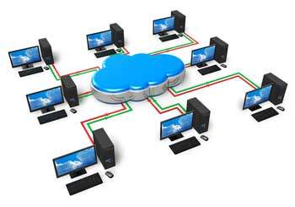
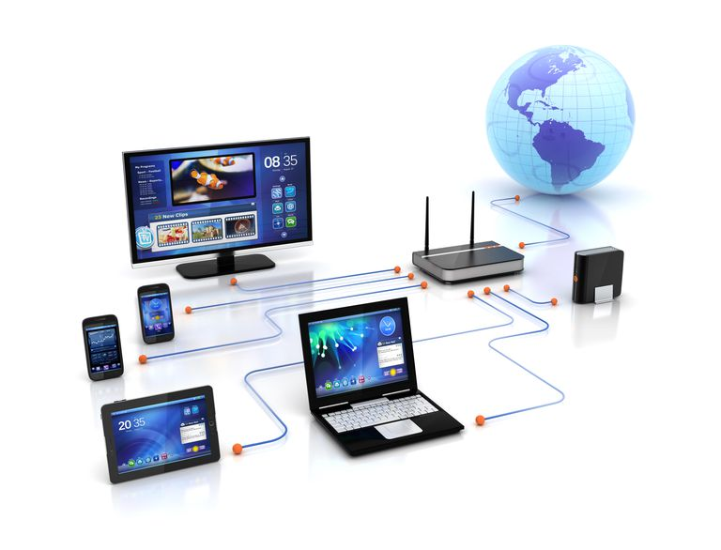
Computer Network: Definition
A computer network is a set of connected computers.
Computers on a network are called nodes.
The connection between computers can be done via cabling, most commonly the Ethernet cable, or wireless through radio waves.
Connected computers can share resources, like access to the Internet, printers, file servers, and others.

Slide 2
NEED OF NETWORKING:
Resource sharing: the goal is to make all programs, equipment’s and data available at any one on the network can share to remains without physically locate
High reliability: the goal is to provide alternative source for supply.
Communication medium: network needs for every computer communication.

Slide 3
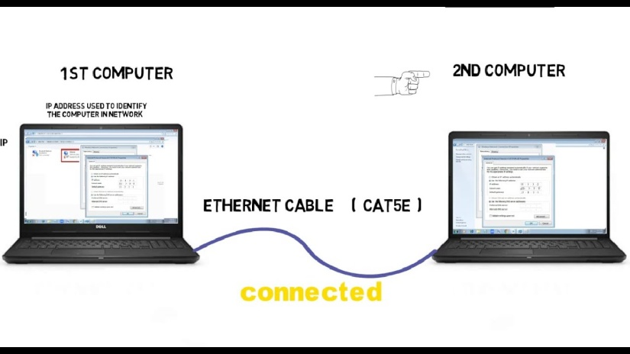
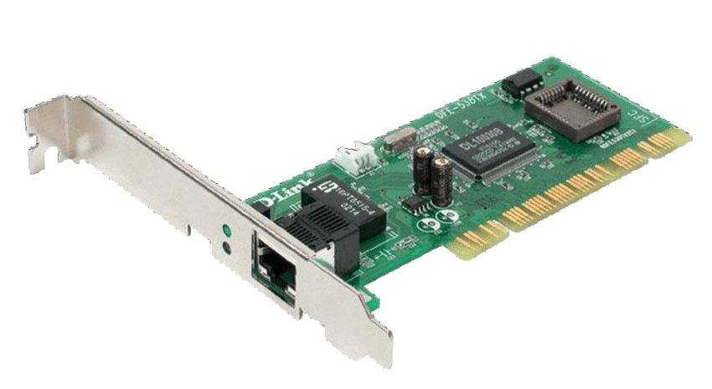
Elements of network:
At least two computers, server or clients
Network interface card (NIC)
A connection medium
Network operating system

Slide 4
Advantages and Disadvantages
ADVANTAGES:
Speed
Cost
Security
Centralized software management
Resource sharing
High reliability
DISADVANTAGES:
If server fails, application may not be available
If network fails can cause loss of data
User should depend on the network

Slide 5
Types of Networks
Based on Architecture
Peer to peer Network
Client Server
Based on Topology
Bus Topology
Ring Topology
Star Topology
Mesh Topology
Tree Topology
Based on area
LAN
MAN
WAN

Slide 6
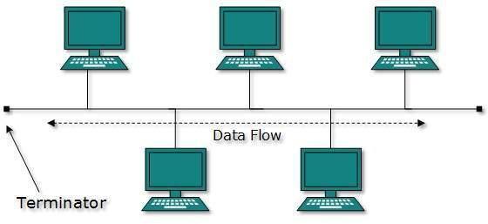
Bus Topology
Each node in bus topology connected to a single cable with the help of interface connectors.
This central cable is the backbone of the network and is known as the bus

Slide 7
A signal from the source travels in both directions to all machines connected on the bus until it finds the intended recipient.
If the machine address does not match the intended address for the data, the machine ignores the data.
Alternatively, if the data matches the machine address, the data is accepted.
Both ends of the bus have terminators.
If signal reaches the terminator removes the signal from the bus.

Slide 8
Advantages & Disadvantages of Bus Topology
Advantages:
Easy to install and maintain
Can be extended easily
Very reliable because of single transmission line
Disadvantages:
failure of the bus cable can make all other devices stop functioning.
Troubleshooting is difficult as there is no single point of control

Slide 9
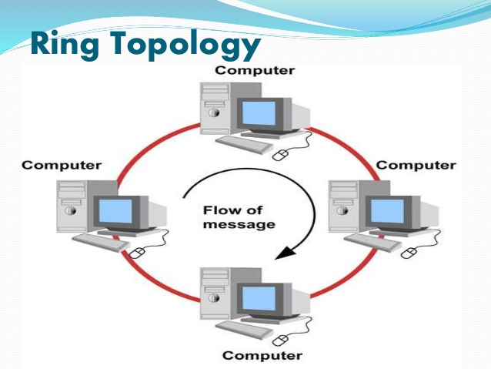
Ring Topology
In ring topology each node connects to exactly two other nodes.
The structure of the network like ring
There is no central controller, all systems with same priority.
Data/signals travel from one node to another, until it finds the destination device.
There is no data collisions
it is classified into single ring topology, dual –ring topology

Slide 10
Advantages & Disadvantages of Ring Topology
Advantages of Ring Topology :
Easy to install new devices into the network
No data packet collisions in the network
Disadvantages of Ring Topology:
If any device/wire fails in the network, entire network fail.

Slide 11
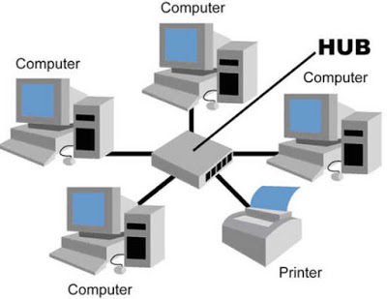
Star Topology
In which each node directly connected with central controller i.e hub/switch
Data to be transmitted through the central controller
The central controller control/manages all the functions of the network
The structure of the network like star.

Slide 12
Advantages & Disadvantage of Star Topology
Advantages
Easy to install and wire
Easy to delete the faulty devices from network
Because of the central controller, operation on the network easy.
Disadvantages
Require more cables than bus topology
If central controller fails, nodes which are connected are disabled.
It is costlier, because central controller.

Slide 13
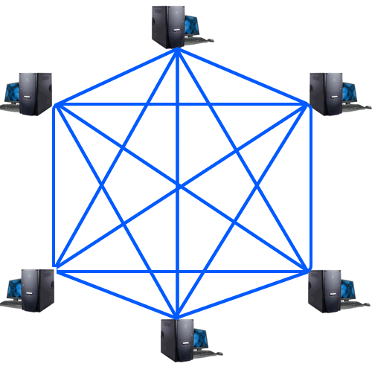
Mesh Topology
In mesh topology every node physically connected to other device on the network
It provides great performance and reliability
if number of nodes increases in the network the complexity of the network also increases

Slide 14
Advantages & Disadvantages of Mesh Topology
Advantages
In which node can transmit data from one node to many other nodes at the same time
Eliminates traffic problems
Disadvantages
Huge amount of cables requires
Installation of node/network is difficult

Slide 15
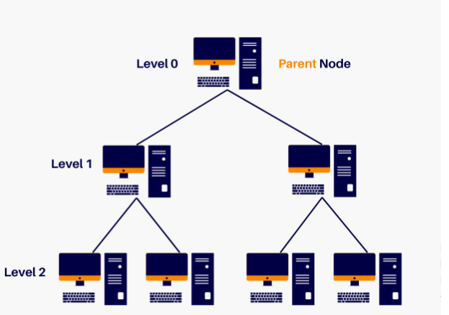
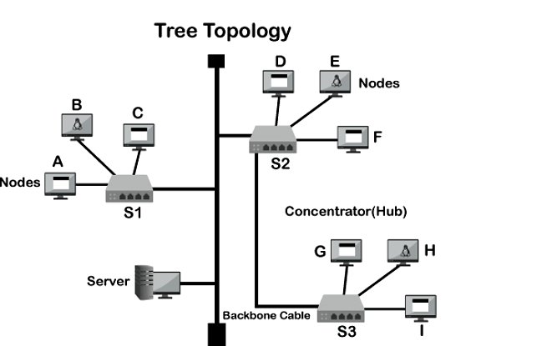
Tree Topology
Tree Topology is having a tree structure in which all the computers are connected like the branches which are connected with the tree.
tree topology is called a combination of a Bus and Star network topology.

Slide 16
Advantages & Disadvantages of Tree Topology
?

Slide 17
Classification of the Networks Based on area
LAN (Local Area Network)
MAN (Metropolitan Area Network)
WAN (Wide Area Network)

Slide 18
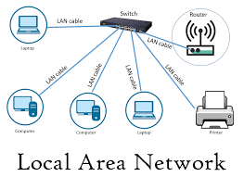
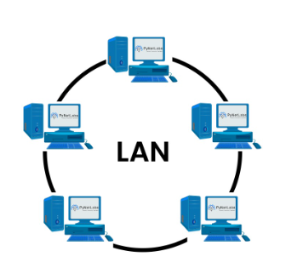
Local Area Network (LAN)
It is also called LAN
LAN designed for small physical areas such as an office, group of buildings or a factory
LANs are used widely as it is easy to design and to troubleshoot
Personal computers and workstations are connected to each other through LANs.
LAN can be a simple network like connecting two computers, to share files and network among each other while it can also be as complex as interconnecting an entire building.
We can use different types of topologies through LAN, these are Star, Ring, Bus, Tree etc.
LAN networks are also widely used to share resources like printers, shared hard-drive etc

Slide 19
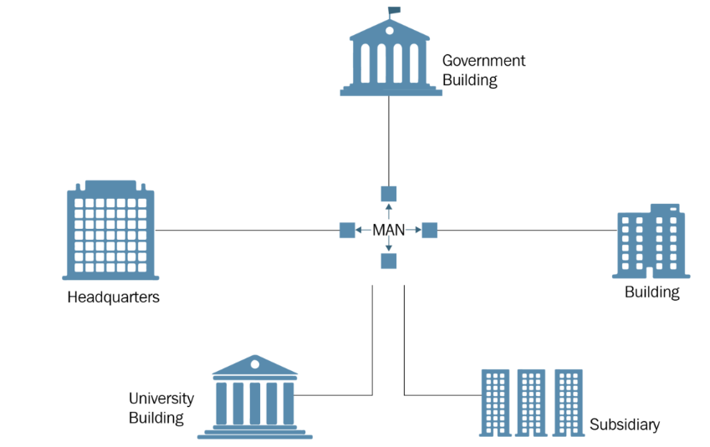
MAN (Metropolitan Area Network)
A metropolitan area network (MAN) is a computer network that connects computers within a metropolitan area, which could be a single large city, multiple cities and towns, or any given large area with multiple buildings.
A MAN is larger than a local area network (LAN) but smaller than a wide area network (WAN).

Slide 20
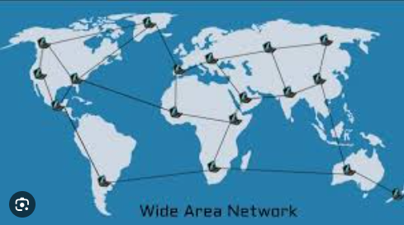
Wide Area Network (WAN)
It is also called WAN. WAN can be private or it can be public leased network.
It is used for the network that covers large distance such as cover states of a country. It is not easy to design and maintain.
Communication medium used by WAN are Satellite links.

Slide 21
Advantages and Disadvantages of LAN,MAN,WAN
?

Slide 22
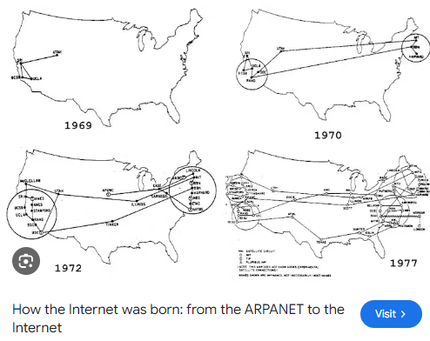
Evolution of Internet
The concept of Internet was started in 1969
The Internet is framed from the concept of Advanced Research Project Agency Network (ARPANET).
ARPANET was developed by United States Department of Defense.
Basic purpose of ARPANET was to provide communication among the various bodies of government.
Initially, there were only four nodes in ARPANET
In 1972, the ARPANET spread over the globe with 23 nodes located at different countries and thus became known as Internet.

Slide 23
Internet
Internet is a world-wide global system of interconnected computer networks.
Internet uses the standard Internet Protocol (TCP/IP).
Every computer in internet is identified by a unique IP address.
IP Address is a unique set of numbers (such as 110.22.33.114) which identifies a computer location.
Internet is accessible to every user all over the world.
A special computer DNS (Domain Name Server) is used to give name to the IP Address so that user can locate a computer by a name.

Slide 24
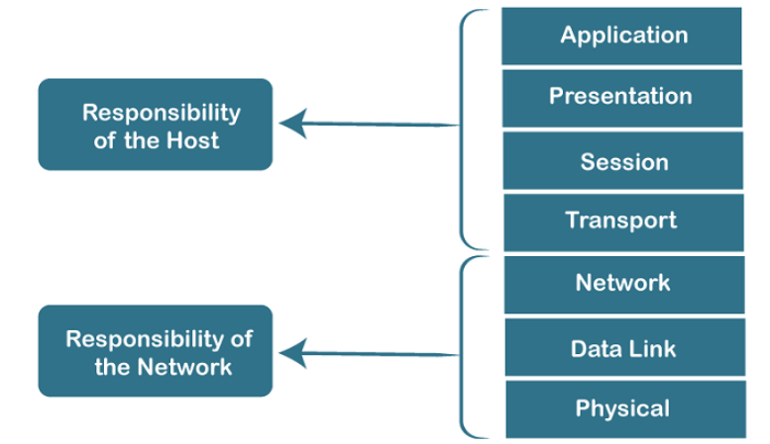
OSI Reference Model
OSI stands for Open System Interconnection is a reference model that describes how information from a software application in one computer moves through a physical medium to the software application in another computer.
OSI consists of seven layers, and each layer performs a particular network function.
OSI model was developed by the International Organization for Standardization (ISO) in 1984, and it is now considered as an architectural model for the inter-computer communications.

Slide 25
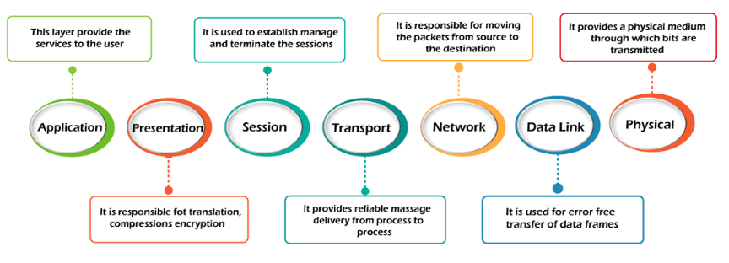
The OSI model is divided into two layers: upper layers and lower layers.
There are the seven OSI layers. Each layer has different functions. A list of seven layers are given below:

Slide 26
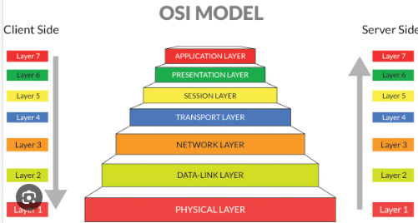
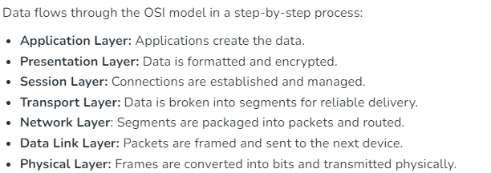
Data Flow in OSI Model

Slide 27
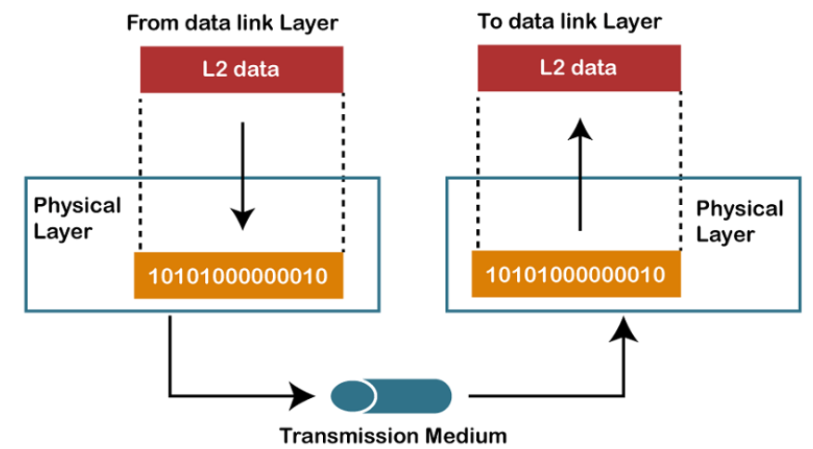
Physical layer
The main functionality of the physical layer is to transmit the individual bits from one node to another node.
It is the lowest layer of the OSI model.
It establishes, maintains and deactivates the physical connection.

Slide 28
Functions of a Physical layer:
Line Configuration: It defines the way how two or more devices can be connected physically.
Data Transmission: It defines the transmission mode whether it is simplex, half-duplex or full-duplex mode between the two devices on the network.
Topology: It defines the way how network devices are arranged.
Signals: It determines the type of the signal used for transmitting the information.

Slide 29
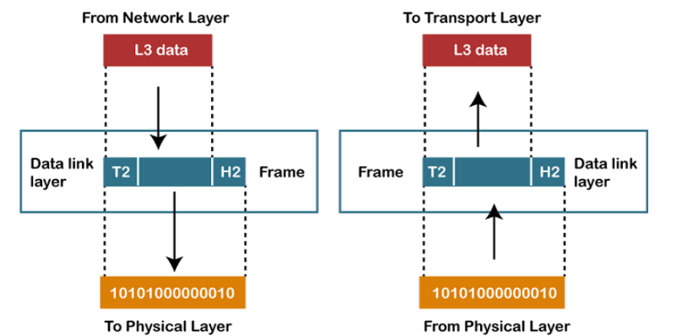
Data-Link Layer
The data link layer is responsible for the node-to-node delivery of the message.
The main function of this layer is to make sure data transfer is error-free from one node to another, over the physical layer.
When a packet arrives in a network, it is the responsibility of the DLL to transmit it to the Host using its MAC address. (Media Access Control)

Slide 30
The packet received from the Network layer is further divided into frames depending on the frame size of the NIC(Network Interface Card).
DLL also encapsulates Sender and Receiver’s MAC address in the header.
The Receiver’s MAC address is obtained by placing an ARP(Address Resolution Protocol) request onto the wire asking “Who has that IP address?” and the destination host will reply with its MAC address.

Slide 31
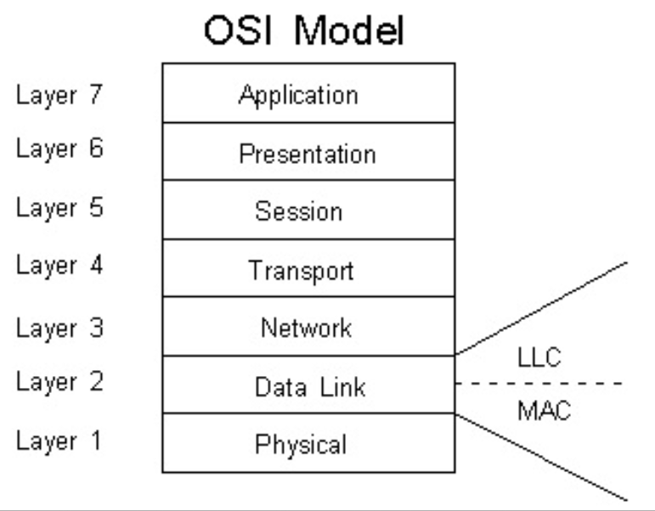
The Data Link Layer is divided into two sublayers:
Logical Link Control (LLC)
Media Access Control (MAC)

Slide 32
Logical Link Control (LLC)
This layer controls the flow control.
The error-checking of the data link layer is performed by LLC.
It can also track the acknowledgments.
While transmitting data, if LLC detects any frame loss, immediately it sends back to the source to transmit over again.
The LLC layer comes above the MAC layer and acts as an interface between the upper layers and the MAC layer.

Slide 33
Medium access control (MAC) sub layer
MAC address is defined as the Media Access Control address.
It is a unique address that is allocated to the NIC of the device. It is used as an address to transmit data within ethernet or Wi-Fi.
This layer acts as an interface between the physical layer and the LLC layer in the OSI model.

Slide 34
Functions of the Data Link Layer
Framing: Framing is a function of the data link layer. It provides a way for a sender to transmit a set of bits that are meaningful to the receiver. This can be accomplished by attaching special bit patterns to the beginning and end of the frame.
Physical Addressing: After creating frames, the Data link layer adds physical addresses (MAC addresses) of the sender and/or receiver in the header of each frame.

Slide 35
Flow Control: The data rate must be constant on both sides else the data may get corrupted thus, flow control coordinates the amount of data that can be sent before receiving an acknowledgment.
Error Control: The data link layer provides the mechanism of error control in which it detects and retransmits damaged or lost frames.
Access Control: When a single communication channel is shared by multiple devices, the MAC sub-layer of the data link layer helps to determine which device has control over the channel at a given time.

Slide 36
Network Layer
The network Layer is the third layer in the OSI model of computer networks.
Its main function is to transfer network packets from the source to the destination.
It involves both the source host and the destination host.

Slide 37
Network Layer services
Packetizing involves encapsulating data into packets suitable for transmission.
Routing determines the optimal path for these packets through the network, ensuring they navigate through multiple nodes and networks efficiently.
Forwarding is the process of directing these packets to their next hop along the selected path.

Slide 38
Transport Layer
The transport layer, or layer 4 of the OSI model, controls network traffic between hosts and end systems to guarantee full data flows.
Data volume, destination, and rate are all controlled by transport-layer protocols including
TCP(transaction Control Protocol)
UDP(User datagram Protocol) DCCP(Datagram Congestion Control Protocol ) and
SCTP(Stream Control Transmission Protocol )

Slide 39
Session Layer - Layer 5
This layer is responsible for the establishment of connection, maintenance of sessions, and authentication, and also ensures security.

Slide 40
Functions of the Session Layer
Session Establishment, Maintenance, and Termination: The layer allows the two processes to establish, use, and terminate a connection.
Synchronization: This layer allows a process to add checkpoints that are considered synchronization points in the data. These synchronization points help to identify the error so that the data is re-synchronized properly, and ends of the messages are not cut prematurely and data loss is avoided.
Dialog Controller: The session layer allows two systems to start communication with each other in half-duplex or full-duplex.

Slide 41
Presentation Layer – Layer 6
The presentation layer is also called the Translation layer.
The data from the application layer is extracted here and manipulated as per the required format to transmit over the network.

Slide 42
functions of the Presentation Layer
Translation: For example, ASCII to EBCDIC.
Encryption/ Decryption: Data encryption translates the data into another form or code. The encrypted data is known as the cipher text and the decrypted data is known as plain text. A key value is used for encrypting as well as decrypting data.
Compression: Reduces the number of bits that need to be transmitted on the network.

Slide 43
Application Layer – Layer 7
Application layer which is implemented by the network applications.
These applications produce the data to be transferred over the network.
This layer also serves as a window for the application services to access the network and for displaying the received information to the user.
Protocols used in the Application layer are SMTP, FTP, etc.

Slide 44
Application Layer – Layer 7
Functions of the Application Layer:
Network Virtual Terminal (NVT): It allows a user to log on to a remote host.
File Transfer Access and Management (FTAM): This application allows a user to access files in a remote host, retrieve files in a remote host, and manage or control files from a remote computer.
Mail Services: Provide email service.
Directory Services: This application provides distributed database sources and access for global information about various objects and services.

Slide 45
Disadvantages of OSI Model
The OSI Model has seven layers, which can be complicated and hard to understand for beginners.
In real-life networking, most systems use a simpler model called the Internet protocol suite (TCP/IP), so the OSI Model is not always directly applicable.
Each layer in the OSI Model adds its own set of rules and operations, which can make the process more time-consuming and less efficient.
The OSI Model is more of a theoretical framework, meaning it's great for understanding concepts but not always practical for implementation.

Slide 46
