Slide 1
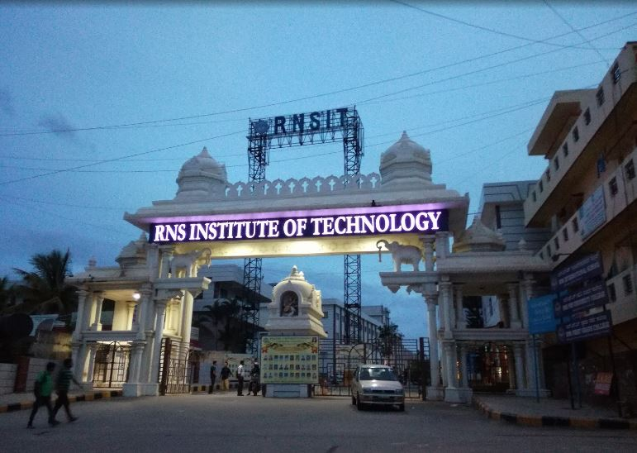


System for Detecting Deepfake in Videos : A Survey
National Conference
on
Computing Technology - 2022 (NCCT'22)
NCCT 252
By
Harshitha G S
Vardhini B H
Vani Shiva Bhat
Annapurna R Shanbhag
Under the Guidance of
Kusuma S

Slide 2
Contents
Introduction
Dataset used
Methodology
Challenges
Conclusion

Slide 3
Introduction
Every day, a large number of Deepfake photos and videos are shared on social media platforms. DeepFake films are spreading, feeding fake news and endangering social, national, and international ties.
Creation of Deepfake videos is based on the idea of replacing a person’s face with somebody else’s face. The requirement to achieve this is that the sufficient number of images of both the persons must be available.
But with the advancement in technology, it has become increasingly challenging to tell apart fake videos from the real ones.

Slide 4
Manipulation methods
Methods | Deepfake Generation | Technique used
Entire Face synthesis | This it creates nonexistent faces | GAN
Identity Swap | Replacing of One person’s face with another person’s face | FaceSwap, ZAO mobile application
Attribute Manipulation | Modification of Specific Features such as face editing, adding spectacles to a face image, and so on | GAN
Expression swap | modification of a person’s face expression | Face2Face, Neural Textures
Picture Animation | Regardless of the initial image, it is animated into a talking head, which is quite similar to the driving video | Fake Image Animation
Image to image generation | Input image and target image will be provided to cGANs networks, and anticipated picture will be accomplished | cGANs (conditional GAN)

Slide 5
Dataset used
Sl.No | Datasets | About
1 | FaceForencic++ | It is a forensics dataset made up of 1000 original video sequences which are modified using 4 different face modification techniques: Deepfakes, Face2Face, FaceSwap, and Neural Textures. The input came from 977 YouTube videos, all of which included frontal face which was clearly visible, allowing tampering methods to create plausible forgerie
2 | CelebA HQ | The CelebA-HQ dataset is an enhanced version of CelebA with 30,000 images at 1024x1024 pixels.
3 | Flicker | They allow us to establish a standard for image localization of textual entity mentions.
4 | UADF | This dataset contains 49 medium-quality real and fake videos.
5 | VoxCeleb | It is free to download and install, and it is available worldwide. After many hours of work, the dataset was created by recording interviews with celebrities and well-known people on YouTube, one of the most popular websites. i)VoxCeleb1’s database contains over 100,000 samples. VoxCeleb2 has nearly a million samples.
6 | CelebDF | Celeb-DeepFake DF, the DF synthesis Algorithm is used to create the videos which is critical to improving visual quality. It is divided into sections that address various visual defects found in current datasets.

Slide 6
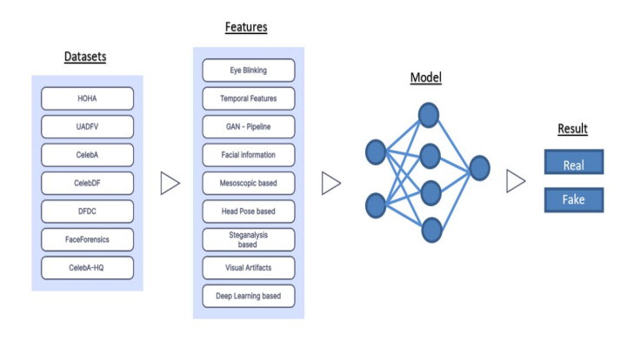
Methodology
Some important models and features used for detection

Slide 7
Sl.No | Title of the paper | Techniques Used | Dataset Used
1 | Deepfake Video Detection Using Recurrent Neural Networks | employs LSTM and RNN, CNN for feature extraction, LSTM for sequence processing | HOHA
2 | Detection of DeepFakes in Videos Utilizing Feature engineering in Deep Learning CNN Frameworks | DWT, CNN+SIFT | False texts, voices, movies, and images are all examples of fraudulent media.
3 | Deep Learning and Super Resolution Algorithms Combined for Deep Fake Detection | CNN Resnet50 Model with Super Resolution Algorithms | CelebA and UADFV
4 | Deepfake Detection Using Clustering based Embedding | Regularization Meso4 algorithm, FWA algorithm, EVA algorithm, Multitask algorithm, and the final Xception-c23 | UADFV, CelebDF, and DeepFakeDetection algorithms
5 | Deepfake Detection Using SVM | DeepFake, Image Processing, SVM, GAN, DFT | CelebA dataset

Slide 8
Sl.No | Title of the Paper | Techniques Used | Dataset Used
6 | DeepFakes and Beyond: A Survey of Fake and Detection and Face Manipulation Databases | CNN, RNN | DFFD
7 | Fighting deepfake with residual noise utilising CNN | InceptionResNet V2, CNN Deep Learning algorithm. | DFDC FaceForensics dataset
8 | Deepfake creation and detection using Deep Learning | MesoNet CNN | Deepfake Detection Challenge
9 | Detecting CNN Generated Facial Images in Real-World Scenarios | Using Generative Adversarial Networks (GANs) CelebA-HQ (CAHQ) | Flickr-FacesHQ (FFHQ)
10 | FaceForensics++: Attempting to Detect Manipulated Facial Images | Dete Using Steganalysis Method | FaceSwap, DeepFakes, Face2Face,Neural Textures,Post Processing Video Quality

Slide 9
Challenges
CHALLENGES IN DEEPFAKE CREATION
Generalization
Temporal coherence
Differences in illumination
Lack of realistic emotions
Hand movements

Slide 10
CHALLENGES IN DEEP FAKE DETECTION
Lack of DF datasets
Unfamiliar attack type
Temporal Aggregation
Unlabelled data

Slide 11
Conclusion
This paper examines DeepFake, a relatively new and well-known method. It describes the DeepFake principles, GAN-based DeepFake applications, and their benefits and drawbacks.
Models for DeepFake detection are also addressed. Most modern deep learning-based detection algorithms are incapable of transferring and generalising, implying that multimedia forensics is still in its infancy.
Several well-known organisations and experts who work to advance applied approaches have expressed strong interest. However, maintaining data integrity requires significant effort, necessitating the implementation of additional security measures.

Slide 12

Thank you

