Slide 1





DESIGN LAB PROJECT
PANTOGRAPH
Submitted to
Dr. Prabhat.k.Agnihotri
Dr. Manish Agrawal
Dr. Satwinder Jit Singh
Submitted on
26th April,2024

Slide 2

Submitted by
TUE_GRP-B
Dharmansh Vyas
2022meb1306
2.Dhruv Agarwal
2022meb1307
3.Gandhe Harshitha
2022meb1308
4.Ganesh Gurjar
2022meb1309
5.Haravath Shirisha
2022meb1311

Slide 3
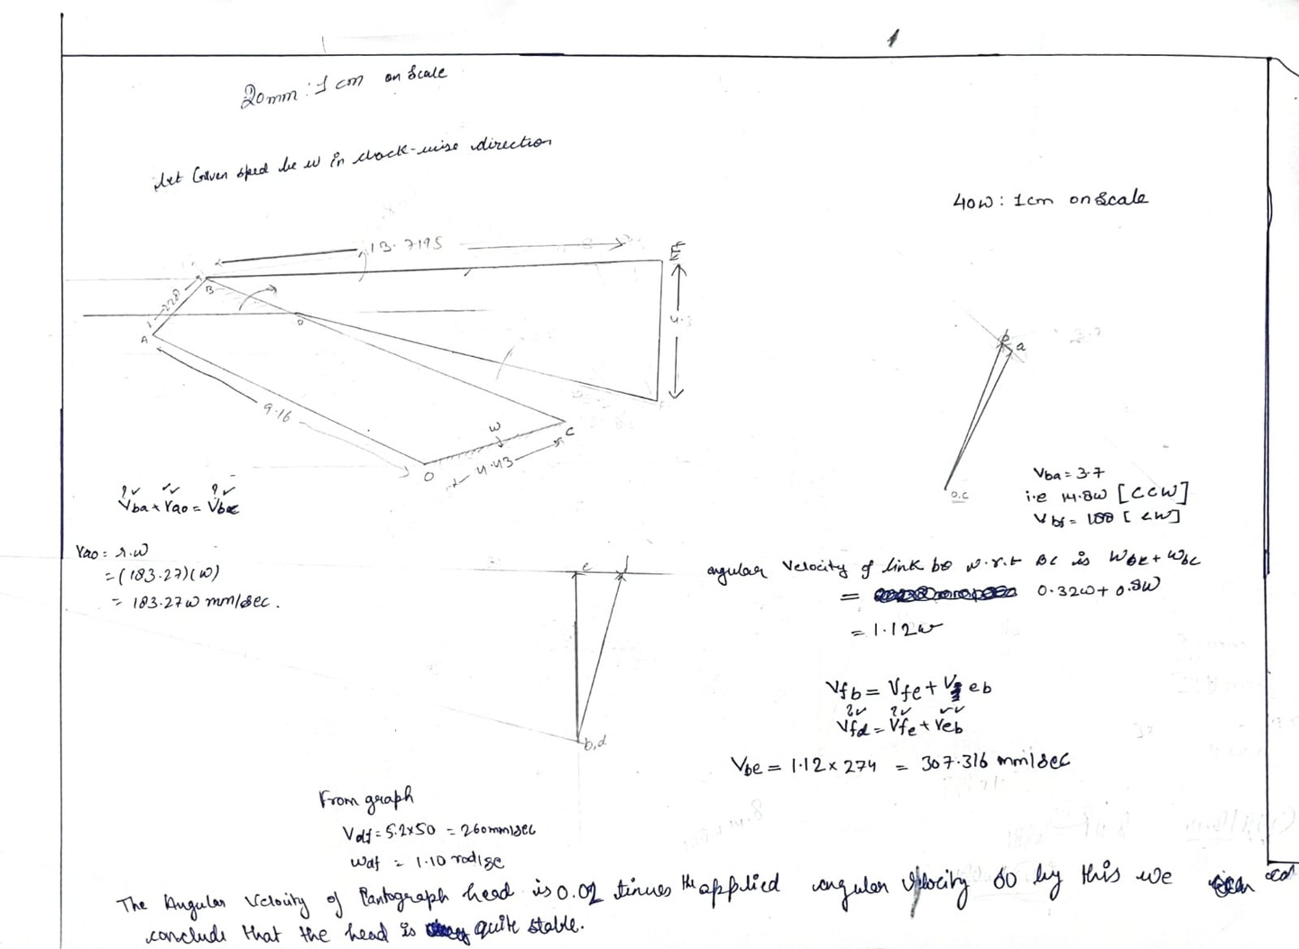
Velocity Analysis Diagram

Slide 4
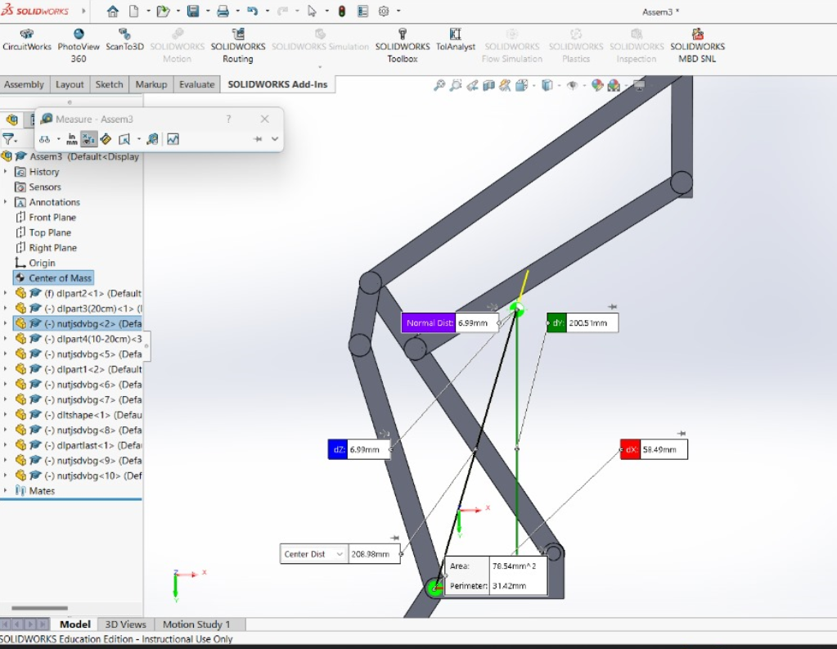
Torque Calculations
Required
input
Torque=0.07688 N.m

Slide 5
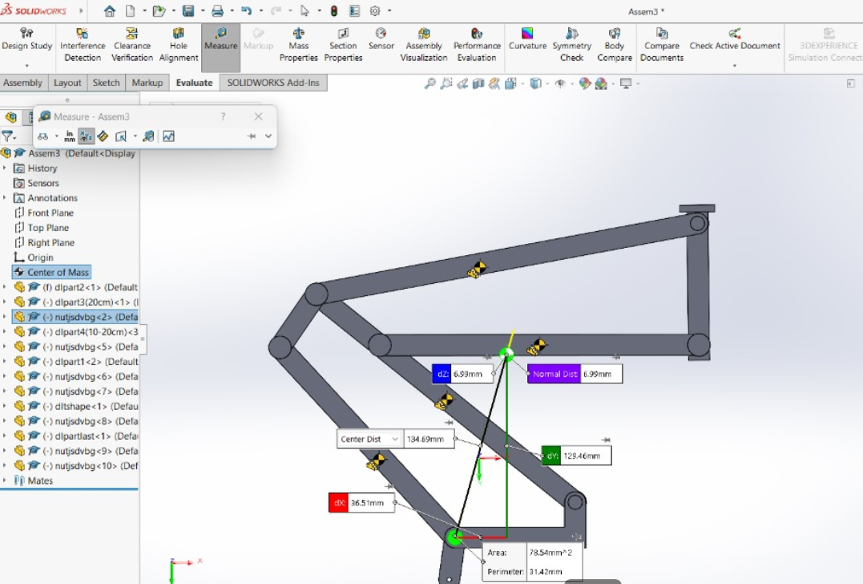
Required
input
Torque=0.048 N.m

Slide 6
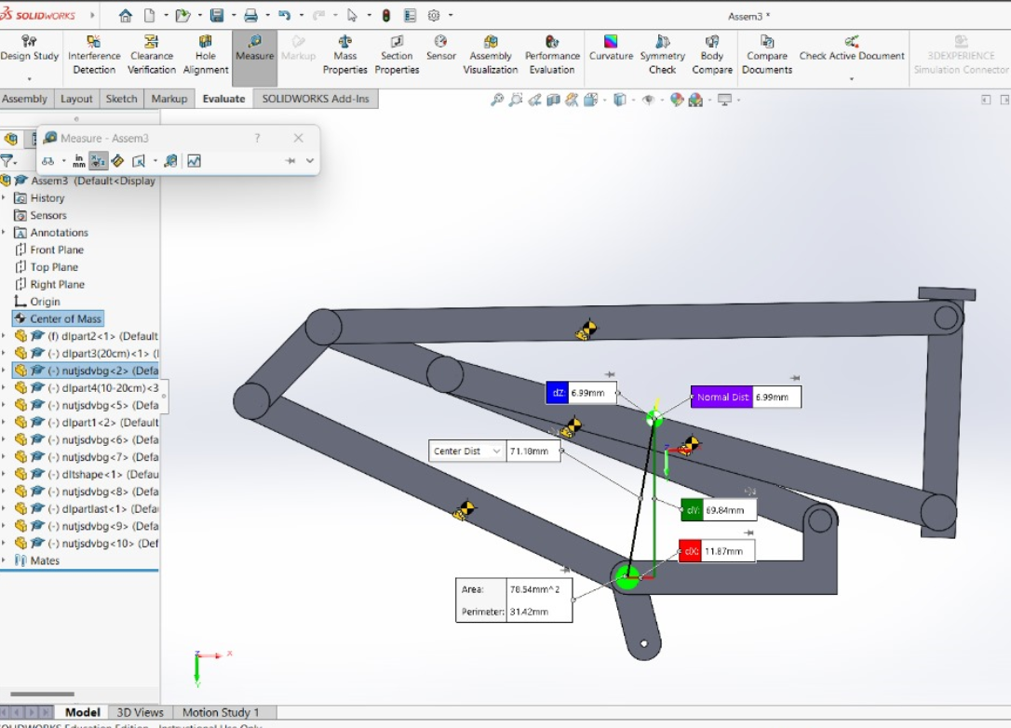
Required
input
Torque=0.0156 N.cm
The torque of the servo motor
we used was 0.85 N.m
It is easily visible
that our tool is
capable of lifting
the mechanism.

Slide 7

Thank you

