Slide 1
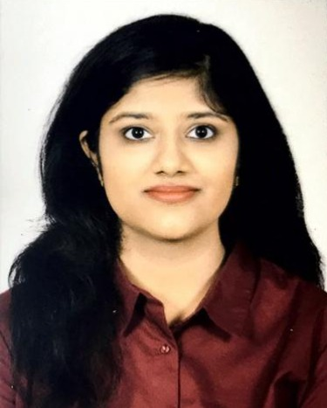

HARSHITHA R
Analyst/Software Engineer
Bachelor of Technology
Electronics and Communication: 2018 - 2022
Skills python
Java 8 /J2EE
Spring Boot
Spring MVC
JPA CRUD
Bootstrap
Data Science
MERN Stack
ReactJS
MongoDB
Database
No SQL database – MongoDB
Web Technologies
HTML5
CSS3
Javascript
AddOns
Github
Additional Details
Excellent Communication Skills
Mumbai
harshitha.g.r@capgemini.com
+91 9841166341
A4
Software Engineer who is Strong in design and integration with intuitive problem-solving skills. Passionate about implementing and launching new projects.
Ready to learn new technologies and implement them to further improve my knowledge.
Easily adaptable and eager to work in a team of dedicated people and serve a key role in the enhancement and development of the project.
Have working knowledge on ReactJS and Java Microservice Development using Spring framework.
Have knowledge and experience in data science and prediction model.
Railway Reservation System
Completed end to end case study of Railway Reservation System Application along with JWT authentication, Swagger in MERN Stack. React Bootstrap used for user interface.

