Slide 1

Fake News Detection
By Harshitha K.S

Slide 2
Problem Statement
Business Problem
The authenticity of Information has become a longstanding issue affecting businesses and society, both for printed and digital media.
On social networks, the reach and effects of information spread occur at fast pace and so amplified that distorted, inaccurate , or false information acquires a tremendous potential to cause real world impacts, within minutes, for millions of users.
Objective
The main Objective of this project to detect whether the news is fake or not by using the classifier

Slide 3
Data Description
There are 6 columns in the dataset
“id”: Unique id of each news article
“headline”: It is the title of the news.
“news”: It contains the full text of the news article
“Unnamed:0”: It is a serial number
“written_by”: It represents the author of the news article
“label”: It tells whether the news is fake (1) or not fake (0).

Slide 4
EDA Steps
1.Understanding of the data
2.Checking the missing values
3.Detecting outliers
4. Data Cleaning

Slide 5
Understanding the dataset
There are 6 columns in the dataset
“id”: Unique id of each news article
“headline”: It is the title of the news.
“news”: It contains the full text of the news article
“Unnamed:0”: It is a serial number
“written_by”: It represents the author of the news article
“label”: It tells whether the news is fake (1) or not fake (0).
We need to build a classifier that differentiate whether the news is Fake or Not

Slide 6
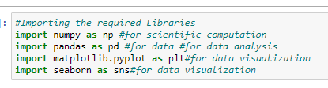

Importing the Libraries and dataset
#Importing the required Libraries
#Importing the dataset required for data analysis

Slide 7

Knowing the Information of the Dataset
#checking the shape of the dataset
Observation:-
df.shape() describes the total rows and columns available in the dataset
There are 20800 rows and 6 columns in the dataset

Slide 8
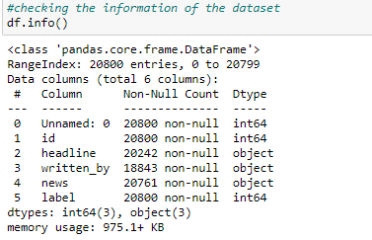
#checking the information of the dataset
Observation:-
df.info() provides information about the data types.
The data info says that there are 3 integer columns and 3 object columns.

Slide 9
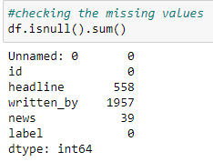
Checking the missing values
df.isnull().sum() Shows the presence of missing values in the data set.
There were missing values present in the dataset.

Slide 10
Checking for numerical columns and their distribution.
Observation
There are more than 2 unique values in all the columns.
Hence the columns are the continuous data.
The data is not ordinal type of categorical data.
Hence outliers can be found in the dataset.

Slide 11

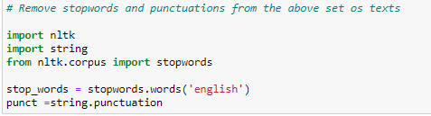
Data cleaning and Importing nlp libraries.
The above are the necessary libraries which is required for text cleaning.

Slide 12
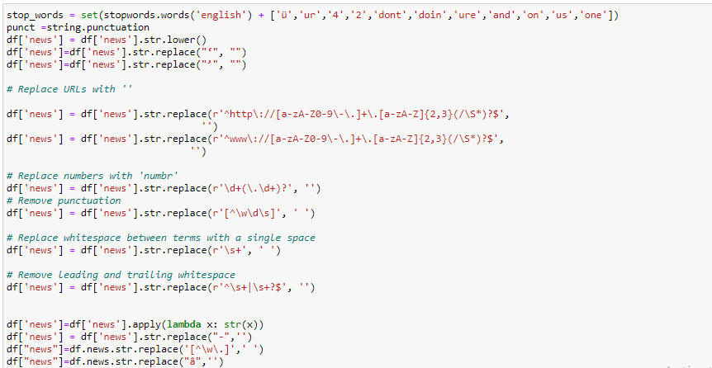
The above is the code to extract only text from the dataset by eliminating all the extra special characters, numerical. By creating the empty list and appending the cleaned data into it.

Slide 13
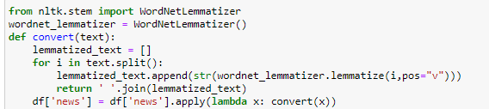

Lemmatization does the same thing as stemming and try to bring a word to its base form, but unlike stemming it do keep in account the actual meaning of the base word i.e. the base word belongs to any specific language. The ‘base word’ is known as ‘Lemma’.

Slide 14
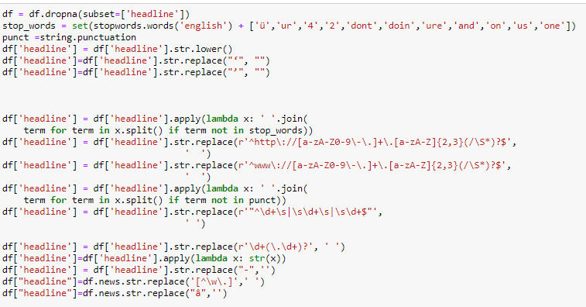
The above is the code to extract only text from the dataset by eliminating all the extra special characters, numerical. By creating the empty list and appending the cleaned data into it.

Slide 15
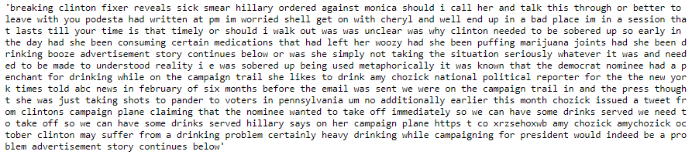
The column which is resulted after cleaning.

Slide 16
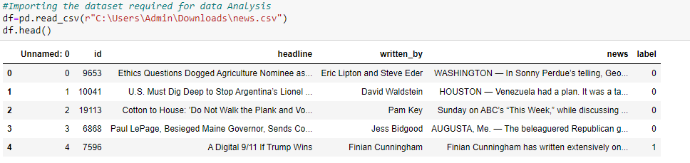
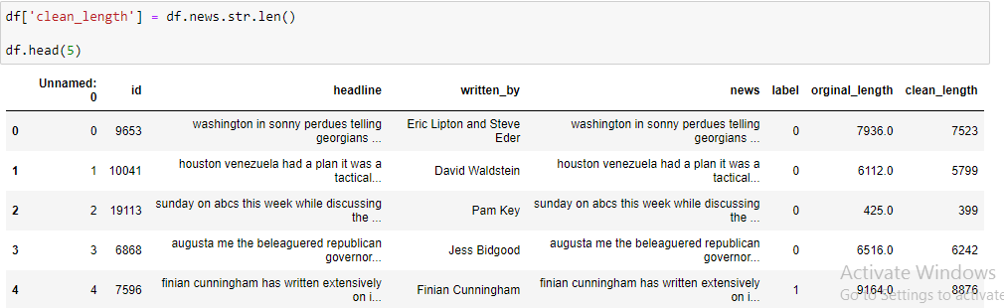
The Dataset view
Dataset with new column.

Slide 17
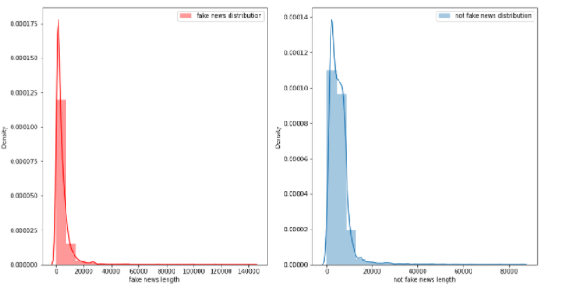
Distplot of Orginal length

Slide 18
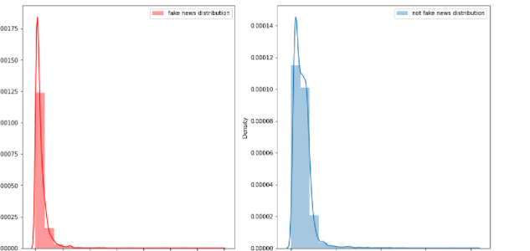
Distplot of Cleaned length

Slide 19

WordCloud of label=1

Slide 20
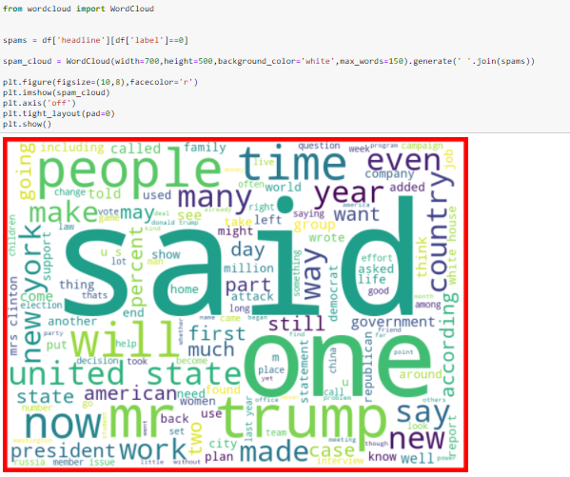
WordCloud of label=0

Slide 21
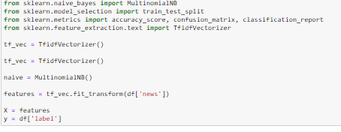
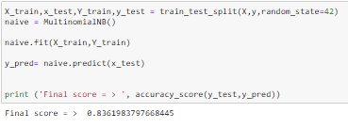
Prediction Using MultinomialNB

Slide 22
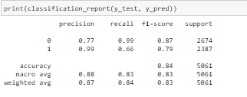
Accuracy Score
The accuracy score of MultinomialNB model was found to be 84 per cent

Slide 23
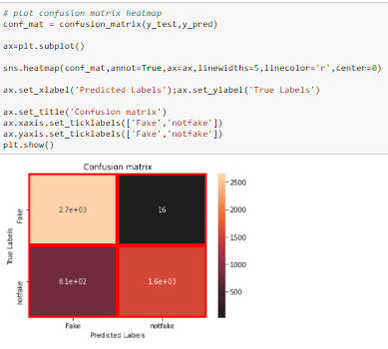
Confusion Matrix

Slide 24
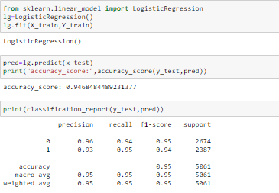
Prediction Using Logistic Regression

Slide 25
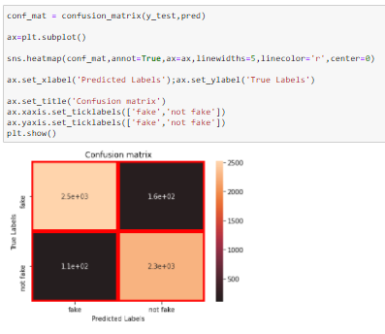
Confusion Matrix

Slide 26
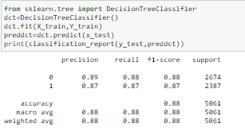
Prediction Using Decision Tree Classifier

Slide 27
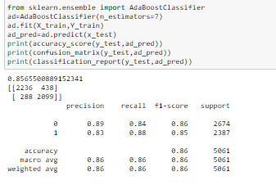
Prediction Using Decision Tree Classifier

Slide 28
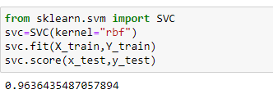
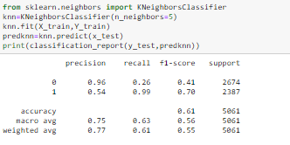
Prediction Using SVM
Prediction Using Kneighbor Classifier

Slide 29
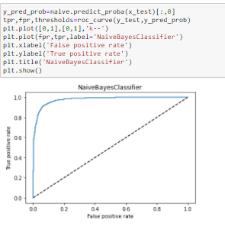
ROC Curve Of NaiveBayesClassifier

Slide 30
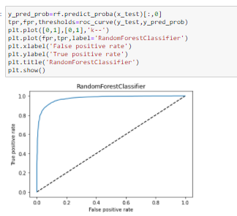
ROC Curve Of Random ForestClassifier

