Slide 1
Quantum-Assisted PINNs for CFD
When, why, and how a variational quantum layer changes PINN learning for PDEs
WISER Global Quantum + AI 2026 · BQP Challenge
Team Entangled Minds
Harshita Bai · Ansh Goel · Manoj Kumar Reddy

Slide 2
THE CHALLENGE
Not “does quantum win?” — but when, why & how
We replace the first hidden layer of a classical PINN with a variational quantum circuit (VQC), then characterise how that substitution changes the learning dynamics — rather than chasing a universal speed-up.
WHEN
WHY
HOW
Under which PDEs and circuit settings does the quantum layer actually change learning?
What mechanism — expressivity, frequency content, trainability — drives the difference?
How do encoding, qubits and entanglement reshape training behaviour?

Slide 3
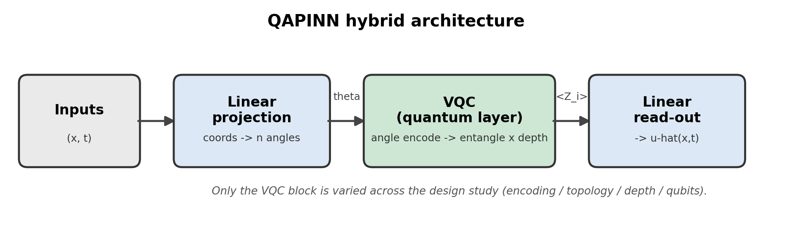
THE IDEA
From classical PINN to hybrid QAPINN
PINN: a neural net trained to satisfy a PDE by penalising its residual through automatic differentiation.
QAPINN: the coordinates (x,t) are encoded into a small quantum circuit; its measured outputs feed the classical read-out. Only the quantum block changes across the study.

Slide 4
APPROACH
Three PDE benchmarks of rising complexity
1
2
3
1D Burgers’
1D Heat
2D Navier–Stokes
Nonlinear convective–diffusive
Linear diffusion
Kovasznay flow, Re = 40
Primary benchmark — sharp gradient
Smooth generalisation check
Coupled vector-valued stress test
Ground truth verified analytically (Cole–Hopf, separation of variables, exact Kovasznay) and cross-checked with SymPy.

Slide 5
METHOD
One controlled experiment matrix
Six architecturally-identical configurations (~2,100–2,450 trainable parameters each), run identically across all three PDEs.
C0
Q1
Q2
Classical PINN
3 qubits · angle · basic
4 qubits · angle · basic
— baseline (FC 25-25-25-25)
the reliable default
width test
Q3
Q4
Q5
5 qubits · angle · basic
3 qubits · re-upload · basic
3 qubits · angle · strongly-ent.
widest circuit
expressivity lever
richest entanglement

Slide 6
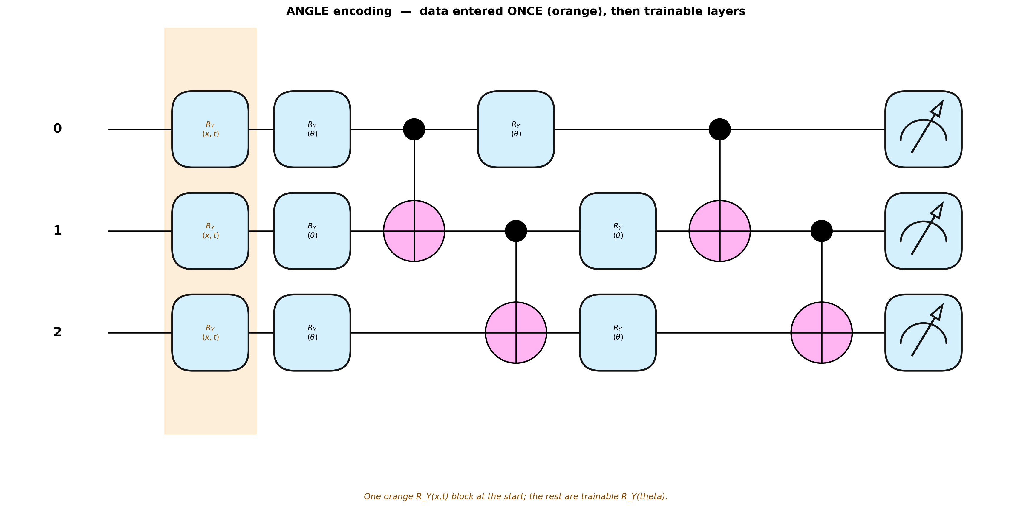
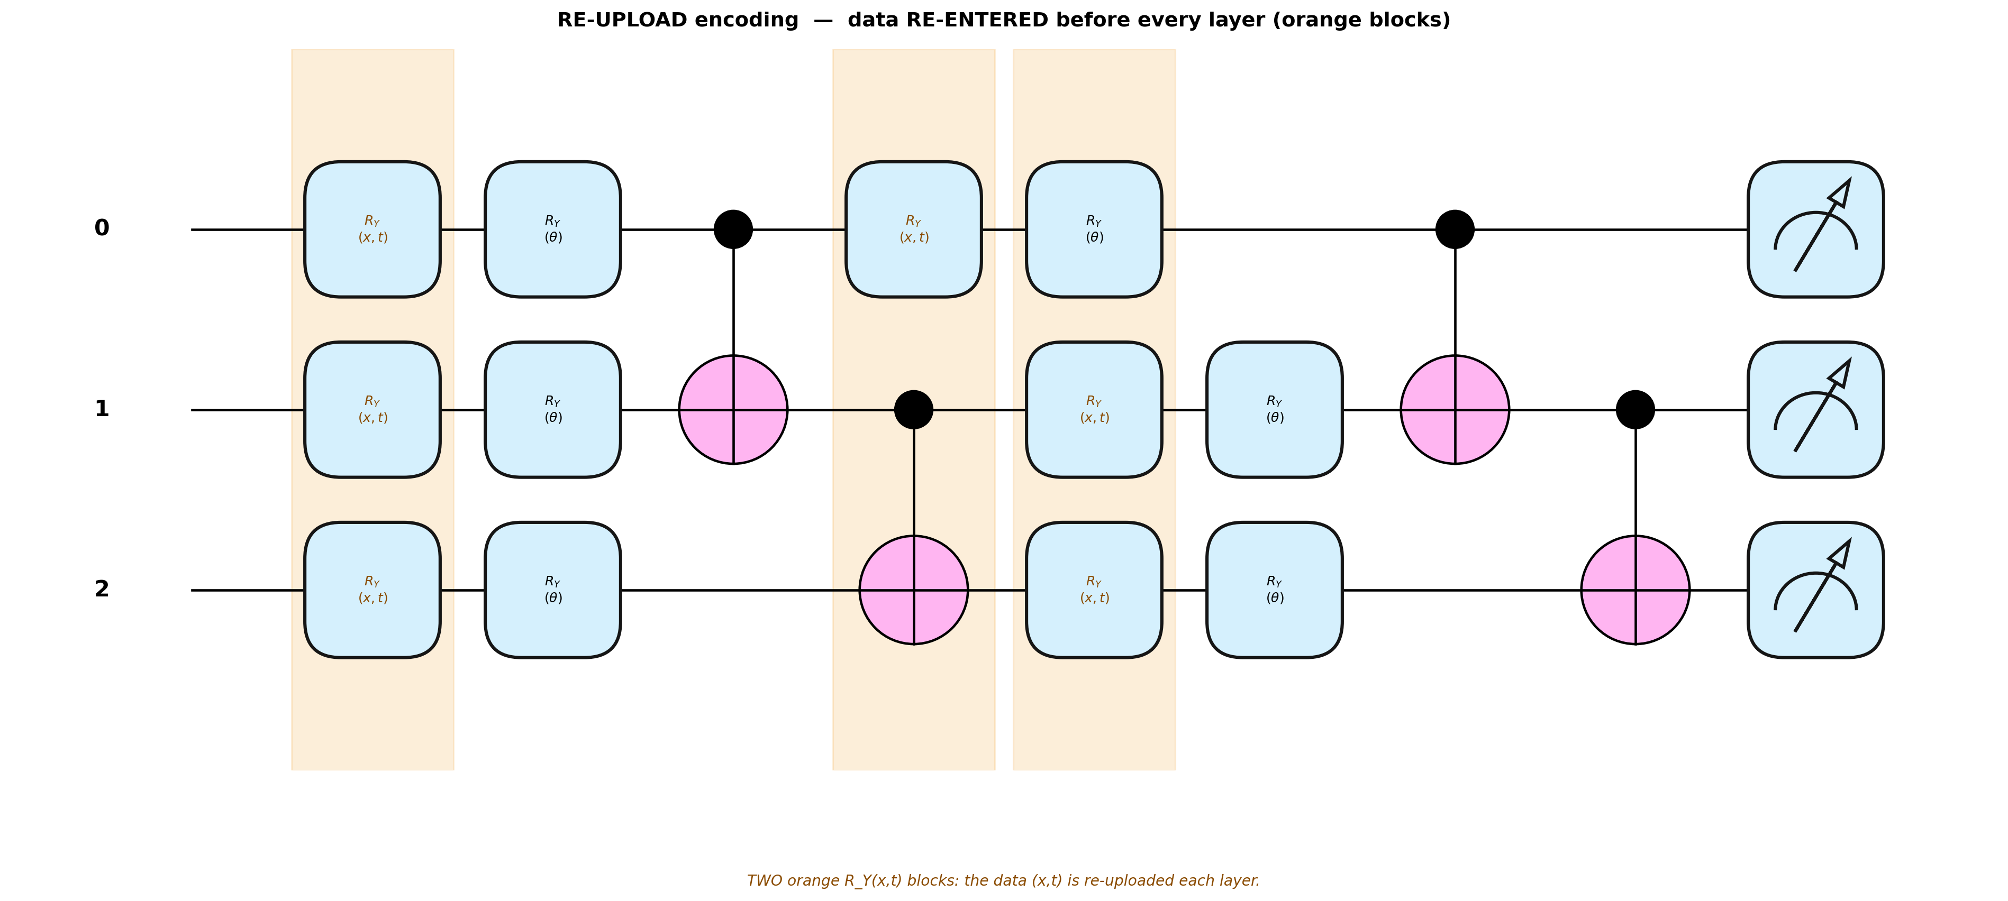
DESIGN AXIS 1 — ENCODING
How the data enters: angle vs re-upload
Encoding sets which Fourier frequencies the circuit can represent. Angle encodes (x,t) once; re-upload re-injects it before every layer for a wider spectrum.
ANGLE — encoded once
RE-UPLOAD — re-entered each layer
Finding: re-upload genuinely widens the spectrum (max freq 1.11 vs 0.64) — but wider expressivity did not translate into better accuracy. The simpler angle encoding was consistently preferred.

Slide 7
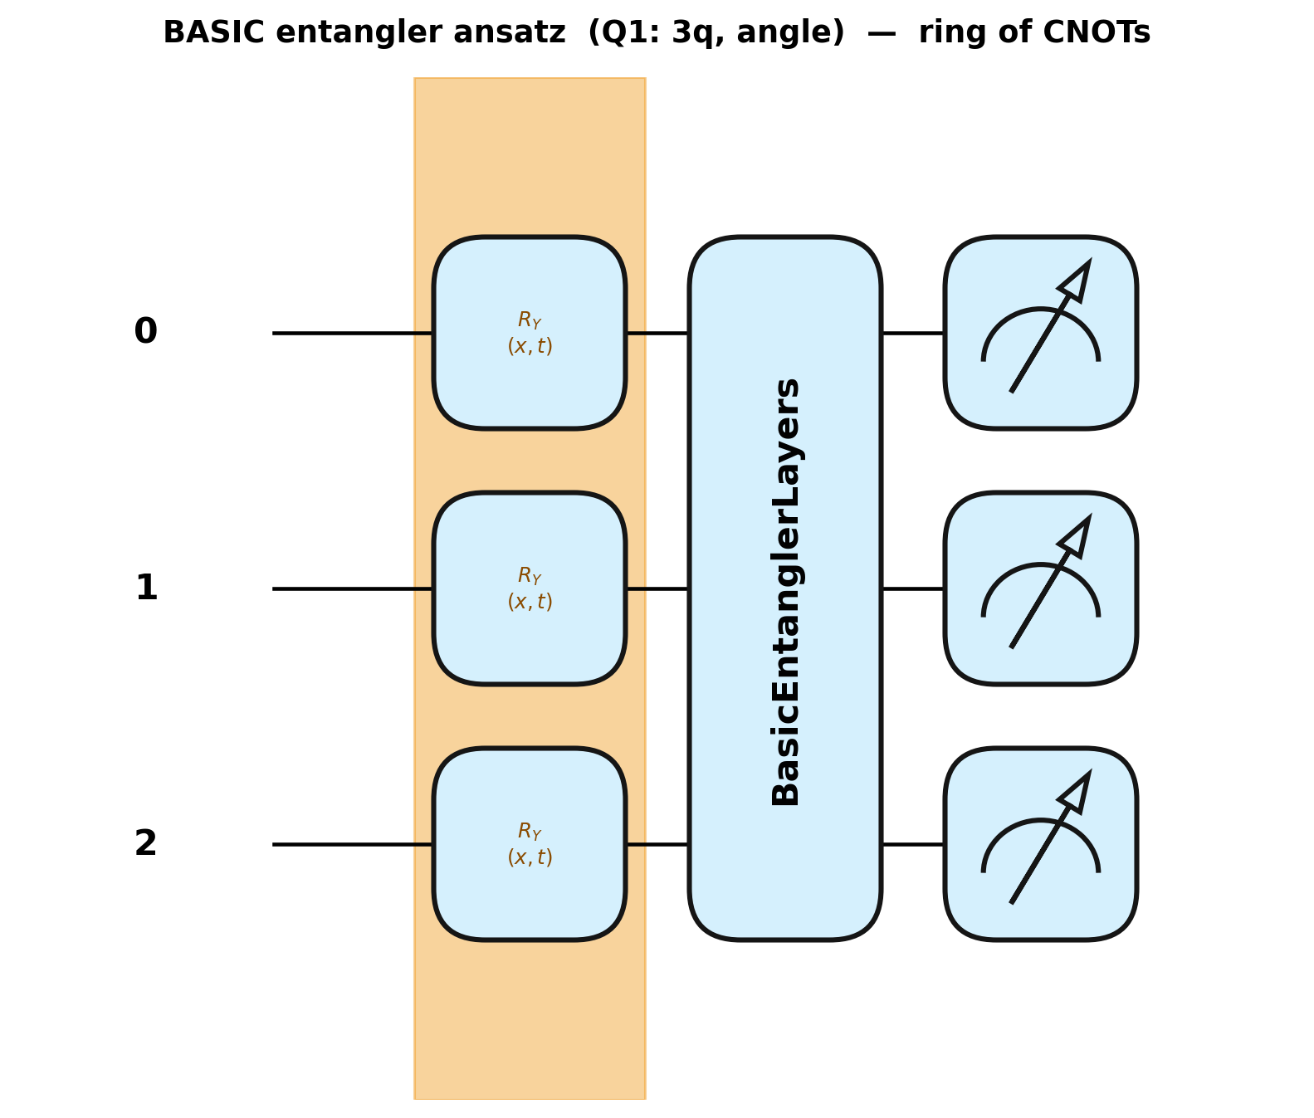
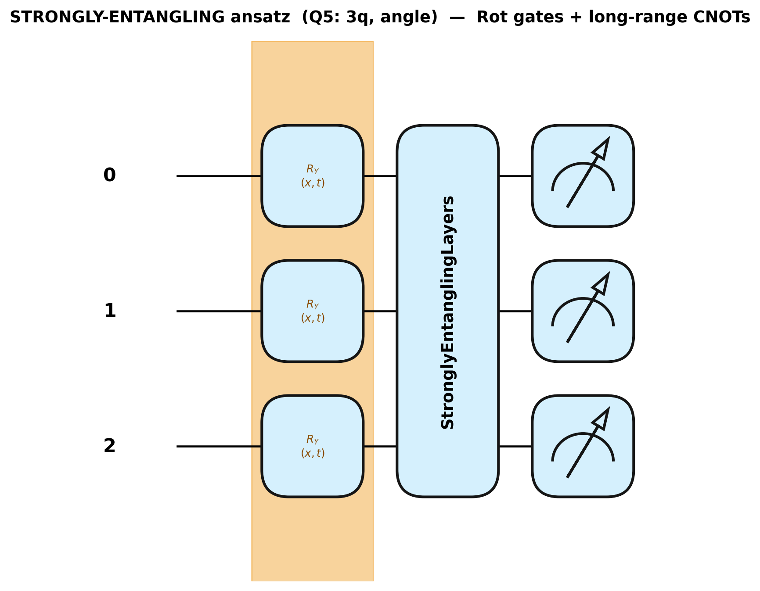
DESIGN AXIS 2 — ENTANGLEMENT
How qubits link: basic vs strongly-entangling
BASIC entangler (Q1–Q3)
STRONGLY-ENTANGLING (Q5)
Finding: the strongly-entangling ansatz (Q5) was the strongest single-seed performer on Burgers & Heat — but its trainability is PDE-dependent (weights near-frozen on Burgers, active on Navier–Stokes). Powerful, but not a safe default.

Slide 8
KEY RESULT · NAVIER–STOKES
The strongest confirmed quantum win
5-qubit angle-encoded QAPINN
0.52
Statistically significant
Welch’s t-test, Bonferroni-corrected α = 0.01
QAPINN (Q3) relative L2 (u,v,p)
p = 0.0037
0.97
The hardest, coupled 2D problem is where the quantum layer helped most — and where it was rigorously confirmed.
classical PINN (C0) relative L2

Slide 9
KEY RESULT · BURGERS’
Best accuracy — and a confirmed gain
0.14
0.42
0.0092
Q5 relative L2 (best)
C0 classical relative L2
Q1 significance (p)
3q · angle · strongly-ent.
baseline
3q · angle · basic — confirmed
Q5 gives the lowest error; Q1 is the only multi-seed-confirmed improvement over classical on the primary benchmark.

Slide 10
KEY RESULT · HEAT
Where classical still wins
Smooth = low-frequency
0.0062
The heat solution is essentially a single Fourier mode. The small quantum circuit has enough expressivity, but a larger classical network — with more parameters — still edges it on raw accuracy.
best QAPINN (Q5) relative L2
0.0039
Takeaway: the quantum advantage here is expressivity-per-parameter, not lower error.
best classical (wider net)

Slide 11
EXPLAINABILITY · EXPRESSIVITY
More expressive ≠ more accurate
Fourier-spectrum analysis of the circuits confirms re-uploading multiplies the accessible frequency components (Schuld et al.) — yet the widest-spectrum config (Q4) is never the best performer.
1.11
0.64
Q4 re-upload max frequency
standard configs max frequency
Expressivity is a capability, not a guarantee — the target PDE decides whether the extra frequencies are useful.

Slide 12
EXPLAINABILITY · TRAINABILITY
The clearest mechanism: a trainability cliff
Barren-plateau scan
Weight-movement (Q5)
6.1–8.6×
Navier–Stokes
7.30% — quantum layer active
Heat
3.33% — weights barely moved
gradient-variance drop from 3 → 4 qubits, reproduced across all three PDEs with identical circuits.
Burgers
3.45% — near-frozen circuit
Same circuit, different training regime — purely a function of the PDE loss landscape.

Slide 13
THE DELIVERABLE
A design rule for problem-specific QAPINNs
1
Start small
3 qubits, angle, basic entangler — most reliably trainable, and the confirmed win on Burgers.
2
Add qubits only on evidence
More qubits buy expressivity but spend gradient-variance headroom.
3
Avoid strong entanglement by default
Check weight-movement early; if near-frozen, simplify the ansatz.
4
Use re-upload selectively
Only when the problem specifically needs wider frequency content.

Slide 14
HONESTY & OUTLOOK
Limitations and where we go next
Limitations
Future work
Burgers multi-seed sweep runtime-interrupted; some wins single-seed only
Heat results are single-seed (no Stage-C test)
Navier–Stokes confirmation covers C0 vs Q3 only
Only expectation-value ⟨Z⟩ measurement tested
Higher-dimensional / full Navier–Stokes flows
Quantum Reservoir Computing as a third baseline
New encodings, ansätze and optimisers
Real quantum hardware and noise-aware simulation

Slide 15
Quantum layers are a problem-specific tool,
not a universal replacement for classical PINNs.
Strongest, confirmed on the hardest 2D flow · expressivity gains that don’t always pay off · a clear trainability cliff · and a design rule to navigate it.
Team Entangled Minds · Harshita Bai · Ansh Goel · Manoj Kumar Reddy — WISER BQP 2026

