Slide 1
News@Northeastern
Harshitha Gowda
Course: INFO6210 Data Management and Database Design

Slide 2
Overview
Introduction
Objective
ER Diagram
Business Guidelines
Overview of Procedure/Triggers/ Functions
Reports on PowerBI & Tableau
Deliverables
Project Map

Slide 3
Introduction
We have hereby designed a database for News@Northeastern wherein we have implemented the database for effective record management.

Slide 4
Objective
To provide timely updates on what happens in the campus as well as throughout the World
Record-Maintaining Database for administrative and Management reasons

Slide 5
Business Guidelines
Offices is created as an entity because Northeastern has 4 different campuses namely Boston (main campus), Seattle, Charlotte and Silicon Valley. Every campus is assumed to have News@Northeastern.
Every Customer Support person is an employee. However, not every employee is in customer support. Hence, a new entity customer support was created.
Since many people contact Customer support. The single department has an one to many relationship with subscribers.

Slide 6
Contd.
For simplicity, we consider that every Show has one and only one Category and is not involved in different categories.
Moreover, Every Guest Speaker is called for just one Show. No Speakers can be act as a guest in multiple shows.
It is assumed that the careers section only displays open internship positions. Every Intern has the same base pay package.

Slide 7
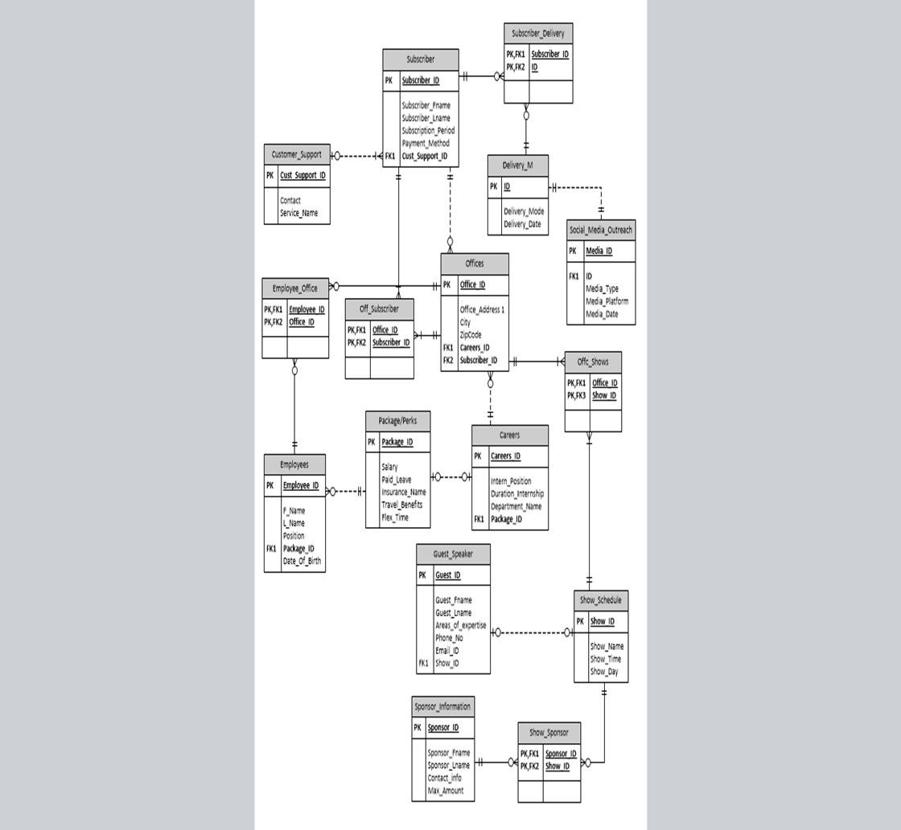

Slide 8
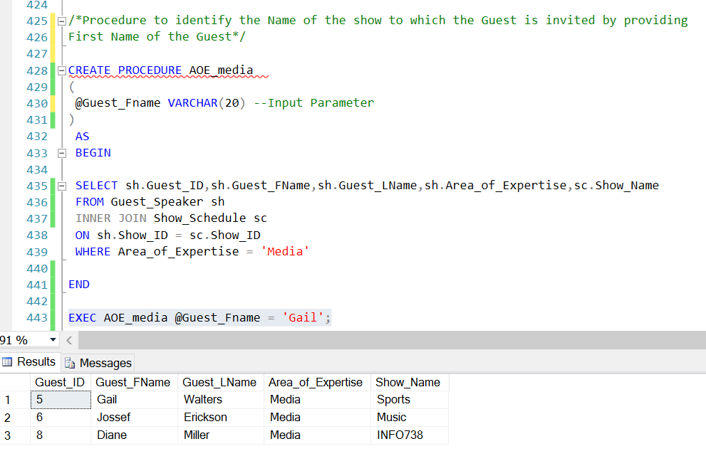
Stored Procedure

Slide 9
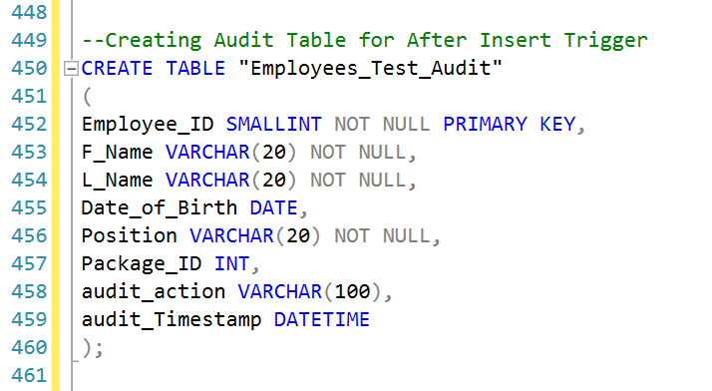
After Insert Trigger (Creating Audit Table)

Slide 10
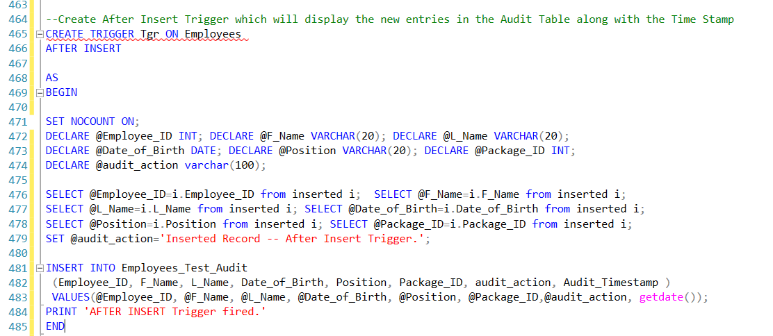
Trigger

Slide 11
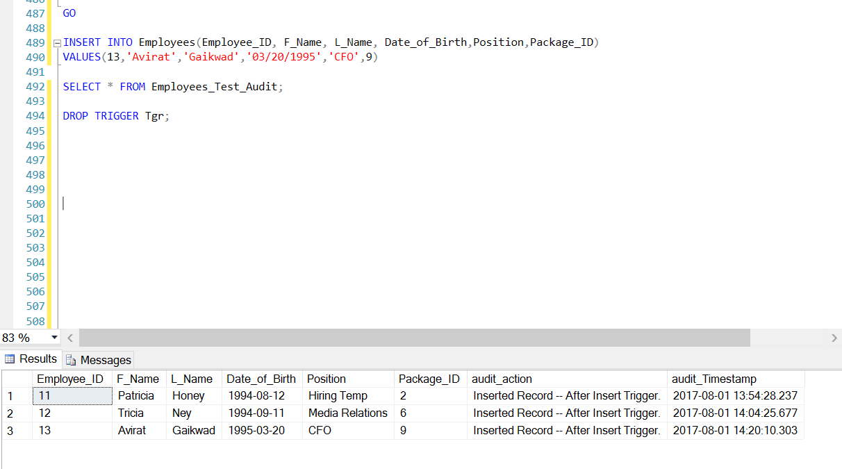
Output

Slide 12
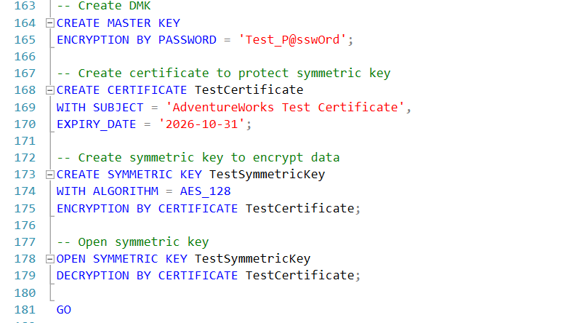
Column Encryption

Slide 13
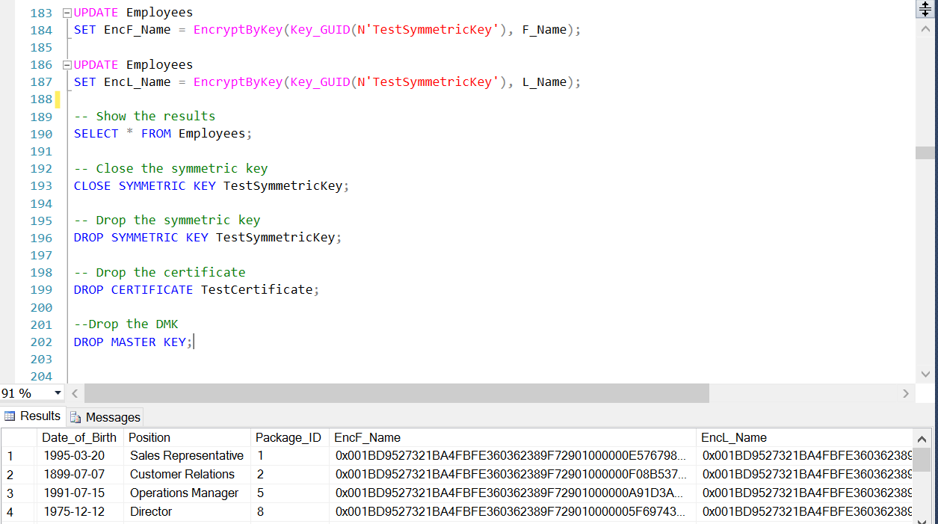
Output

Slide 14
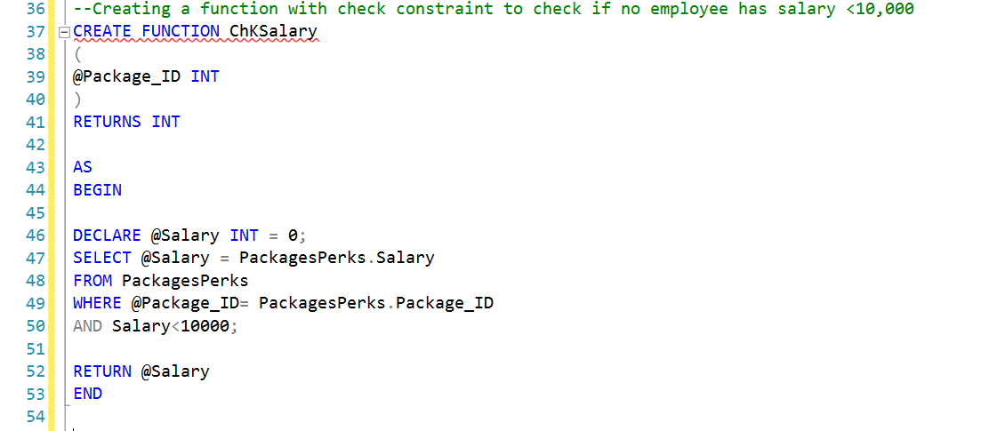
Check Function

Slide 15
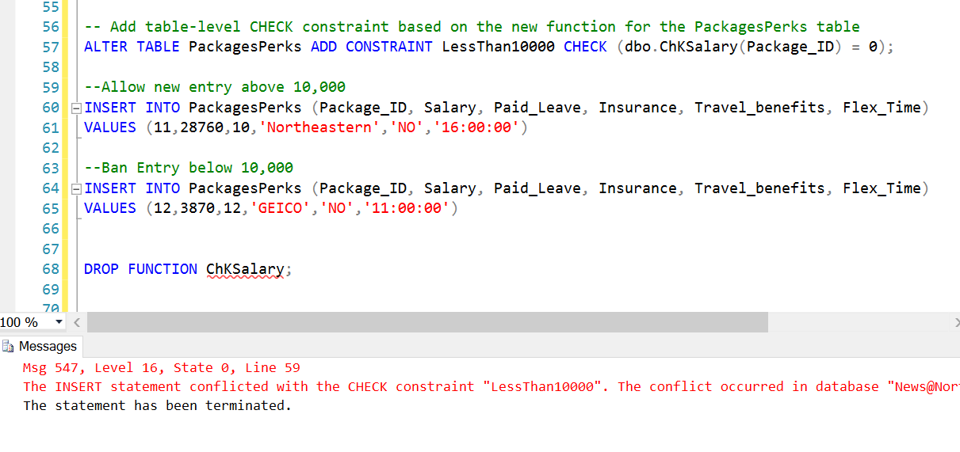
Output

Slide 16
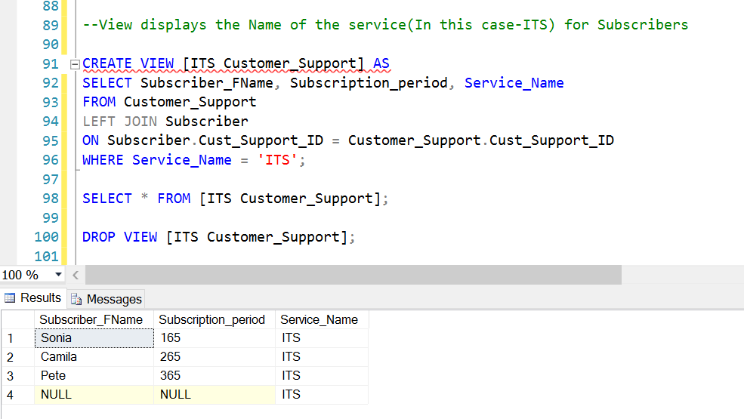
SQL Views View-1

Slide 17
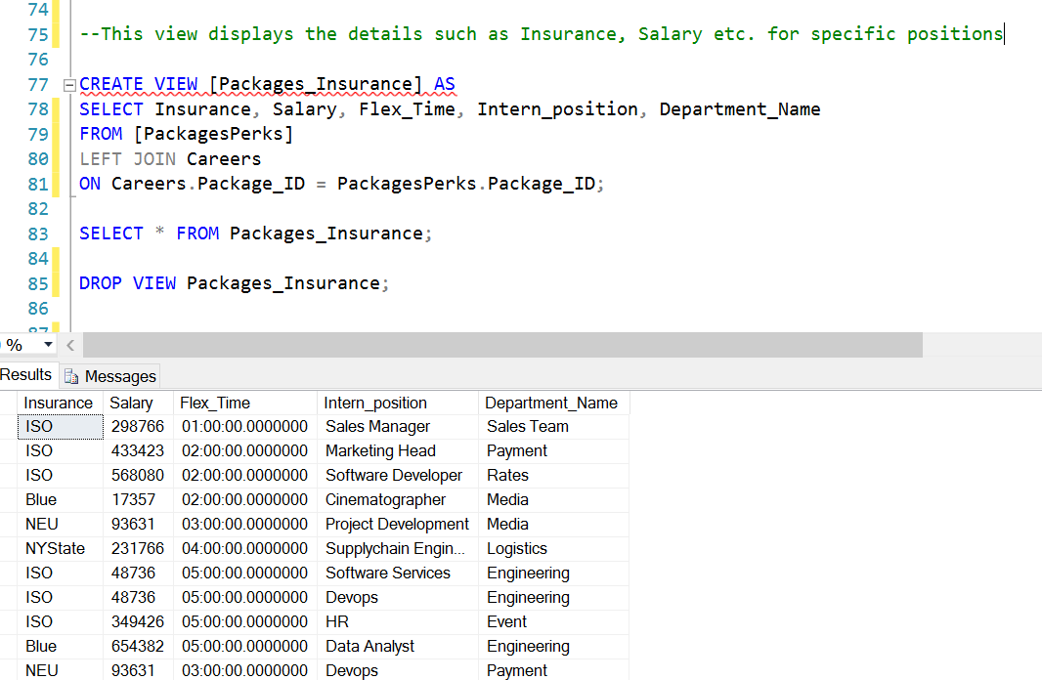
View-2

Slide 18
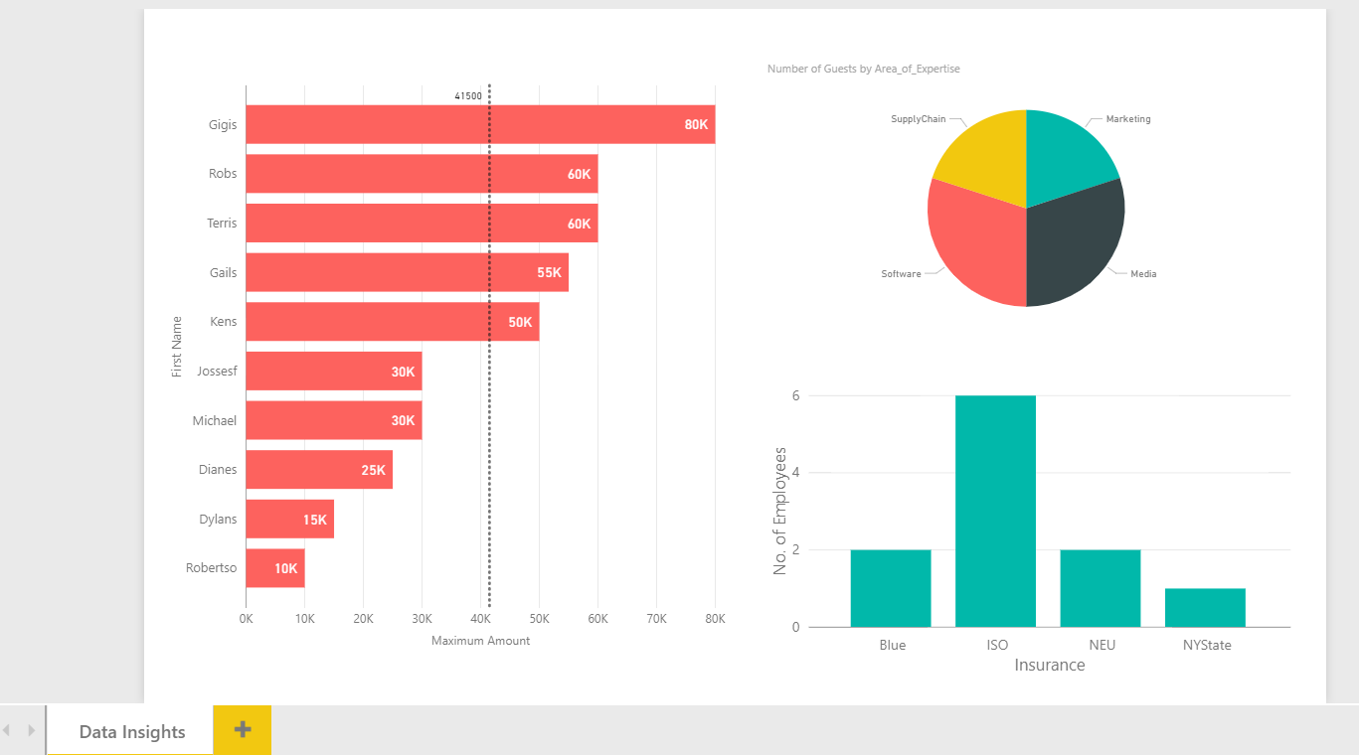
PowerBI Report

Slide 19
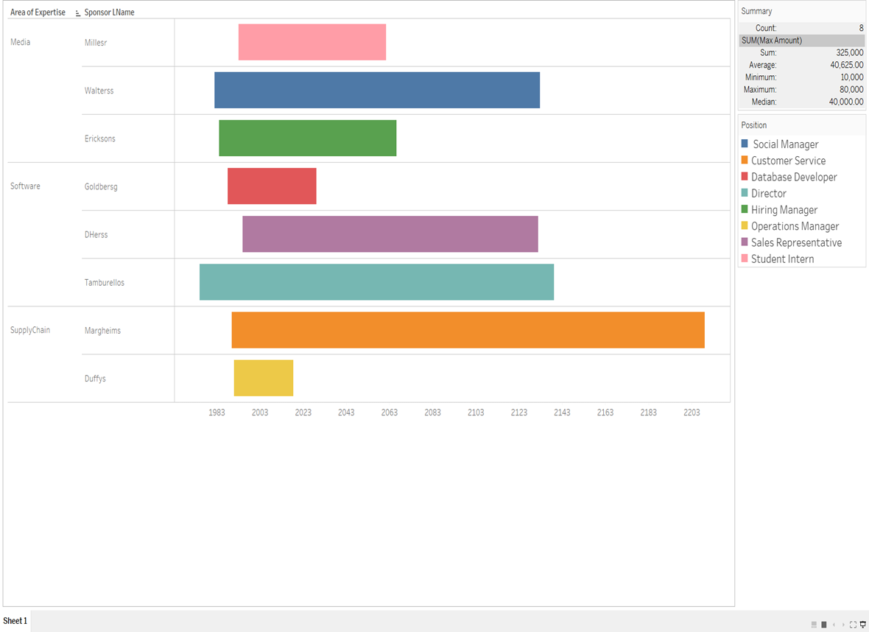
Tableau

Slide 20
THANK YOU!!

