Slide 1
MULTITHREADING
Using C#

Slide 2
Thread
Thread is the fundamental unit of execution.
More than one thread can be executing code inside the same process (application).
On a single-processor machine, the operating system is switching rapidly between the threads, giving the appearance of simultaneous execution.

Slide 3
Why Threads?
Maintain a responsive user interface while background tasks are executing
Distinguish tasks of varying priority
Perform operations that consume a large amount of time without stopping the rest of the application

Slide 4
Thread Class
Thread class is used for working with threads. It allows creating and accessing individual threads in a multithreaded application.
The first thread to be executed in a process is called the main thread. When a C# program starts execution, the main thread is automatically created.
Thread class is present in System.Threading Namespace
implements various methods & properties that allows to manipulate concurrently running threads.

Slide 5
Properties of Thread Class
CurrentThread
IsAlive
IsBackground
Name
Priority
ThreadState
CurrentContext

Slide 6
Methods Of Thread Class
public void Abort()
public void Interrupt()
public void Join()
public void Start()
public static void Sleep(int millisecondsTimeout)
public static void SpinWait(int iterations)
public static bool Yield()

Slide 7
Creating Threads
Threads are created by extending the Thread class. The extended Thread class then calls the Start() method to begin the child thread execution.

Slide 8
Managing Threads
The Thread class provides various methods for managing threads.
The following example demonstrates the use of the sleep() method for making a thread pause for a specific period of time

Slide 9
Destroying Threads
The Abort() method is used for destroying threads.
The runtime aborts the thread by throwing a ThreadAbortException. This exception cannot be caught, the control is sent to the finally block, if any.

Slide 10
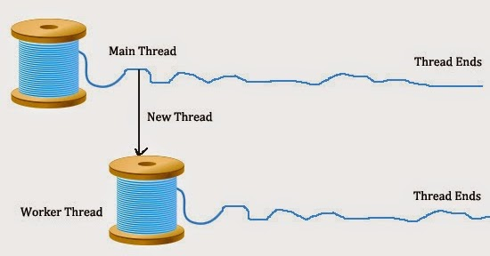
Multithreading
C# supports parallel execution of job or program code through multithreading.
Multithreading contains two or more program codes which run concurrently without affecting to each other and each program codes is called thread.

Slide 11
Thank You

