Slide 1

Gokaraju Rangaraju Institute of Engineering and Technology (Autonomous) Department of Artificial Intelligence and Machine Learning Engineering
Anomaly Detection in Smart Grids using Deep Neural Networks
Under the Guidance of:
Mrs. A. Madhavi
Assistant professor
Department of CSE (AI & ML)
Presented by:
1. Harshitha Chilupuri (21241A6619)
2. Annapurna Nomula (21241A6650)
3. Akanksha Sangem (21241A6657)

Slide 2
Abstract
Anomaly detection in smart grids is increasingly vital due to the complexity of modern power systems. This study presents a deep learning-based method for real-time fault detection and stability classification in Smart Grids. A tailored DNN captures temporal and statistical patterns from voltage, current, and frequency data. Techniques like ReLU activation, Xavier initialization, L2 regularization, and Adam optimizer ensure robust learning and other Deep Learning algorithms ensure robust learning. With high temporal resolution, the data captures rapid changes in system dynamics, enabling precise identification of short-lived anomalies. It features multivariate recordings from multiple grid nodes, offering a comprehensive view of system behavior.

Slide 3
Objectives
To predict imminent smart grid failures using a deep neural networks.
To preprocess and structure grid failure data for effective model training.
To design a multi-layer neural network architecture with ReLU activations.
To train the model using sigmoid cross-entropy loss function with L2 regularization, optimized via the Adam optimizer.
To evaluate model performance using key metrics such as accuracy, recall, precision, and F-score.

Slide 4
Existing Approaches (Literature Survey)
Ref. No. | Methodology | Dataset Name | Advantage | Drawbacks | Results
1. | Smart grids includes data collection, preprocessing, and feature extraction, followed by applying machine learning algorithms like Isolation Forest, SVM, and CNNs to detect anomalies such as theft or cyberattacks. | "NIPS 2012" data set, "IEEE CAS 2010". | Improved detection accuracy and adaptability to evolving threats. | High computational cost, data imbalance, and real-time detection challenges. | Isolation Forest (IF), Random Forest, and Deep Neural Networks (DNNs) have achieved accuracy rates over 90%.
2. | Supervised machine learning models such as Support Vector Machine (SVM), Decision Trees, K-Nearest Neighbor (k-NN), Naïve Bayes, Discriminant Analysis, Logistic Regression, and Neural Networks​ | historical time series, network events, and simulated data from various digital repositories​ | The study highlights AI-based anomaly detection methods that enhance smart grid security and efficiency. | Many approaches require large datasets, high computational power, and lack generalization across different grid models. | Achieved a high accuracy of 95.6%

Slide 5
Existing Approaches (Literature Survey)
Ref. No. | Methodology | Dataset Name | Advantage | Drawbacks | Results
3. | The study employed Random Forest, Naïve Bayes, J-Ripper, and One-R classifiers for anomaly detection in smart grids​. | Mississippi State University Critical Infrastructure Protection Center (MSU-CIPC) Power System Dataset​ | Machine learning models effectively detect anomalies in smart grids, distinguishing between cyber-attacks and natural disturbances. | Some models require high computational resources and large datasets for accurate detection. | The Random Forest classifier achieved the highest accuracy, with attack detection precision of 92.1% and recall of 98.9%
4. | The study employed Random Forest, Naïve Bayes, J-Ripper, and One-R classifiers for anomaly detection in smart grids​. | Mississippi State University Critical Infrastructure Protection Center (MSU-CIPC) Power System Dataset​. | Machine learning models effectively detect anomalies in smart grids, distinguishing cyber-attacks from natural disturbances. | Some models require high computational resources and large datasets, limiting real-time deployment. | The Random Forest classifier achieved the highest accuracy, with attack detection precision of 92.1% and recall of 98.9%​

Slide 6
Existing Approaches (Literature Survey)
Ref. No. | Methodology | Dataset Name | Advantage | Drawbacks | Results
5. | The methodology involves feature extraction, anomaly detection frameworks, and hybrid AI solutions to detect smart grid anomalies efficiently​. | The dataset used contains 128 features related to voltage, current, frequency, and relay status, categorized into natural, no-event, and attack​. | The proposed AI-based models improve anomaly detection accuracy, effectively identifying cyber-attacks and operational faults in smart grids. | High computational requirements and dependence on large labeled datasets limit real-time adaptability and scalability. | The Unsupervised Learning model achieved a high accuracy of 99% on IEEE 39, 118, and 2848 bus systems, demonstrating strong anomaly detection performance​.
6. | The study uses deep neural networks (DNNs) to detect electricity theft in smart grids by analyzing smart meter consumption data and identifying abnormal usage patterns. | the study uses real-world smart grid data collected from smart meters for electricity theft detection​. | High accuracy, automated scalability, reduced false positives, proactive detection, and real-time monitoring. | Data privacy concerns, need for large training data, high computational cost, and vulnerability to adversarial attacks. | Achieved over 95% accuracy, with high precision, recall, and F1-score in detecting electricity theft.

Slide 7
Existing Approaches (Literature Survey)
Ref. No. | Methodology | Dataset Name | Advantage | Drawbacks | Results
7. | Convolutional Neural Network (CNN) combined with the Blue Monkey (BM) algorithm to detect electricity theft in smart grids. | The dataset used in the paper is a real consumer electricity usage dataset provided by the State Grid Corporation of China (SGCC). | High accuracy (92%), efficient feature reduction, automated detection, and scalability. | Requires large datasets, high computational cost, data privacy concerns, and retraining needs. | Achieved 92% accuracy, reducing features from 1,035 to 666, improving efficiency​.
8. | Convolutional Neural Networks (CNNs) for electricity theft detection by analyzing smart meter data, combined with the Blue Monkey (BM) algorithm for feature selection and optimization. | State Grid Corporation of China (SGCC) electricity consumption dataset, containing 42,372 records over 1,035 days​. | Efficient feature selection, automated detection, and scalability. | Requires large datasets, high computational cost, data privacy concerns, and model retraining needs. | Achieved 92% accuracy, reducing features from 1,035 to 666, improving efficiency and detection speed​.

Slide 8
Existing Approaches (Literature Survey)
Ref. No. | Methodology | Dataset Name | Advantage | Drawbacks | Results
9. | Isolation Forest (IF) for anomaly detection in smart grids by identifying deviations in electricity consumption patterns. | Smart grid data from the Energy Systems Research Laboratory, Florida International University​. | efficient anomaly detection, real-time monitoring, and optimized feature selection using PCA. | Requires a large dataset, potential false positives, high computational cost, and dependency on data stationarity. | The Isolation Forest model successfully detected anomalies with 98.74% accuracy.
10. | machine learning-based anomaly detection techniques in smart grids, categorizing them into supervised and unsupervised learning models for analyzing and predicting anomalies. | SGCC (State Grid Corporation of China), UCI Smart Grid Dataset, and real-time data from power grid testbeds. | Improved security, high accuracy, scalability, and automated detection. | High computational cost, data dependency, false positives, and privacy concerns. | deep learning and ensemble models achieving anomaly detection accuracy of above 90%.

Slide 9
Existing Approaches (Literature Survey)
Ref. No. | Methodology | Dataset Name | Advantage | Drawbacks | Results
11. | A hybrid CNN-based approach, where CNN extracts features from power consumption data, and traditional machine learning algorithms classify anomalies. Additionally, Generative Adversarial Networks (GANs) | real-world electricity consumption dataset | High detection accuracy, automatic feature extraction, handles imbalanced data with GAN, and effective against multiple attack vectors. | Computationally expensive, requires large datasets, potential false positives, and dependency on synthetic data quality. | The hybrid CNN-based detector achieved an accuracy of 98.91%.
12. | Ensemble Voting-Based Anomaly Detection System (ADS) for smart grid security, combining Random Forest (RF) and Convolutional Neural Networks (CNN) for classification. | The CIC-IDS2017 dataset is a benchmark dataset for intrusion detection systems (IDS), created by the Canadian Institute for Cybersecurity (CIC). | adaptive to complex attacks, improved feature extraction using autoencoders, and effective handling of imbalanced data with SMOTE. | Computationally expensive, requires large datasets, potential overfitting, and dependency on labeled data for training. | The ensemble voting-based model achieved 98.29% accuracy, 99% precision.

Slide 10
Existing Approaches (Literature Survey)
Ref. No. | Methodology | Dataset Name | Advantage | Drawbacks | Results
13. | A hybrid LSTM-GIN model is used, where LSTM captures temporal patterns and Graph Isomorphism Network (GIN) encodes structural relationships. | real-world power grid data or a benchmark dataset for anomaly detection. | captures both structural and temporal patterns, prevents overfitting, and effectively detects power grid anomalies. | Computationally expensive, requires detailed network structure data, potential scalability challenges, and dependency on high-quality labeled data. | The hybrid LSTM-GIN model achieved 99.92% accuracy.
14. | Multi-Task Gaussian Process (MTGP) model for anomaly detection in smart grids, combined with a One-Class Support Vector Machine (OC-SVM). | smart grid based on the IEEE 123-bus system | Label-free anomaly detection, error de-correlation, and effective for rare faults. | High computational cost, less effective for frequent faults, and complex implementation. | Precision 85.86% for anomaly detection tasks.

Slide 11
Existing Approaches (Literature Survey)
Ref. No. | Methodology | Dataset Name | Advantage | Drawbacks | Results
15. | LSTM-based neural network for prediction and an LSTM autoencoder. | The UCI Machine Learning Repository - Individual Household Electric Power Consumption Data Set. | LSTM autoencoders improve anomaly detection accuracy and can identify both local and global anomalies effectively. | The method requires large datasets and is computationally intensive, limiting scalability. | Achieves 85% precision, 80% recall, 82% F1 score, 90% accuracy.

Slide 12
Existing Approaches (Literature Survey)
[1] The paper explores about Smart grid anomaly detection that involves a pipeline of data collection, preprocessing, and feature extraction, followed by the application of machine learning algorithms such as Isolation Forest, Support Vector Machines (SVM), and Convolutional Neural Networks (CNNs) to identify anomalies like electricity theft and cyberattacks. Datasets like “NIPS 2012” and “IEEE CAS 2010” are commonly used to train and evaluate these models. Techniques including Isolation Forest, Random Forest, and Deep Neural Networks (DNNs) have achieved detection accuracies exceeding 90%, demonstrating strong potential in enhancing grid security. Despite these advancements, challenges such as high computational costs, class imbalance in data, and the need for real-time detection remain significant barriers to practical deployment.

Slide 13
Existing Approaches (Literature Survey)
[2] Traditional anomaly detection in smart grids relies on rule-based systems, statistical models, and threshold-based techniques. These methods struggle with detecting advanced cyber-attacks and real-time adaptability. AI-driven approaches, including machine learning, deep learning, decision trees, and SVM, have improved detection accuracy. Traditional anomaly detection methods in smart grids, such as rule-based systems and statistical models, face challenges with advanced cyber-attacks and real-time adaptability. AI-driven techniques, including machine learning, deep learning, decision trees, and SVM, have significantly enhanced detection accuracy. Newer approaches, like federated learning, hyperdimensional computing, and graph-based methods, are being explored to improve scalability and efficiency for more effective anomaly detection in smart grids. Emerging techniques like federated learning, hyperdimensional computing, and graph-based methods are being explored for better scalability and efficiency​.

Slide 14
Existing Approaches (Literature Survey)
[3] Traditional anomaly detection in smart grids relies on rule-based systems, statistical methods, and threshold-based techniques. Recent AI-driven approaches, including machine learning, deep learning, and hybrid models like Random Forest, SVM, and Neural Networks, have improved accuracy and adaptability. However, these methods struggle with detecting sophisticated cyber-attacks and adapting to dynamic grid conditions. Recent approaches incorporate machine learning, deep learning, and hybrid models, improving accuracy and adaptability. Techniques like Random Forest, SVM, Neural Networks, and Federated Learning have been explored, but challenges remain in computational efficiency and real-time detection​.

Slide 15
Existing Approaches (Literature Survey)
[4] The authors review existing anomaly detection approaches in smart grids, highlighting the use of machine learning, deep learning, and hybrid models to improve detection accuracy. They discuss how methods like Random Forest, SVM, and Neural Networks enhance real-time monitoring and cybersecurity. Challenges such as high computational costs, data imbalance, and real-time adaptability are also addressed. Challenges like high computational costs, data imbalance, and the need for real-time adaptability are addressed. The authors stress the importance of scalable, efficient, and interpretable AI models to enhance smart grid security and overcome current limitations. The paper emphasizes the need for scalable, efficient, and interpretable AI models to enhance smart grid security while overcoming current limitations.

Slide 16
Existing Approaches (Literature Survey)
[5] The study provides a comprehensive anomaly detection approaches in smart grids, highlighting the limitations of rule-based and statistical models in detecting complex cyber-attacks and adapting to dynamic conditions. They explore the benefits of machine learning and deep learning models such as Random Forest, SVM, CNN, and LSTM, which improve detection accuracy and real-time monitoring. The study also discusses emerging techniques like federated learning, hyperdimensional computing, and graph-based models, addressing scalability and efficiency challenges. Finally, the authors emphasize the need for lightweight, adaptive solutions to overcome computational constraints, data imbalance, and real-time processing limitations in smart grid anomaly detection​.

Slide 17
Existing Approaches (Literature Survey)
[6] The authors explore electricity theft detection in smart grids using deep neural networks (DNNs), highlighting the advantages of deep learning in identifying abnormal consumption patterns. They discuss how DNNs leverage smart meter data to enhance detection accuracy, reduce false positives, and improve grid stability. The paper also addresses challenges such as data privacy, computational costs, and the adaptability of models to evolving theft techniques. Additionally, the authors emphasize the need for scalable, real-time detection systems and collaboration between utility companies, policymakers, and researchers to ensure the effective implementation of AI-driven solutions in smart grids.

Slide 18
Existing Approaches (Literature Survey)
[7] The study explore the use of deep learning for electricity theft detection in smart grids, emphasizing the effectiveness of Convolutional Neural Networks (CNNs) combined with the Blue Monkey (BM) algorithm. They highlight how deep learning can analyze consumption patterns, enhance detection accuracy, and optimize feature selection. The paper also addresses challenges such as data privacy, computational complexity, and evolving theft strategies. To improve efficiency, the authors stress the need for advanced machine learning techniques and collaboration between utility companies, data scientists, and policymakers to ensure secure and intelligent energy management.

Slide 19
Existing Approaches (Literature Survey)
[8] The authors explore the use of deep learning for electricity theft detection in smart grids, emphasizing the effectiveness of Convolutional Neural Networks (CNNs) combined with the Blue Monkey (BM) algorithm for feature selection. They highlight how machine learning models analyze consumption patterns to enhance detection accuracy, reduce false positives, and improve grid security. The paper also discusses challenges such as data privacy, computational complexity, and evolving theft strategies. To ensure efficient implementation, the authors stress the importance of collaboration between utility companies, data scientists, and policymakers in developing robust and scalable smart grid solutions. he paper addresses challenges like data privacy, computational complexity, and evolving theft strategies. It stresses collaboration between utility companies, data scientists, and policymakers to develop efficient and scalable smart grid solutions.

Slide 20
Existing Approaches (Literature Survey)
[9] The Study explore the application of machine learning for anomaly detection in smart grids, focusing on the Isolation Forest (IF) algorithm for identifying electricity theft and cyberattacks. They highlight how Principal Component Analysis (PCA) optimizes feature selection, improving detection accuracy and efficiency. The study also addresses challenges such as data stationarity, computational complexity, and potential false positives in anomaly detection. To enhance grid security, the authors emphasize the importance of collaboration between energy providers, data scientists, and cybersecurity experts, ensuring the reliable and intelligent management of smart grids. Challenges such as data stationarity, computational complexity, and false positives are addressed. The paper emphasizes collaboration between energy providers, data scientists, and cybersecurity experts to enhance smart grid security and management.

Slide 21
Existing Approaches (Literature Survey)
[10] The paper presents the review various machine learning-based anomaly detection methods in smart grids, highlighting their role in identifying cyber threats and system failures. They emphasize how supervised and unsupervised learning models can analyze consumption patterns, detect anomalies, and enhance grid security. The paper also discusses challenges such as data dependency, computational complexity, and privacy concerns in anomaly detection. They emphasize the use of supervised and unsupervised models to detect anomalies and improve grid security. To ensure effective implementation, the authors stress the importance of real-world dataset validation, model optimization, and collaboration between energy providers, data scientists, and policymakers in securing smart grid infrastructure.

Slide 22
Existing Approaches (Literature Survey)
[11] A novel explore the use of deep learning for energy theft detection in smart grids, proposing a hybrid CNN-based approach that combines CNN for feature extraction and traditional machine learning algorithms for classification. They highlight how Generative Adversarial Networks (GANs) address dataset imbalance by generating realistic synthetic data, improving detection performance. The study also discusses challenges such as computational complexity, potential false positives, and dependency on synthetic data quality. To ensure effective implementation, the authors emphasize the need for robust frameworks, real-world dataset validation, and collaboration between energy providers, data scientists, and cybersecurity experts in securing smart grid infrastructure.

Slide 23
Existing Approaches (Literature Survey)
[12] The authors explore the use of ensemble voting-based anomaly detection in smart grid security, leveraging Random Forest (RF) and Convolutional Neural Networks (CNN) to classify cyber threats. They highlight how autoencoders (AE) enhance feature extraction and SMOTE addresses dataset imbalance for improved detection accuracy. The paper also discusses challenges such as computational complexity, model interpretability, and reliance on labeled data. To ensure robust anomaly detection, the authors emphasize the need for advanced machine learning frameworks, real-world validation, and collaboration between cybersecurity experts, data scientists, and energy providers in securing smart grid infrastructures.

Slide 24
Existing Approaches (Literature Survey)
[13] A novel explore anomaly detection in power grids using a hybrid LSTM-GIN model, which integrates Long Short-Term Memory (LSTM) networks for temporal pattern analysis and Graph Isomorphism Networks (GIN) for structural encoding. They highlight how the graph-based approach improves accuracy by capturing both node relationships and time-series trends in power grid components. The study also addresses challenges such as overfitting, computational complexity, and scalability in real-world grid monitoring. To enhance power grid security, the authors emphasize the importance of advanced deep learning frameworks, real-world dataset validation, and collaboration between researchers, utility providers, and cybersecurity experts.

Slide 25
Existing Approaches (Literature Survey)
[14] The authors explore the advantages of integrating big data into the education system, highlighting its ability to capture real-time data on student performance, behaviors, and learning processes across various contexts. They discuss how data mining techniques can be leveraged to identify trends, predict student outcomes, and personalize learning experiences to better suit individual needs. The article also addresses several challenges in educational data mining, such as concerns over privacy, ethical issues, and the complexities of processing large amounts of unstructured data. To ensure the effective use of big data, the authors examine the limitations of existing educational data systems and emphasize the importance of collaboration among educators, data scientists, and policymakers. In conclusion, the paper underscores the need for the development of robust frameworks to manage these challenges while maximizing the benefits of big data in education.

Slide 26
Existing Approaches (Literature Survey)
[15] The authors explore the advantages of using big data in education, highlighting its ability to collect real-time data on student performance, behavior, and learning in various environments. They discuss how data mining can uncover trends, predict student success, and personalize learning experiences. The article also addresses the challenges of educational data mining, including privacy concerns, ethical issues, and the complexity of analyzing large amounts of unstructured data. In addition, the authors point out the limitations of existing educational data systems and emphasize the need for collaboration among educators, data scientists, and policymakers. The paper concludes by stressing the importance of creating robust frameworks to effectively manage these challenges and harness the potential of big data.

Slide 27
Software & Hardware Requirements
Minimum Hardware Requirements:
CPU: Intel i5 (8th Gen+)/AMD Ryzen 5+
RAM: 8GB (16GB recommended)
Storage: 20GB free space (SSD preferred)
OS: Windows 10/11, macOS 10.15+, Linux (Ubuntu 20.04+)
Minimum Software Requirements
Programming Language: Python 3.8+
Libraries & Frameworks: TensorFlow, NumPy, pandas, scikit-learn, matplotlib
ML Utilities: ReLU activation, Xavier initialization, L2 regularization, Adam optimizer
Visualization: seaborn, TensorBoard (for monitoring training)

Slide 28
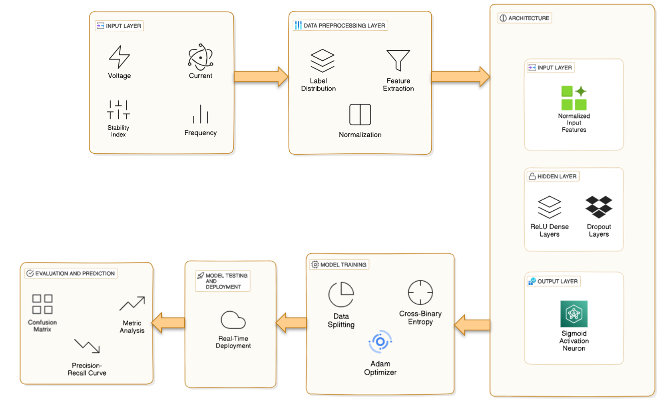
Proposed Method: Architecture Diagram

Slide 29
Description for Architecture Diagram
The architecture diagram illustrates a Smart Grid Anomaly detection system structured into data preprocessing, model design, training, and evaluation. It starts by collecting grid data such as voltage, current, frequency, and stability index to predict failures and assess performance. Preprocessing involves feature extraction, normalization, and label distribution analysis. A deep neural network is built using TensorFlow with ReLU activations, dropout layers, and Xavier initialization. The model is trained using data splitting, L2 regularization, cross-binary entropy loss, and the Adam optimizer. Evaluation includes real-time deployment and metrics like accuracy, precision, recall, and F-score for effective anomaly detection.

Slide 30
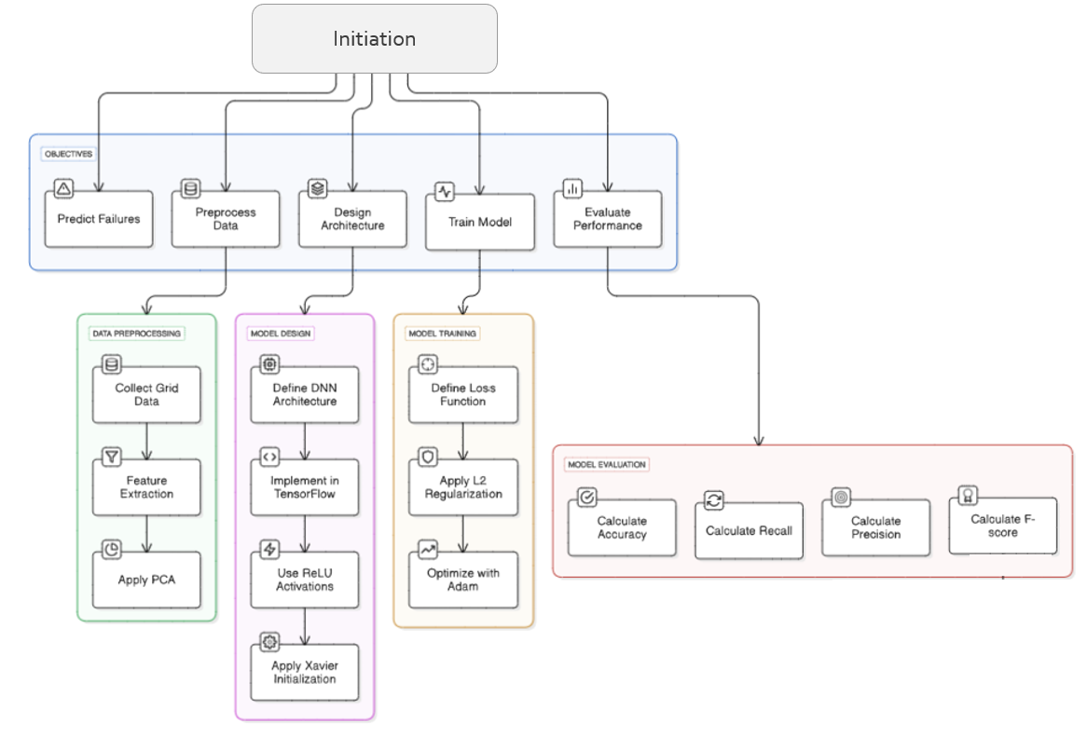
Proposed Method: Module Connectivity Diagram

Slide 31
Description for Module Connectivity Diagram
This diagram outlines a streamlined workflow for developing a deep learning model to predict failures. It begins with defining five key objectives: predicting failures, preprocessing data, designing the architecture, training the model, and evaluating performance. The preprocessing stage includes collecting grid data and extracting features. In the model design phase, a deep neural network is built using TensorFlow with ReLU activations and Xavier initialization. The training phase involves defining a loss function, applying L2 regularization, and optimizing with Adam. Finally, model evaluation is done by calculating accuracy, recall, precision, and F-score, ensuring reliable performance assessment.

Slide 32
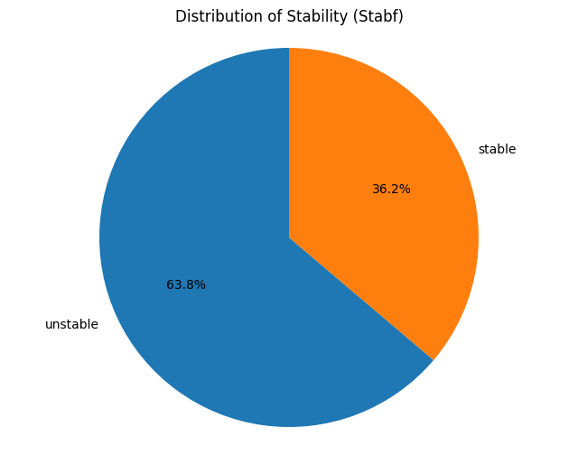
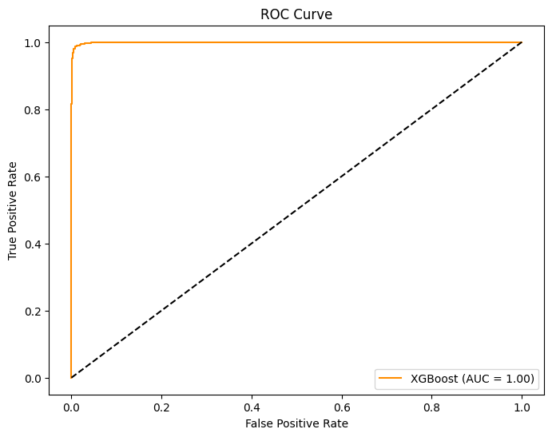
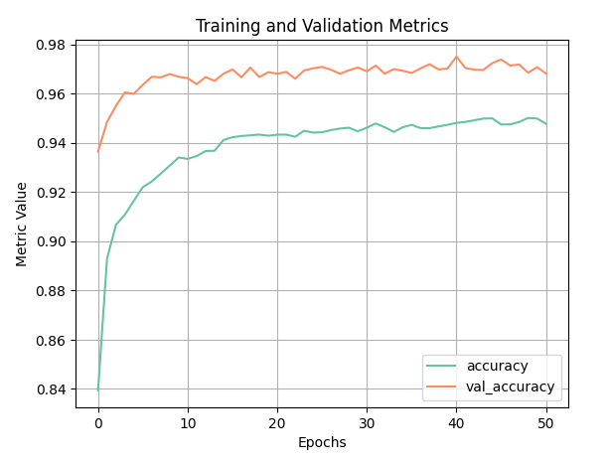
Experimental Results

Slide 33
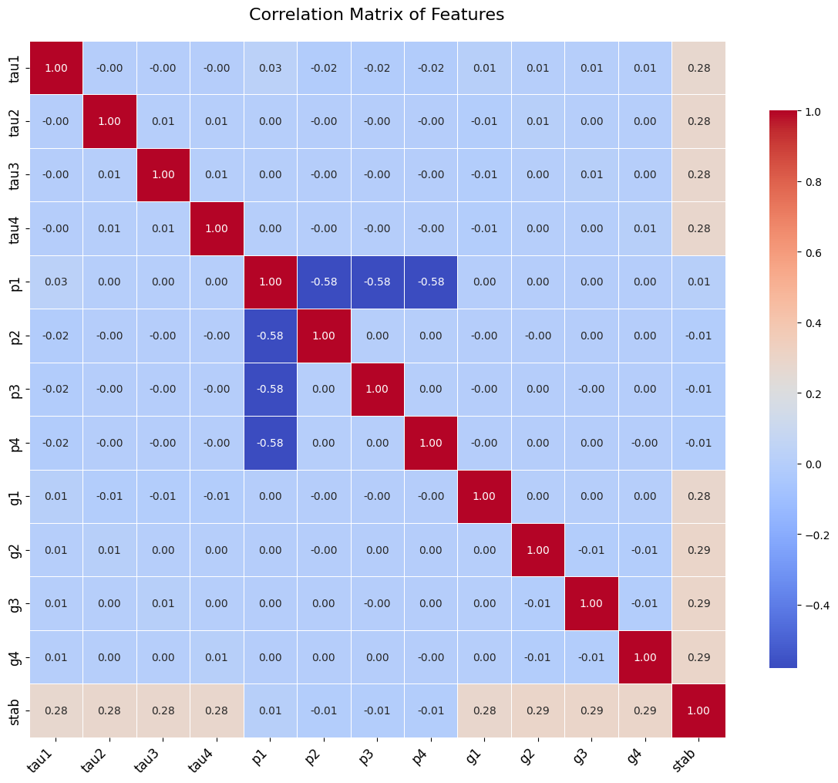
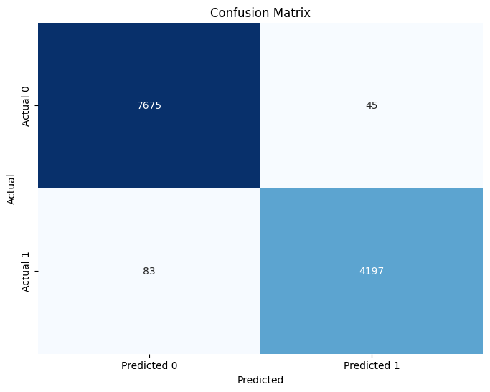
Experimental Results

Slide 34
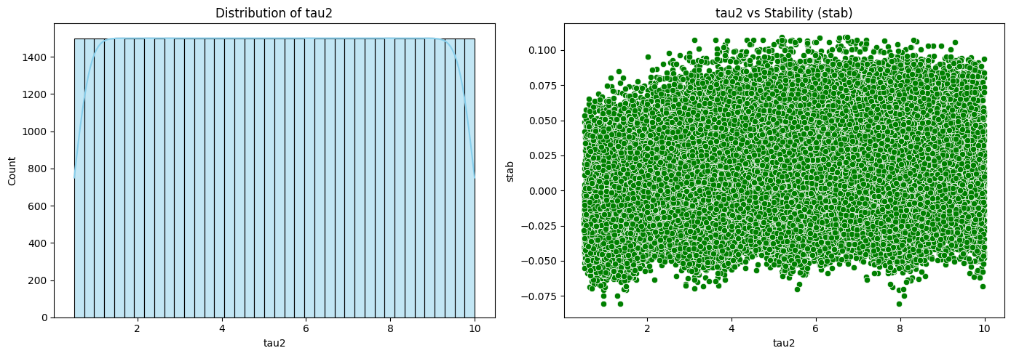
Experimental Results

Slide 35
Advantages of Proposed Method
Real-time Fault Detection: The method provides timely identification of faults, ensuring prompt responses to system anomalies.
High Temporal Resolution: Enables detection of short-lived anomalies, capturing rapid changes in system dynamics for better fault management.
Comprehensive System Monitoring: Utilizes multivariate recordings from multiple grid nodes, offering a detailed and holistic view of system behavior.
Scalability: The approach can be applied to large, complex grid systems with multiple data points, making it adaptable to different power grid environments.

Slide 36
Limitations of Proposed Method
Heavy Reliance on Manual Feature Engineering: Many current models depend on handcrafted features, making them less adaptable to the complex and dynamic nature of smart grid data.
Scalability and Real-Time Processing Limitations: Traditional methods often struggle with efficiently processing large-scale data in real time, hindering their practical deployment in expansive grid systems.
Sensitivity to Noise and Data Variability: Existing approaches can be prone to high false positive or negative rates due to their limited robustness against noisy and highly variable smart grid measurements.

Slide 37
Conclusion and Future Enhancements
Conclusion:
The proposed deep learning-based system for real-time fault detection and stability classification in Smart Grids effectively captures both temporal and statistical patterns from multivariate data such as voltage, current, and frequency. Leveraging techniques like ReLU activation, Xavier initialization, L2 regularization, and the Adam optimizer ensures robust learning. With high temporal resolution and comprehensive monitoring across multiple grid nodes, the model offers precise and scalable detection of anomalies, contributing significantly to the resilience and intelligence of modern power systems.
Future Enhancements:
Integrate Edge Computing to enable low-latency fault detection directly at grid nodes.
Develop a Mobile Dashboard App for real-time fault monitoring and alerts.
Incorporate Explainable AI (XAI) methods to make fault predictions more interpretable for operators and engineers.
Enable Cloud Storage and Analytics for storing fault data and deriving long-term insights.
Add Cybersecurity Anomaly Detection to recognize both operational faults and potential malicious interventions.

Slide 38
References (Cont..)
[1] Anomaly Detection Techniques in Smart Grid Systems[2023]
DOI: 10.1109/AIIoT58121.2023.10174485
[2] A Review of Smart Grid Anomaly Detection Approaches Pertaining to Artificial Intelligence Marcelo Fabian Guato Burgos , Jorge Morato and Fernanda Paulina Vizcaino Imacaña [2024]
DOI: 10.3390/app14031194
[3] Anomaly Detection in Smart Grids using Machine Learning Techniques[2020]
DOI:10.1109/ICPC2T48082.2020.9071434
[4] Anomaly Detection Techniques in Smart Grid Systems
DOI: 10.1109/AIIoT58121.2023.10174485
[5] Anomaly Detection in Smart Distribution Grids with Deep Neural Network by Ming Zhou[2022]
DOI: 10.7939/r3-eey0-rr47

Slide 39
References (Cont..)
[6] Electricity Theft Detection In Smart Grids Based On Deep Neural Network[2021]
DOI:10.11591/eei.v10i4.2875
[7] Electricity-theft detection in smart grids based on deep learning[2021]
DOI:10.11591/eei.v10i4.2875
[8] Time Series Anomaly Detection for Smart Grids: A Survey[2021]
DOI:10.1109/EPEC52095.2021.9621752
[9] Anomaly Detection in Smart Grids: A Survey From Cybersecurity Perspective [2022]
DOI:10.1109/SGRE53517.2022.9774221
[10] An Introductory Review Of Anomaly Detection Methods In Smart Grids Preethi G1 , Anitha Kumari[2021]
DOI: 10.4108/eai.7-12-2021.2314604

Slide 40
References (Cont..)
[11] Smart Grid Security: An Effective Hybrid CNN-Based Approach for Detecting Energy Theft Using Consumption Patterns Muhammed Zekeriya Gunduz and Resul Das [2023]
DOI:10.3390/s24041148
[12] Ensemble Voting-Based Anomaly Detection for a Smart Grid Communication Infrastructure Hend Alshed, Laila Nassef, Nahed Alowidi and Etimad Fadel1[2022]
DOI: 10.32604/iasc.2023.035874
[13] Power Grid Anomaly Detection via Hybrid LSTM-GIN Model (Student Abstract) Amelia Jobe , Richard Ky , Sandra Luo , Akshay Dhamsania , Sumit Purohit , Edoardo Serra
DOI: 10.1609/aaai.v38i21.30457
[14] Anomaly detection in smart grids using multi-task Gaussian processes - Aman Karra
DOI:10.21203/rs.3.rs-471723/v1
[15] Anomaly Detection in Electricity Consumption Data using Deep Learning- Kardi, M.; AlSkaif, T.; Tekinerdogan, B.; Catalao, Joao P.S.
DOI: 10.1109/EEEIC/ICPSEurope51590.2021.9584650

