Slide 1


A Temporal–Spatial Autoencoder for EEG Eye-State Anomaly Detection
ADITYA INSTITUTE OF TECHNOLOGY AND MANAGEMENT

Slide 2

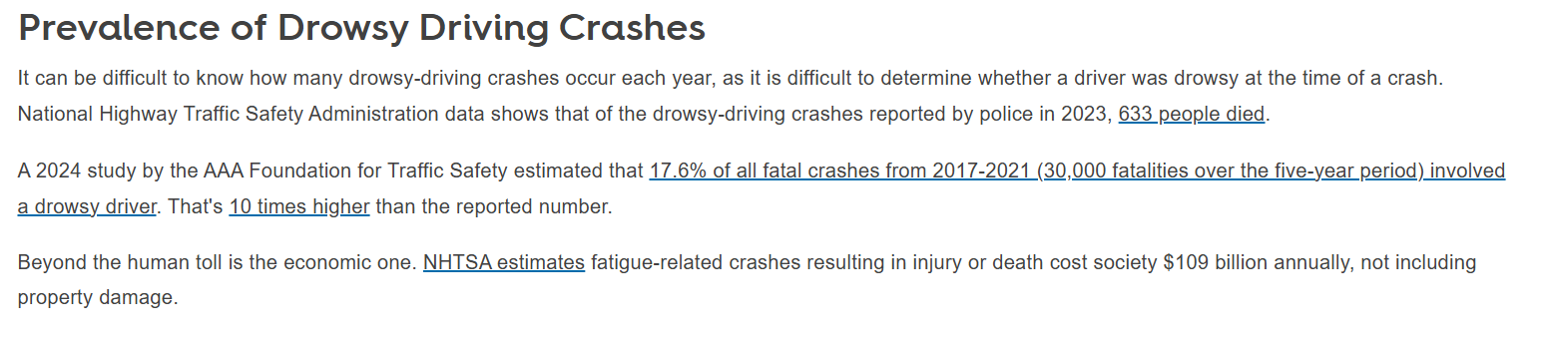
Problem Statement
Drowsy driving causes 17.6 % to 20% of all vehicle accidents
https://dl.acm.org/doi/fullHtml/10.1145/3627631.3627656
90% Failure in Adverse Conditions: Current camera-based monitors (DMS) fail when drivers wear polarized sunglasses, face masks, or encounter low-light/glare environments.

Slide 3
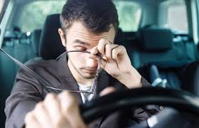


Problem Statement
The Data Scarcity Gap
The "Rare Event" Data Gap: Traditional AI requires thousands of "accident" or "eye-closure" samples to learn; however, in real-world driving or aviation, these life-threatening events are statistically rare and unpredictable.
Privacy & User Intrusiveness
Constant video monitoring is often rejected by drivers, pilots, and patients due to privacy concerns, creating a significant barrier to the widespread adoption of safety tech

Slide 4


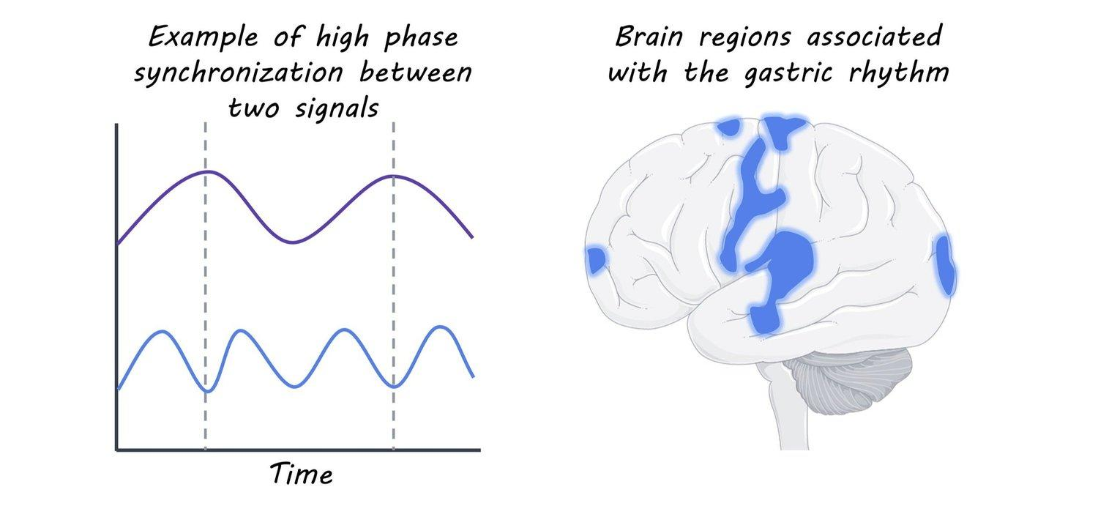

Proposed Idea
Camera-Free Monitoring Uses neural signals (EEG) to track eye-states with zero privacy issues.
Data Training Trained only on alert data to detect eye-closure as a mathematical anomaly.
Spatio-Temporal Intelligence Simultaneously captures rhythm and brain-region interactions.
We propose a Temporal–Spatial Autoencoder for EEG eye-state anomaly detection using only normal data.
Ultra-Fast Response Operates at 0.267 ms—over 300x faster than a human blink.

Slide 5
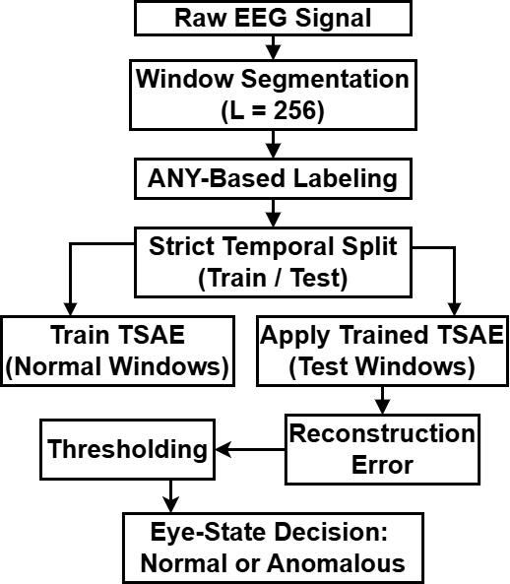
Overall Framework of Proposed Method
Figure 1. Overall processing pipeline of the proposed TSAE-based EEG eye-state anomaly detection framework.

Slide 6
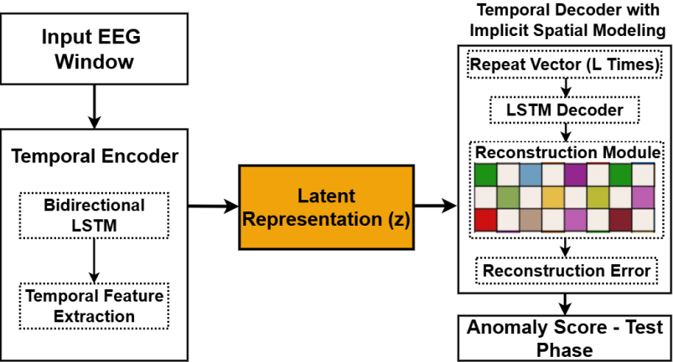
Proposed Temporal–Spatial Autoencoder (TSAE) Architecture
Figure 2. Architecture of the proposed Temporal–Spatial Autoencoder (TSAE).

Slide 7

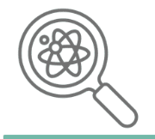
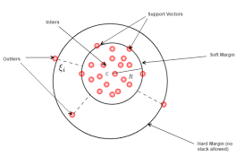
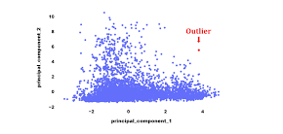
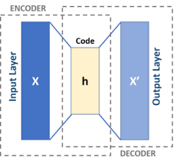
Dataset & Experimental Setup
UCI EEG Eye-State Dataset
14 EEG Channels (10–20 System)
Sampling Rate ≈ 128 Hz
14,980 EEG Samples
Eye Open / Eye Closed Labels
Window Length = 256 samples
One-Class Training (Eye-Open Only)
Strict Temporal Train–Test Split
Leakage-Free Evaluation
Dataset
Experimental Design
Compared Models
TSAE
One Class Support Vector Machine (OCSVM)
Isolation Forest (IF)
Conventional Autoencoder (AE)
Proposed Temporal–Spatial Autoencoder (TSAE)

Slide 8
Results & Discussion
Quantitative Performance Comparison
Table 1. Performance comparison of anomaly detection models.
Model | ROC- AUC | PR- AUC | Recall @ FAR =1% | Recall @ FAR =5% | Recall @ FAR =10% | FAR at 80% Recall
OCSVM | 0.7667 | 0.8306 | 0.3333 | 0.3333 | — | 0.2000
IF | 0.8667 | 0.8972 | 0.5000 | 0.5000 | 0.5000 | 0.2000
AE | 0.9667 | 0.9762 | 0.8333 | 0.8333 | 0.8333 | 0.0000
Proposed TSAE | 1.0000 | 1.0000 | 1.0000 | 1.0000 | 1.0000 | 0.0000
The perfect ROC-AUC should be interpreted within the controlled dataset setting and leakage-free evaluation protocol.

Slide 9
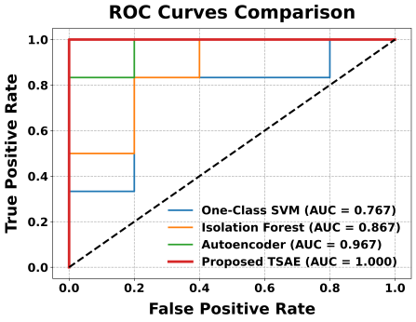
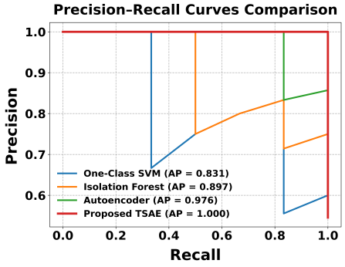
ROC and Precision–Recall Analysis
Figure 3. ROC curve comparison of all models.
Figure 4. Precision–Recall curve comparison of all models.
Observations
Classical models show limited separation
Autoencoder improves detection capability
Proposed TSAE dominates entire operating region
ROC and PR Curve Comparison
Performance evaluated under class imbalance
Key Result
TSAE achieves perfect discrimination between normal and eye-closure EEG windows

Slide 10
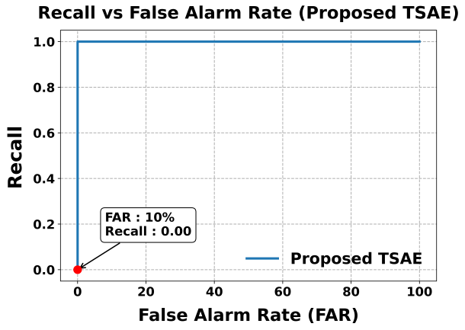
False Alarm Rate (FAR) Analysis
False Alarm Controlled Performance
Evaluates practical operating reliability
Key Findings
Recall = 1.0 even at low FAR levels
0% False Alarms required for 80% Recall
Stable performance across thresholds
Practical Insight
Suitable for continuous real-time EEG monitoring
Figure 5. Recall versus false alarm rate for the proposed TSAE.

Slide 11
Conclusion
Eye-state detection formulated as
One-Class Anomaly Detection
Proposed Temporal–Spatial Autoencoder
captures temporal & inter-channel EEG structure
Leakage-free temporal evaluation framework
Major Outcomes
ROC–AUC = 1.00
Reliable detection at low false alarm rates
Real-time feasible inference performance
Future Work
Cross-subject EEG evaluation
Longer real-world recordings
Lightweight deployment optimization
Real-time monitoring applications
Key Takeaway
Preserving temporal and spatial EEG structure significantly improves anomaly detection reliability.

Slide 12
References
Elshewey, A.M., Elaziz, M.A., Mirjalili, S., Ewees, A.A.: EEG-based optimization of eye state classification using modified-BER metaheuristic algorithm. Scientific Reports 14, Art. no. 24489 (2024).
Eid, M.M., Alharbi, A.H., Alhussan, A.A., Towfek, S.K., Adlan, F., Khafaga, D.S.: Classification of eye states using EEG data: a comparative analysis of machine learning algorithms. In: Proc. 4th International Conference on Electronic Engineering (ICEEM), pp. 1–7. IEEE, Menouf (2025).
Raza, A., Yusoff, M.Z.: Deep learning approaches for EEG-motor imagery-based BCIs: Current models, generalization challenges, and emerging trends. IEEE Access 13, 151866–151893 (2025).
Abooelzahab, D.M., Zaher, N., Soliman, A.H., Chibelushi, C.: Deep learning vs. conventional techniques for processing and classifying EEG brain disorders: A survey. In: Proc. International Congress on Human–Computer Interaction, Optimization and Robotic Applications (HORA), pp. 1–6. IEEE, Istanbul (2024).
Saghafi, A., Tsokos, C.P., Farhidzadeh, H.: Common spatial pattern method for real-time eye state identification using electroencephalogram signals. IET Signal Processing 11(8), 936–941 (2017).
Sun, C., Mou, C.: Survey on the research direction of EEG-based signal processing. Frontiers in Neuroscience 17, Art. no. 1203059 (2023).
Abibullaev, B., Keutayeva, A., Zollanvari, A.: Deep learning in EEG-based BCIs: A comprehensive review of transformer models, advantages, challenges, and applications. IEEE Access 11, 127271–127301 (2023).
Mondal, S., Nag, A.: A computational eye state classification model using EEG signal based on data mining techniques: comparative analysis. Physical and Engineering Sciences in Medicine 48, 1761–1774 (2025).
Dharmendra, K., Riya, K., Verma, D.K., Vats, S.: Hybrid EEG-based eye state classification using LSTM, neural networks, and multivariate analysis. Journal of Information Technology Management 17(Special Issue on SI: Intelligent Security and Management), 16–31 (2025).
Zeng, Z., et al.: Residual self-calibrated network with multi-scale channel attention for accurate EOG-based eye movement classification. IEEE Journal of Biomedical and Health Informatics 29(1), 118–127 (2025).

Slide 13
THANK YOU
IEEE 10th International Conference on Research in Intelligent Computing in Engineering (RICE-2025)

