Slide 1


AI Travel Planner
Plan Smarter. Explore Better.
An AI-powered travel planning system that turns your preferences into a complete, budget-aware travel itinerary.
Neella Harshitha

Slide 2




The Problem
Travel planning is fragmented, time-consuming, and overwhelming.
Information Overload
No Budget Awareness
Dozens of tabs, apps & blogs just to plan one trip
Generic plans ignore real local cost structures
Manual Effort Required
One-Size-Fits-All Plans
No single tool links destination & activities
Static templates fail to adapt to user preferences

Slide 3




Key Features
Smart Itinerary Generation
Day-by-day plans with places, activities & local transport recommendations
Budget-Aware Planning
₹500/day city-specific logic with cost-sensitive place suggestions
LLM Fallback Handling
Rule-based parser first; LLM activates seamlessly when parsing fails
Real-World API Integration
Live location data, travel recommendations & images from external APIs
Clean Streamlit UI
Simple form inputs, structured itinerary display, fully responsive layout

Slide 4


System Architecture
User
Input
Rule-Based
Parser
LLM
Fallback
MCP
Layer
APIs
Text / Form
Regex + Logic
JSON Extraction
Tool Orchestration
Loc · Img · Recs
Fallback ↓
triggers →
{ Structured JSON }
OUTPUT: Complete Itinerary + Budget Estimate + Place Cards

Slide 5




AI Logic: Decision Model
Conceptual Decision Flow
Ipriority: budget > duration > preferences
Budget
Scoring
& Weights
scoring: cost fit + rating + preference relevance
Duration
Recommendation
Decision
Preferences
Transparent rule-driven scoring
Destination
LLM only used for input parsing, not for core planning decisions

Slide 6
Tech Stack
FRONTEND
PARSER
Streamlit
Python / Regex
Python-based interactive web UI
Rule-based structured input extraction
LLM
ORCHESTRATION
Claude / GPT API
MCP Protocol
Natural language → structured JSON fallback
Tool routing without LangChain/LangGraph
LOCATION API
Google Places / OSM
Real-time destination & POI data

Slide 7

The Solution
One system that turns input into complete travel plans instantly.
Smart Itinerary
Generation
User Input
(Text or Form)
Real-world
API Data
Budget-Aware
Planning
Hybrid AI · MCP Orchestration · Streamlit UI

Slide 8
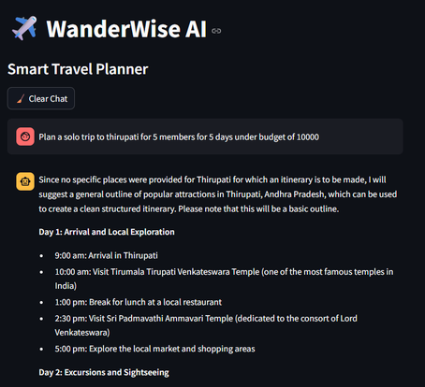
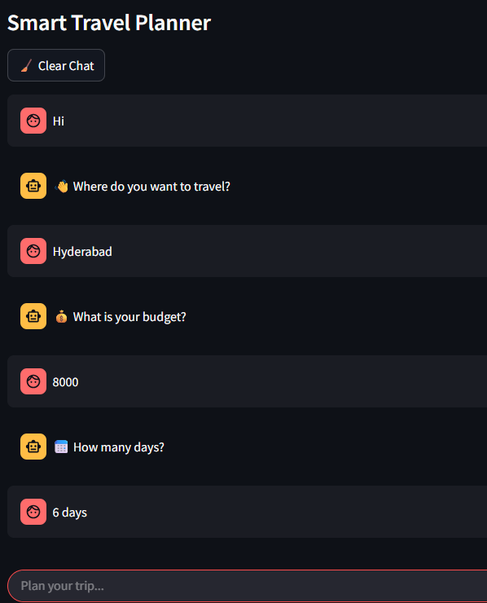
Demo Output
Sample: 3-Day Hyderabad Trip · ₹500/day Budget
Day 1
History & Heritage
Day 2
Culture & Lakes
🕌 Charminar — ₹25
🎨 Salar Jung Museum — ₹20
🌊 Hussain Sagar — Free
🏰 Golconda Fort — ₹35
☕ Irani Chai @ Nimrah — ₹15
🍽️ Paradise Biryani — ₹120
🍛 Dhaba Dinner — ₹120
🛏️ Budget Hotel — ₹280
Total: ₹460
Total: ₹435

Slide 9

Challenges & Edge Cases
INPUT
INTEGRATION
Ambiguous User Input
API Rate Limits
→ LLM fallback normalizes free-text to JSON reliably
→ Caching layer + retry logic prevents service interruptions
PLANNING
ROBUSTNESS
Budget Accuracy
Parser Failures
→ City-specific cost tables with average fallback estimates
→ Graceful degradation — always falls back to LLM seamlessly
Conflicting Preferences
→ Priority ranking: budget > duration > style preferences

Slide 10
Future Scope
What's next for AI Travel Planner
01
02
Voice Input Support
Multi-city Routing
Spoken trip preferences via speech-to-text
Optimize multi-destination tours with travel time
03
04
Booking Integration
Personalization Engine
Direct hotel & flight booking via OTA APIs
Learn from history to improve future recommendations
05
Collaborative Planning
Multi-user trips with shared budget & voting

Slide 11
Questions :
What problem are you solving?
What makes your project unique?
Where is AI used in your project?
What if user input is ambiguous?
How can this be improved?

Slide 12

AI Travel Planner
Plan Smarter. Explore Better.
Hybrid Parser + LLM
MCP Tool Orchestration
Budget-Aware AI
Streamlit UI
Built with Python · Claude API · MCP · Streamlit
Thank You 🙏

