Slide 1
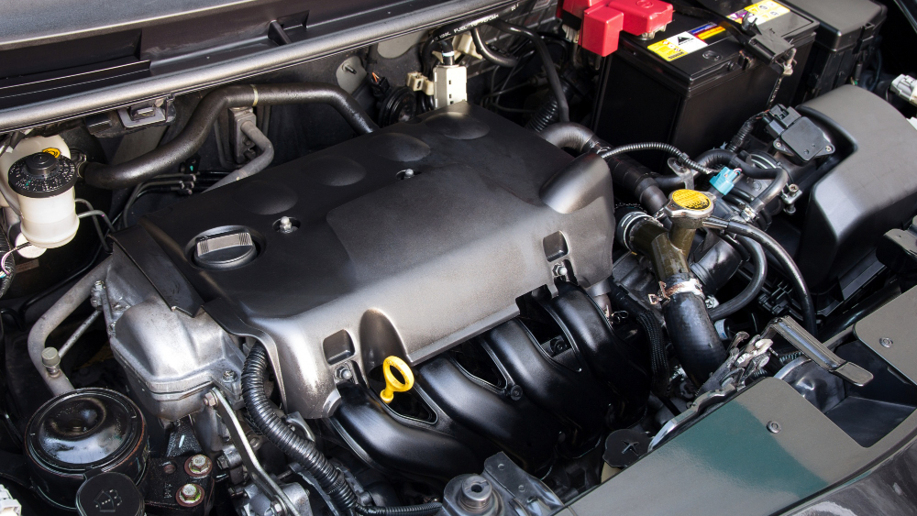
PREDICTIVE MODELLING FOR ENGINE MAINTENANCE AND REPAIR PREDICTION IN AUTOMOTIVE VEHICLES USING RANDOM FOREST CLASSIFIER
Harshitha Poolakanda Somanna
x22150366
Jose Geo Vattolly
x22139508

Slide 2
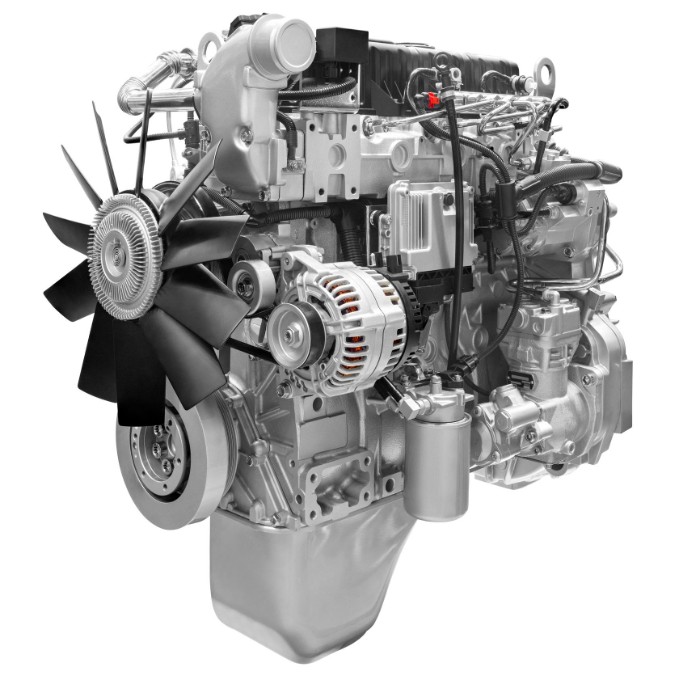
Introduction
Engines play a vital role in the performance and reliability of vehicles.
Traditional methods rely on predetermined schedules which leads to inefficiency, increased cost, and unexpected failures.
Predictive maintenance in engines plays a critical role as it increases the efficiency and sustainability of vehicles.
Early diagnosis of these situations is made possible by predictive modeling
Early detection helps in providing informed decisions to the vehicle owners and reduces the cost of maintaining them.

Slide 3
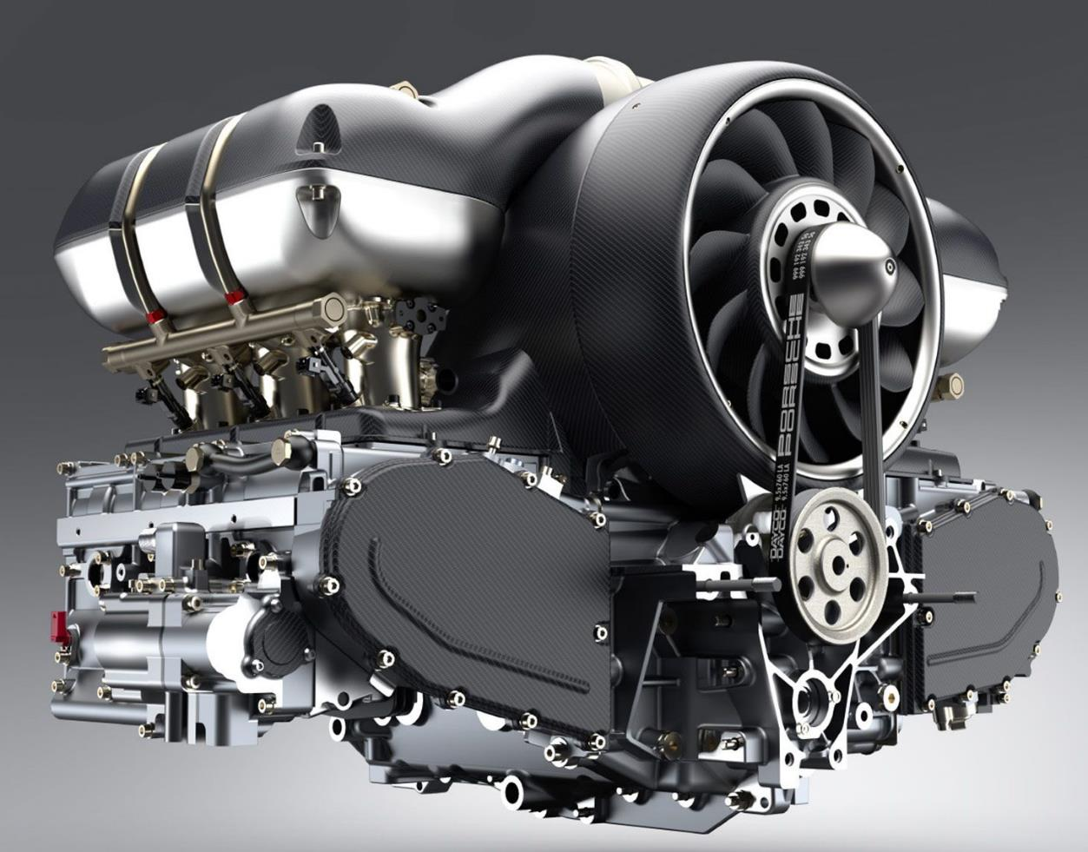
Business Value
To what extent can predictive modeling be used to predict the engine’s condition based on the given measurements.
To what extent can predictive modeling techniques be used to identify early warning signs of engine failures
Failure prediction in engines
Ensuring intact components are not exchanged too early.
Sustainability of the engine.
Cost savings
Easy Maintenance for the vehicle owners
Better sales of automotive vehicles.
Allows maintenance and repair processes to be carried out as required by the actual condition of the system and planned into already-scheduled production downtimes.

Slide 4
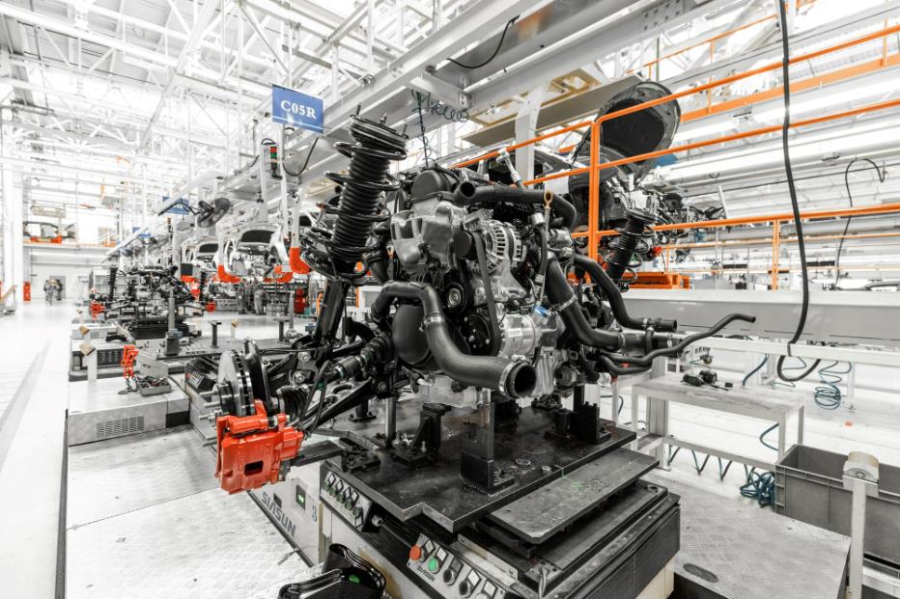
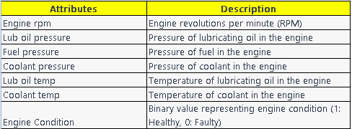
Datasets Description

Slide 5
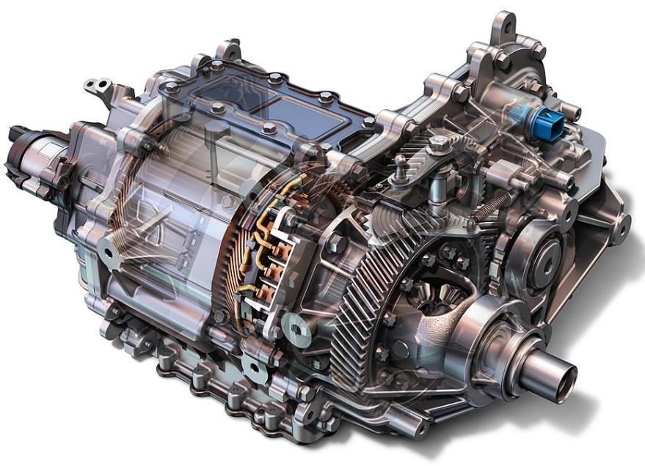
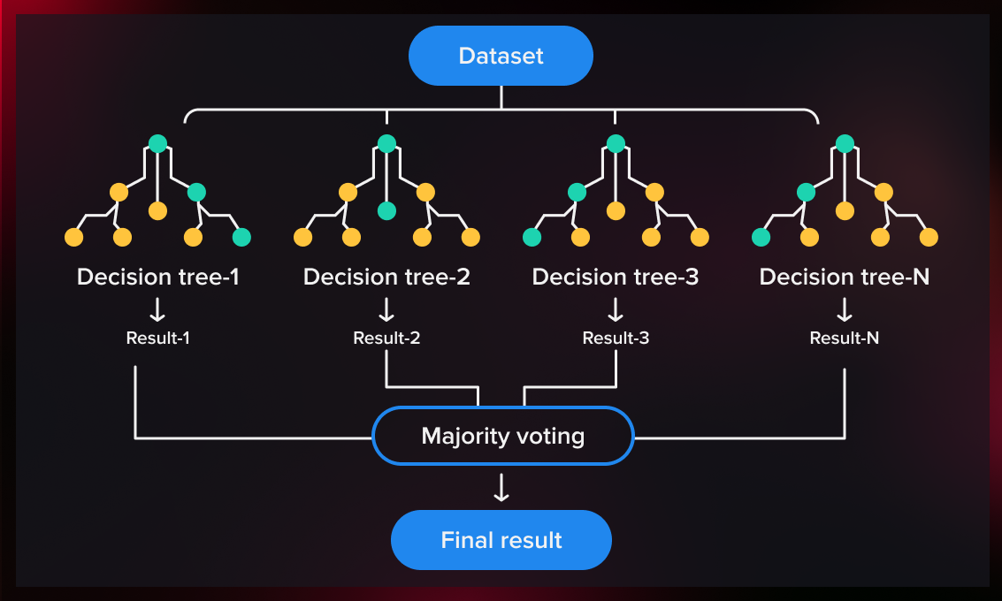
Machine Learning Model

Slide 6
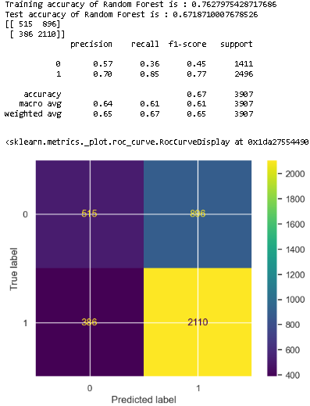
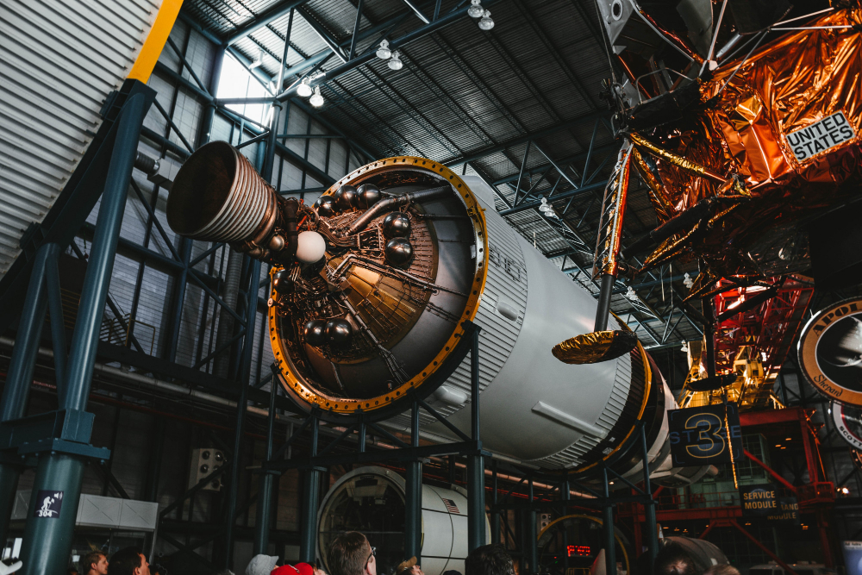
Evaluation Result

Slide 7
Conclusion
Predictive maintenance obtain early warnings of potential engine failures.
Random Forest Classifier was proven robust performance and ability to recognize important elements that influence the results of classification jobs.
Engine RPM, Fuel pressure, Lub oil temperature and Lub oil pressure are found to be effective indicators in maintaining the engine health.
Allows maintenance and repair processes to be carried out as required by the actual condition of the system and planned into already-scheduled production downtimes.
Electromagnetism

Slide 8
Thank You

