Slide 1


Slide Title
SOLAR CHEAT SCAN: DETECTION OF TAMPERING OF SOLAR FORECASTS USING ML
PRESENTED BY:
RANGI VANI PRIYA (2203A51441)
MOOLA HARSHITHA (2203A51430)
DEVIREDDY VINISHA (2203A51200)
ANNAM VARSHINI (2203A51830)
MOHAMMAD SAMREEN (2203A51829)

Slide 2
.
Slide Title
Problem Identification
Solar forecast data can get corrupted due to sensor faults, communication errors, or tampering.
Existing forecasting models cannot detect manipulated or suspicious values.
No system verifies authenticity of forecast data before use.
Incorrect data causes operational failures, financial losses, and poor planning.
Manual detection is impossible due to large, nonlinear time-series datasets.

Slide 3
Slide Title
Objective
Collect and merge solar + weather data.
Build ML regression models to predict AC power.
Detect deviations between actual and predicted values.
Generate tamper scores and classify Normal/Tampered data.
Develop a stacking ensemble for accurate detection.
Forecast AC power for the next 15 days.
Provide visualization and explainability through dashboards.

Slide 4
Slide Title
Literature Review
Previous works focused mainly on improving forecasting accuracy.
Deep learning models (CNN–LSTM, AE–LSTM) detect anomalies but lack specificity
for tampering.
Some studies explored adversarial attacks on energy systems.
No integrated system combining prediction, deviation scoring, and classification.
Existing solutions lack explainability and cannot detect subtle manipulation.

Slide 5
Slide Title
Defining the Objective
Primary Goals
Accurately forecast AC power using ML regression models.
Detect abnormal deviations indicating possible tampering.
Generate tamper scores and classify data as Normal or Tampered.
Build a stacking ensemble model for highly accurate tamper detection.
Integrate solar and weather data through proper preprocessing and feature engineering.
Provide a clear dashboard to visualize predictions and tamper alerts.
Secondary Goals
Produce 15-day future AC power forecasts.
Estimate future tamper probability based on trends.
Use SHAP explainability to interpret model behavior.
Improve model performance through advanced feature engineering.
Enhance system usability with visual reports and interactive charts.
Enable easy scalability for real-time deployment in solar plants.

Slide 6
Slide Title
Proposed Plan
Collect and merge solar AC power and weather datasets using timestamps.
Preprocess data through cleaning, scaling, and outlier/missing value handling.
Create feature engineering components like time-based, rolling, and lag features.
Train regression models to predict expected AC power and select the best model.
Calculate deviation between actual vs predicted values and generate tamper scores.
Train classification and stacking ensemble models to detect Normal/Tampered data.
Forecast AC power for the next 15 days and analyze future risk.
Build a dashboard to visualize predictions, deviations, and tamper alerts.

Slide 7
Slide Title
System Architecture
Input Sources
Solar AC power data
Weather parameters (irradiation, temperature, humidity, wind)
Timestamp-based dataset alignment
Processing Modules
Data Preprocessing: cleaning, merging, scaling
Feature Engineering: time-based, rolling, lag features
Forecasting Module: ML regressors predict expected AC power
Deviation Analysis: compute deviation & tamper score
Classification Module: Normal/Tampered detection using stacking
Future Forecasting: 15-day AC power prediction
Visualization: dashboard with graphs & tamper alerts
Output
Normal / Tampered classification
AC power forecast (15 days)
Deviation charts & tamper alerts
Interactive dashboard visualizations

Slide 8
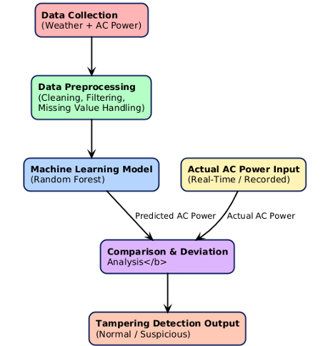
Slide Title
Work Flow

Slide 9
Slide Title
Technology
Tech Used: Python 3.x, Pandas, NumPy, Scikit-Learn, XGBoost, LightGBM, Matplotlib, Seaborn, SHAP, SMOTE
Modules: Preprocessing, Feature Engineering, Forecasting, Deviation Analysis, Classification, 15-day Prediction
Dashboard: Streamlit, Plotly/Matplotlib
Tools: Jupyter, VS Code, GitHub

Slide 10
Slide Title
Core Algorithms
Regression Models:
Gradient Boosting Regressor (best)
Random Forest Regressor
XGBoost Regressor
Classification Models:
Logistic Regression
SVM
Random Forest
XGBoost
Stacking Ensemble (best)
Tamper Detection Logic:
Compute deviation: |Actual – Predicted|
Calculate tamper score
Apply threshold for Normal / Tampered labeling

Slide 11
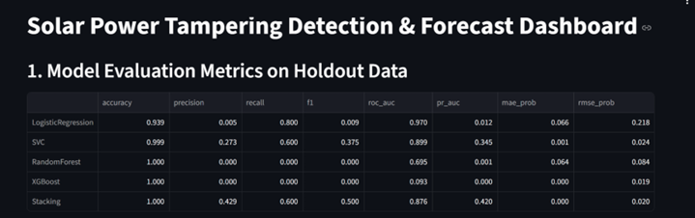
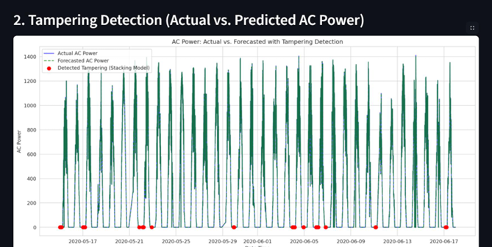
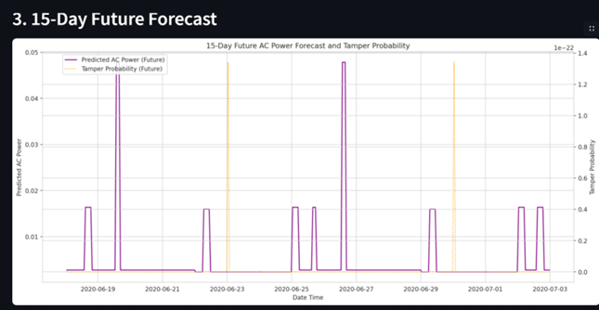
Slide Title
Results & Demo

Slide 12
Slide Title
Conclusion
Developed a robust ML-based system for tamper detection in solar forecasting.
Integrated forecasting, deviation analysis, and classification into a single pipeline.
Achieved high accuracy in both prediction and tamper detection.
Built a visual dashboard for easy interpretation and real-time monitoring.
System can be deployed in solar plants to ensure trustworthy data and improve
decision-making.

Slide 13


