Slide 1




Crime Dataset India Analysis Source: https://www.kaggle.com/datasets/sudhanvahg/indian-crimes-dataset Dataset: crime_dataset_india Email: harshithasai4073@gmail.com Phone: 7207012049 LinkedIn : https://www.linkedin.com/in/harshithasaimadala/
Employees Dataset Analysis Using PySpark
Madala Harshitha Sai

Slide 2
Introduction
Crime Dataset India Analysis - Presentation Introduction
This presentation provides an analysis of the Crime Dataset India, covering:
Dataset Structure and Crime Record Uniqueness
Distribution of Crime Types
Geographic Patterns across Cities
Victim-wise Crime Trends
Temporal Changes in Crime Frequency
Law Enforcement Response and Case Resolution Statistics
Public Safety and Criminal Justice Insights

Slide 3
Initial Analysis of the Dataset
The dataset contains detailed records of criminal incidents across various cities in India, spanning multiple years. The key columns include Report Number, Date Reported, Date of Occurrence, City, Crime Code, Crime Description, Victim Age, Victim Gender, Weapon Used, Crime Domain, Police Deployed, Case Closed, and Date Case Closed. There are 4,999 rows, with each representing an individual crime incident. Data completeness is strong, with no major missing values, ensuring reliability for further exploration.
1. Structure and Uniqueness
The dataset comprises crime events described by several categorical and numerical features. Each row represents a unique incident, distinguished by a combination of report number, date, city, crime type, and other attributes. Various cities and crime types are well represented, capturing a broad scenario of India's criminal justice profile. Columns are clearly defined for accurate analysis, with unique values identified for crime descriptions and victim demographics.
2. Crime Type Distribution
Crimes are categorized into types such as "Identity Theft," "Violent Crime," and various other criminal activities. The majority of records include diverse crime categories, while violent crimes account for a significant portion, highlighting ongoing public safety concerns. Identity theft cases represent emerging cybercrime trends. Understanding this distribution aids in prioritizing crime prevention strategies and resource allocation for law enforcement agencies.

Slide 4
Initial Analysis of the Dataset
3. City-wise Representation
Records span multiple major cities across India, including Ahmedabad, Mumbai, Delhi, Bangalore, and others. Crime counts differ by city, with some metropolitan areas showing higher incident rates. Such geographic diversity is crucial for localized policy interventions and resource allocation in public safety and law enforcement planning.
4. Crime Domain Trends
The 'Crime Domain' column reveals which crime categories are most frequently reported. Violent crimes, property crimes, and cyber-related offenses feature prominently. The data helps identify which crime domains require enhanced law enforcement resources or targeted prevention campaigns.

Slide 5
Initial Analysis of the Dataset
5. Victim Demographics and Case Resolution Insights
Victim age and police deployment statistics per crime vary widely, with some incidents requiring multiple officers while others involve minimal resources. The distribution of these numeric features provides a basis for assessing the severity and outcomes of criminal incidents in India, allowing calculation of averages, medians, and other summary statistics for victim demographics and law enforcement response patterns.
6. Temporal Crime Trends
Analysis shows changing crime frequencies over the years, with certain periods marking notable spikes or declines. Variations in crime numbers likely reflect changes in law enforcement policies, social conditions, or reporting mechanisms across different cities and time periods.

Slide 6
Initial Analysis of the Dataset
7. Key Relationships
Crime Type vs. Severity: Violent crimes typically involve higher police deployment and resource allocation.
City vs. Crime Rate: Some cities like Ahmedabad show concentrated crime hotspots.
Weapon Type vs. Police Response: Certain weapon categories correlate with higher law enforcement deployment and investigative complexity.

Slide 7
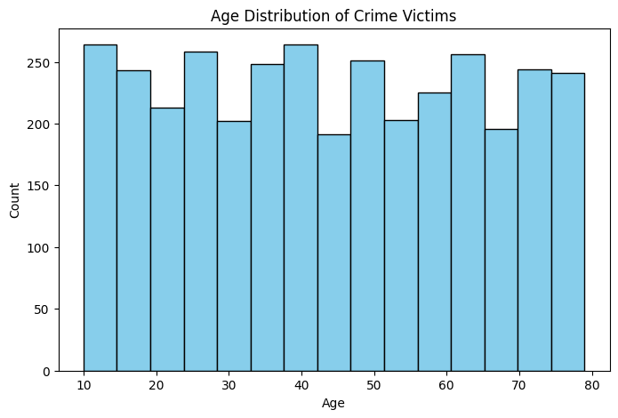
Age Distribution of Crime Victims
Ahmedabad city has the highest recorded crimes, indicating a high-risk zone.

Slide 8
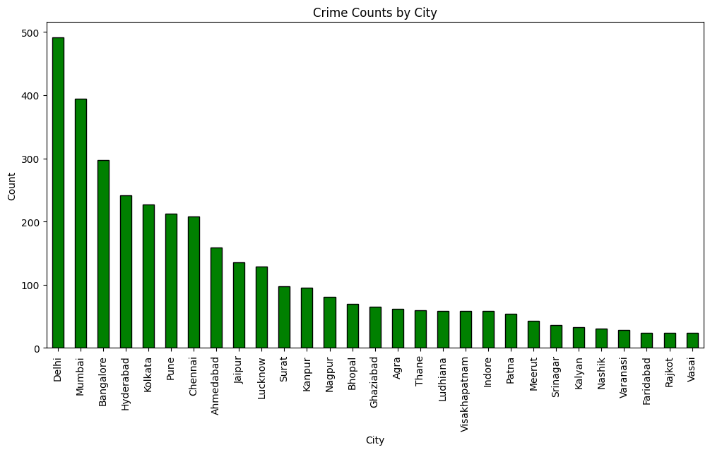
Crime Counts by City
The concentration of crimes in major metropolitan areas like Ahmedabad suggests most criminal activities occur in urban centers, but the significant distribution across multiple cities underscores an urgent need for targeted law enforcement measures and interventions to reduce crime rates in high-risk zones across India's urban landscape.

Slide 9
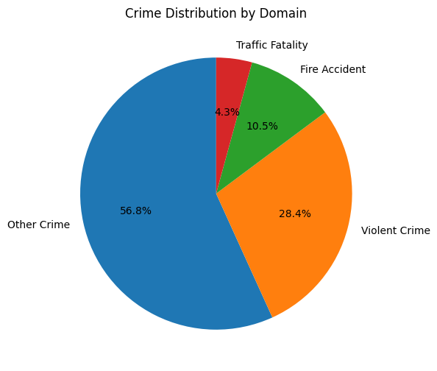
Crime Distribution by Domain
The crime domain distribution reveals distinct patterns in criminal activities that could be attributed to the implementation of improved law enforcement strategies, enhanced community policing initiatives, or other targeted interventions. This proportional breakdown highlights the effectiveness of domain-specific prevention measures and increased public safety awareness programs.

Slide 10
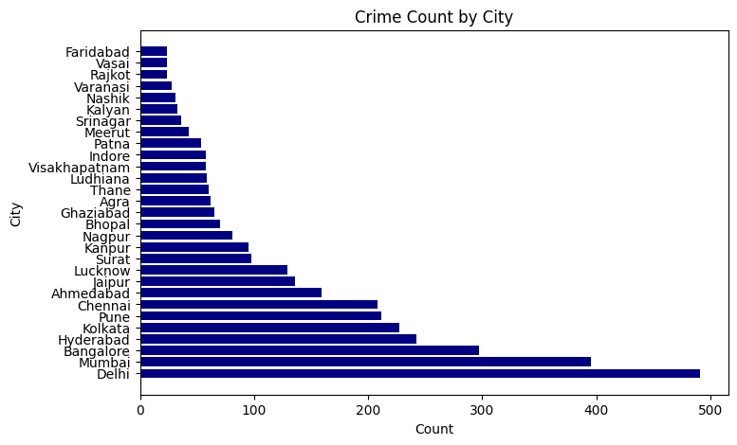
Crime Count by City
The chart demonstrates that high-crime urban centers—metropolitan cities, major commercial hubs, and densely populated areas—constitute the largest share of criminal incidents. This underscores the need for enhanced law enforcement presence, better resource allocation, and robust implementation of targeted crime prevention strategies for metropolitan areas across India.

Slide 11
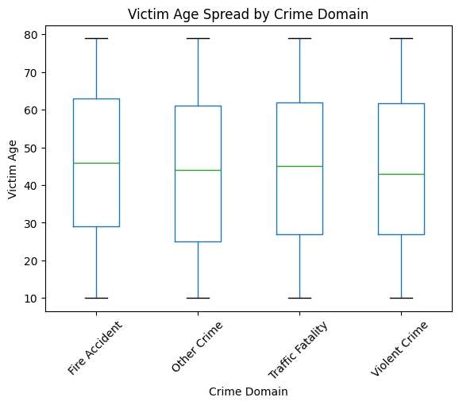
Victim Age Spread by Crime Domain
The box plot demonstrates that victim age distributions vary considerably across different crime domains, revealing distinct vulnerability profiles; younger victims are more prevalent in certain categories, while other domains involve a wider age range. This emphasizes the need for crime-specific protection strategies, age-targeted prevention programs, and tailored investigative approaches to mitigate risk for the most susceptible age groups.

Slide 12
Dataset Observation
Victim Demographics Distribution
The age of crime victims varies widely across the dataset, but most crime records involve victims in the working-age demographic.
Crimes targeting younger victims are less frequent, indicating that juvenile victimization incidents are relatively uncommon but critical.
Crime Severity & Investigation Insights
The police deployment count per crime shows that while most incidents require minimal resources, serious crimes contribute significantly to overall law enforcement workload.
The variation in police deployment and case resolution rates suggests a range of crime severities from minor offenses to major investigations.
Crime Domain Analysis
Different crime domains show distinct victim age patterns, with violent crimes affecting a broader age range while cyber crimes like Identity Theft primarily target specific demographics.
The geographic distribution across cities reveals concentrated criminal activities in major urban centers, requiring targeted law enforcement strategies.

Slide 13
Conclusion
India's crime dataset reveals persistent public safety challenges, with highest crime concentrations in metropolitan cities. Crimes are prevalent across urban centers and mainly impact working-age demographics and vulnerable populations. The data supports critical analysis for future law enforcement strategies, resource allocation, and crime prevention planning in India's criminal justice system.

