Slide 1

STUDENT DETAILS
YANDRAPATI.HARSHITHA SAMPATH
20761A05J2
LAKIREDDY BALIREDDY COLLEGE OF ENGINNEING

Slide 2

PROJECT TITLE
CREATING
A
PORTFOLIO

Slide 3


AGENDA
A portfolio website is a unique way to showcase your work and let others know about yourself. It’s like an evergreen platform for your projects, case studies, and information about you. In addition, it’s one of the best ways to express your personality, experience, and capabilities.

Slide 4

PROJECT OVERVIEW
As a developer or student , you need an online presence. You can cultivate this online presence on social media platforms such as Twitter, Facebook, and Instagram. But those are not entirely your own, as the moderators of those platforms have almost full control over your account.
With your own portfolio website, it's live on your own domain online. And people can easily find you when they search for your name on a search engine like Google, provided you put the right things in place when it comes to SEO.

Slide 5

WHO ARE THE END USERS OF THIS PROJECT?
A well-constructed portfolio offers you the opportunity to produce evidence of having achieved the learning outcomes of a module. These include knowledge, understanding, the skills of critical reflection and reflexivity, and the ability to make appropriate connections between theological study, practice and experience. Portfolios are most commonly associated with work, placement or context-based learning, but not exclusively so. Portfolios comprise a number of different assessment tasks, some or all of which are usually set by the module tutor.

Slide 6

SOLUTION AND PROPOSITION
A portfolio website presents your professionalism and dedication to the craft better and more clearly than any CV. You don’t just tell, you show actual cases and examples which speak volumes. Moreover, owing to the portfolio website, you can show your mature and sophisticated approach to selling your work along with yourself.
Your portfolio is the only web-space where everything is up to you. You are able to create a never-seen-before platform with unique content and achieve a recognizable identity the way you imagine it. A private portfolio website lets your inner creator go far beyond any cliché.
An online portfolio is certain to make you available and searchable for new clients. It lets your potential employers find you the moment they get round to using a search engine or looking through candidates’ applications.

Slide 7
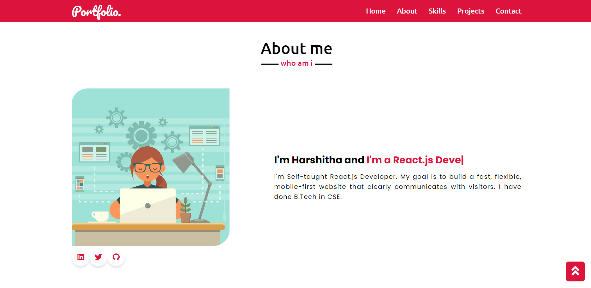
CUSTOMIZATION OF PROJECT
The folder structure consists of index.html, style.css, and script.js files and an images folder. We'll write all CSS in the style.css file and the JavaScript in the script.js file .
In the index.html file, you can see the HTML boilerplate code with the Bootstrap CDN, and a link to the external style sheet and JavaScript.
Here, the script.js file is loaded after loading all the HTML code.

Slide 8
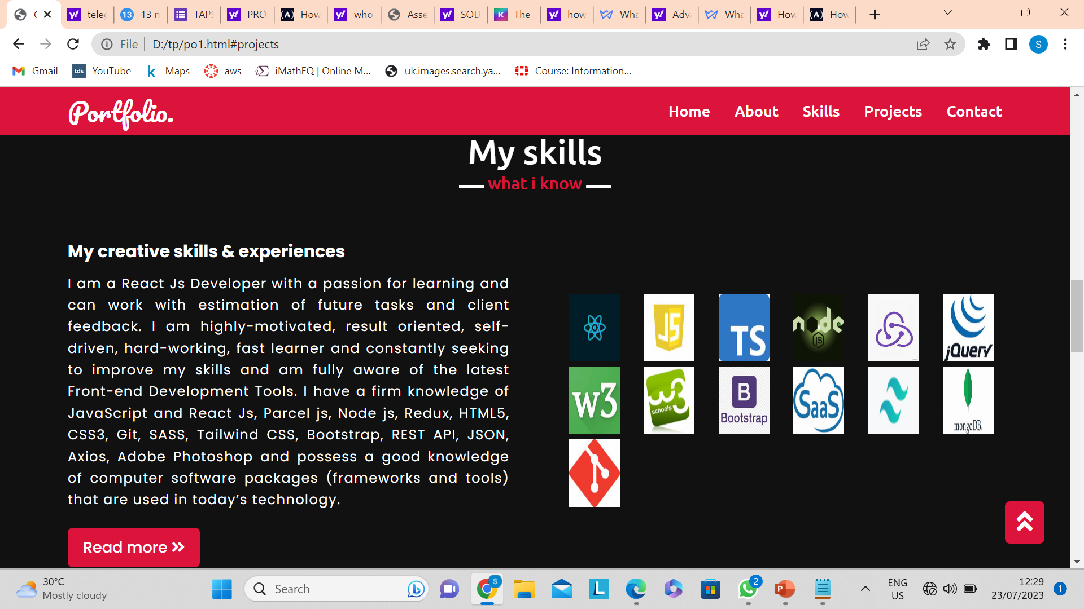
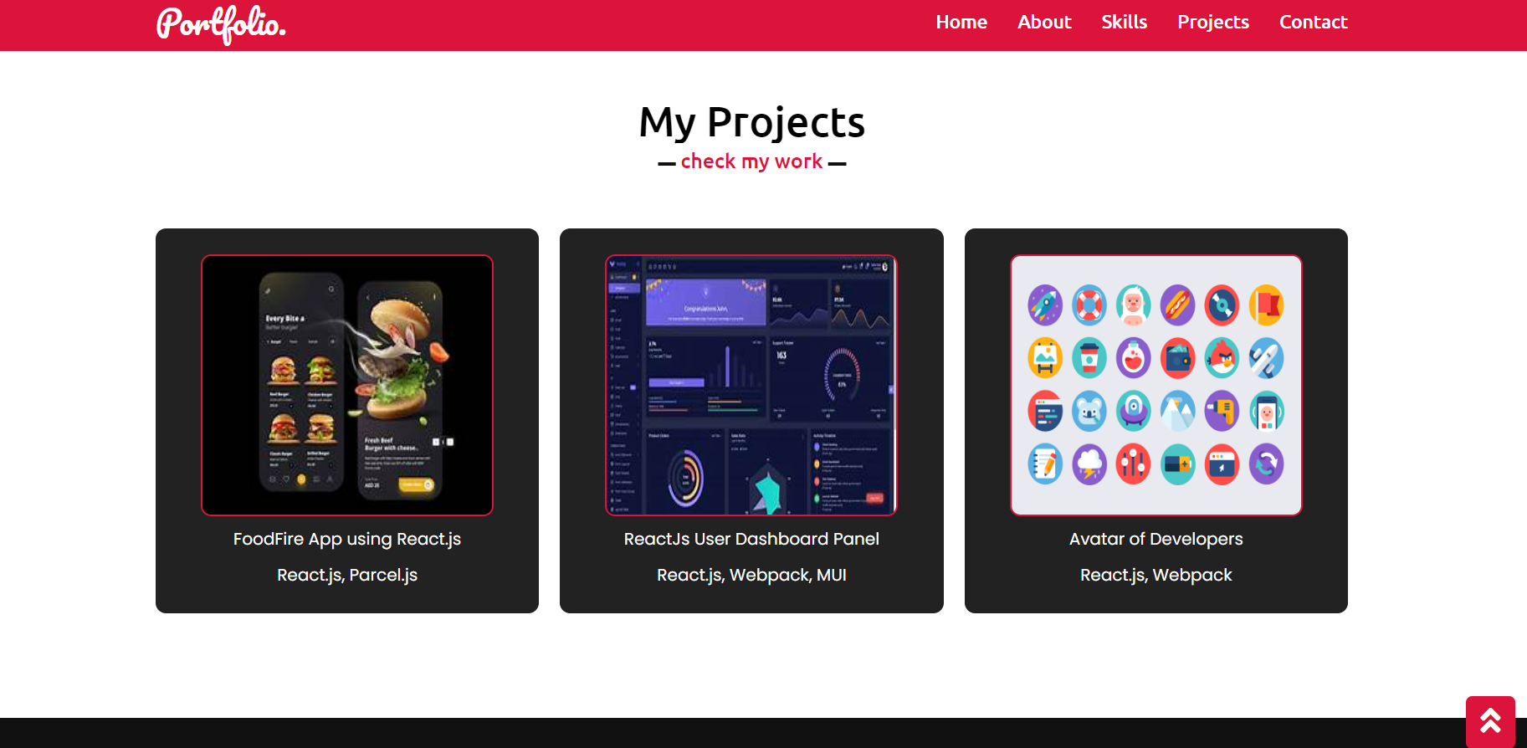
MODELLING

Slide 9
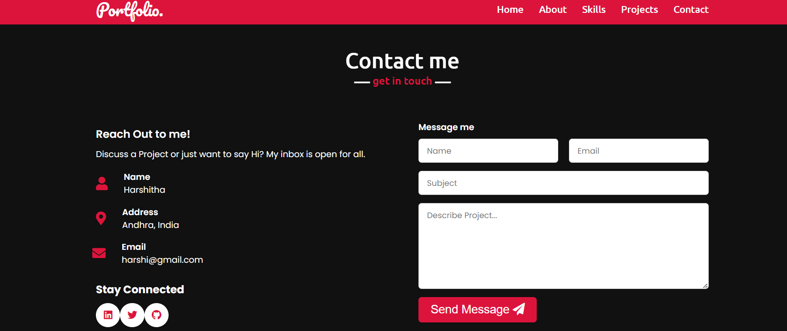
RESULTS
It provides a platform to showcase your relevant skills and experience
It shows your personality
t lets hiring managers find you instead of you reaching out to them
you are easily searchable on search engines like Google

Slide 10
LINKS
https://github.com/HarshithaSampath/Portfolio
REFERENCED LINKS
https://www.w3schools.com/Css/css_link.asp
https://www.javatpoint.com/javascript-tutorial
https://www.w3schools.com/html/html_attributes.asp

