Slide 1
Sales Performance Dashboard

Slide 2
Objective
To create an interactive dashboard that highlights sales performance across Product Categories, Regions, and Months.

Slide 3
Dataset Used
Source: Superstore_Sales.csv
Columns:
Order Date
Region
Category
Sales
Profit
Tools Used:
Power BI

Slide 4
Key Insights
1. The West region had the highest sales in Q3.
2. Technology category drove most of the revenue.
3. Sales increased significantly in December due to year-end purchases.

Slide 5
Filters
Filters Used:
Region (Slicer)
Category (Slicer)

Slide 6
Design Choices
Visuals Used:
Line Chart → Sales trend over time
Bar Chart → Sales by region
Donut Chart → Category contribution

Slide 7
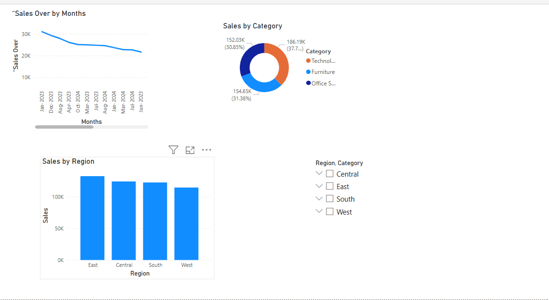

Slide 8
Conclusion
This dashboard helps analyze sales data across months, regions, and product categories, allowing key business insights.

