Slide 1
Sales dataset Dashboard Report

Slide 2
Project Overview
Dataset: sales_data
Objective: Build an interactive dashboard to uncover key business insights.
Focus Areas: Revenue, Profit, Product Lines, Territory, Time Trends

Slide 3
Summary KPIs
Total Revenue and Profit displayed using Card visuals.
Unique customer count derived using DAX.
KPI card highlights Revenue vs. Goal.

Slide 4
Time Series Analysis
Line chart used to display profit trends over time.
Date hierarchy enables drill-down into Year, Quarter, Month, and Day.
Useful for identifying seasonal patterns and performance trends.

Slide 5
Product and Region Analysis
Bar chart compares Total Profit by Product Line.
Map visualization displays Revenue by Territory.
Slicers for ProductLine, Territory, and Year enable interactivity.

Slide 6
Key Takeaways
Consistent revenue from core product lines.
Asia and Europe drive significant revenue.
KPI goal analysis helps measure monthly target performance.

Slide 7
Recommendations
Continue investing in high-performing product lines.
Explore underperforming regions.
Review monthly sales performance against targets regularly.

Slide 8
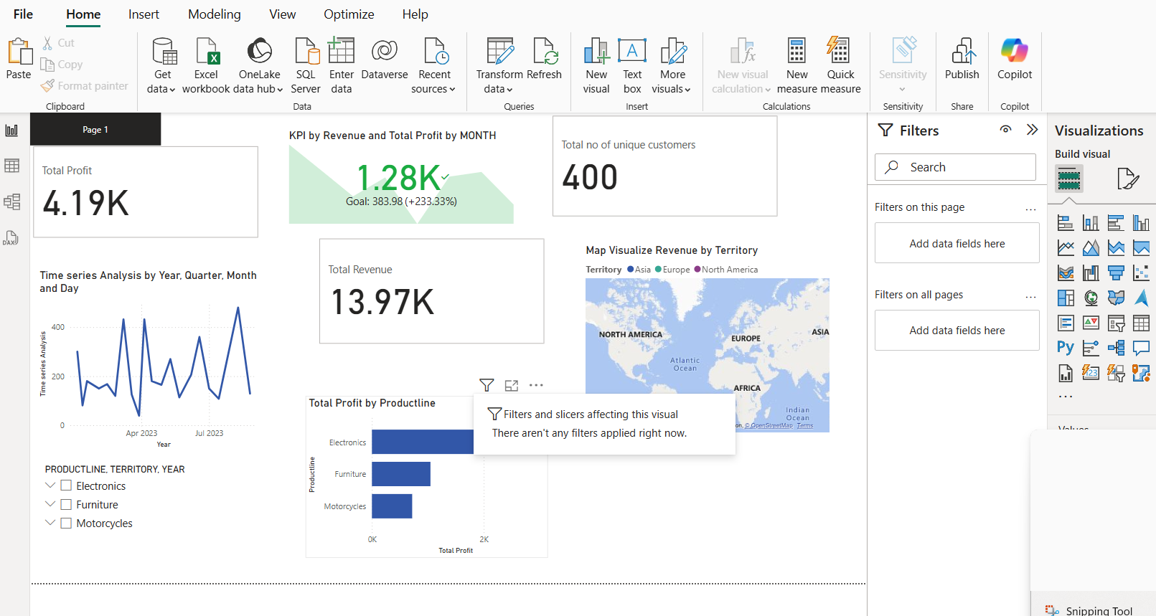

Slide 9
Thank You

