Slide 1
Superstore Sales Performance Analysis
Prepared by: [Harshitha]
Tool Used: Power BI
Date: [24-06-2025]

Slide 2
Project Overview
Dataset: Superstore Sales Data (1000 orders)
Objective: Identify key sales and profit drivers
Focus Areas: Regions, Categories, Products

Slide 3
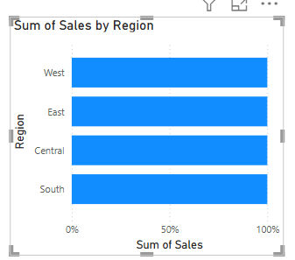
Sales by Region
West Region leads in sales followed by East, Central, and South.

Slide 4
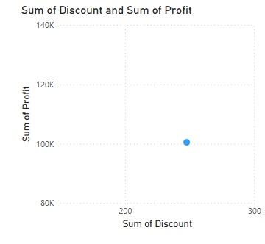
Profit vs Discount
Moderate discounts show stable profit levels. Pricing strategy optimization is needed.

Slide 5
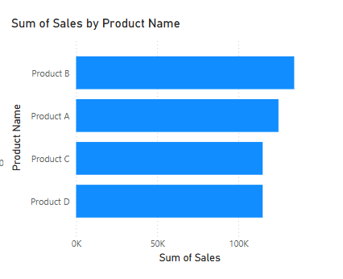
Top Products by Sales
Product B leads in sales, followed by A, C, and D.

Slide 6
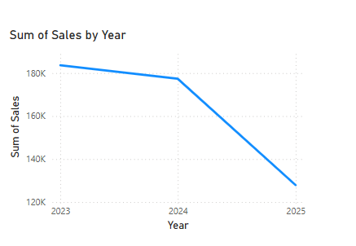
Sales Trend Over Years
Sales peaked in 2023 and declined in 2024 and 2025.

Slide 7
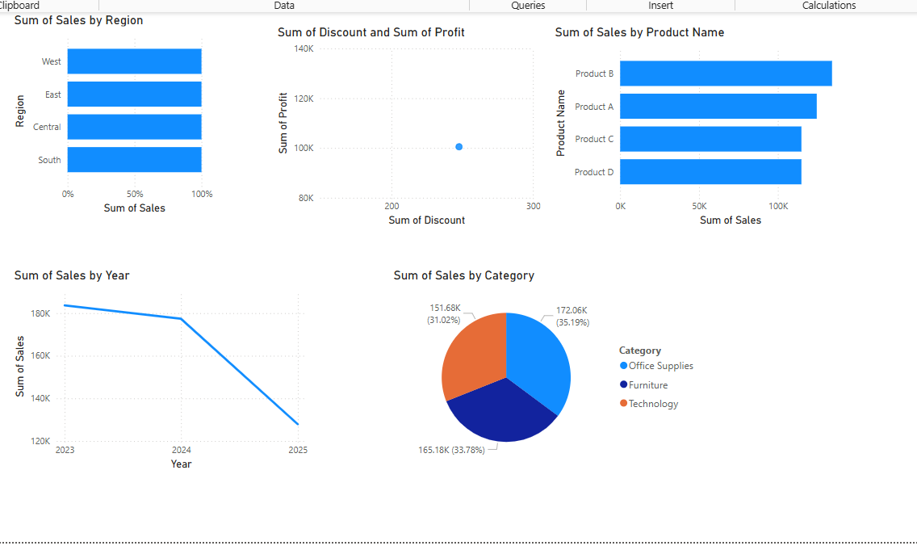
Sales by Category
Technology (35.19%) is the top-selling category, followed by Furniture and Office Supplies.

Slide 8
Key Takeaways
West region drives the highest sales.
Product B is the top performer.
Technology leads in category sales.
Slight sales decline in recent years.
Discount strategies need review.

Slide 9
Recommendations
Investigate reasons for declining sales post-2023.
Focus on marketing for top products.
Optimize discount policies.
Strengthen performance in South & Central regions.

Slide 10
Conclusion
Data storytelling helps uncover actionable insights.
The analysis provides a foundation for strategic decision-making.

Slide 11
Screenshot

Slide 12
Thank You

