Slide 1

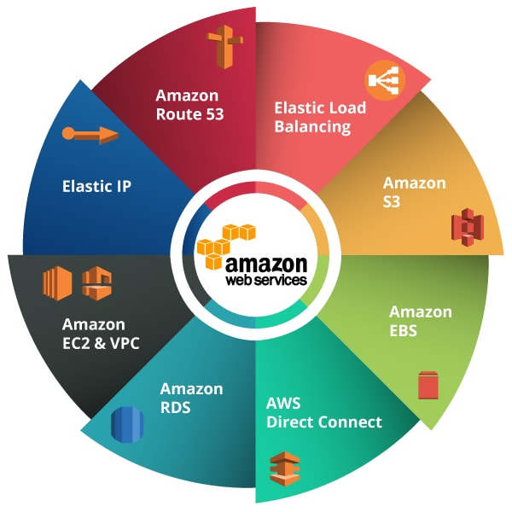
AWS Networking Services.
HM

Slide 2


Introduction to AWS Networking Services
AWS networking services are designed to provide a secure, reliable, and scalable network infrastructure for applications running on AWS. These services allow you to connect your applications, users, and data centers to AWS in a way that meets your specific performance and security requirements.
HM

Slide 3
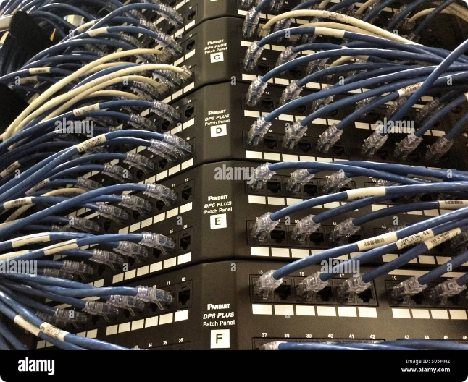
Virtual Private Cloud (VPC)
A VPC is a virtual network that you create in AWS. It allows you to configure your own private network within the AWS cloud. This provides you with a secure and isolated environment to run your applications. VPCs can be configured with subnets, route tables, and security groups to ensure that only authorized traffic can access your resources.
Security
Scalability
VPCs provide a secure and isolated environment for your applications.
VPCs allow you to scale your network infrastructure as your needs grow.
Control
You have full control over your network configuration.

Slide 4

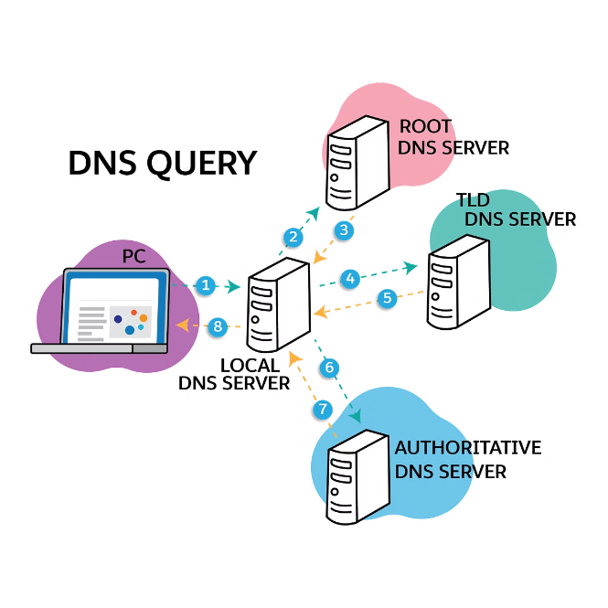
Route 53 - DNS and Domain Name Management
Route 53 is a highly available and scalable Domain Name System (DNS) service. It allows you to map domain names to IP addresses and manage your DNS records. Route 53 also provides health checks to monitor the availability of your applications and can automatically route traffic to healthy instances.
1
Domain Registration
Register your domain name with Route 53.
2
DNS Record Creation
Create DNS records to map domain names to IP addresses.
3
Health Checks
Configure health checks to monitor the availability of your applications.
4
Traffic Routing
Route traffic to healthy instances using Route 53's routing features.

Slide 5





Amazon CloudFront - Content Delivery Network (CDN)
CloudFront is a global content delivery network (CDN) that delivers content to users with low latency and high availability. It caches content at edge locations around the world, which means that users can access content from a location close to them, resulting in faster loading times. CloudFront also provides security features such as SSL/TLS encryption and access control lists to protect your content.
Request from User
A user requests a web page from a website.
CloudFront Edge Location
CloudFront's edge location serves the content if it's cached.
Origin Server
If the content is not cached, CloudFront fetches it from the origin server.

Slide 6
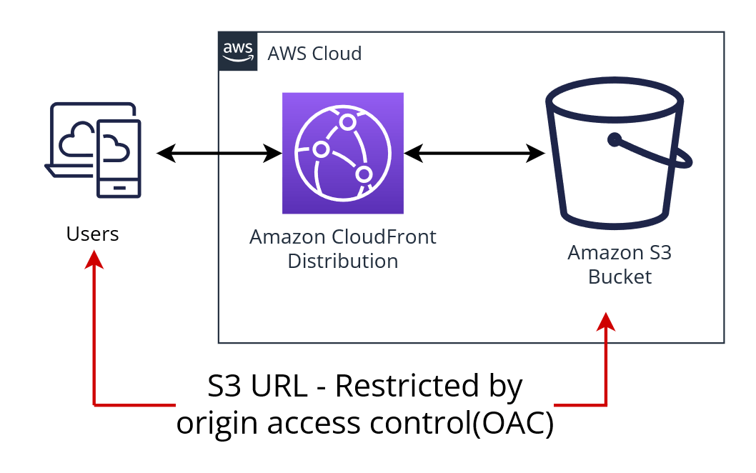

STEPS TO CONFIGURE CLOUD FRONT -
1
Go to S3 service and load the objects.
4
Copy the distribution domain name
and paste it in new tab.
2
CREATE A BUCKET
3
CREATE DISTRIBUTION
Create a bucket with name and upload the files to it.
Create a new OAC (origin access control)
Setup web application firewall
Copy the policy code and paste it in bucket and save the changes.

Slide 7

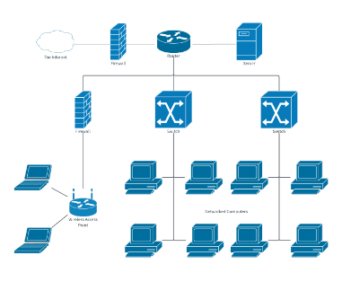
Conclusion
In summary, AWS networking services offer flexible, scalable, and secure solutions that cater to a variety of business needs, from small startups to large enterprises. These services enable businesses to build and manage a reliable cloud infrastructure that is optimized for performance, security, and cost-efficiency. AWS continues to evolve, adding new features to meet the growing demands of cloud-based networking.

