Slide 1

Seasonal Agriculture Performance Analysis
Kotha.Harshitha
ACE ENGINEERING COLLEGE
AICTE STU ID : STU6a6b6789920bd1785423753

Slide 2

PROBLEM STATEMENT
Agricultural activities are influenced by seasonal variations in environmental conditions,
farming practices, resource availability and market conditions. As a result, agricultural
performance may differ from one season to another.
However, raw agricultural data does not clearly explain how agricultural performance changes
across seasons or what patterns can be observed in different seasonal conditions.
The problem is to analyze the given agricultural dataset and investigate seasonal differences
in agricultural performance by identifying meaningful patterns, trends, relationships and
variations within the available data.

Slide 3
Project Description
Seasonal Agriculture Performance Analysis is a data analytics project that studies agricultural performance across different seasons, regions, and farming conditions. The project analyzes factors such as crop production, environmental conditions, farming practices, resource usage, and economic outcomes.
The main aim is to identify seasonal patterns, trends, relationships, and variations in agricultural performance. The findings can help understand how seasonal conditions affect agriculture and support better planning and data-driven decision making.

Slide 4

WHO ARE THE END USERS?
Farmers – To understand seasonal crop performance and improve farming decisions.
Agricultural Officers – To monitor agricultural trends and support farmers.
Agricultural Researchers – To study seasonal patterns and relationships in agriculture.
Government & Policy Makers – To use data insights for agricultural planning and policies.
Agribusinesses – To understand crop production and market-related trends.
Students & Data Analysts – To study and analyze agricultural data.

Slide 5

Technology Used
  Python – For data cleaning, analysis, and calculations.
  Pandas – For handling and processing the dataset.
  NumPy – For numerical calculations.
  Matplotlib – For creating graphs and visualizations.
  Seaborn – For statistical data visualization.
  Jupyter Notebook / Google Colab – For writing and executing the analysis.
  CSV / Excel – For storing and managing the agricultural dataset.

Slide 6
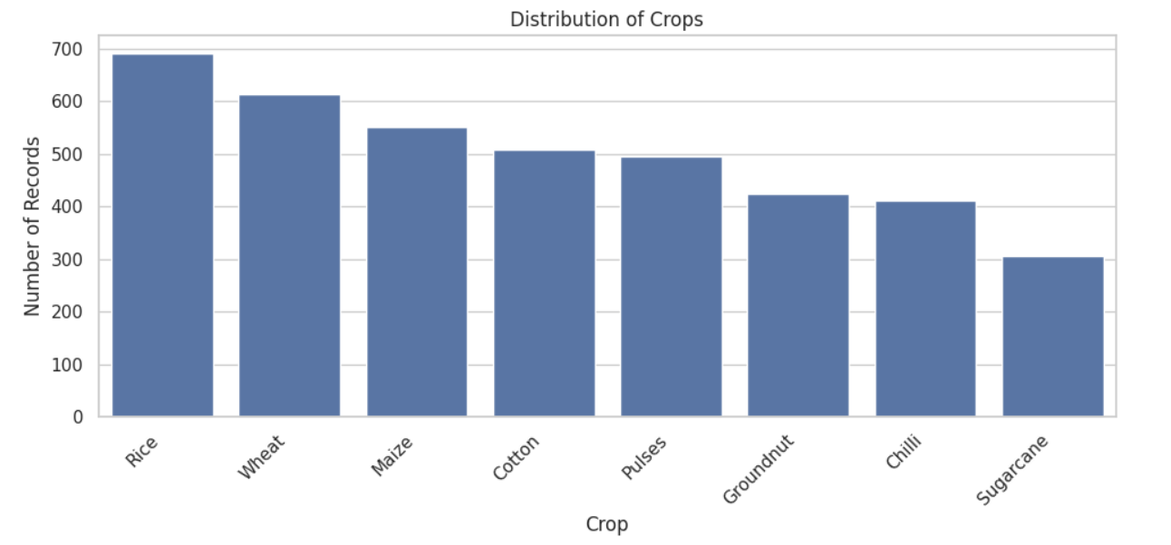
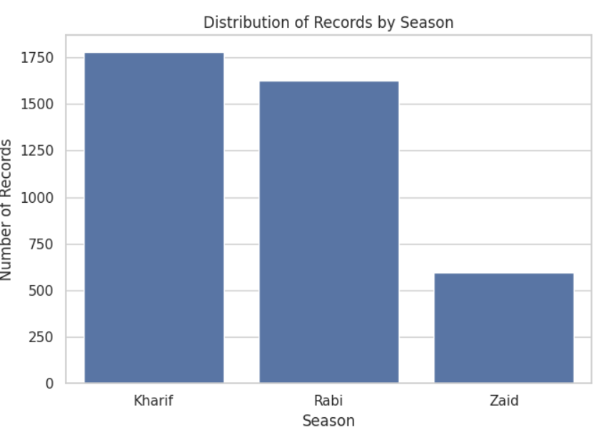
RESULTS

Slide 7
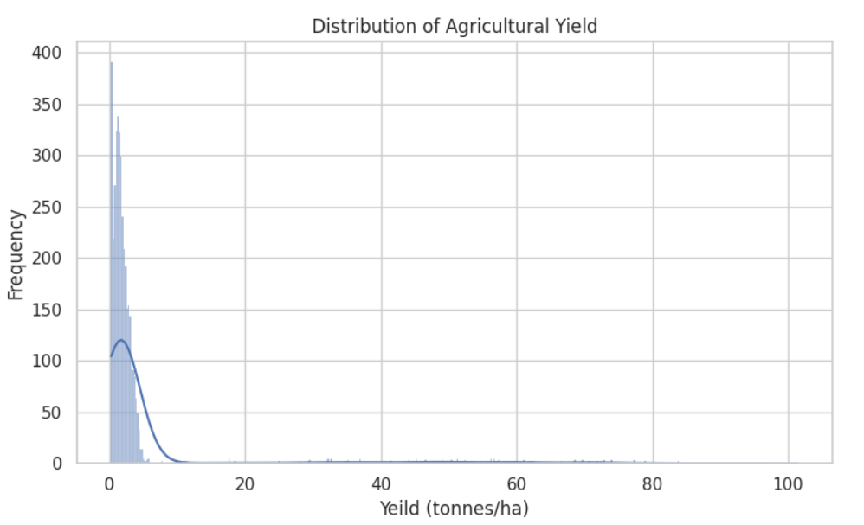
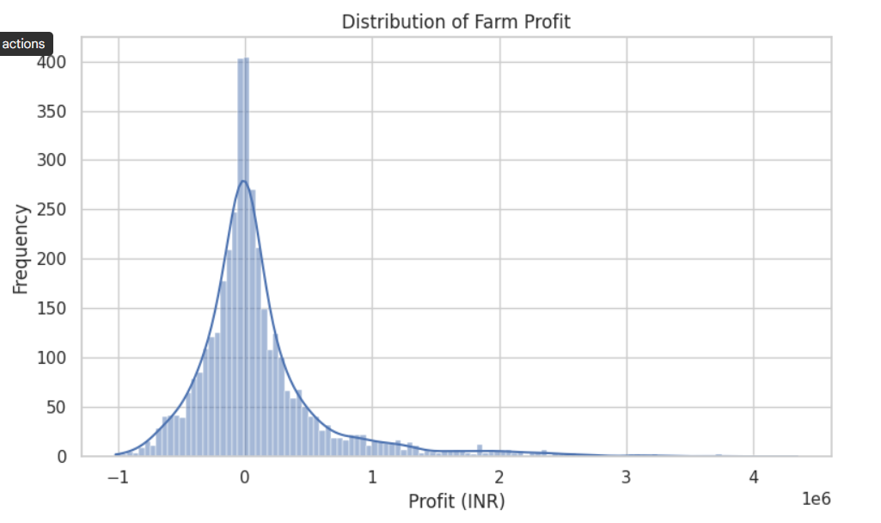
RESULTS

Slide 8
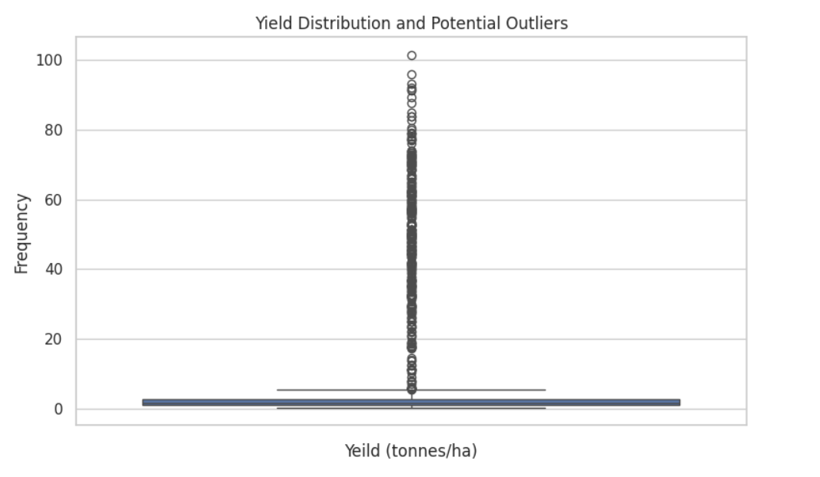
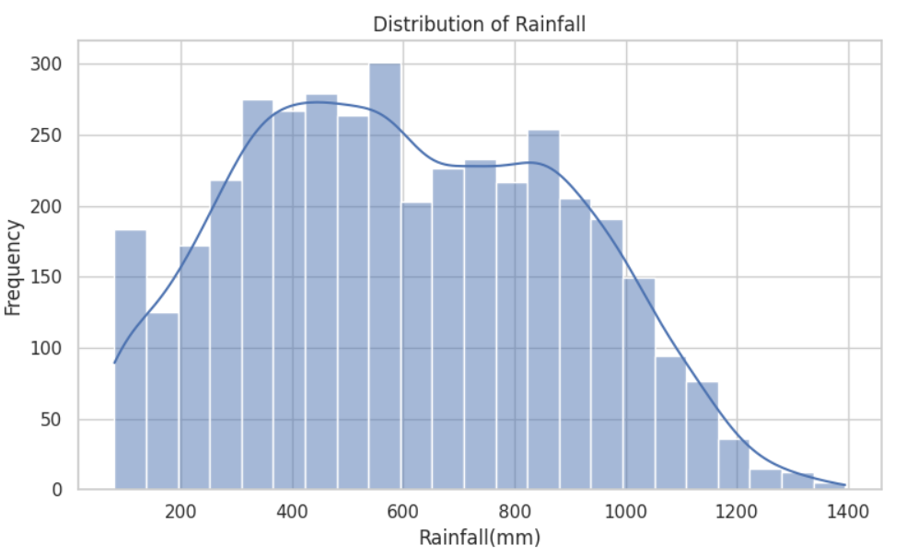
RESULTS
[Add screen shots of your code ]

Slide 9
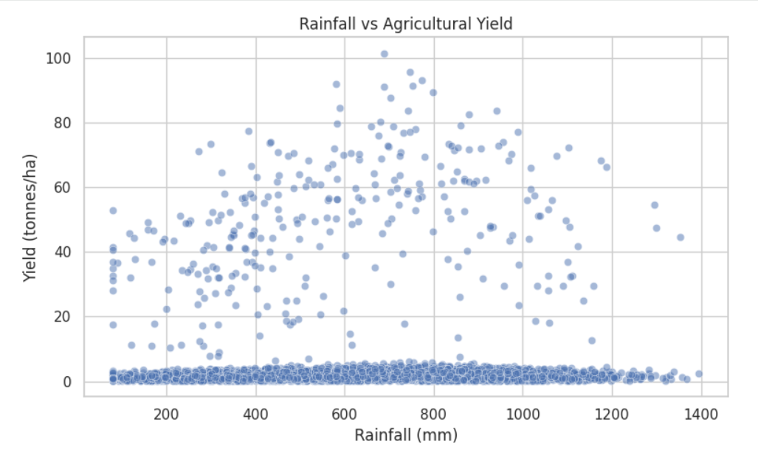
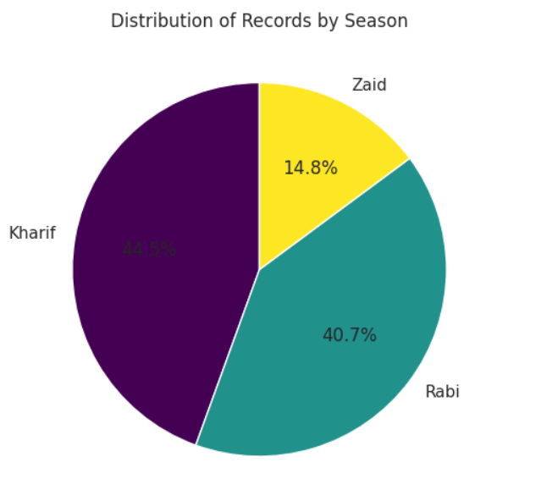
RESULTS
[Add screen shots of your code ]

Slide 10
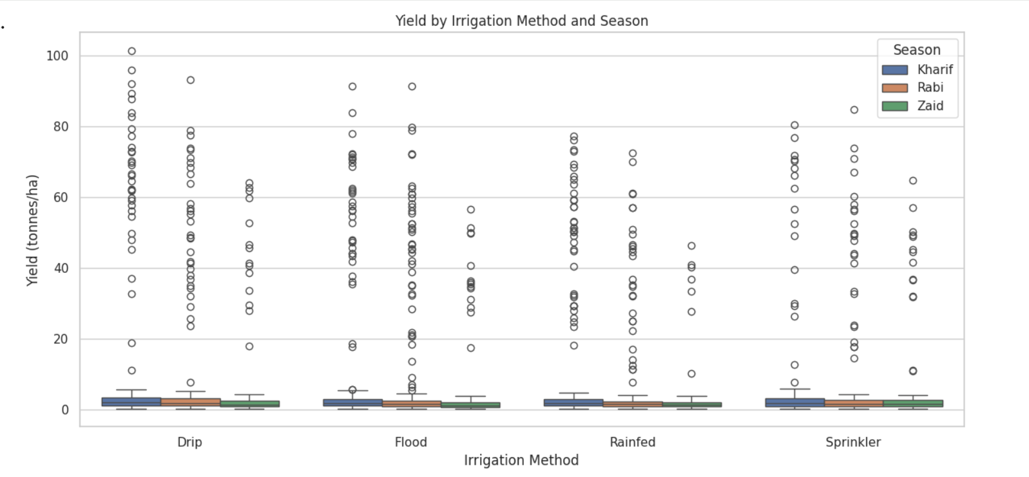
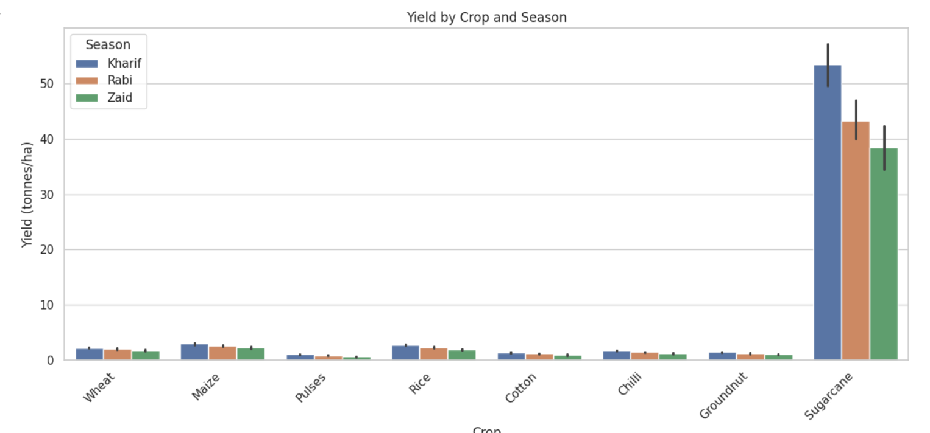
RESULTS
[Add screen shots of your code ]

Slide 11
Future scope
Predict crop performance for upcoming seasons using historical data.
Weather-based analysis to understand the effect of rainfall, temperature, and other conditions.
Crop recommendation based on season, soil, and environmental conditions.
Yield prediction to help farmers estimate expected production.
Real-time data integration using weather and agricultural data sources.
Machine Learning models can be used to improve prediction accuracy.
Interactive dashboards can be developed for easy monitoring and decision-making.
Mobile/Web application can be developed to make the insights easily accessible to farmers and agricultural officers.

Slide 12
GitHub Link

Slide 13
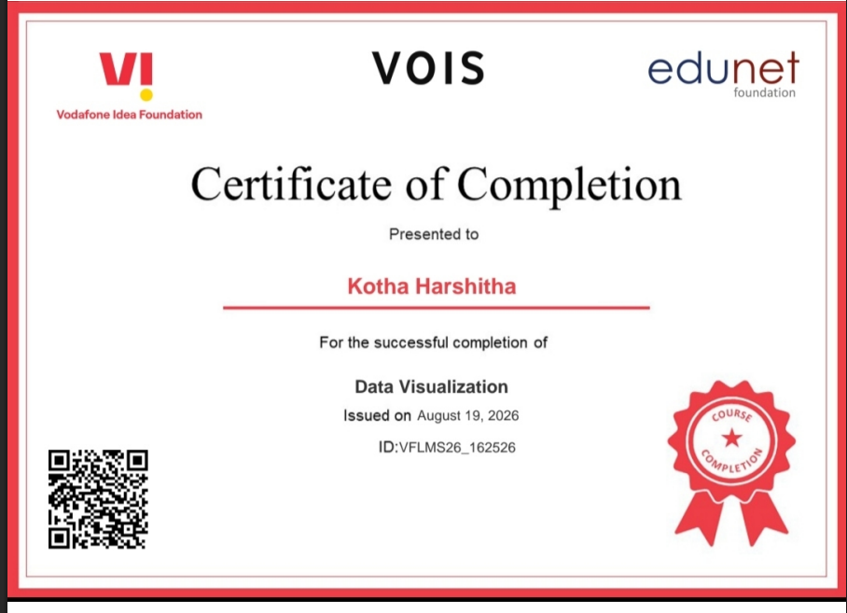
VOIS Course completion certificate -
Course name- Data Visualization

Slide 14
Thank you
.
.

