Slide 1


Bigdata & Hadoop
by
Vasu

Slide 2

Apache Hive

Slide 3
Hive Overview
Hive is a data warehousing software. A Query engine
Hive Provides HiveQL - Hive Query Language which manipulates data on top of Hadoop
Hive is NOT a database (RDBMS)
Hive Originated from Facebook, founded by Jeff Hammer Bacher who was working with Facebook (2010)
“Hive” Name is derived from the term “beehive”

Slide 4
Hive Overview
Hive is NOT a database (RDBMS) but it consist of catalog or namespace of tables
Hive table is a logical structure like Relational Database
Default namespaces of Hive for variables are
hivevar, hiveconf, system and env.
Default directory for database/tables/hdfsFile are
hive.metastore.warehouse …… path location … /user/hive/warehouse

Slide 5
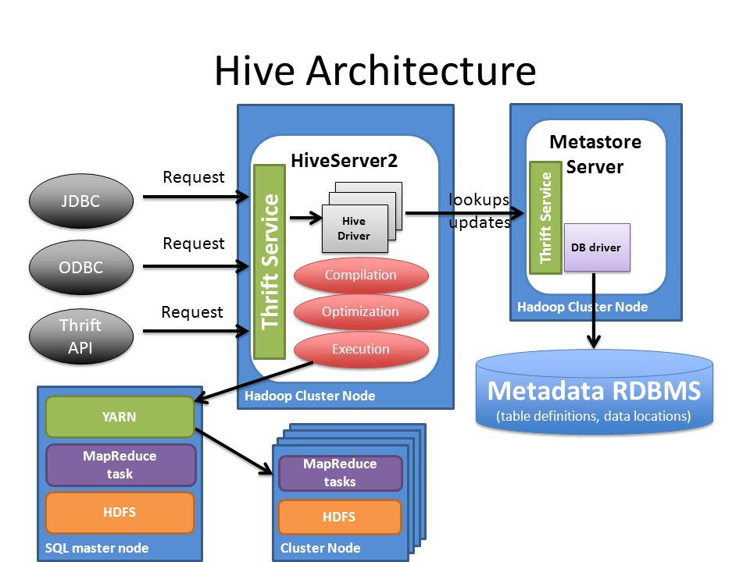
Hive Architecture

Slide 6
Hive Architecture
Process Flow
UI :- From the User Interface, user Submit queries . Hive Driver receives Queries
Hive Driver – (Parser, Compiler, Optimizer, Execution Engine)
Driver :- JDBC/ODBC drivers or interfaces receives HQL queries from UI
Metastore - Integrates HDFS data, Hive Tables, Schema which is stored in RDBMS (MySQL)
Hive Conf file : Refer – hive-site.xml
Hive Driver consist of three major activities : -
Optimizer - Provides logical plan for transformations like, Join and aggregating data
Compiler :- Compiler parses the query and converts the logical plan into Physical Execution Plan.
in the back-ground, DAG Converts the plan and splits the query into Map Task & Reduce Task
Executor - Uses NameNode & DataNode for fetching HDFS Files and also
uses Resource Manager & Node Manager to execute the MapReduce tasks
SerDe - Serialization & Deserialization will be done at the temporary location

Slide 7
Hive Metastore
Metastore
Hive Metastore provides an integration service or repository to maintains metadata information.
Metadata - Hive Table,, HDFS File location, Schema in Database (mysql)
Embedded
Hive Metastore uses Apache’s Derby database and both Metastore & Derby database together runs in the same Hive Sever process location -All process in one JVM
This is a default metastore mode used for testing purpose – only one user can be active at time.
Local
Hive Metastore & Hive server runs in the same JVM . But Database runs as different process
All process will be running in a Single physical system , but JVM and Database runs as separate process
Remote
Hive Metastore runs independently in a separate JVM process. Using JDBC driver, Thrift Network API services to connect with Metastore DB – Database(mysqll) . HiveServer will be running in a separate process or JVM.
All Hive Metastore ,Hive Server & Database services will be running as a separate process in a single host.

Slide 8
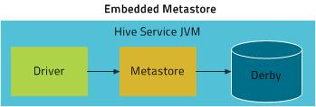
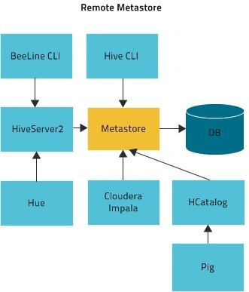
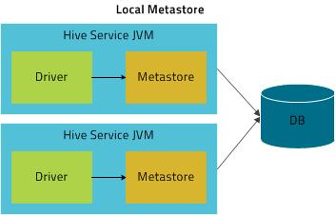
Hive Metastore

Slide 9
Hive tables
Managed table or Internal table (Default)
External Table
Temporary Table
Skewed Table
Transaction Table

Slide 10
Hive Schema
Hive Schema
Hive Schema / Metadata is stored in Conventional RDBMS in a database
Hive uses Read-on-Schema where as ….
RDBMS uses Write-on-Schema …. Unlike Hive

Slide 11
Hive Queries
Order by
Sort by
Group by
Distribute by
Cluster by

Slide 12
Hive Joins
Inner Join
Left outer Join
Right outer Join
Full outer Join
MAP Join
Shuffle/Reduce Join
Sort-Merge-Bucket (SMB) Join
Skew Join

Slide 13
Hive Partitions
Static Partitions (Manual)
Dynamic Partitions
Buckets (cluster)

Slide 14
Hive Clients
Hive CLI (Hive Server 1 & 2)
Beeline (Hive Server 2)
Hue (Web UI - Query Editor)
HD Insight (Azure)
Impala (Cloudera)

Slide 15
Hive Advanced Features
ACID Properties (ORC)
Table Properties (Transaction Table)
Views
User-Defined Functions
Vectorization (Parquet / ORC)
Security (Sentry & Ranger)
Compression (Snappy & Gzip )
Windowing Analytics
Explain - Query optimization
HCatalog - A Storage management Layer for HDFS , particularly RCFile(ORC & Parquet)

Slide 16
Hive Delimiters
Default Delimiter is - ‘\001’ or CTRL A (^A)
Row level delimiter ‘\n’
TAB Delimiter - ‘\t ’
Comma delimiter - ‘ , ’

Slide 17
Hive Data Types
String - STRING (32767 bytes), VARCHAR (65535), CHAR (255), TEXT (2 GB)
Date - DATE, TIMESTAMP (yyyy-mm-dd hh:mm:ss)
Numeric - INT, TINYINT, SMALLINT, BIGINT, DOUBLE, FLOAT, DECIMAL
(4 byte) 8 byte (38,18)
Misc - BOOLEAN, BINARY
Complex data type - Array, Struct, Map, Union (Collection Data types)

Slide 18

Vasu

