Slide 1


Bigdata & Hadoop
by
Vasu

Slide 2
Pig Overview
Pig Latin is a Scripting language
Pig provides high level MapReduce scalability
Pig was developed by Yahoo
Grunt is Pig’s interactive shell.

Slide 3
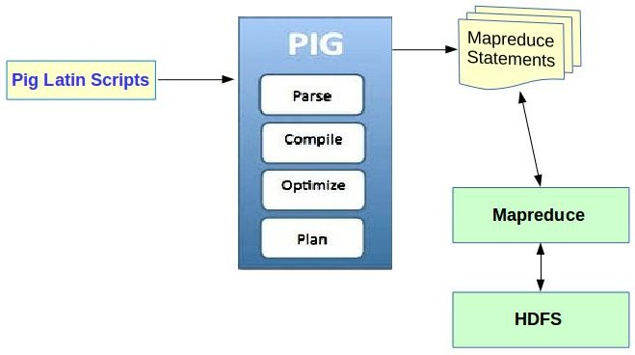
Pig Architecture

Slide 4
Pig Data types
Supports Primitive Data types - int, float, double, long, chararray, bytearray, datetime
Also Special Pig data types
Tuples - Collection of fields (column)
Bag - Collection of Tuples (row)
Map - A set of Key Value pair

Slide 5
Pig commands
Load / Store
Foreach …. Generate → to transform
Group
Sort
Filter
Aggregate → Sum, Avg, Max, Min , Count

Slide 6

Vasu

