Slide 1


Bigdata & Hadoop
by
Vasu

Slide 2

HBase Architecture

Slide 3
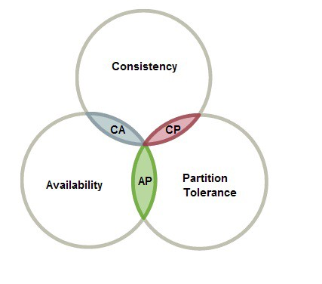
HBase & CAP Theorem

Slide 4
HBase & CAP Theorem
What is CAP Theorem ?
In a distributed System, CAP theorem applies two of the three characteristics, they are:
Consistency, Availability, and Partition
Consistency
Consistency means the clients will see same data from all the node at the same time. Whenever the data is updated in one Node, immediately, data will be parallelly replicated to other nodes in the cluster.
Availability
Whenever a client sends a request for data, any one of the node will respond to fulfil the request even when other nodes are down . No Single point of failure
Partition (tolerance when non-interaction of nodes)
Partition is a partial communication or break-in message in a distributed system – a lost connection among nodes or delayed response resulting message lost or partial data failure.
Partition tolerance will make the cluster continuously working even if there is break in communication between nodes

Slide 5





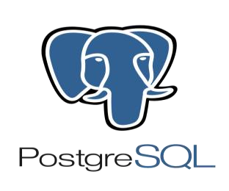









HBase & CAP Theorem
Classification of
NoSQL
Consistency:
All nodes see the
same data at the
same time.
CA
CP
Partition Tolerance:
AP
System continues to
Availability:
operate despite
arbitrary message loss
response whether it is
successful or failed.

Slide 6
HBase Overview
HBase is Hadoop Database
HBase is Distributed , Non-relational Database – Not RDBMS
HBase is NoSQL Database (Not Only SQL)
HBase is a Column-Oriented , Key-Value store NoSQL database
HBase is running on top of HDFS
HBase originated from Google’s Bigtable developed using Java (2010)
HBase uses built-in shell commands to manipulate data which are written in Ruby Shell script
External Phoenix software is used in HBase to execute DDL DML SQL statements to manipulate data

Slide 7
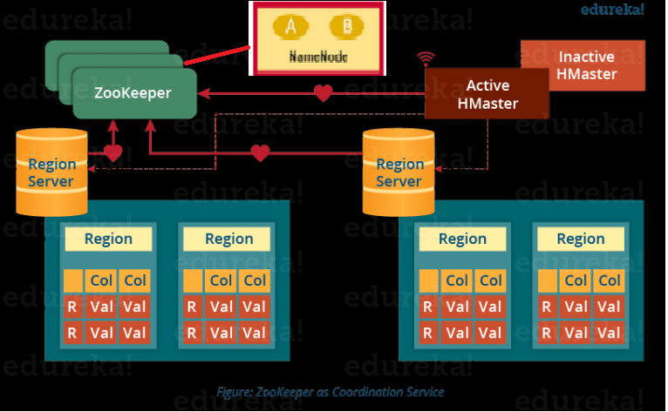
HBase Architecture

Slide 8
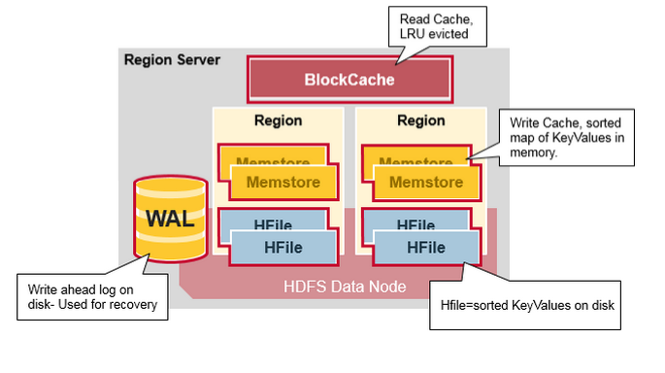
HBase Architecture

Slide 9
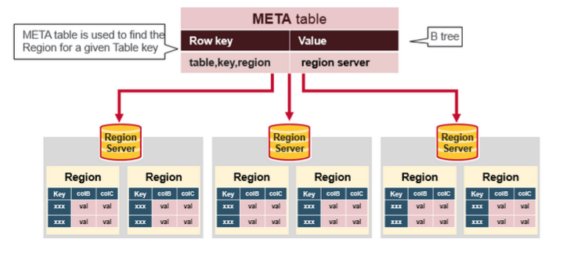
HBase Architecture

Slide 10
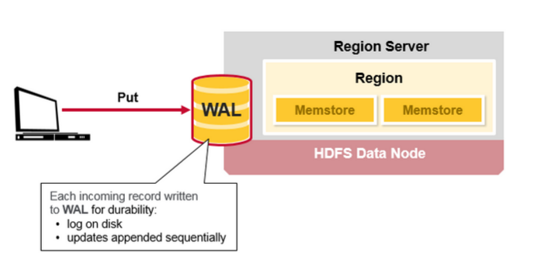
HBase Architecture

Slide 11
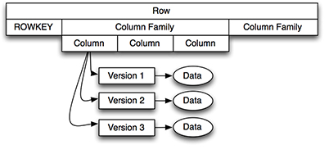
HBase Architecture

Slide 12
HBase Architecture
Regions - Data resides in Regions for read & write . HBase tables are stored
into rows in Regions. Cluster of Region is called Region Server
(A Region server can handle 1000 regions )
Masters - Coordinating with Regions servers and also responsible for executing
DDL Statement - create, delete tables. HMaster takes care of fault-tolerance
Zookeeper - A Co-ordination service between NameNode, Region Server and HMaster
maintains the cluster ,configuration & Metadata (META table)

Slide 13
HBase Architecture
BlockCache - It is a Read cache
MemStore - It is a Key-Value pair Write cache for new data ,before writing into disk
WAL - Write Ahead Log - One per Region Server. New data gets stored in an appended manner
to a log file in disk , Used incase of failure
HFile - File format for storing physical data in terms of Key , Value pair
META Table - A System table used to keep track of Regions which contains the server name and a region
identifier comprising a table name and the start row-key (META table is stored in Zookeeper)
Bloom Filter - An in-memory reference option (array table) to retrieve data from HFile
Tombstone A place where deleted records are maintained. Deleted records are hiden
Encoding - Eliminates data duplication 4-types of encodes are → Prefix, Prefix_Tree, Diff, Fast & Fast_Diff,
Compaction - Combining all relevant small files as one file to enhance performance
Compression - Supports Snappy , LZO, GZip formats

Slide 14
HBase Features
Schema less – No pre-defined schema , Flexible schema creation during runtime
Key Value Store - Each Key points to a array of Value stored as bytes
No data type - Used to store Structured , Semi Structured & Unstructured data. All data will be
stored as byte array type
Large datasets - Utilized to store high voluminous data (Billions of rows & Numerous columns)
Wide-Colum-Stores - Wide column stores are database management systems that organize related
values into columns. Groups of these columns, called “Column Families”
(two-dimensional key-value store)
Data type Byte array
Read & Write - Faster read and re-write (update) access - high through put, low latency &
Consistent
Fail-over - Provides fail-over using WAL . HBase tables are replicated to handle Fail-over
Sharding - A method of Splitting & Storing Single logical datasets into multiple database
nodes Horizontal Partitioning – Storing rows of same table

Slide 15

Vasu

