Slide 1


Bigdata & Hadoop
by
Vasu

Slide 2

Sqoop

Slide 3
Sqoop Architecture
Sqoop is an Import & Export Tool
Sqoop is an interface to transfer data - a command line interpreter
Sqoop Import or extracts RDBMS data to Hadoop HDFS, Hive and NoSQL DB (HBase)
Sqoop Export data from HDFS, Hive and NoSQL back to RDBMS
Sqoop works like ETL Tool - Extraction & Loading
Sqoop means “SQL-to-Hadoop”
Sqoop was initially developed by Cloudera, then later on by Apache (2012)

Slide 4
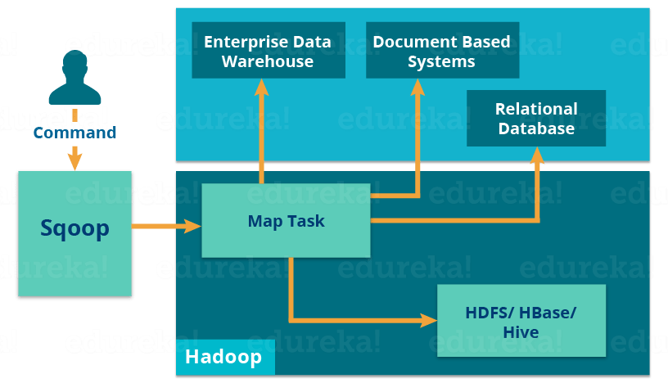
Sqoop Architecture

Slide 5
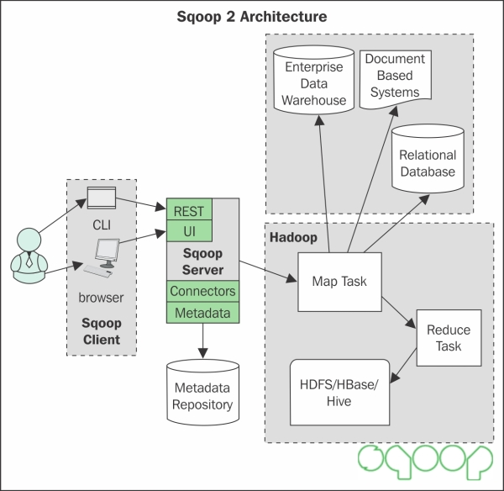
Sqoop Architecture

Slide 6
Sqoop Architecture
Sqoop Driver
JDBC Driver , a Java API, interacts with RDBMS to transfer metadata (schema) & data
Sqoop Connector
Specific SQL connectors to work with Oracle,DB2, Teradata, PostgresSQL & MySQL
Sqoop has many built-in common connectors and also compatible with many direct connectors to integrate with various RDBMS
Work-Flow
Sqoop client , first contacts JDBC driver which uses appropriate Connector to retrieve the data from the relevant RDBMS table
Sqoop uses Map task ( no reducer & aggregation) to store data in HDFS /Hive/HBase

Slide 7
Sqoop Architecture
Sqoop supports various file formats
Text, Sequence (binary file format) ,Parquet, ORC, Avro etc
Text file format is default format
Sqoop supports compression formats
Compression – Snappy, Gzip, Lzo (compression not default – to be enabled)
Sqoop supports Char type line delimiters and field level delimiters
For End-of-line ‘\n’ is the default delimiter, Comma ‘,’ is default field delimiter
Supports -tables
Supports Partitioning

Slide 8
Sqoop features
Sqoop transfer of data from RDBMS like Mysql, Postgres, Oracle, Teradata, DB2 etc.
Sqoop uses low-cost, fast data transfer to Hadoop like ETL (Extract, Load) tool
Sqoop can execute the data transfer in parallel, so execution can be quick and more cost effective.
Sqoop can integrate with sequential data available from IBM Mainframe.
Sqoop uses YARN feature for Fault-tolerance
Sqoop supports Kerberos – Security authentication
Sqoop provides full-load and incremental-load
Sqoop imports multiple tables from a database (all tables) at a time

Slide 9
Performance tuning
-- direct (Sqldump pushes the data instead of JDBC pulls the data)
-- split-by (transfers data based on specific column)
-- num-mapper (used for concurrent task, default is 4)
-- boundry-query (used with range of value – Min <value>& Max <value>)
-- last-value (incremental append)
-- options-file (Reusable arguments)
-- fetch-size (specify the num-of-records to retrieve each time – depending upon
network speed & memory)
-- batch (for exporting multiple files)
-- job (recalls saved import & export commands & parameters – used in incremental
append)

Slide 10

Vasu

