Slide 1
Microsoft Cybersecurity Incidents Classification with Machine Learning
Domain: Cybersecurity and Machine Learning

Slide 2
Objective and Goal
Objective
Enhance the efficiency of SOCs by developing a machine learning model that can accurately predict the triage grade of cybersecurity incidents. Utilizing the comprehensive GUIDE dataset.
Goal
Create a classification model that categorizes incidents as true positive (TP), benign positive (BP), or false positive (FP) based on historical evidence and customer responses
Be robust enough to support guided response systems in providing SOC analysts with precise, context-rich recommendations.

Slide 3
Business Use Cases
Security Operation Centres (SOCs): Automating the triage process by accurately classifying cybersecurity incidents, allowing analysts to respond to critical threats.
Incident Response Automation: Enabling guided response systems to automatically suggest appropriate actions for different types of incidents, leading to quicker mitigation of potential threats.
Threat Intelligence: Improved accuracy in identification of true and false positives.
Enterprise Security Management: Enhanced security posture by reducing false positives

Slide 4
Data Exploration and Understanding
Initial Inspection
Loading the train.csv dataset and perform an initial inspection to understand the shape of the dataframe ,check data types, duplicated records, Target variable distribution and non null record counts.
Exploratory Data Analysis
Statistical summary of numerical data columns and correlations ,missing values ,detect outliers and class imbalances.

Slide 5
Data Pre processing Steps
Handling Missing Data: Dropping columns with more than 80% missing values and Imputation strategies median for numerical and mode for categorical data columns.
Outlier handling : Implemented Inter quartile range method to detect and remove outliers.
Feature Engineering: Creating time date features from timestamp, normalizing data.
Encoding Categorical Variables: One-hot and label encoding.
Feature Scaling: Standardization to ensure equal contribution of features.

Slide 6
Data Splitting and Sampling
Split data into training and validation sets for robust model evaluation.
80-20 train-validation split with stratified sampling.
Outcome: Ensures balanced class distribution across training and validation sets

Slide 7
Model Selection and Training
1.Baseline models
Model Name | Precision | Recall | F1-Score | Accuracy | Use case
Logistic Regression | 0.77(Macro avg) 0.87(Weighted avg) | 0.72(Macro avg) 0.88(Weighted avg) | 0.74(Macro avg) 0.87(Weighted avg) | 88% | Suitable for problems with linear relationships. Limited effectiveness with class imbalance
Decision Tree | 0.86(Macro avg) 0.94(Weighted avg) | 0.87(Macro avg) 0.94(Weighted avg) | 0.87(Macro avg) 0.94(Weighted avg) | 94% | Ideal for problems with non-linear relationships and smaller datasets

Slide 8
2.Advanced Models
Model Name | Precision | Recall | F1 -score | Accuracy | Use case
Random Forest | 0.95(Macro avg) 0.98(Weighted avg) | 0.96(Macro avg) 0.98(Weighted avg) | 0.96(Macro avg) 0.98(Weighted avg) | 98% | Effective for high-dimensional data and capturing complex feature interactions
XG Boost | 0.95(Macro avg) 0.98(Weighted avg) | 0.95(Macro avg) 0.98(Weighted avg) | 0.95(Macro avg) 0.98(Weighted avg) | 98% | Ideal for structured data.
Light GBM | 0.96(Macro avg) 0.98(Weighted avg) | 0.95(Macro avg) 0.98(Weighted avg) | 0.96(Macro avg) 0.98(Weighted avg) | 98% | Excellent for real-time predictions and processing large-scale datasets
Neural Networks | 0.75(Macro avg) 0.88(Weighted avg) | 0.76(Macro avg) 0.88(Weighted avg) | 0.76(Macro avg) 0.88(Weighted avg) | 88% | Best for handling large datasets with non-linear relationships, including image and text data.

Slide 9
Model Evaluation
Evaluation Metrics:
Macro-F1 Score: Measures balanced performance across all classes by averaging the F1 Scores for each class.
Precision (Macro): Evaluates the accuracy of positive predictions by focusing on minimizing false positives across all classes.
Recall (Macro): Assesses the model’s ability to detect actual positives by focusing on maximizing true positive detection across all classes.

Slide 10
Hyper parameter Tuning
Random Search: An efficient method for hyperparameter optimization that samples from a predefined range of hyperparameters randomly, quicker than Grid Search and can find optimal settings by exploring different combinations of parameters.
SMOTE (Synthetic Minority Over-sampling Technique): Addresses class imbalance by generating synthetic samples for the minority class. This technique helps improve model performance by providing a more balanced training dataset and reducing bias towards the majority class.

Slide 11
Tuning Process - Insights
Random Forest: Optimal parameters {'n_estimators': 100, 'min_samples_split': 2, 'min_samples_leaf': 1, 'max_features': 0.75, 'max_depth': 50, 'bootstrap': False} improved the macro-F1 score to 92%. The model achieved 96% accuracy with strong precision and recall across all classes.
Impact of Tuning: Enhanced precision and recall, especially for minority classes, with very few misclassifications in the confusion matrix.
[[ 1607 107 31]
[ 126 1823 46]
[ 204 78 12881]]
Performance: Achieved 96% accuracy, 92% macro-F1 score.

Slide 12
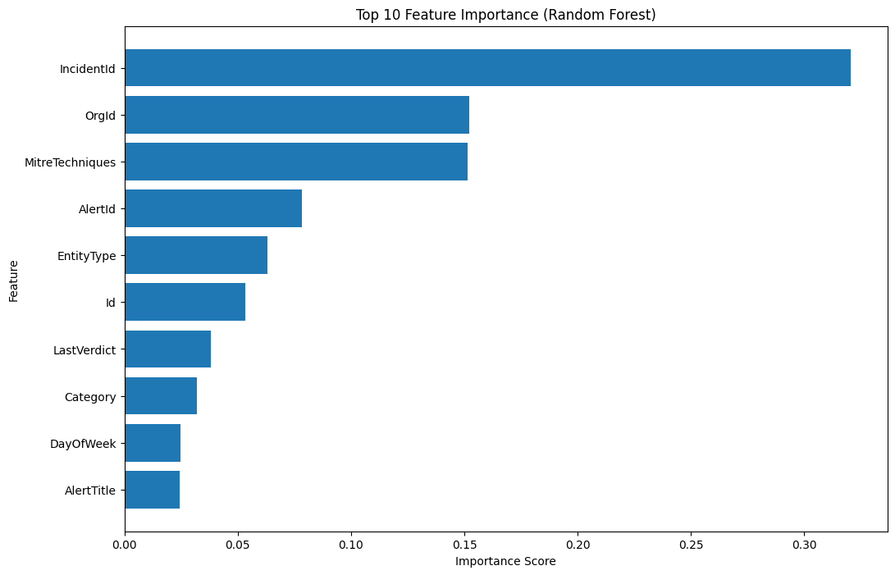
Model Interpretation
Techniques Used:
Feature Importance: Analyzing importance scores derived from Random Forest models.
Error Analysis: Reviewing misclassified cases to identify potential areas for improvement
Top Features:
Incident Id: 0.32
Org Id: 0.15
MITRE Techniques: 0.15
Alert Id: 0.08
Entity Type: 0.06
Impact on Predictions:
Incident Id and Org Id significantly influence the model's classification, particularly in distinguishing between different classes.

Slide 13
Error Analysis and Performance
Total Misclassifications | Accuracy | Precision | Recall | F1-score | Confusion Matrix Summary
592 | 96% | 0.83 (Class 0) 0.91 (Class 1) 0.99 (Class 2) | 0.92 (Class 0) 0.91 (Class 1) 0.98 (Class 2) | 0.87 (Class 0) 0.91 (Class 1) 0.99 (Class 2) | The model is highly accurate. Occasional misclassifications, particularly between classes 0 and 1. Class 2 is predicted with the highest accuracy.

Slide 14
Final Evaluation on Test Set
Macro Precision | Macro recall | Macro f1 score | Accuracy | Confusion matrix summary
0.8353 | 0.8975 | 0.8631 | 94% | High performance across classes with strong generalization
Conclusion:
The model shows robust performance and is suitable for real-world deployment.

Slide 15
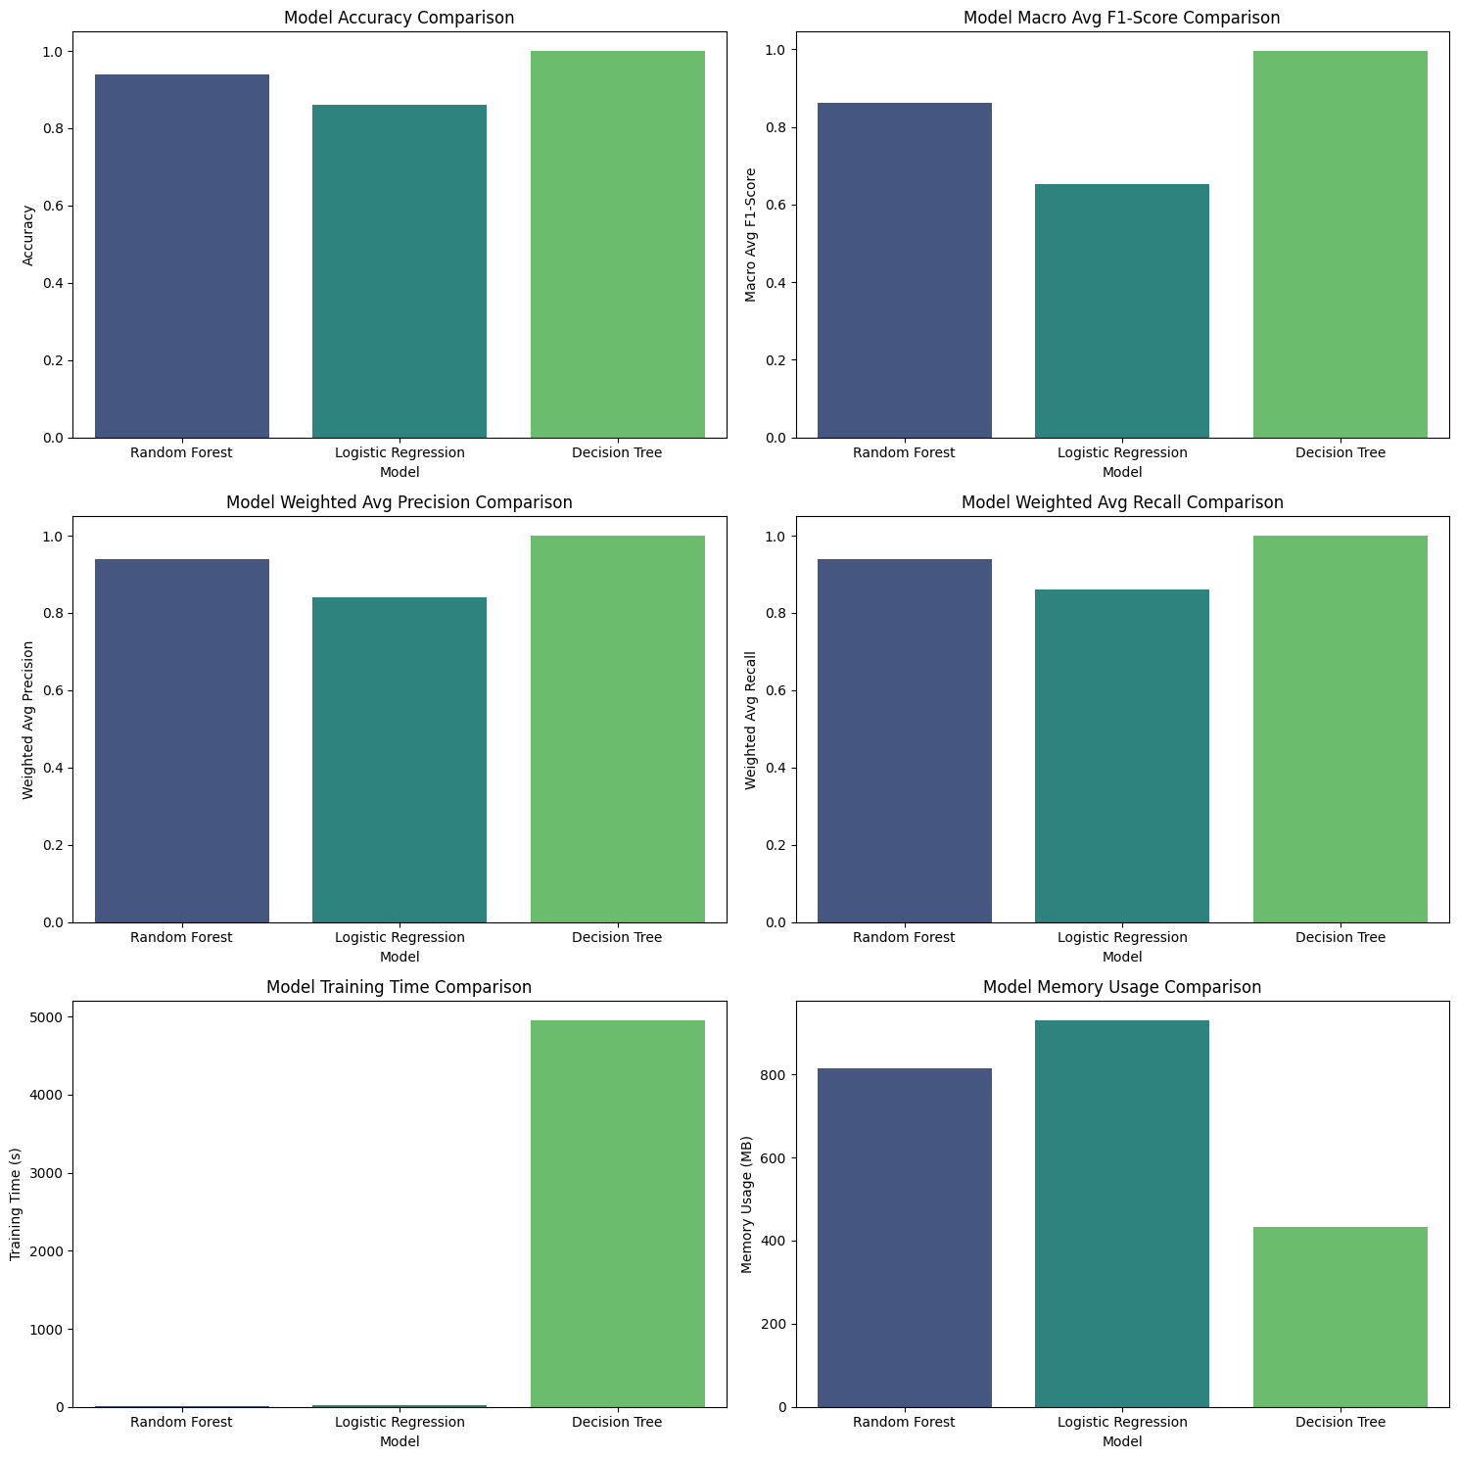
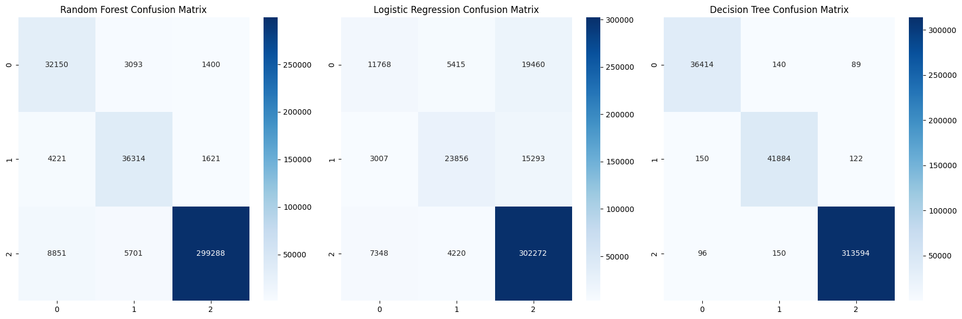
Comparison to Baseline models
Logistic Regression: Accuracy OF 86% , Macro F1-Score is 0.66
Challenges: Higher false positives, lower F1-score
Decision Tree: Accuracy of 100% Macro F1-Score is 0.995
Strengths: High accuracy, but high training time and memory usage
Random Forest: Accuracy of 94% Macro F1-Score is 0.86
Advantages: Significant improvement over baselines, efficient training and memory usage
Summary :
Random Forest shows significant performance gains with a balanced trade-off in efficiency compared to Logistic Regression and Decision Tree.

Slide 16
Business Impact
Enhanced Efficiency: Automated triage reduces workload on SOC analysts.
Improved Accuracy: Lower false positive rates ensure real threats are prioritized.
Scalable Solution: Models like Random Forest and XGBoost can be integrated into existing systems with minimal modifications.

Slide 17
CONCLUSION
Challenges faced | Solutions implemented | Recommendations | Future enhancement
Data Imbalance: Majority class (Benign Positive) dominating, causing skewed predictions. | Techniques like SMOTE and class weighting | Deploy the Random Forest model to automate triage and enhance response times. | Continuous Learning: Implementing online learning algorithms to adapt to new data in real-time.
Model Overfitting: Initial models overfitted due to class imbalance and irrelevant features. | Cross-validation, regularization, and pruning | Increase data collection, especially for minority classes, to improve model robustness. | Model Optimization: Exploring advanced models like BERT for text analysis in incident descriptions
High Dimensionality: Many features with potential noise, requiring careful feature selection. | Feature selection :Dimensionality reduction and importance analysis to identify key features | Continuous monitoring of model performance to adapt to evolving threats. | Feature Engineering: Further exploration of new features, particularly those derived from domain knowledge

Slide 18
Thank You !

