Slide 1
STATISTICAL ANALYSIS ON HISTorical WEATHER DATA OF SANTA BARBARA,UNITED STATES.
BY HARSHITHA SEELAMANTHULA
seelamanthulaharshitha@gmail.com

Slide 2

CONTENTS
INTRODUCTION
DATA DESCRIPTION
DATA CLEANING AND FORMATTING
DATA VISUALISATION
STATISTICAL ANALYSIS
CONCLUSION
END

Slide 3

INTRODUCTION
The main objective of this analysis is to draw meaningful insights from the dataset using MS EXCEL
It is a Historical weather data of Santa Barbara, a city on the central California coast , United States.
The dataset was collected from ‘Kaggle’ website.

Slide 4
DATA DESCRIPTION
This data was collected manually from Weather Underground.
Variables contained are: Date, Average Temperature (ºF), Average Dew Point (ºF), Average Humidity (%), Maximum Wind Speed (mph), Average Wind Speed (mph), Average Pressure (in Hg), Precipitation (in). Variables were measured daily.

Slide 5

DATA CLEANING AND FORMATTING:
DATA CLEANING:
As observed from the data set, the values of the year 2015
were recorded from middle of the year. This may cause some
inefficiency to our analysis , so we remove records of 2015.
The actual dataset is considered from the year 2016-2022.
CONDITIONAL FORMATTING:
Using the Filter function in MS excel, we check for the null values
in the records in each column . This also helps to understand the
range of values in each variable.

Slide 6
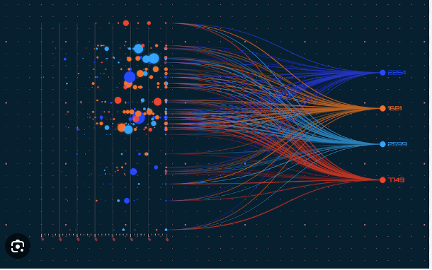
DATA VISUALISATION:
Visualizing data helps us to understand the distribution of
data points .This gives us clear understanding of hidden
patterns.
Taking the leverage of Pivot tables, visuals are created
between vivid variables from the data set such as

Slide 7
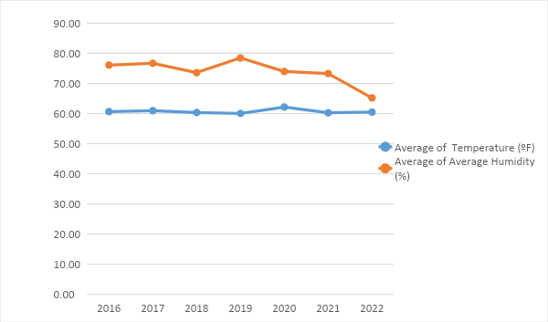
1.TEMPERATURE VS HUMIDITY
From the above graph, the pattern of temperature and humidity over the years has been constant approaching to similar point in the year of 2022.

Slide 8
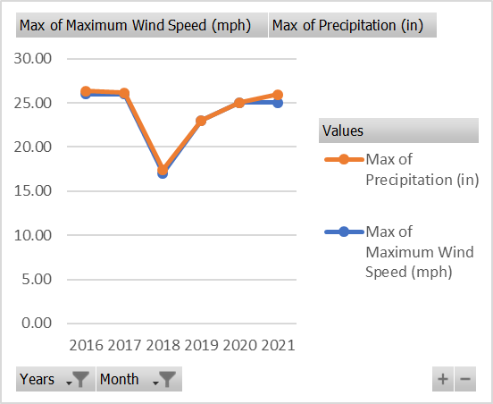
2.WINDSPEED VS PRECIPITATION
In general the relation between Windspeed and Precipitation goes hand in hand.
For this data , we can show their relation by calculating the Correlation Coefficient.
So the Coefficient obtained was 0.1505 which shows a positive and decent relation.
Graphically it is shown as

Slide 9
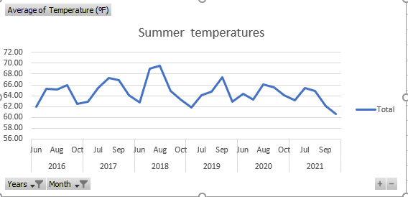
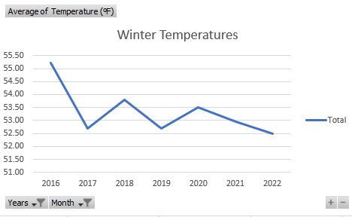
3.Summer and Winter Temperatures.
To know the distribution of temperature during summers in Santa Barbara in the months of Mid July to Early Octobers, We use pivots to filter out the months required and for Winter temperatures during Dec-Feb.

Slide 10
STATISTICAL ANALYSIS
Statistical Analysis involves Regression analysis , Forecasting time series.
What is Regression?
Regression analysis is a powerful statistical method that allows you
to examine the relationship between two or more variables of interest.
From the data , the relationship between variables can be shown with Regression Coefficients such as Windspeed vs Precipitation(Linear) , Humidity vs Temperature , Pressure(Multiple)

Slide 11
Forecasting the data:
Time series forecasting is a technique for the prediction of events through a sequence of time. It predicts future events by analyzing the trends of the past, on the assumption that future trends will hold similar to historical trends.
It involves building models through historical analysis and using them to make observations and drive future strategic decision-making.

Slide 12
HYPOTHESIS TESTING:
NULL HYPOTHESIS H0:There is no significant relation between Windspeed and precipitation
ALTERNATE HYPOTHESIS H1:There is a significant relation between the variables.
REGRESSION ANALYSIS:
1)Linear regression , which is between two variables.
Regression analysis between WINDSPEED VS PRECIPITATION:
OUTPUT INTERPRETATION:
1)Multiple R=0.1505.The maximum Windspeed has positive coefficient . It implies that R too has a positive sign . So they are positively related.
2)R^2=0.0226.It shows 2.3% variation explained by Y with respect to X.
3)Significant F=4.752E-13 ~ 0.00
So , P(0.00)<Alpha(0.05) Reject H0 which is H0:There is no significant relation between Windspeed and Precipitation.
SUMMARY OUTPUT
Regression Statistics
Multiple R | 0.150548
R Square | 0.022665
Adjusted R Square | 0.022236
Standard Error | 0.20496
Observations | 2284
ANOVA
 | df | SS | MS | F | Significance F
Regression | 1 | 2.223104 | 2.223104 | 52.920395 | 4.75246E-13
Residual | 2282 | 95.86331 | 0.042008
Total | 2283 | 98.08641
 | Coefficients | Standard Error | t Stat | P-value | Lower 95% | Upper 95% | Lower 95.0% | Upper 95.0%
Intercept | -0.05216 | 0.013161 | -3.96347 | 7.614E-05 | -0.077974054 | -0.02636 | -0.07797 | -0.02636
Maximum Wind Speed (mph) | 0.00724 | 0.000995 | 7.274641 | 4.752E-13 | 0.005288111 | 0.009191 | 0.005288 | 0.009191

Slide 13
4)The Regression equation of the form : Y=beta0+betaX.
Y=-0.052+0.0072X
5)Inference: We conclude that There is a significant relation between Windspeed and Precipitation.
2)Multiple regression , which is for more than two variables.
Regression analysis between HUMIDITY VS TEMPERATURE,PRESSURE:
OUTPUT INTERPRETATION:
1)Multiple R=0.060 is positive . But the coefficients of temperature and Pressure are negative.
So , r must be negative . This shows there may be negative relation between the variables.
2)Coefficient of determination R^2 is 0.0036.This shows 0.36% of variation in Y is explained by X1,X2.

Slide 14
HYPOTHESIS TESTING:
NULL HYPOTHESIS H0:There is no significant relation between the variables.
ALTERNATE HYPOTHESIS H1:There is a significant relation between the variables.
3)Significant F=0.0162.So.P(0.0162)<alpha(0.05)
REJECT H0.
4)The regression equation of the form:
Y=beta0+betaX1+beta2X2.
Y=128.527-0.0018X1-1.8091X2.
5)Inference : We conclude that there is significant relation between the variables.
6) From the table, P value of temperature is 0.969. which is > 0.05.So temperature is not a significant factor to humidity.
SUMMARY OUTPUT
Regression Statistics
Multiple R | 0.060037793
R Square | 0.003604537
Adjusted R Square | 0.002730889
Standard Error | 13.74743507
Observations | 2284
ANOVA
 | df | SS | MS | F | Significance F
Regression | 2 | 1559.503451 | 779.7517 | 4.1258458 | 0.016270511
Residual | 2281 | 431090.6859 | 188.992
Total | 2283 | 432650.1894
 | Coefficients | Standard Error | t Stat | P-value | Lower 95% | Upper 95% | Lower 95.0% | Upper 95.0%
Intercept | 128.5270524 | 19.45194243 | 6.607415 | 4.852E-11 | 90.38170499 | 166.6724 | 90.3817 | 166.6724
Temperature (ºF) | -0.001879367 | 0.048993843 | -0.03836 | 0.9694046 | -0.097956516 | 0.094198 | -0.09796 | 0.094198
Average Pressure (inHg) | -1.809186181 | 0.632338516 | -2.8611 | 0.0042601 | -3.049204882 | -0.56917 | -3.0492 | -0.56917
7) P value of pressure is 0.004.which is less than 0.05.So
Pressure is significant factor for humidity

Slide 15
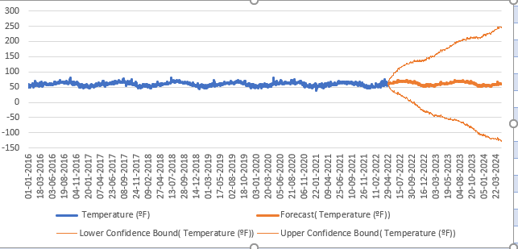
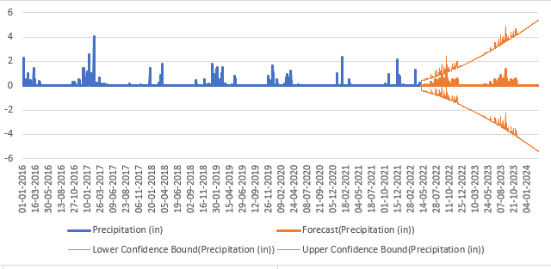
Forecasting the weather data
Using the “Forecast sheet” in Excel , one can predict future values of any variable with respect to time:
Here Temperature and Precipitation are predicted until the year 2024.
So , this helps to get to know the crucial pattern to be prepared for any calamities.
This was the analysis done on the WEATHER DATA OF YEAR 2015-2022.This might be just a drop in a ocean of performing
analysis statistically.

Slide 16
THANK YOU!

