Slide 1
REVA FAQ Chatbot
From Web Scraping to AI-powered Chatbot with Azure and LangChain
Harshith D

Slide 2
Project Overview
Goal: Create a chatbot that answers FAQs from REVA University’s website
Tech Stack: Python, BeautifulSoup, Pandas, Azure Table Storage, Azure AI Search, Streamlit, LangChain, Azure OpenAI
Process Flow:
1. Scrape data from website
2. Store in Azure Table Storage
3. Index with Azure Cognitive Search
4. Query with AI chatbot

Slide 3
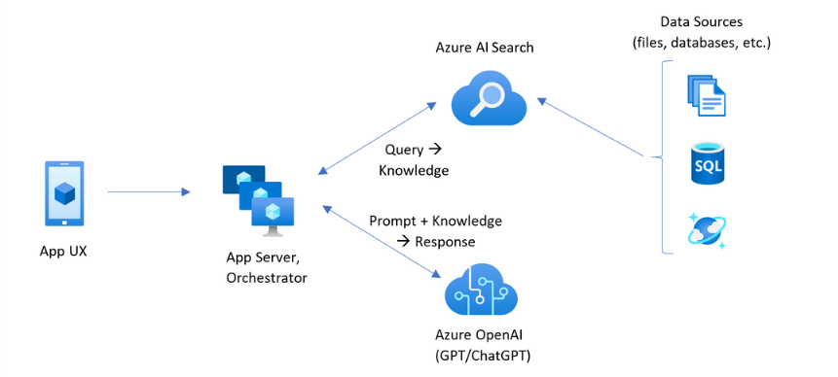
Final Architecture Diagram
Flow:
1. Website → Web Scraper → CSV
2. CSV → Azure Table Storage
3. Table Storage → Azure Cognitive Search (Index)
4. Streamlit → LangChain → Azure OpenAI → User

Slide 4
Step 1: Web Scraping
Tool Used: requests + BeautifulSoup
Purpose: Extract FAQ questions & answers from https://www.reva.edu.in/faq
Key Code Points:
- Identify HTML tags for Q&A
- Handle collapse panels in Bootstrap
- Save to CSV (reva_faq_output.csv)
Output: CSV with columns Question and Answer

Slide 5
Step 2: Storing in Azure Table Storage
Tool Used: azure.data.tables
Purpose: Store structured FAQ data for indexing
Key Code Points:
- Create Azure Table if not exists
- Use PartitionKey and RowKey (UUID for uniqueness)
- Insert rows from CSV into table
Benefits: Scalable NoSQL storage for structured search

Slide 6
Step 3: Indexing with Azure Cognitive Search
Purpose: Enable keyword & semantic search over FAQs
Steps:
1. Create an index in Azure AI Search (azuretable-index)
2. Add data source → Azure Table Storage
3. Create indexer to sync data
Fields:
- Question (searchable)
- Answer (retrievable)
Output: Search-ready dataset for chatbot

Slide 7
Step 4: Building the Chatbot (Streamlit + LangChain)
Tool Used: Streamlit UI + LangChain pipeline
Retriever: AzureAISearchRetriever → fetch top 3 answers from azuretable-index
LLM: AzureChatOpenAI → format and generate friendly answers
Prompt Template:
Context: {context}
Question: {question}
User Flow:
1. User types question
2. Retriever fetches relevant docs
3. LLM answers based on context

Slide 8
Benefits & Future Enhancements
Benefits:
- Automated FAQ updates
- Scalable Azure backend
- AI-powered answers
Future Enhancements:
- Multi-language support
- Voice chatbot integration
- Real-time FAQ sync

Slide 9

Thank You

