Slide 1




PARTICIPANT PRESENTATION
Participant Details
Qiskit
Fall Fest
2026
PROJECT TITLE
Quantum-Assisted Traffic Signal Optimization Using QAOA
TRACK
Hackathon
TEAM NAME
NULL POINTER
TEAM LEADER
Harshit Kumar
EMAIL / CONTACT
harshitkumar3005@gmail.com
Hackathon · Team Details
TEAM MEMBERS
Harshit Kumar (Team Lead) · Himansu Rauniyar · Aditya Pattar
INSTITUTION / ORGANISATION
SIT Tumkur · Dept. of CSE
COUNTRY
India

Slide 2
Problem Statement
Fixed timers waste everyone's time
83.5 s
• Most city signals still run fixed timers, blind to the queues in front of them.
• At rush hour, green time goes to empty roads while the busy road backs up.
• Timing N signals over T slots is combinatorial: 2^{N·T} possible plans, re-decided every 30 s.
average wait per vehicle with fixed timers at rush hour (our 2×2 simulation)
2³²
Problem: how do we choose every signal's phase, every 30 s, to minimise waiting across the whole grid, and can QAOA solve it?
possible plans for a 4×4 grid planned just one minute ahead

Slide 3
Objectives & Novelty
Objectives
What's new
1
Model a city signal grid as a QUBO / Ising problem.
Signal timing, not routing. Earlier quantum traffic work optimises routes; we time the lights.
Green waves emerge. Squared predicted queues couple neighbours; nothing is hand-coded.
QAOA in closed loop. Tested as a live controller on a traffic simulator, deployed online.
2
Solve it with QAOA, built and simulated in Qiskit.
3
Run QAOA as a live controller that re-plans every 30 s.
4
Benchmark quality, cost, scalability and noise vs classical.

Slide 4
Solution & Quantum Advantage
Read queues
›
Predict
›
QUBO
›
QAOA
›
Apply 30 s
One qubit per signal per slot: |0⟩ = north–south green, |1⟩ = east–west green. Cost = Σ squared queues + switching penalty → Ising H = Σ hZ + Σ JZZ.
Why quantum
• The QUBO is the native input of QAOA.
• One circuit holds all 2^{n} plans in superposition.
• Depth p trades circuit cost for quality.
Quantum advantage: honest status
• No speed-up yet: brute force solves 18 qubits in 0.1 s.
• We show feasibility: optimal plans, robust to noise.
• The pipeline is hardware-ready as devices grow.

Slide 5
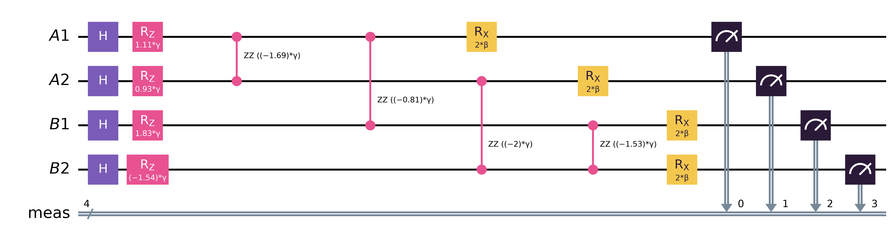
Algorithm & Circuit Design
H superposition of every plan
RZ · RZZ (γ) queue pressure + couplings to neighbours and next slot
RX (β) mixer between plans
Measure 1024 shots, keep the cheapest plan
Trained with COBYLA + INTERP; p = 1–4. At 8 qubits, p = 2: 80 CNOTs, depth 75.
H = Σ h_{k} Z_{k} + Σ J_{kl} Z_{k}Z_{l} |γ,β⟩ = Π e^{−iβΣX} e^{−iγH} |+⟩^{⊗n}
Fig.: one QAOA layer for a 2×2 grid (qubits A1–B2), drawn with qc.draw("mpl").

Slide 6
Implementation & Tech Stack
Tech stack
How it is built
Python 3.11
core language
Qiskit 2.x
circuits · Statevector
qtraffic/ package: network, simulator, QUBO formulation, QAOA solver, controllers.
Benchmarks: 4 scenarios × 5 controllers, 3 seeds; up to 32-qubit circuit analysis.
Quality: 26 automated tests, GitHub Actions CI, MIT licence.
Live: qtraffic.harshithk.tech
Qiskit Aer
noisy shot simulation
NumPy · SciPy
QUBO maths · COBYLA
Streamlit
live dashboard
Docker · nginx
deployed on our VPS

Slide 7
Results & Analysis
−64%
wait vs fixed timers at rush hour (83.5 → 30.2 s); 12% below actuated.
100% optimal plans found up to 12 qubits
0.85 → 0.93 approx. ratio as p goes 1 → 4
1% noise still optimal on Qiskit Aer
Limit: classical solvers are still faster at this size.

Slide 8
Impact & Real-World Applications
1
Commuters
2
Cities
3
Quantum community
• Shorter waits at busy junctions.
• Less idling, so less fuel burnt and fewer emissions.
• Smoother green waves along arterials.
• Adaptive control for smart-city corridors.
• Handles event and emergency surges.
• Reuses existing queue detectors.
• A real-world QUBO benchmark for QAOA.
• Open source (MIT) and reproducible.
• Ready for IBM Quantum hardware.

Slide 9
Challenges & Future Scope
Challenges we hit
Future scope
P(optimum) shrinks as qubits grow, so sampling matters.
CNOT count grows with the city: 32 qubits ≈ 450 CNOTs at p = 2.
Noise above 1–2% visibly lowers solution quality.
Aer crashed in containers; fixed by tuning glibc's TLS reserve.
1
Run on IBM Quantum via Qiskit Runtime with error mitigation.
2
Split cities into corridors that fit on one device.
3
Real traffic data: SUMO and live detector feeds.
4
Richer model: turning movements and pedestrians.

Slide 10
CLOSING
Thank You
Questions?
Inspiring Minds. Shaping Tomorrow.
GITHUB REPOSITORY
github.com/Harshithk00/Vhack
DEMO VIDEO LINK
vhack.harshithk.tech
Live dashboard: qtraffic.harshithk.tech
Team NULL POINTER · Harshit Kumar (Lead) · Himansu Rauniyar · Aditya Pattar

