Slide 1





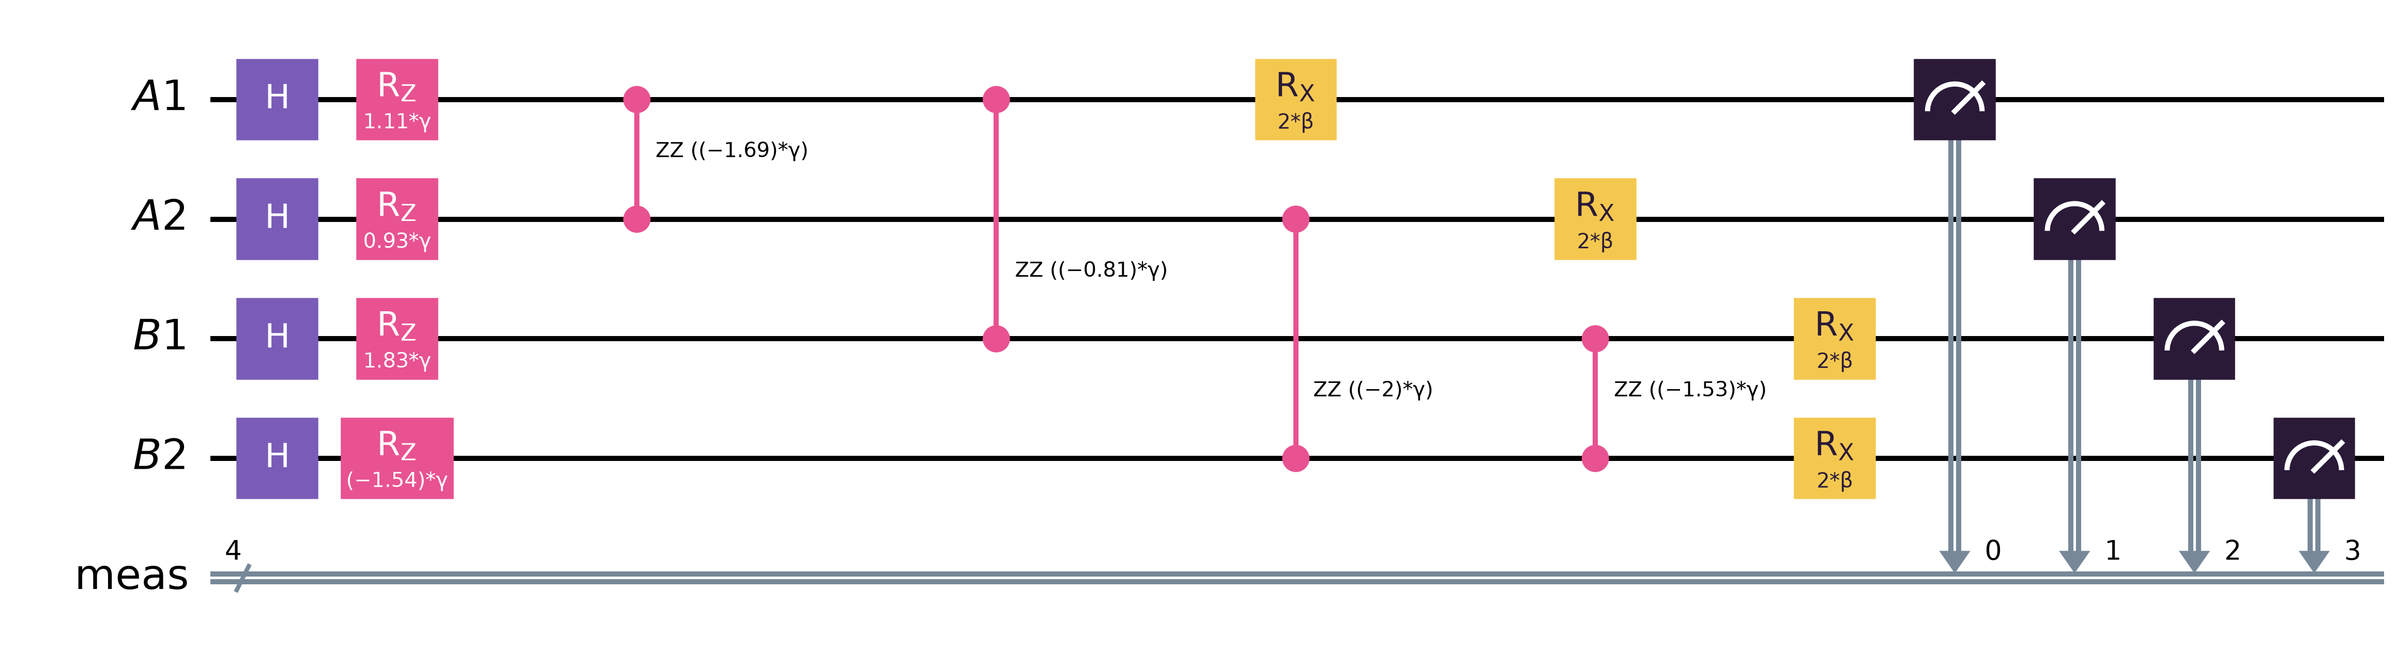
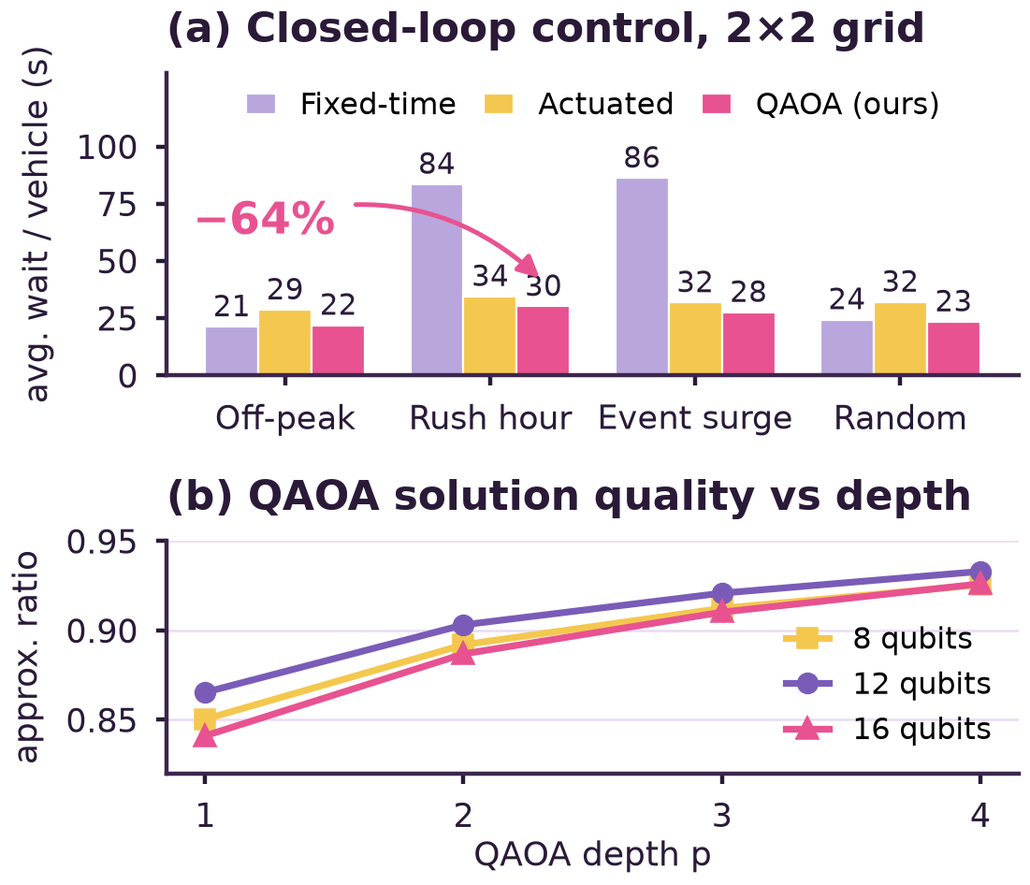
Poster no: ____
VTU HOSTS · IBM QUANTUM PRESENTS
Quantum-Assisted Traffic Signal Optimization Using QAOA
Hackathon Track | Team NULL POINTER | Harshit Kumar (Lead), Himansu Rauniyar, Aditya Pattar | CSE, SIT Tumkur
Introduction & Motivation
Background: Congestion wastes time, fuel and clean air, yet most city signals still run fixed timers that ignore real queues.
Problem Statement: Timing N signals over T slots is combinatorial: there are 2^{N·T} possible plans, re-decided every 30 s.
Objective: Solve signal timing with QAOA in Qiskit and test it as a live controller against classical methods.
Research Gap / Existing Challenges
Proposed Methodology / Framework
• Today's signals optimise each junction alone.
• Quantum traffic work targets routing [3, 4].
• QAOA is rarely tested as a live controller.
Receding-horizon control loop, every 30 s:
1. Encode: one qubit per signal per slot (x = 1 → E–W green).
2. Predict queues for T slots, linear in x; build the QUBO.
3. Map to Ising H_{C}; train QAOA angles γ, β with COBYLA.
4. Sample 1024 shots; apply the cheapest plan for 30 s.
5. Re-plan with live queues, warm-starting the angles.
Baselines: fixed-time, actuated, simulated annealing, exact.
System Architecture / Implementation
1. Circuit: H → RZ/RZZ cost → RX mixer, × p layers.
2. Scale: 4–16 qubits, p = 1–4; 8 qubits at p = 2: 80 CNOTs, depth 75.
3. Stack: Qiskit 2.x, Aer noise model, COBYLA + INTERP [2].
4. Readout: 1024 shots → cheapest plan applied.
Applications / Use Cases
• Adaptive signals for smart-city corridors.
• Event and emergency traffic surges.
• A real-world QUBO benchmark for QAOA on IBM Quantum.
Theoretical Model / Algorithm
Demo video + live app
QUBO cost: E(x) = Σ_{i,t} (Q²_{NS} + Q²_{EW}) + w · switches
Ising Hamiltonian (x = (1−Z)/2):
H = Σ h_{k} Z_{k} + Σ J_{kl} Z_{k}Z_{l}
QAOA state (p layers): |γ,β⟩ = Π e^{−iβΣX} e^{−iγH} |+⟩^{⊗n}
Squared queues couple neighbours, so green waves emerge.
Conclusion & Key Contributions
1. QAOA found the optimum on every instance ≤ 12 qubits.
2. −64% wait vs fixed timers at rush hour (83.5 → 30.2 s).
3. Optimal even at 1% gate noise; quality 0.85 → 0.93.
Honest limit: classical solvers are still faster at this size.
Experimental Results
Future Work
1. Run on IBM Quantum hardware via Qiskit Runtime.
2. Split cities into corridors that fit one device.
3. Real data: SUMO and live detector feeds.
Acknowledgement
We thank Visvesvaraya Technological University, IBM Quantum, the Qiskit community and the Dept. of CSE, SIT Tumkur.
References
1. E. Farhi, J. Goldstone, S. Gutmann, arXiv:1411.4028 (2014).
2. L. Zhou et al., Phys. Rev. X 10, 021067 (2020).
3. F. Neukart et al., Front. ICT 4, 29 (2017).
4. Hybrid QAOA for traffic congestion, arXiv:2504.08275 (2025).
Fig. 1: (a) Avg. wait, 3 seeds; (b) QAOA quality vs depth p.
Visvesvaraya Technological University
Qiskit Fall Fest 2026
Poster Presentation

