Slide 1
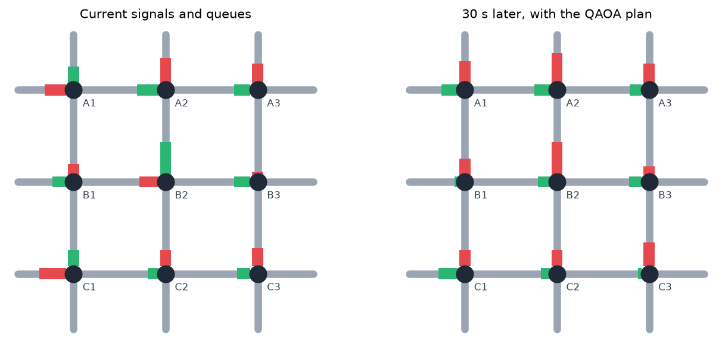
Fixed-timer traffic lights waste everyone's time
Quantum-Assisted Traffic Signal Optimization using QAOA
Most city signals still run on fixed timers, blind to the queues in front of them
At rush hour, green time goes to empty roads while the busy road backs up
Coordinating signals is combinatorial: 4 signals planned 1 minute ahead already have 256 possible plans
83.5 s
2³²
average wait per vehicle with fixed timers at rush hour (our simulation, 2×2 grid)
possible signal plans for a 4×4 grid, one minute ahead
A 3×3 grid: queues now (left) and 30 s later with our QAOA plan (right)
Watch the demo: vhack.harshithk.tech
Notes:
Hi, I'm Harshit Kumar, team lead of team NULL POINTER from CSE at SIT Tumkur. Most signals run on fixed timers. In our simulation of a 2x2 grid at rush hour, fixed timers make each vehicle wait 83.5 seconds on average. Coordinating many signals is a combinatorial problem: the number of plans explodes as 2 to the power of signals times time slots.

Slide 2





Each signal becomes a qubit, and QAOA picks the plan
Our approach
Read queues
Predict
QUBO
QAOA
Apply
Live queue length on every approach, every 30 seconds
Queues for the next 1–3 slots, linear in the signal bits
Cost = Σ squared queues + switching penalty
Ising Hamiltonian minimised by a Qiskit circuit
Best sampled plan runs for 30 s, then re-plan
One qubit per signal per 30-s slot
|0⟩ = north–south green |1⟩ = east–west green
4 signals × 2 slots = 8 qubits = 256 plans explored at once
E(x) = Σ (Q_NS² + Q_EW²) + w · switches
Squaring the queues couples a signal to its neighbours, so green waves emerge on their own instead of being hand-coded.
Notes:
Every signal in every 30-second slot is one qubit: 0 means north-south green, 1 means east-west green. We predict the queues, build a QUBO whose cost is the squared queues plus a switching penalty, convert it to an Ising Hamiltonian and solve it with QAOA in Qiskit. The best plan runs for 30 seconds, then we re-plan with fresh data.

Slide 3
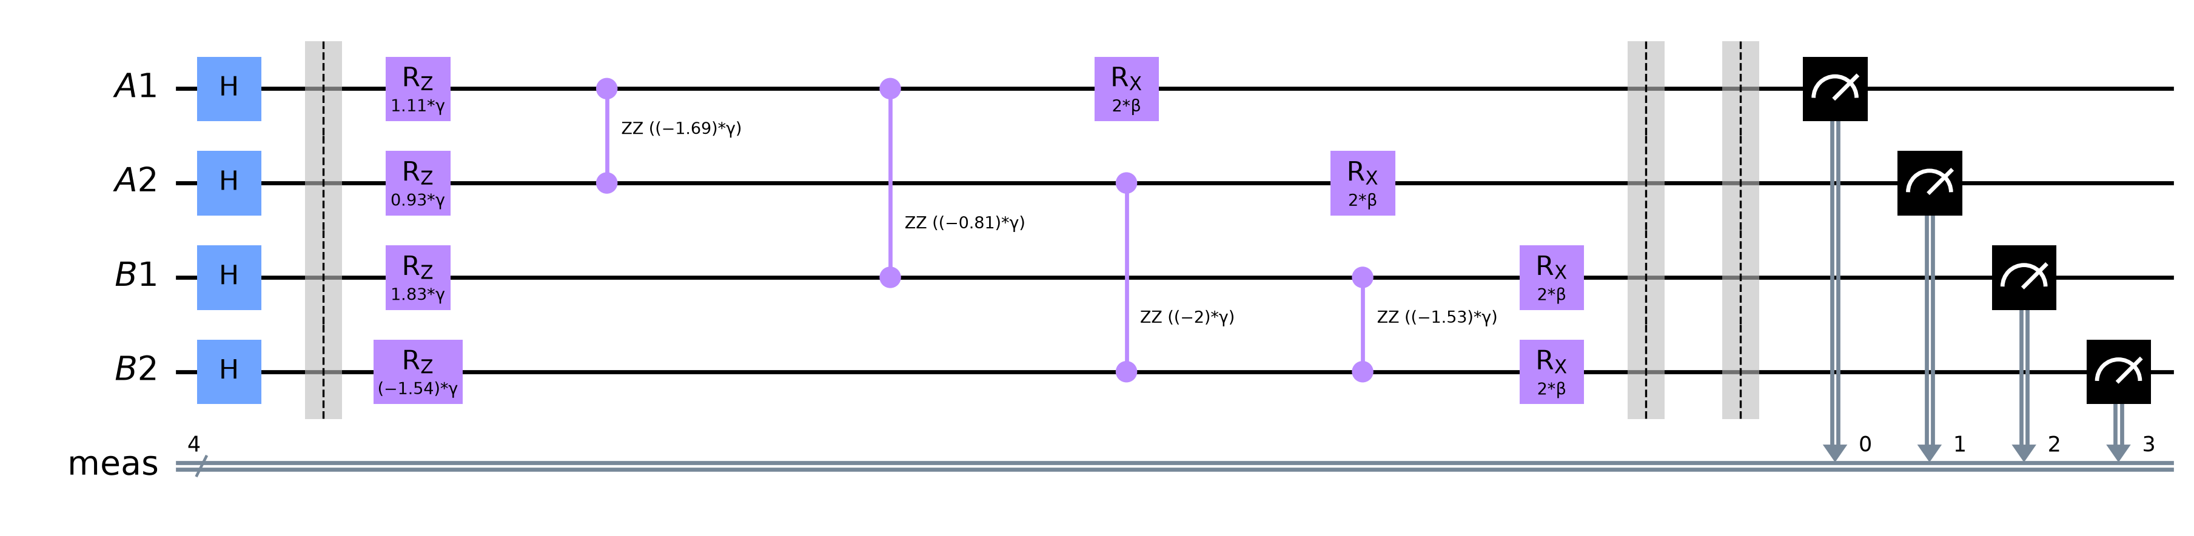
Cost layer, mixer, measure: one QAOA layer for 4 signals
The quantum circuit
H
RZ · RZZ (γ)
RX (β)
Measure
Superposition of every possible plan
Cost: each signal's queue pressure, plus couplings to neighbours and next slot
Mixer: lets probability move between plans
Sample 1024 shots, keep the cheapest plan
Notes:
This is the real Qiskit circuit for one QAOA layer on a 2x2 grid. Hadamards create a superposition over all plans. RZ gates encode each signal's queue pressure and RZZ gates encode the couplings between neighbours. RX is the mixer. COBYLA trains the angles gamma and beta, and we sample the circuit to pick the cheapest plan. At depth p=2 for 8 qubits the circuit has 80 CNOTs and depth 75 after transpiling.

Slide 4
QAOA control cuts rush-hour waiting by 64%
Results · 30 min of simulated traffic, 3 seeds
−64%
wait vs fixed timers at rush hour (83.5 s → 30.2 s)
100%
optimal plans found by QAOA up to 12 qubits
0.85 → 0.93
approximation ratio as depth p goes 1 → 4
1% noise
QAOA still finds the optimum on Qiskit Aer
Notes:
Same random arrivals for every controller. In light traffic QAOA ties fixed timers; under heavy or uneven traffic it beats both fixed-time and actuated control, and matches the exact brute-force optimum. Deeper circuits improve the approximation ratio from 0.85 to 0.93, and it still finds the optimum with 1 percent gate noise. Honest limit: at this size classical solvers are faster.

Slide 5



From simulation to real streets
Next steps
Run on IBM Quantum
Split the city
Real traffic data
Same circuit through Qiskit Runtime on real hardware, with error mitigation
Decompose large grids into corridors that each fit on one quantum device
Connect to SUMO and live detector feeds instead of simulated arrivals
Try it yourself
Demo video vhack.harshithk.tech
Live dashboard qtraffic.harshithk.tech
Code (MIT) github.com/Harshithk00/Vhack
Team NULL POINTER Harshit Kumar (Team Lead) · Himansu Rauniyar · Aditya Pattar
Notes:
Next: run the same circuit on IBM Quantum hardware, split real cities into corridors that fit on a device, and connect to SUMO and live detector data. The demo video, the live dashboard and the MIT-licensed code are all linked here. Thank you from team NULL POINTER.

