Slide 1
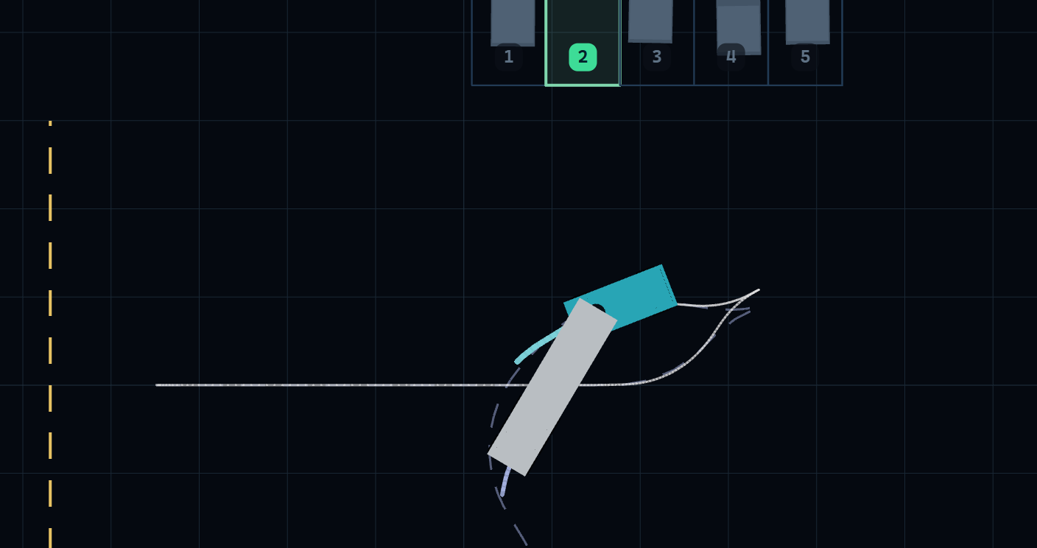
Robotics · Semester 3 · Group B9
Model Predictive Control for Automated Reverse Docking
Trajectory tracking and constraint management of an articulated tractor-trailer, with step-by-step driver guidance
Harshith KV AID25119
G Venugopalan AID25115
Rithvik Arulprakash AID25148
Vipin Sudhakar AID25166
Notes:
Title. Group B9. Same project as our first review, now completed: a model-predictive controller that reverses a tractor-trailer into a parking bay without jackknifing, and turns its output into instructions a human driver can follow.

Slide 2
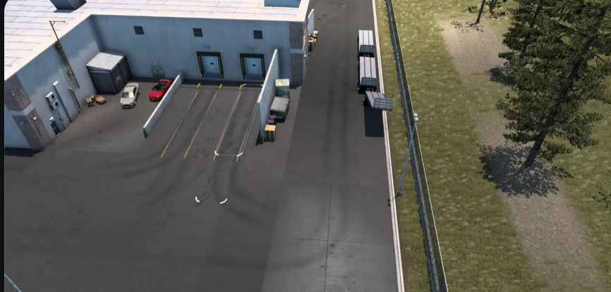
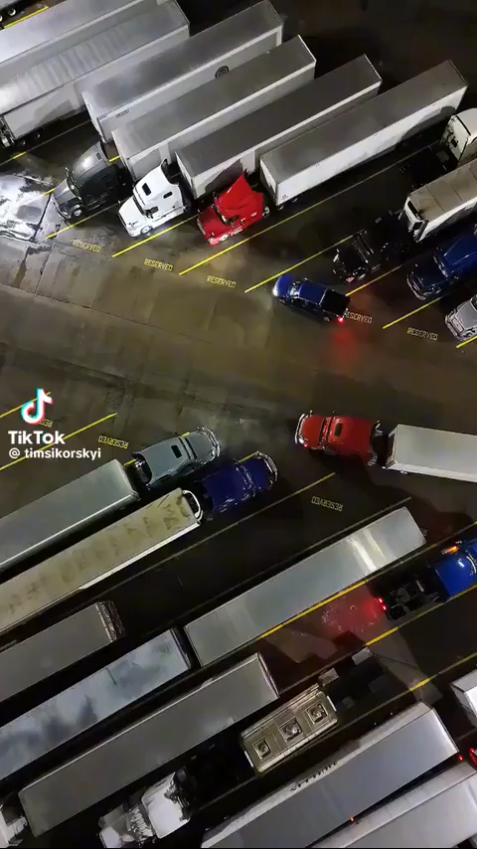
Introduction: reverse docking in real yards
Reversing to a warehouse dock
Long trailer, tight bays, blind spots
Every docking ends in reverse
Introduction
Notes:
Two clips from our first review. Left: a tractor-trailer reversing to a warehouse dock. Right: a crowded truck lot. In both, the final manoeuvre is a reverse, where the driver cannot see the trailer end and the vehicle is unstable. Click a clip to play it.

Slide 3
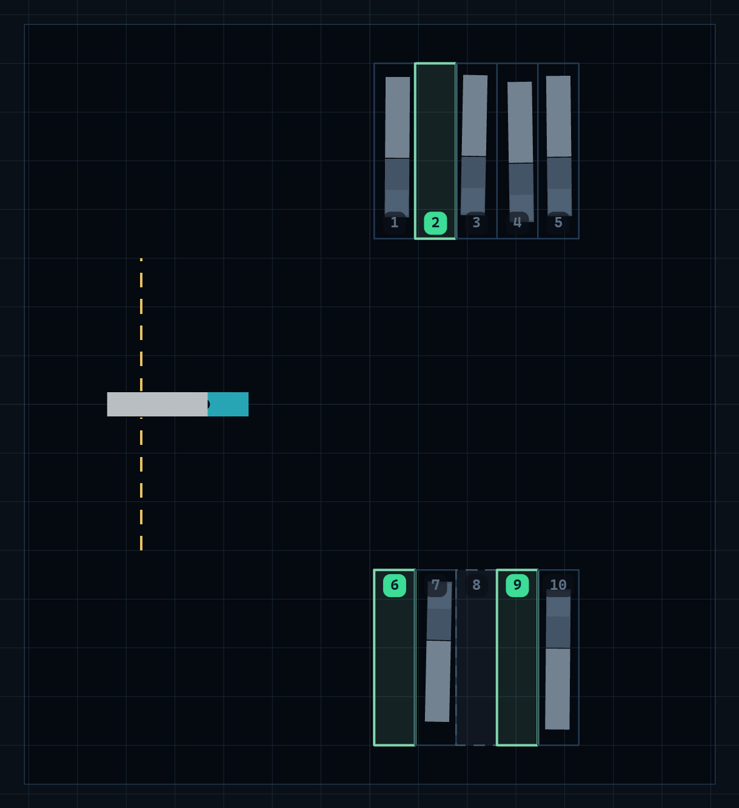
The core challenge: kinematic instability
Forward: the trailer self-aligns (stable)
Reverse: an inverted pendulum; hitch angle ψ grows exponentially
Uncorrected, the rig folds: a jackknife
Goal: dock in reverse with ψ inside safe limits
This project: a co-pilot that says how to steer, how fast and how far
Our yard: green = free bays
Introduction
Notes:
Forward driving is self-stabilising; reversing behaves like balancing an inverted pendulum: a small hitch-angle error grows until the rig folds. Our objective from the first review is unchanged: dock in reverse while keeping the hitch angle inside safe limits. What is new is that the system now also guides a human driver. The picture is our simulated yard.

Slide 4
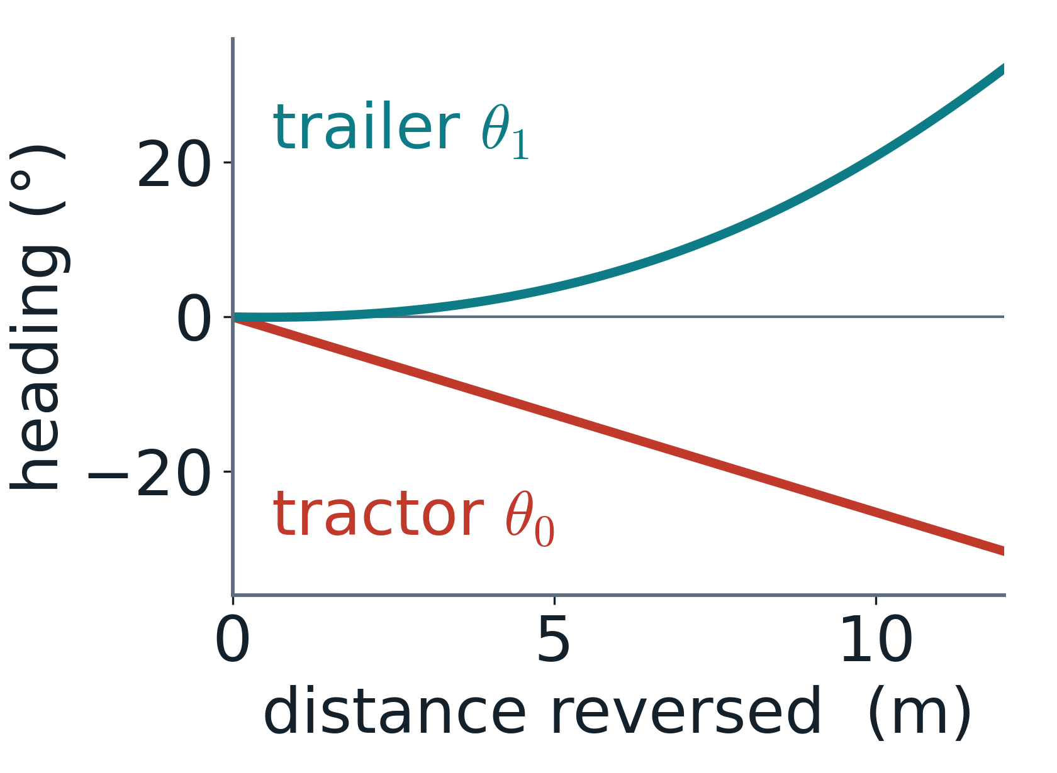
The “non-minimum phase” dilemma
Goal: swing the trailer one way
1
First: turn the tractor the other way
2
Then: follow the trailer round
3
A reactive PID steers straight at the error ⇒ wrong way first ⇒ jackknife
Same steering input, reversing: headings move apart
Introduction
Notes:
Reversing is non-minimum phase: to move the trailer one way you must first turn the tractor the other way. The chart is from our model: reversing with a constant 10-degree steer, the tractor heading turns one way while the trailer heading turns the other. A controller that only reacts to the present error steers the wrong way and folds the rig. This is why we need a controller that looks ahead.

Slide 5
Historical approaches & their limits
PID
Fuzzy logic
Geometric paths
Reacts to present error
Blind to the future
Hand-written rules
No hard guarantees
Ideal curves
Ignore steering lock and ψ
Our approach: plan on the real model (Hybrid A*), then look ahead with hard limits (NMPC)
Introduction
Notes:
Why the classic controllers are not enough. PID only reacts, so it cannot make the counter-intuitive first move. Fuzzy rules work in practice but give no guarantee that the hitch limit is respected. Geometric planners draw curves the vehicle cannot follow. Our answer combines a planner that uses the real vehicle model with a predictive controller that enforces the hitch limit as a hard constraint.

Slide 6
Literature review (1/2): the three closest works
# | Title | Authors | Year | Venue
[1] | Parking Assistance for Trailer-Truck Transport Vehicles Using Sensor Fusion and Motion Planning (base paper) | G. Alenchery et al. (7 authors) | 2026 | arXiv 2605.02716
[2] | An Intrinsically Stable MPC Approach for Anti-Jackknifing Control of Tractor-Trailer Vehicles | M. Beglini, T. Belvedere, L. Lanari, G. Oriolo | 2022 | IEEE/ASME T-Mech 27(6)
[3] | Robust Tube-Based Decentralized Nonlinear MPC of an Autonomous Tractor-Trailer System | E. Kayacan, E. Kayacan, H. Ramon, W. Saeys | 2015 | IEEE/ASME T-Mech 20(1)
Literature review
Notes:
Three works closest to ours. [1] is our base paper (arXiv, May 2026). [2] is the anti-jackknife MPC from Sapienza Rome. [3] is robust NMPC for an agricultural tractor-trailer.

Slide 7
Literature review (2/2): outcomes and limitations
# | Outcomes | Limitations
[1] | Layered design: sensor fusion → Hybrid A* → NMPC → LQR A* + B-spline path on a tractor-trailer model (CLI simulation) | NMPC only proposed, not implemented Jackknifing observed in tests No quantitative results
[2] | Reverse tracking without hitch divergence (I/O linearisation + IS-MPC) Simulation and prototype experiments | Needs a given reference trajectory No obstacle-aware parking No driver-facing output
[3] | Robust NMPC + moving-horizon estimation 5–8 cm error on straight lines (field) | Forward driving only No hitch-angle (jackknife) constraint
Literature review
Notes:
Key point: [1] proposes exactly our pipeline, Hybrid A* plus NMPC, but only implemented A* and reports jackknifing. [2] solves reverse tracking but needs a given trajectory. [3] is forward-only with no hitch constraint.

Slide 8
Base paper [1]: proposed vs. built
Layer | In [1] | This project
Path planning | A* + B-spline | Hybrid A* on (x, y, θ₀, ψ)
Tracking | NMPC proposed, not built | NMPC built, hard |ψ| ≤ 60°
Jackknife | observed in tests | 0 limit violations
Output | autonomy concept | driver instructions
Evaluation | qualitative | 110 scenarios, measured
Sensing (camera / LiDAR fusion in [1]) is left as future work: we assume a known pose
Literature review
Notes:
Change since our first review: we originally cited Shah (2019), a feedback controller for reverse docking. Once we found [1], it matched our pipeline, Hybrid A* plus NMPC, so it became the base paper. The table shows what [1] proposed and what we actually built and measured. Shah's idea of analysing the motion in distance travelled rather than time survives in our instability analysis.

Slide 9
Research gaps
1
Proposed, not built
2
No hard jackknife guarantee
NMPC and a hitch limit are only proposed in [1]
[1] observed jackknifing; [3] has no hitch constraint
3
Planning kept separate
4
No driver output, no metrics
[2], [3] track a given path; no obstacle-aware parking
No human-executable guidance; no measured evaluation
Research gaps
Notes:
Four gaps. The biggest: the NMPC layer in the base paper was never built, and without it the rig jackknifed.

Slide 10
Objectives
1
Model the tractor-trailer kinematics and quantify why reversing is unstable
2
Plan collision-free, kinematically feasible paths (Hybrid A*) into four bay layouts
3
Track the path with NMPC under a hard hitch-angle limit |ψ| ≤ 60°
4
Turn the optimal controls into driver instructions: gear, speed, wheel turns, distance
5
Certify on 110 scenarios against an unaided-driver baseline
Objectives
Notes:
Five objectives; each maps to a methodology block and a result.

Slide 11
Problem statement
GIVEN
Yard map (walls, parked rigs), gate pose, target bay pose
FIND
SUBJECT TO
Ẋ = f(X, U) and |v| ≤ 2 m/s
DELIVER
Instructions a human can follow: gear · speed · wheel turns · hold distance
Problem statement
Notes:
Formally: find the input history U(t) = (speed, steering) that takes the rig from the gate to the bay, obeying the kinematics, never exceeding 60 degrees of hitch angle or 35 degrees of steering, and keeping 25 cm from obstacles. The answer must be something a person can execute.

Slide 12
Methodology: the pipeline
Yard & model
Hybrid A* planner
NMPC tracker
Driver advisor
Certify & view
4 layouts, seeded fill
collision-free path
hard |ψ| ≤ 60°
wheel turns, km/h
110 scenarios
slides 14–18
slides 19–20
slides 21–22
slide 23
slides 24–25
Offline: every free bay is planned, driven in closed loop and certified; the viewer replays certified runs
Methodology
Notes:
Five blocks. Maths for each block is on the slides shown under it. Everything runs offline and is replayed, so a live demo cannot stall.

Slide 13
System architecture (software-in-the-loop)
Python core
Certify & export
React viewer
NumPy · SciPy
110 free bays
Three.js · Vite
Kinematic model
Hybrid A* planner
NMPC tracker
Driver advisor
Guided run
Unaided run
5 pass checks
JSON plan library
3-D yard
Guidance bar
Instruments
Live maths
Changed since review 1: CasADi + 60 Hz WebSockets → certified runs, replayed
Methodology
Notes:
Our first review showed a live CasADi solver streaming to the browser over WebSockets at 60 Hz. That was hard to install on Windows and could not keep up. The final system solves everything offline in plain Python with NumPy and SciPy, certifies every bay, and exports a JSON library. The React and Three.js viewer replays certified runs, so the demo needs no install and cannot stall.

Slide 14
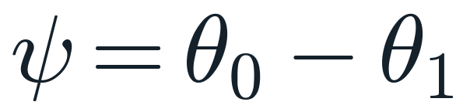
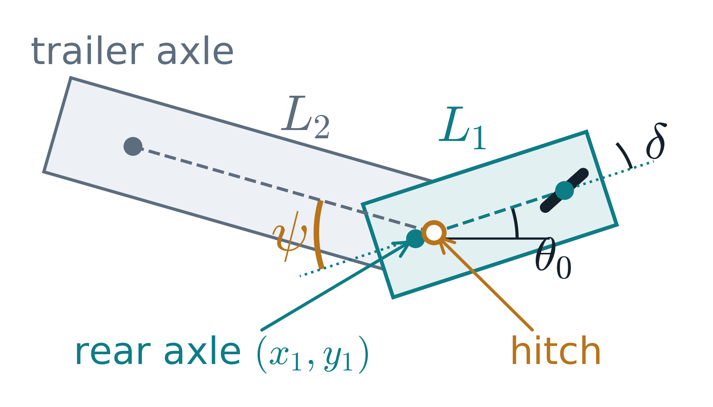
State-space formulation: state, input, geometry
(hitch angle)
Parameter | Value
L₁ tractor wheelbase | 4.0 m
L₂ hitch → trailer axle | 8.0 m
d hitch ahead of axle | 0.5 m
δmax steering lock | 35°
ψcrit hard hitch limit | 60°
v yard speed | ≤ 2 m/s
Car-like tractor + one trailer, hitch offset d [2]
Methodology · model
Notes:
Four states: rear-axle position x1,y1, tractor heading theta0 and hitch angle psi. Two inputs: speed v (negative in reverse) and steering delta. Parameters are a 4 m tractor and an 8 m trailer.

Slide 15
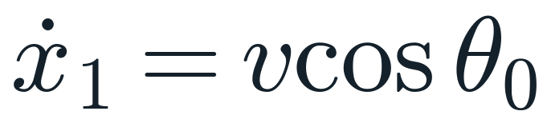
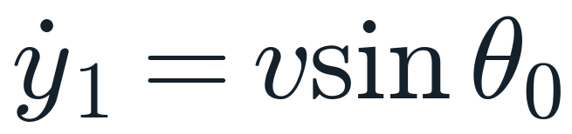
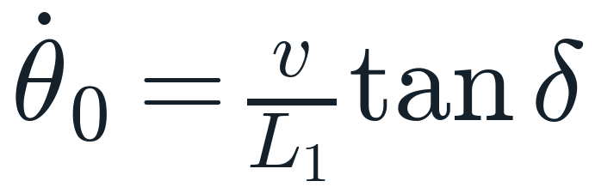
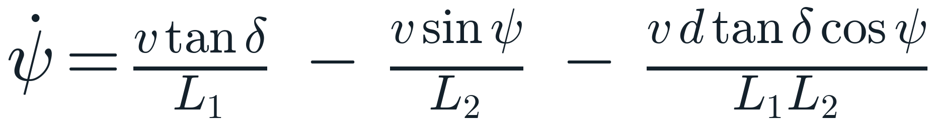
Control inputs & system kinematics
steering
hitch
offset
Steering term: the driver’s only lever on ψ
Hitch term −v sinψ / L₂: restoring when v > 0, destabilising when v < 0
Every term ∝ v: the path depends on distance s, not speed, so speed is chosen separately
Integrated with RK4; one model shared by planner, NMPC and viewer [2]
Methodology · model
Notes:
The heart of the problem is psi-dot. Its hitch term, minus v sin psi over L2, has the sign of minus v: going forward it pulls psi back to zero, reversing it pushes psi away. Because every term is proportional to v, dividing by speed gives a model in distance travelled, which is why the base paper parameterises in space.

Slide 16
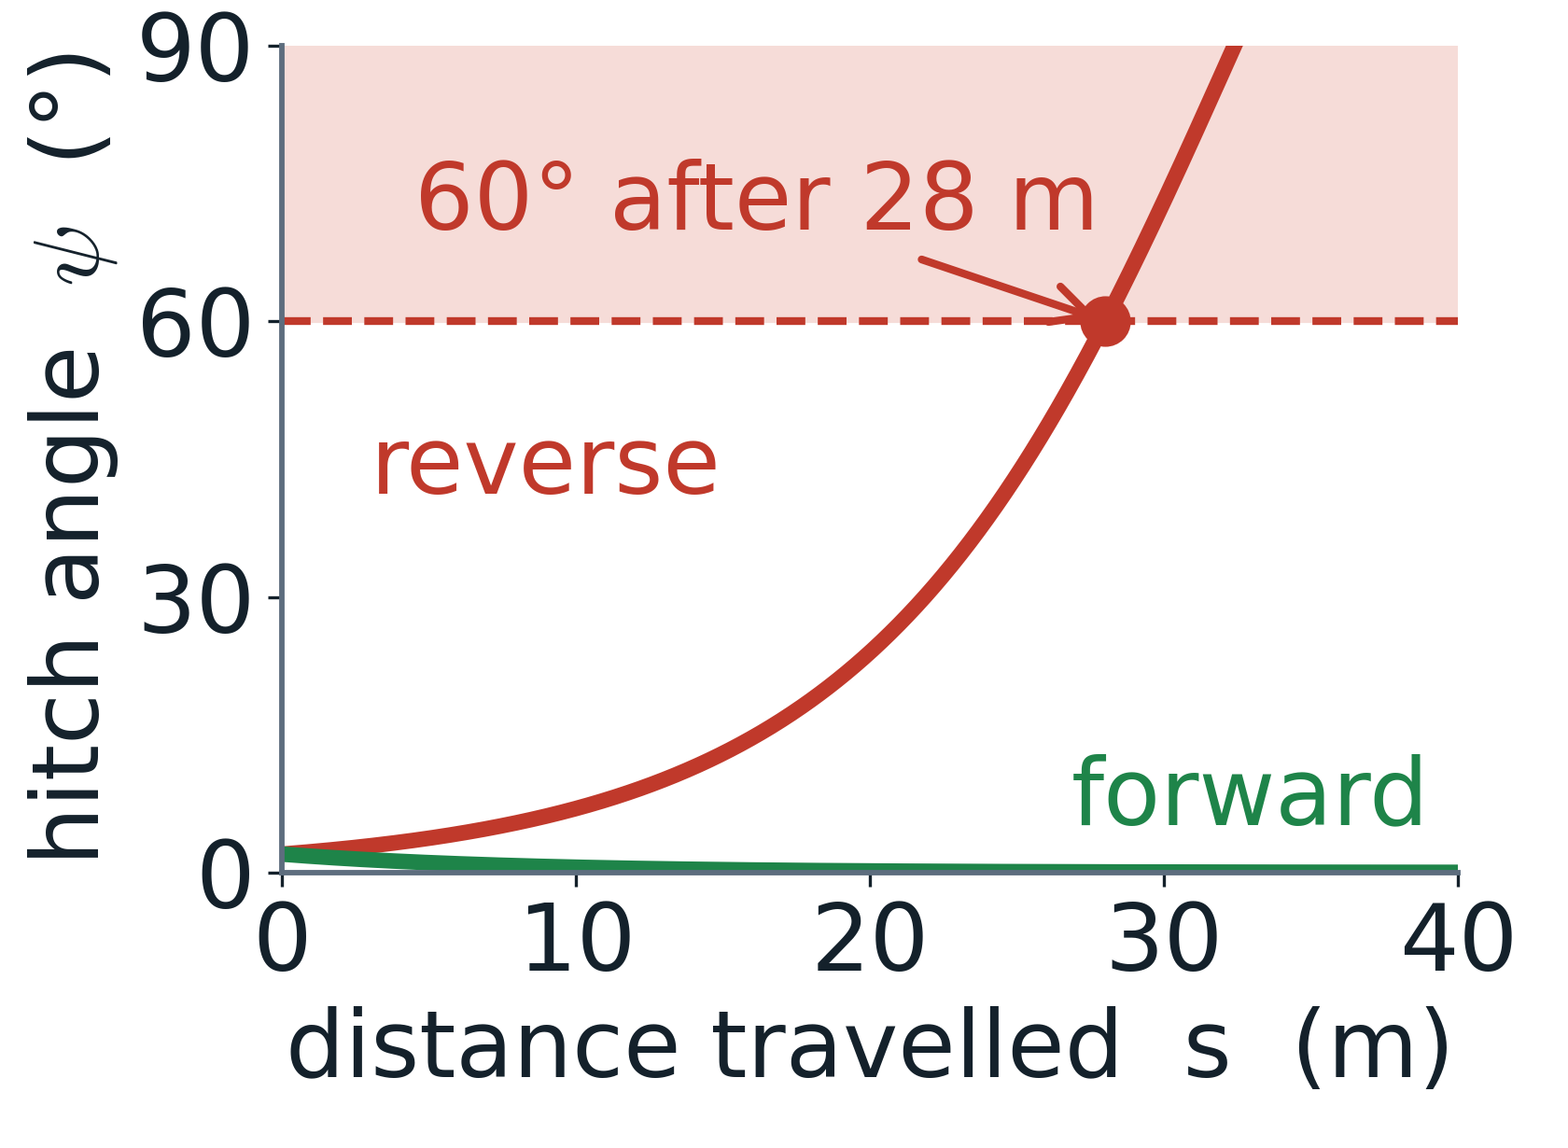
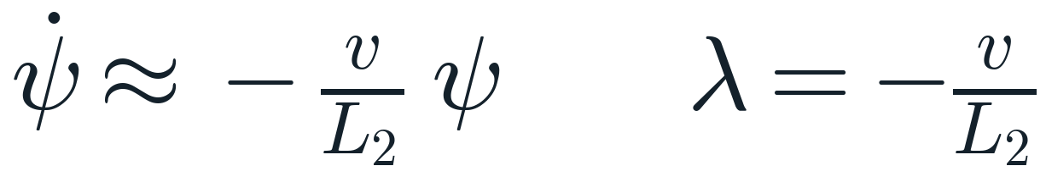
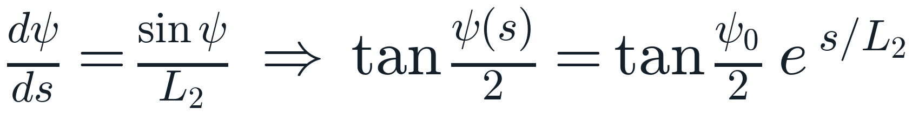
Why reversing is unstable
Straight line (δ = 0), small ψ:
v > 0: λ < 0, ψ decays (stable)
v < 0: λ = |v|/L₂ > 0, ψ grows ×e every 8 m
Exact solution in distance s:
2° error: 60° at 28 m, jackknife at 30 m
Closed form matches the simulator exactly
Methodology · model
Notes:
Linearise at psi = 0 with zero steering: psi-dot = -(v/L2) psi. The eigenvalue is -v/L2, negative forward and positive in reverse. Written in distance the equation is separable: tan(psi/2) grows like e^(s/L2). With L2 = 8 m a 2-degree error hits 60 degrees after 28 m. Our simulator gives 28.0 m and 30.3 m, identical to the closed form.

Slide 17
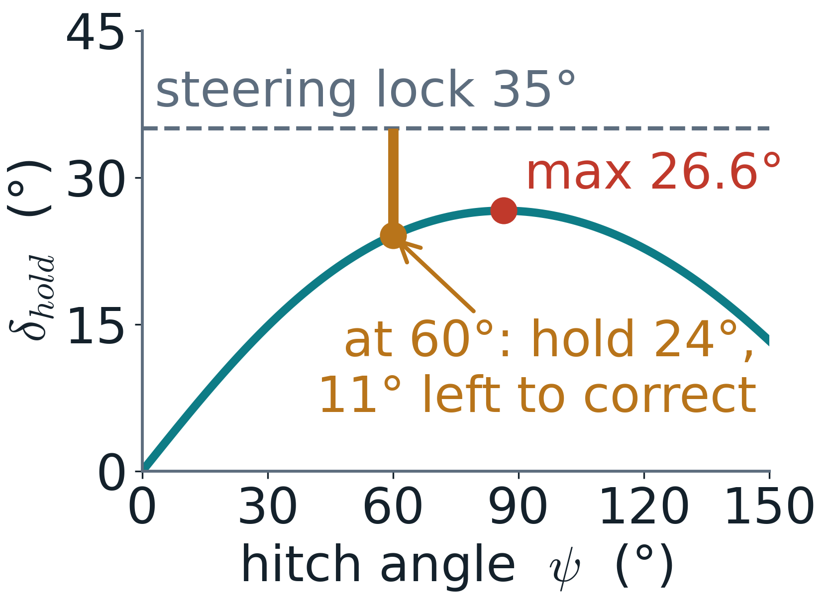
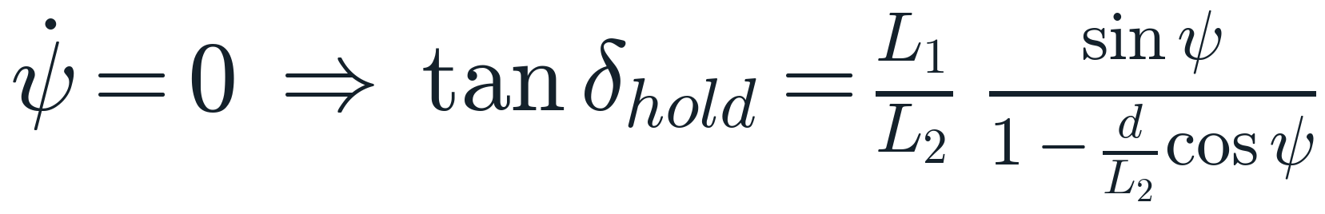
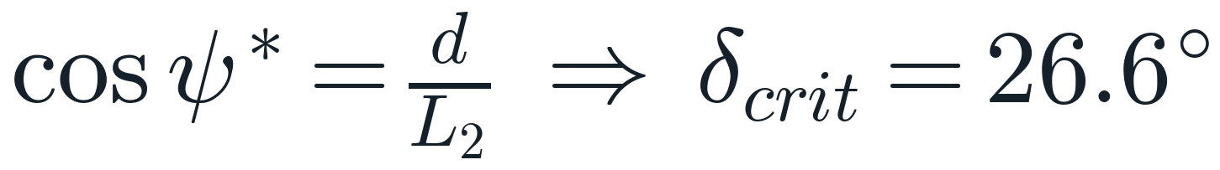
How much steering can hold a hitch angle?
Steady state (ψ̇ = 0):
Maximum of the right-hand side:
Above 26.6°: no equilibrium, the rig folds
At ψ = 60°: hold 24°, 11° of lock left to recover
So: NMPC hard limit 60°; planner stays ≤ 52°
Methodology · model
Notes:
Set psi-dot to zero to find the steering that holds a given hitch angle. The curve peaks at 26.6 degrees of steering, at psi near 86 degrees. At 60 degrees you need 24 degrees just to hold, leaving 11 degrees of our 35-degree lock to pull the trailer back. That is the mathematical reason for choosing 60 degrees as the hard limit.

Slide 18
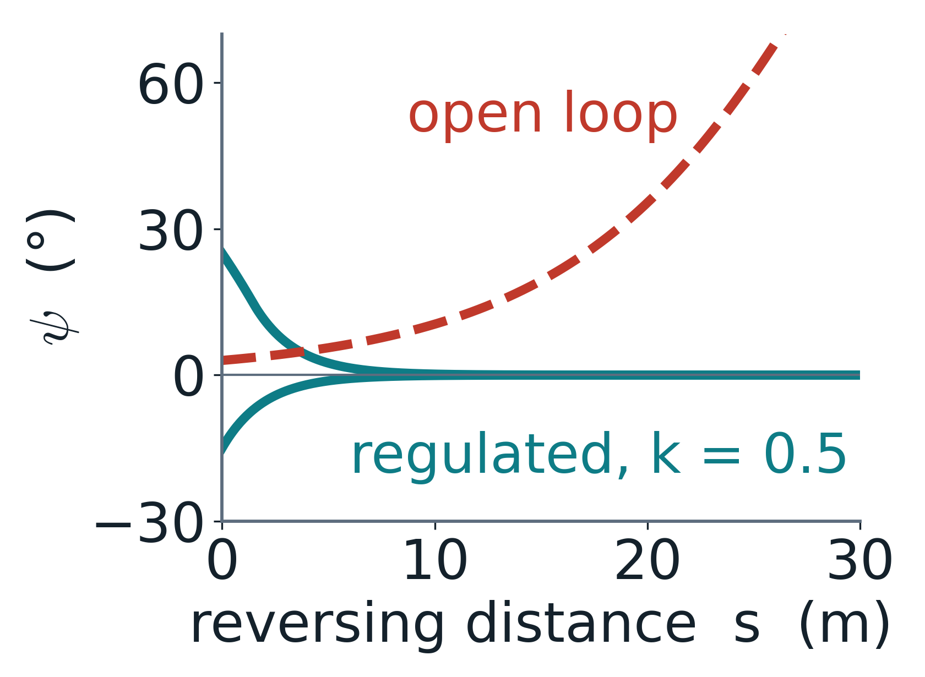
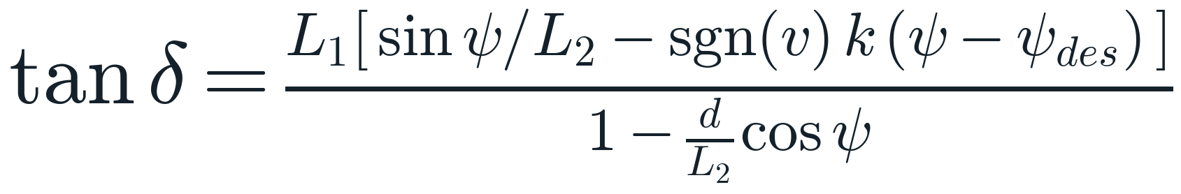
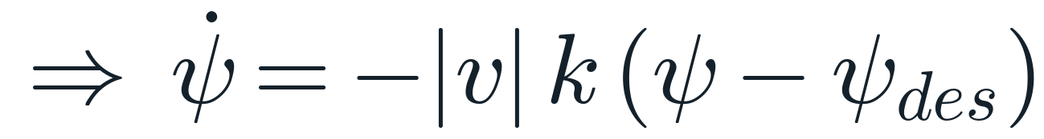
Hitch-angle regulator (feedback linearisation)
Choose δ by inverting the ψ̇ equation:
Stable in both gears: error ×1/e every 2 m
Builds the planner’s motion primitives
NMPC’s last-resort fallback
Methodology · model
Notes:
Substituting this steering law into the psi-dot equation cancels the unstable hitch term and leaves psi-dot = -|v| k (psi - psi_des), which is stable whatever the sign of v. With k = 0.5 per metre the error shrinks by e every 2 m. This makes reversing behave like driving forward and is the building block of the planner.

Slide 19
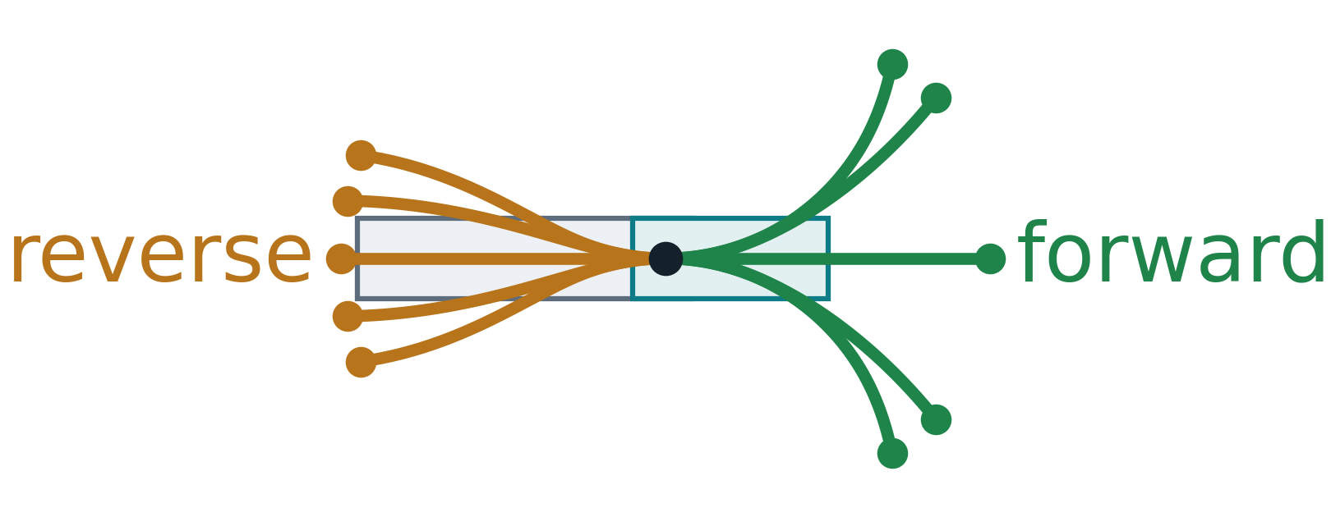
Hybrid A* planner: search and cost
Search state (x, y, θ₀, ψ) on a 0.5 m × 5° × 12° lattice [4]
10 motion primitives per node: 2 gears × ψdes ∈ {0, ±25°, ±45°}, 2 m each
Pruned if |ψ| > 52° or clearance < 0.35 m (signed-distance field)
c_gear: 1.0 forward, 1.4 reverse
ψdes, Δψdes: gentle, steady steering
|ψ| / ψplan: keep the hitch straight
switch: +6 per gear change
Primitives from one pose
Methodology · planner
Notes:
Hybrid A* searches continuous poses snapped to a lattice. Each expansion runs the regulator for 2 m towards one of five hitch set-points, forward or reverse, on the real model. Branches that exceed 52 degrees or come within 35 cm of an obstacle are discarded. The cost adds distance, a reverse premium and penalties for sharp or changing steering, hitch angle and gear changes.

Slide 20
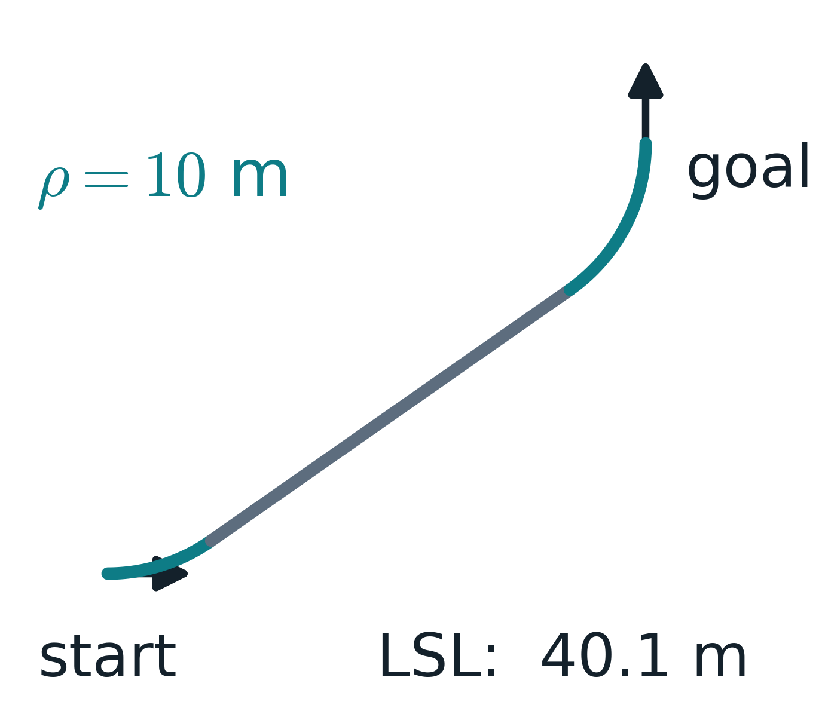
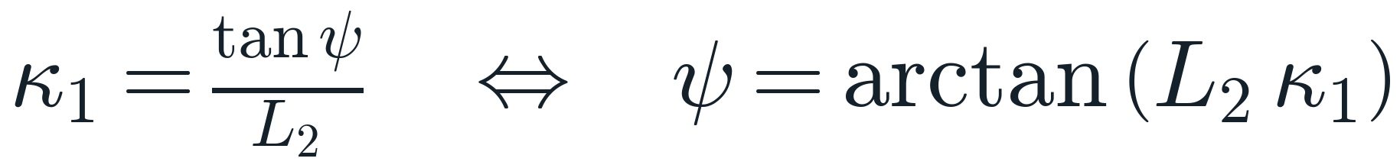
Hybrid A* planner: heuristic and final approach
Flat output: trailer-axle curvature fixes ψ
Heuristic (cost-to-go estimate):
Trailer axle ≈ a car whose “steering” is ψ ⇒ Dubins path [5], ρ = 10 m
ε = 3: weighted A*, plans in 0.1–6 s
Analytic shot: Dubins path simulated on the real model; kept only if collision-free and it ends in the bay
Methodology · planner
Notes:
The trailer axle is a flat output: its path curvature alone fixes the hitch angle, psi = arctan(L2 kappa). So the trailer axle behaves like a car whose steering is psi, and the shortest Dubins path of the trailer axle is a good cost-to-go estimate. Near the goal we try an analytic shot: simulate that Dubins path on the real model and accept it only if it is collision-free and lands in the bay.

Slide 21
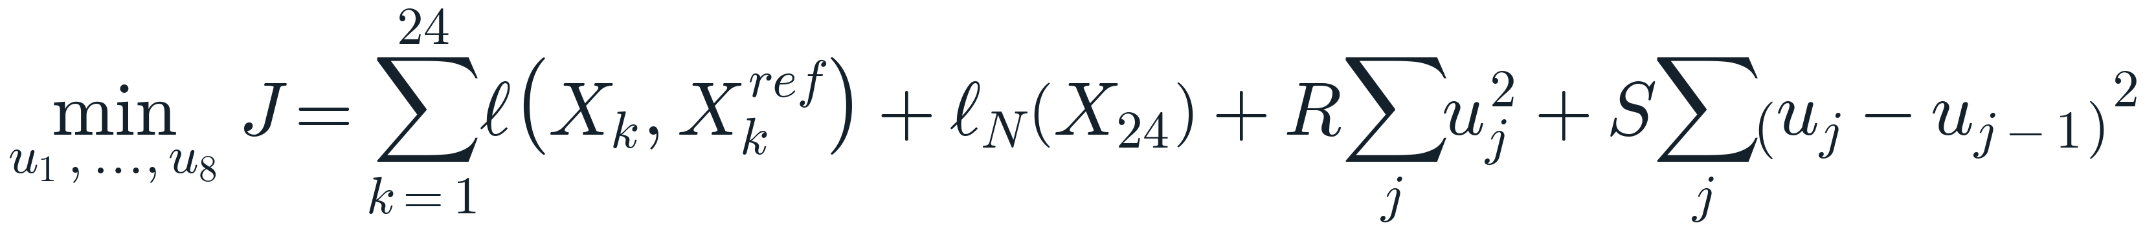
NMPC: the prediction horizon and objective
Our formulation:
Implemented: horizon 24 × 0.4 s = 9.6 s, 8 steering blocks
p₁ = trailer axle: the main target, because in reverse the tractor axle is non-minimum-phase [2]
Methodology · NMPC
Notes:
Top line is the cost from our formulation document: tracking error, control effort and control smoothness. Below is exactly what the code minimises: the trailer axle position and heading are weighted most, the hitch angle deviation is weighted 15, the steering itself is cheap and changes of steering are expensive, so the wheel does not jerk. The trailer axle is the main target because, in reverse, the tractor rear axle initially moves the wrong way: it is the non-minimum-phase output.

Slide 22
Preventing the jackknife: NMPC hard constraints
Single shooting, RK4 prediction:
Hard constraints at every step k:
horizon 9.6 s = 8 × 1.2 s
8 unknowns: steering corrections
SLSQP [6] (SciPy [8]), warm start
Fallback: ψ-only, then regulator
94–154 ms per solve (≤ 250 ms)
u₁
u₂
u₃
u₄
u₅
u₆
u₇
u₈
apply u₁ for 0.25 s, then re-solve
Methodology · NMPC
Notes:
The optimiser chooses eight steering corrections, each held for 1.2 s, around the planner steering. States are predicted with RK4 and the hitch limit, steering lock and clearance are hard inequality constraints, solved with SciPy SLSQP. Only the first 0.25 s is applied, then the problem is re-solved from the new state: receding horizon. If no feasible solution exists we keep the hitch limit and drop clearance; failing that, the stable regulator takes over. Measured: 94 to 154 ms per solve, inside the 250 ms control period.

Slide 23
From optimal control to driver instructions
Steering-wheel turns (20:1 ratio):
Reverse · 2 km/h
1 turn right · 9 m
Speed schedule along the path:
Quantised to ¼ turn; phases < 4 m merged ⇒ 6–16 instructions
Each: gear · km/h · wheel turns · hold distance · hitch margin
Methodology · advisor
Notes:
The NMPC outputs a road-wheel angle every quarter second; nobody can follow that. We convert to steering-wheel turns at a 20 to 1 ratio, round to quarter turns, and merge short phases, giving 6 to 16 instructions per manoeuvre. Speed is slowed where steering is large and respects acceleration and braking limits. The strip at the top is the live guidance bar from our app.

Slide 24
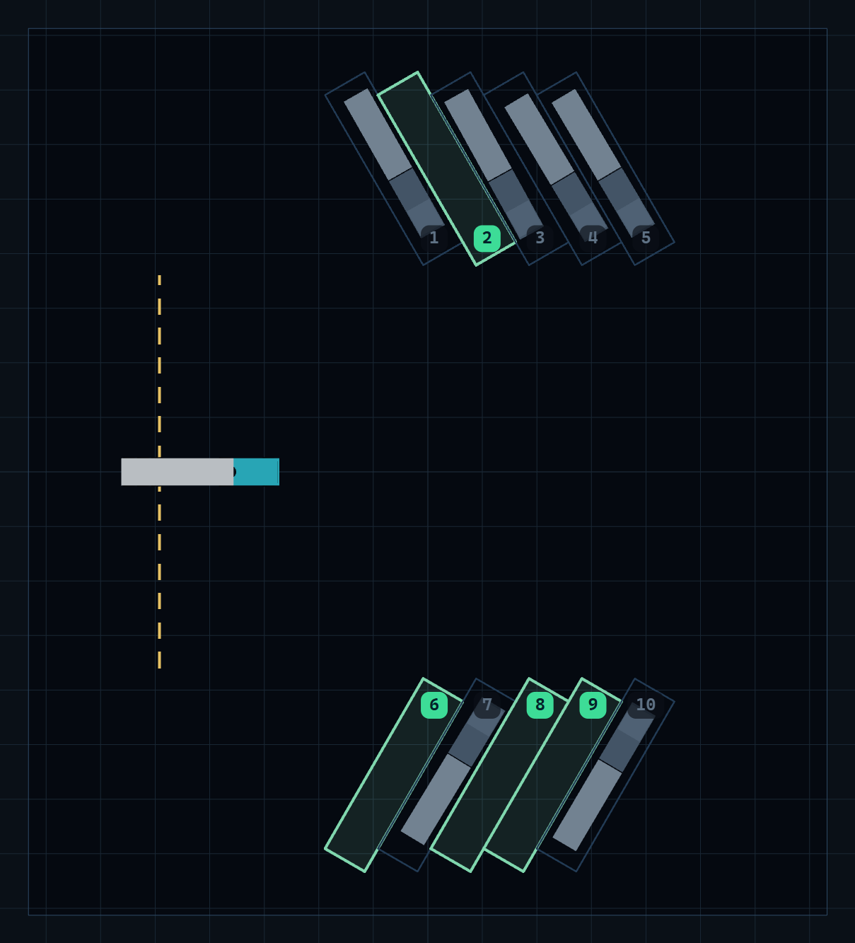
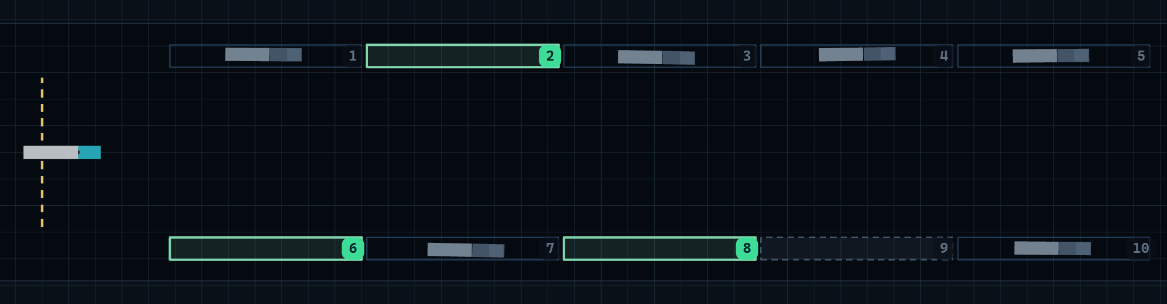
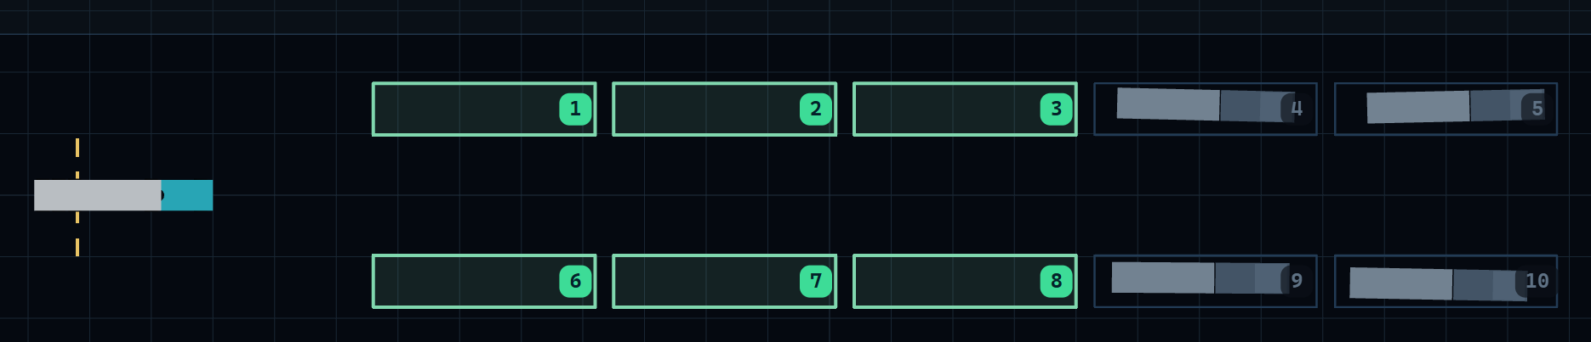
Test scenarios: 4 layouts × 6 random fills
Cross 90°
24 free bays
Angled 60°
24 free bays
Parallel · 24 free bays
Tandem (forward in) · 38 free bays
110 free bays: every one planned, driven and checked
Results
Notes:
Four layouts, each filled at random six times with parked rigs: 110 free bays. Three layouts need reversing; tandem is a forward pull-in, which acts as a control case.

Slide 25
Evaluation protocol
Plan (Hybrid A*)
Guided run (NMPC)
Unaided run (same path)
Certify
Unaided = tractor-only path follower: no hitch model, no look-ahead, no limit
✓
No jackknife
Only certified bays are offered to the driver; the rest show as “too tight”
✓
|ψ| ≤ 60° at every instant
✓
≥ 0.10 m from every obstacle
✓
≤ 0.8 m from the bay centre
✓
≤ 10° heading, ≤ 12° hitch
Results
Notes:
Every free bay goes through the same pipeline. The guided run must pass all five checks to be offered; the unaided run uses the identical path and vehicle, only without the hitch model, so the comparison is fair.

Slide 26
Results at a glance
98/110
60/60
0
53.3°
bays certified for guidance
unaided reverses jackknife
hitch-limit violations with NMPC
worst hitch angle (limit 60°)
Min. clearance 0.25 m · plans in 0.1–6 s · NMPC 94–154 ms per solve
Results
Notes:
98 of 110 bays pass every check; 12 are flagged as too tight rather than offered. Without guidance every one of the 60 reversing runs jackknifes. With NMPC the hitch limit was never violated; the worst case was 53.3 degrees against the 60-degree limit.

Slide 27
Results by layout
Median error | lateral | heading
Cross | 0.58 m | 2.0°
Angled | 0.17 m | 4.2°
Parallel | 0.72 m | 6.4°
Tandem | 0.10 m | 3.2°
Unaided parks only in tandem (forward in): reversing is where guidance matters
Results
Notes:
Guidance parks every certified bay in every layout. The unaided driver parks only the tandem bays, which are driven forward, and jackknifes on every reversing layout. Median parking error is 10 to 72 cm laterally and 2 to 6 degrees of heading.

Slide 28
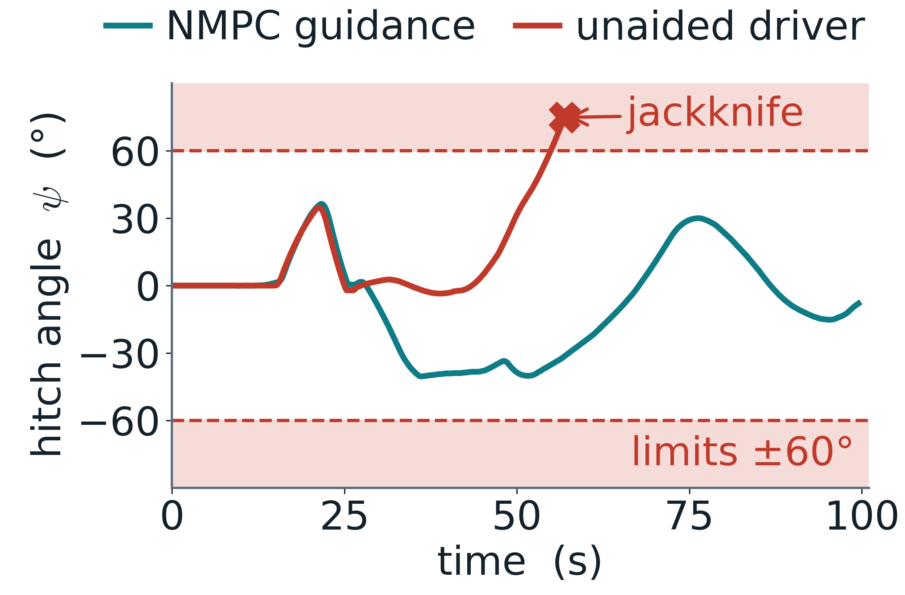
One run in detail: cross layout, bay 6
Same start, path and vehicle
Guided: peak |ψ| 40°
Parked 0.58 m, 4.7° off
Unaided: past 60° at 55 s
Jackknife at 57 s (75°)
Results
Notes:
Same scenario, two drivers. Both follow the same forward set-up. Once reversing starts, the unaided hitch angle runs away and folds at 57 seconds. The NMPC deliberately lets psi go to about minus 40 degrees to swing the trailer, then brings it back, and parks 58 cm from the centre line.

Slide 29
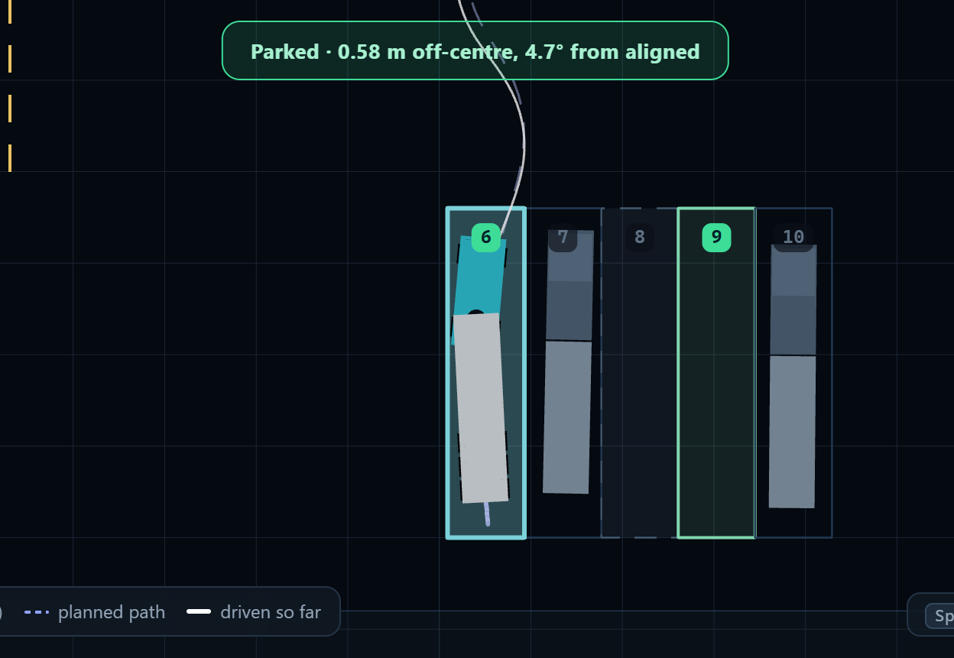
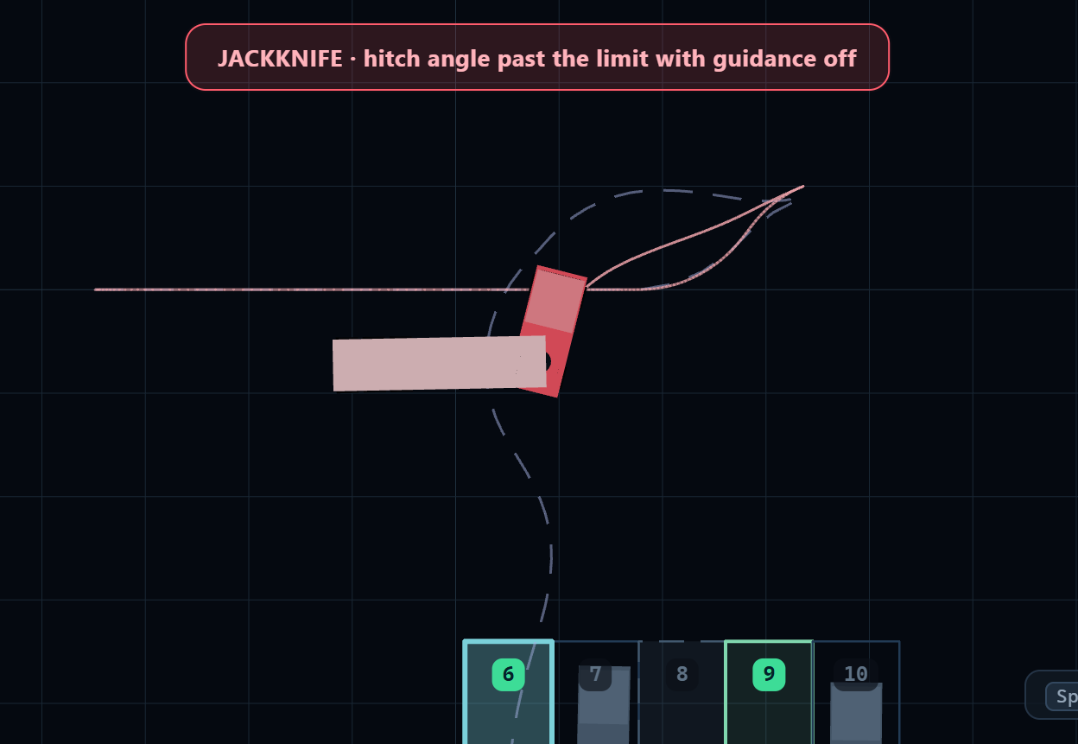
Guidance ON vs OFF, same bay
ON: parked, 0.58 m off-centre
OFF: jackknife after 57 s
Results
Notes:
Screenshots from our app at the end of each run: left with NMPC guidance, parked in bay 6; right, the unaided driver folded the rig short of the bays.

Slide 30
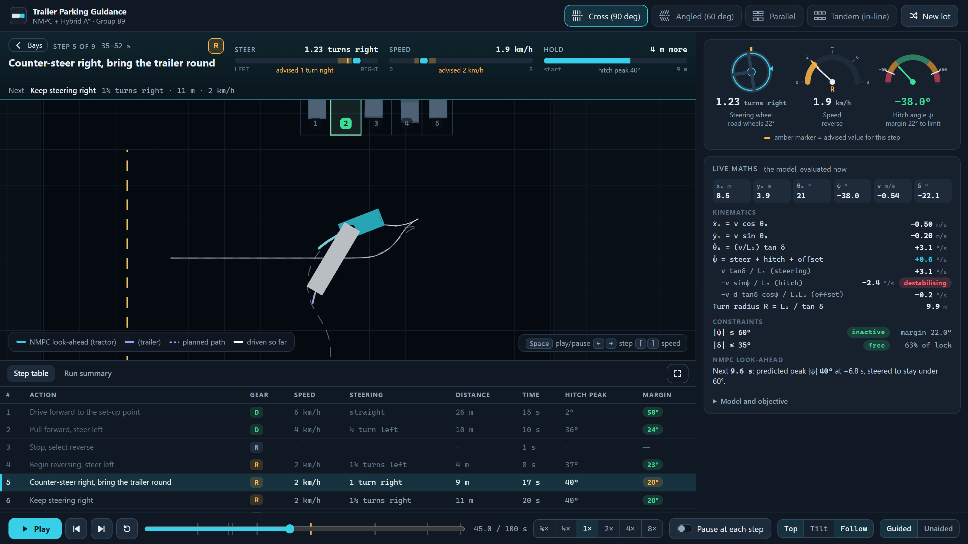
The driver guidance interface
1
Instruction vs advised
1
3
2
NMPC look-ahead
2
4
3
Instruments
4
Live maths
5
Step table
5
Results
Notes:
Our web app during a run. (1) the current instruction with live steering and speed against the advised values, (2) the NMPC 9.6-second look-ahead drawn in the yard, (3) steering wheel, speedometer and hitch gauge, (4) the kinematic equations evaluated live, with the hitch term flagged destabilising, (5) the full instruction table. Playback can be slowed to quarter speed or paused at each step.

Slide 31
Academic alignment: syllabus integration
1
Unit 1 · Rigid-body transforms: rear axle → hitch → trailer frames
2
Unit 2 · Kinematics of wheeled mobile robots
3
Unit 3 · Advanced feedback control
Syllabus
Notes:
How the project maps to the course. Unit 1: the hitch and trailer-axle positions are chained rigid-body transforms of the tractor pose; we use them for drawing and for collision checking of both bodies. Unit 2: the wheels roll without sliding, which gives the non-holonomic kinematic model. Unit 3: the feedback-linearising hitch regulator and the NMPC with a hard hitch-angle constraint.

Slide 32
Limitations & future scope
Limitations
Future scope
Runs precomputed, then replayed
Kinematic model: no tyre slip or load transfer
Roomy aisles (32–40 m); 12/110 bays not certified
One trailer, simulated yard
Live solver: server or in-browser
Faster NMPC (acados / IPOPT) for tight yards
Camera / LiDAR pose feedback, as in [1]
Driver-in-the-loop trials with reaction delay
Limitations & future scope
Notes:
Honest limits: the runs are computed offline and replayed; the model ignores tyre slip, which is acceptable at yard speeds; aisles are generous; 12 bays could not be certified. Next steps: a live solver, a faster NLP solver for tighter yards, closing the loop with real sensing, and trials with human drivers.

Slide 33
Conclusion
Instability: a 2° error hits 60° in 28 m
Hybrid A* + NMPC with a hard 60° hitch limit
98/110 parked; 60/60 unaided jackknife
Human output: gear, km/h, wheel turns
Built and measured what [1] proposed
Conclusion
Notes:
In one sentence: we turned the Hybrid A* plus NMPC architecture that the base paper proposed into a working, measured system that keeps the hitch angle inside a hard limit and tells a human driver exactly what to do.

Slide 34
References (1/2)
[1] G. Alenchery et al., “Parking Assistance for Trailer-Truck Transport Vehicles Using Sensor Fusion and Motion Planning,” arXiv:2605.02716 [cs.RO], 2026.
[2] M. Beglini, T. Belvedere, L. Lanari, G. Oriolo, “An Intrinsically Stable MPC Approach for Anti-Jackknifing Control of Tractor-Trailer Vehicles,” IEEE/ASME Trans. Mechatronics, 27(6), 4417–4428, 2022.
[3] E. Kayacan, E. Kayacan, H. Ramon, W. Saeys, “Robust Tube-Based Decentralized Nonlinear Model Predictive Control of an Autonomous Tractor-Trailer System,” IEEE/ASME Trans. Mechatronics, 20(1), 447–456, 2015.
[4] D. Dolgov, S. Thrun, M. Montemerlo, J. Diebel, “Path Planning for Autonomous Vehicles in Unknown Semi-structured Environments,” Int. J. Robotics Research, 29(5), 485–501, 2010.
References
Notes:
References cited on the slides as [n].

Slide 35
References (2/2)
[5] L. E. Dubins, “On Curves of Minimal Length with a Constraint on Average Curvature, and with Prescribed Initial and Terminal Positions and Tangents,” American J. Mathematics, 79(3), 497–516, 1957.
[6] D. Kraft, “A Software Package for Sequential Quadratic Programming,” DFVLR-FB 88-28, German Aerospace Center (DLR), 1988.
[7] J. B. Rawlings, D. Q. Mayne, M. M. Diehl, Model Predictive Control: Theory, Computation, and Design, 2nd ed., Nob Hill Publishing, 2017.
[8] P. Virtanen et al., “SciPy 1.0: Fundamental Algorithms for Scientific Computing in Python,” Nature Methods, 17, 261–272, 2020.
References
Notes:
References cited on the slides as [n].

Slide 36
Thank you
Questions?
Group B9
Harshith KV · G Venugopalan
Rithvik Arulprakash · Vipin Sudhakar
Live demo: run_demo.bat → any layout → any green bay
Notes:
Offer the live demo: pick a layout, pick a green bay, show guidance, then switch to Unaided on the same bay.

