Slide 1

STOCK PRICE PREDICTION
A complete analysis
Deepcraft

Slide 2

BACKGROUND
Stock Price Prediction: Predicting future stock prices by analyzing historical data and other influential factors.
Importance:
Informs investment strategies
Aids in managing financial risks
Facilitates better financial planning
Challenges:
High volatility: Stock prices can change rapidly and unpredictably.
Market efficiency: Prices may already incorporate all known information, making it harder to predict future movements.
External factors: News, economic trends, and global events can heavily influence prices.
Data complexity: Requires processing large amounts of diverse and multi-dimensional data.

Slide 3
EXPLORATORY DATA ANALYSIS (EDA) & CHALLENGES
Dataset Overview:
The dataset contains 9202 rows and 7 columns.
Features:
日付け (Date) - Stock trading date.
終値 (Closing Price) - Price at market close.
始値 (Opening Price) - Price at market open.
高値 (High Price) - Highest price during the trading day.
安値 (Low Price) - Lowest price during the trading day.
出来高 (Volume) - Number of shares traded.
変化率 % (Change Rate %) - Percentage change in price.
Data Types:
Most columns contain numerical data, except for the date and volume. The volume is stored as a string with a suffix (M for million, B for billion) and needs to be converted into numerical format. Additionally, the change rate is stored as a string but can be converted into a numerical value for analysis.

Slide 4
Key Insights:
Date Range: The data spans several years, providing a rich time series for analysis.
Missing Data: No missing data was identified, but the format of volume and percentage change columns requires cleaning for accurate analysis.
Challenges:
Data cleaning: Handling different volume formats and ensuring consistency
Feature selection: Determining most relevant features for prediction
Data normalization: Scaling features to a common range for model input

Slide 5
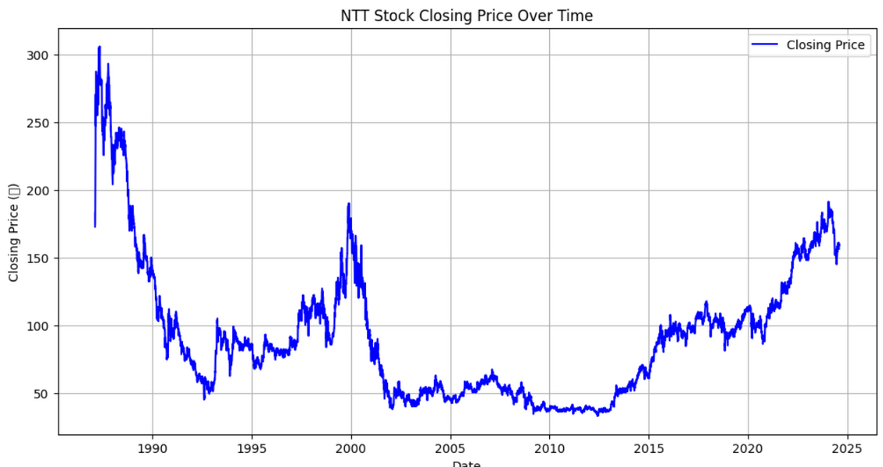
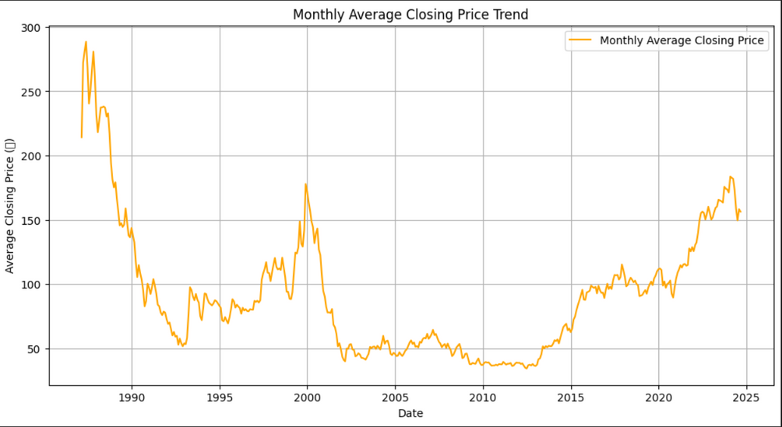
CLOSING PRICE AND AVERAGE CLOSING PRICE OVER TIME

Slide 6
DATA PREPROCESSING & FEATURE ENGINEERING
Column Renaming:
The original column names are in Japanese, requiring renaming for clarity in analysis:
日付け → Date
終値 → Closing_Price
始値 → Opening_Price
高値 → High_Price
安値 → Low_Price
出来高 → Volume
Volume Conversion:
Convert Volume from strings like 79.15M (million) and 173.91M into numerical values for analysis.
Change Rate Removal:
The Change Rate % column was excluded as the core focus was on stock price trends and technical indicators.

Slide 7
DATA PREPROCESSING & FEATURE ENGINEERING
Feature Engineering:
Technical indicators added:
Simple Moving Average (SMA):
SMA-20: Average closing price over the last 20 days
SMA-50: Average closing price over the last 50 days
Relative Strength Index (RSI): Momentum indicator measuring speed and change of price movements

Slide 8
MODEL TRAINING AND ARCHITECTURE
Input:
The model analyzes 500 days of historical stock prices and trading volumes, along with calculated indicators like the 20-day and 50-day simple moving averages (SMA) and the stock’s relative strength index (RSI) to capture trends. This extensive "window" of data helps the model learn patterns and stock price movements over time.
Each 500-day sliding window of input data includes:
5 core features: Closing Price, Opening Price, High Price, Low Price, and Volume.
3 engineered features: 20-day SMA, 50-day SMA, and RSI.
Shape of Input:
Each training example is structured as a matrix with dimensions of 500 days and 8 features. The matrix consists of the following features for each of the 500 days.

Slide 9
MODEL TRAINING AND ARCHITECTURE
How the Model Works:
LSTM Model: Imagine the model as a highly advanced calculator that learns patterns from past stock movements. It’s special because it can remember important patterns and trends over long periods, which is crucial in predicting stock prices.
Model Architecture:
LSTM:
The model is built using Long Short-Term Memory (LSTM) networks, designed for time series prediction.
The LSTM reads the data in a forward direction, capturing temporal relationships by taking previous predictions into account.
Layers:
Two LSTM layers: Capture short-term and long-term dependencies in stock price trends.
Dropout layers: Prevent overfitting by randomly "dropping" connections during training.
Dense output layer: Predicts 5 values at once (Closing Price, Opening Price, High Price, Low Price, Volume) for the next day.

Slide 10
MODEL TRAINING AND ARCHITECTURE
Output:
For each day, the model predicts what the stock price and trading volume will be the next day based on what it learned from the past 500 days.
The model predicts the stock prices (Closing, Opening, High, Low) and Volume for the next day.
Training:
The model starts with random guesses and improves its predictions as it “learns” from the data. It adjusts itself after each prediction to get better over time.
To make sure it doesn't overlearn specific patterns (which could lead to mistakes on new data), it stops training when further improvement isn't seen.
Data is split into 80% training and 20% testing sets, ensuring no data leakage.
The model is trained using Mean Squared Error (MSE) as the loss function, with Adam optimizer for efficient learning.
Early stopping is applied to prevent overfitting, halting training if the model’s performance stops improving on the validation set.

Slide 11
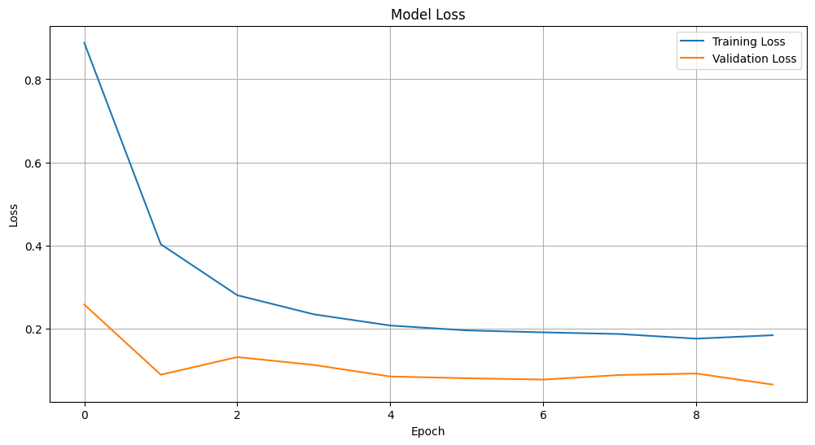
MODEL TRAINING AND VALIDATION LOSS

Slide 12
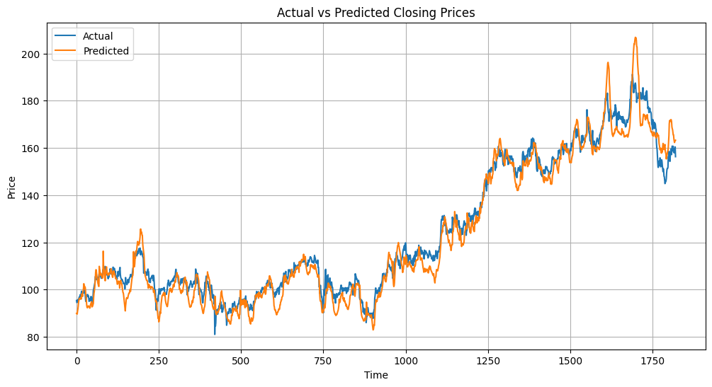
TEST RESULTS

Slide 13
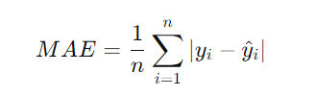

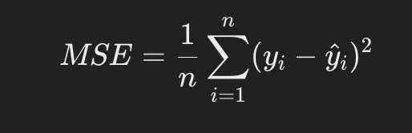
EVALUATION METRICS
Mean Absolute Error (MAE):
What It Does: Measures how far the predictions are from the actual values, on average.
Example: If the MAE is 5, on average, the model's predictions are off by $5 compared to the actual stock prices.
Formula:
Mean Squared Error (MSE):
What It Does: Similar to MAE but emphasizes larger errors by squaring them. So, if the model makes a big mistake, this metric will make it stand out more.
Example: If MSE is high, it means the model made some big mistakes in its predictions.
Formula: 1/n ( yi - yi )^2
n
| yi-yi |
i=1
n
i=1

Slide 14
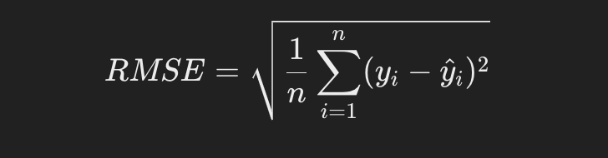
EVALUATION METRICS
Root Mean Squared Error (RMSE):
What It Does: Gives an overall idea of how far off the predictions are, but in the same units as the stock price, making it easy to understand.
Example:If RMSE is 10, the predictions are usually off by about $10 from the actual price.
Formula:

Slide 15
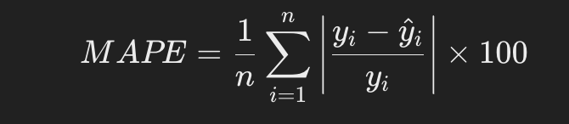
EVALUATION METRICS
Mean Absolute Percentage Error (MAPE):
What It Does: Shows the average error as a percentage of the actual stock prices. It’s useful to see how large the errors are relative to the actual prices.
Example:A MAPE of 5% means the model's predictions are, on average, off by 5% compared to the actual stock prices.
Directional Accuracy:
What It Does: This checks whether the model correctly predicted whether the stock price would go up or down, even if it didn’t get the exact price right.
Example: If the model has a directional accuracy of 70%, it predicted the right direction of price movement 7 out of 10 times.
Formula: Directional Accuracy=(Total Predictions/Correct Directions)​×100

Slide 16
HYPOTHESIS TESTING
Hypothesis 1: Bidirectional LSTM vs Single LSTM
Null Hypothesis (H0): There is no significant difference in prediction accuracy between Bidirectional LSTM and Single LSTM models for stock price prediction.
Alternative Hypothesis (H1): Bidirectional LSTM significantly outperforms Single LSTM in stock price prediction accuracy.
Test: Compare performance metrics of Bidirectional LSTM vs. Single LSTM models.
Hypothesis 2: Single LSTM vs ARIMA
Null Hypothesis (H0): There is no significant difference in prediction accuracy between Single LSTM and ARIMA models for stock price prediction.
Alternative Hypothesis (H1): Single LSTM significantly outperforms ARIMA in stock price prediction accuracy.
Test: Compare performance metrics of Single LSTM vs. ARIMA models.

Slide 17
VERIFICATION RESULTS 1: BIDIRECTIONAL LSTM VS SINGLE LSTM
Bidirectional LSTM performance:
Mean Absolute Error (MAE): 0.12747968863940268
Mean Squared Error (MSE): 0.06448157598947236
Root Mean Squared Error (RMSE): 0.25393222715809893
Mean Absolute Percentage Error (MAPE): 1.1047046461361674
Directional Accuracy: 0.4791323448654585
Single LSTM performance:
Mean Absolute Error (MAE): 0.09340626181852835
Mean Squared Error (MSE): 0.062390767296148756
Root Mean Squared Error (RMSE): 0.25889029532976873
Mean Absolute Percentage Error (MAPE): 0.9845926309016917
Directional Accuracy: 0.48194719471947194
Statistical Analysis:
Error Metrics: The Single LSTM model consistently outperforms the Bidirectional LSTM model across all error metrics (MAE, MSE, RMSE, and MAPE). The differences range from about 10% to 30% improvement.
Directional Accuracy: The Single LSTM model shows a slightly higher directional accuracy (48.19% vs 47.91%), but the difference is minimal (less than 1%).

Slide 18
Insights:
Rejection of Alternative Hypothesis: The results contradict the alternative hypothesis. Instead of Bidirectional LSTM outperforming Single LSTM, we observe the opposite.
Model Complexity vs Performance: This case demonstrates that more complex models (like Bidirectional LSTM) don't always lead to better performance. The simpler Single LSTM model appears more effective for this specific stock price prediction task.
Overfitting Possibility: The Bidirectional LSTM's poorer performance might indicate overfitting to the training data, failing to generalize well to new data.
Time Series Nature: The better performance of Single LSTM suggests that for this stock price data, the forward-looking nature of a single LSTM might be more appropriate than the bidirectional approach.
Practical Implications: While the Single LSTM shows better performance, it's worth noting that both models have relatively low directional accuracy (below 50%), indicating challenges in predicting stock price movements accurately.
Further Investigation Needed: It would be valuable to examine the models' performance over different time periods or with various hyperparameter configurations to ensure the robustness of these findings.

Slide 19
VERIFICATION RESULTS 2: SINGLE LSTM VS ARIMA
ARIMA model performance:
Mean Absolute Error (MAE): 3.652
Root Mean Squared Error (RMSE): 5.120
Mean Absolute Percentage Error (MAPE): 2.469%
Directional Accuracy: 0.443
Single LSTM performance:
Mean Absolute Error (MAE): 0.09340626181852835
Root Mean Squared Error (RMSE): 0.25889029532976873
Mean Absolute Percentage Error (MAPE): 0.9845926309016917
Directional Accuracy: 0.48194719471947194

Slide 20
Statistical Analysis:
Error Metrics: The Single LSTM model significantly outperforms the ARIMA model across all error metrics (MAE, MSE, RMSE, and MAPE). The differences are substantial:
MAE: LSTM is about 41 times lower
RMSE: LSTM is about 28 times lower
MAPE: LSTM is about 2.7 times lower
Directional Accuracy: The Single LSTM model shows a higher directional accuracy (48.19% vs 47.91%), with an improvement of 5.50 percentage points.

Slide 21
Insights:
Support for Alternative Hypothesis: The results strongly support the alternative hypothesis. The Single LSTM model significantly outperforms the ARIMA model in stock price prediction accuracy across all metrics.
Model Complexity and Performance: This comparison demonstrates the potential advantages of more complex, non-linear models (LSTM) over traditional time series models (ARIMA) for stock price prediction tasks.
Handling Non-linearity: The superior performance of LSTM suggests it's better at capturing complex, non-linear patterns in stock price data compared to ARIMA, which assumes linear relationships.
Predictive Power: While LSTM significantly outperforms ARIMA, it's important to note that its directional accuracy is still below 50%, indicating the inherent difficulty in predicting stock price movements.
Scale of Improvement: The dramatic reduction in error metrics highlights the potential for substantial improvements in prediction accuracy when using LSTM over ARIMA for this task.
Practical Implications: The results suggest that for this particular stock price prediction task, LSTM could be a much more reliable tool for forecasting compared to ARIMA, potentially leading to better-informed decision-making in financial contexts.

