Slide 1

System Performance Analyzer
Team no- 250
Sub- SE-VI-T250
Team name: Architechs
Members: Harshit Jasuja, Yashika Dixit, Shivendra Srivastava

Slide 2
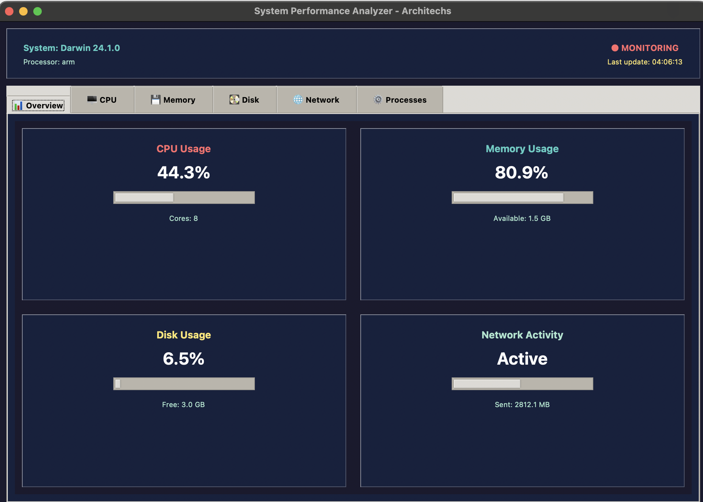
Objective
The primary goal of the System Performance Analyzer is to provide an intuitive, resource-efficient, and visually appealing GUI tool for real-time monitoring of macOS system performance. This includes tracking:
CPU usage
RAM consumption
Disk utilization
System specifications and OS metrics

Slide 3
Problem Statement & Proposed Solution
Problem Statement:
Users often lack simple, open-source performance monitoring tools tailored for their specific interface.
Native Activity Monitor is comprehensive but not always user-friendly for quick performance snapshots.
Cross-platform tools often don’t scale well visually or functionally on macOS due to resolution and framework constraints.
Proposed Solution:
A Python-based desktop application utilizing Tkinter and psutil for lightweight, efficient system tracking.
Smooth real-time graphing using matplotlib, with alert popups for threshold breaches.
Inclusion of modern UI/UX elements like splash screens and modular navigation for better user experience.

Slide 4
Updated Workflow / Architecture
High-Level Architecture:
User Interaction Layer:
Graphical Interface via tkinter
Buttons, panels, graphs, and alert popups
System Metrics Engine:
psutil library gathers live data on CPU, memory, disk, battery, and processes
Visualization Engine:
matplotlib generates smooth, real-time graphs
Embeds charts directly within the Tkinter window using FigureCanvasTkAgg
Thread Management:
Threads ensure non-blocking updates to graphs and metrics without freezing the UI
Utility Modules:
Export log data to JSON
Theme switch (light/dark)
Splash screen integration on startup

Slide 5
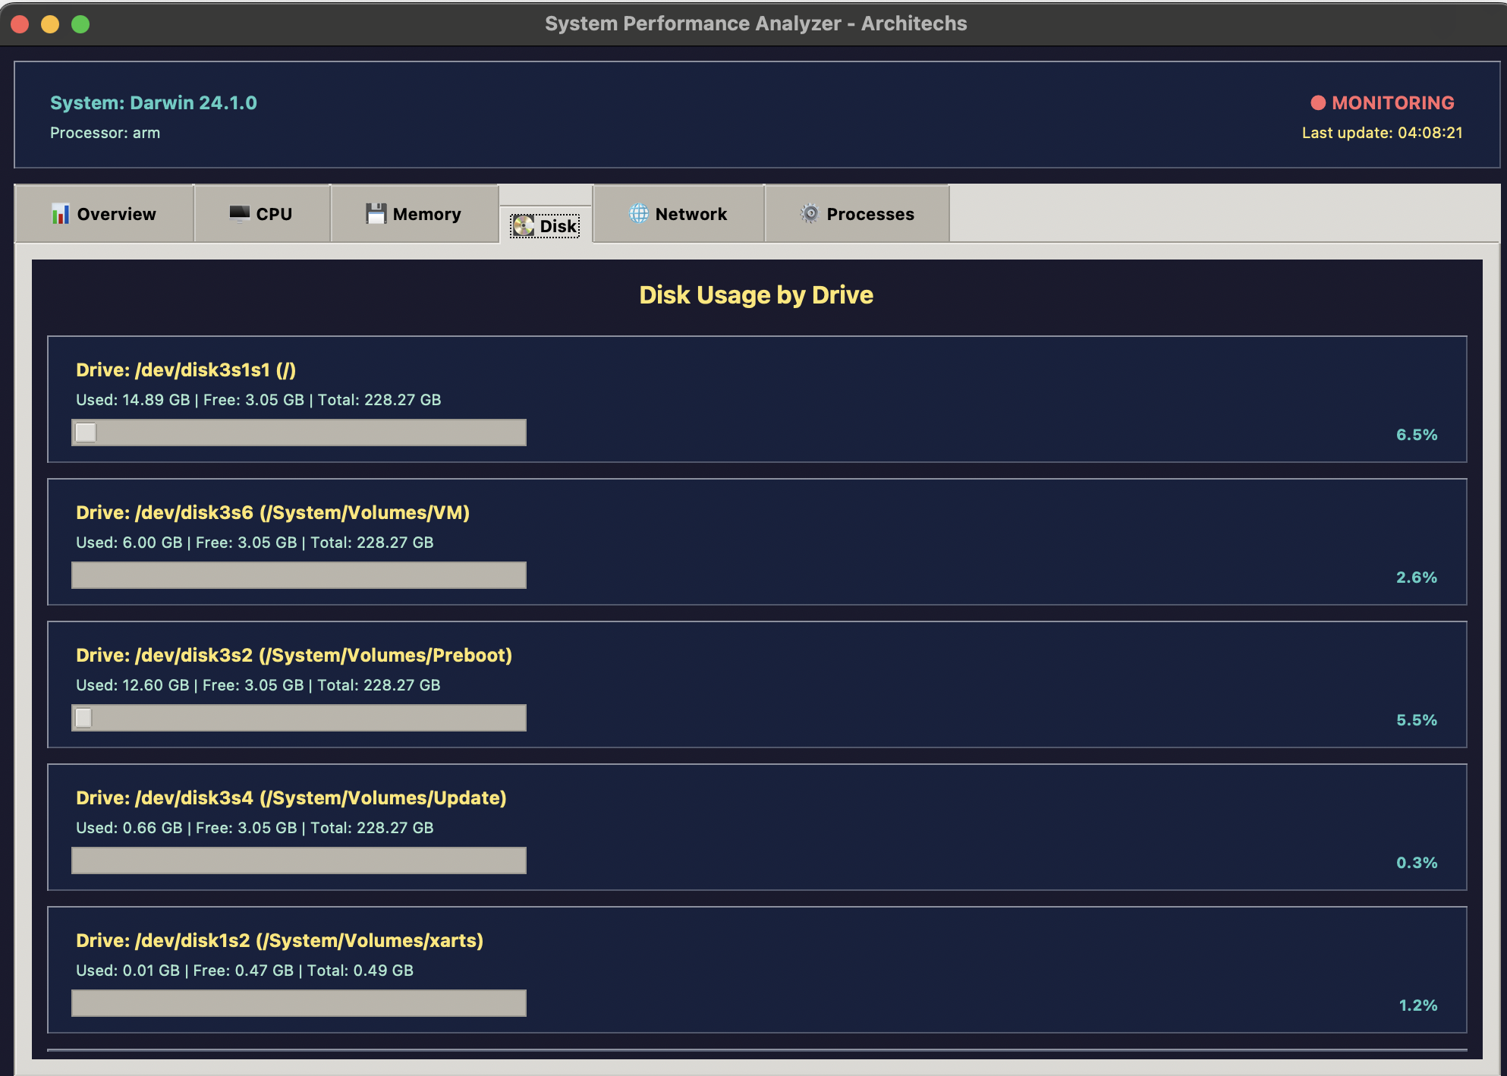
Key Features
Splash Screen with Branding Visually appealing startup screen with team and app identity.
Real-Time Resource Graphs
CPU utilization over the last 60 seconds
Memory usage tracking
Disk space info
System Information Display Fetch and display OS, processor, RAM, boot time, and system name.
Modular, Scalable GUI Adapted specifically for macOS 13” screens.
Multithreading Support For smooth GUI performance during heavy metric computation.
Alert System Notifies users with popup dialogs on resource overuse.
Log Export Export performance data to JSON for record keeping.

Slide 6
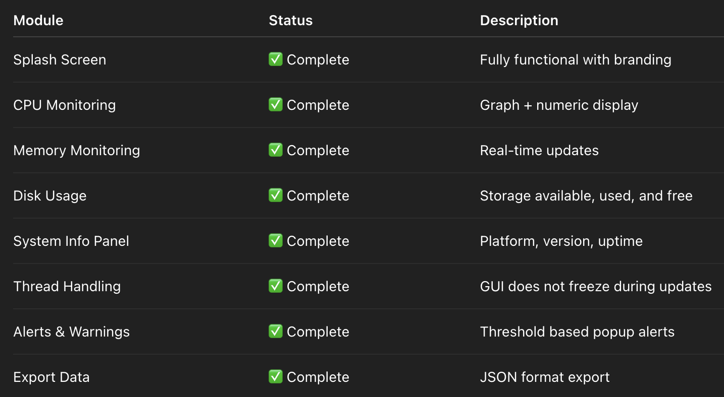
Technical Progress Overview

Slide 7
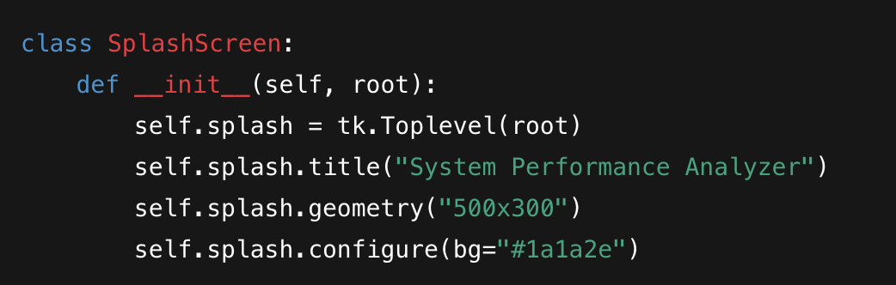
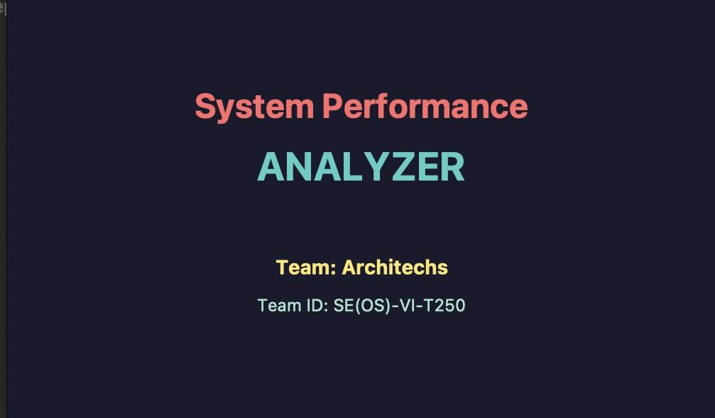
Code Snippet – Splash Screen
Functionality:
Initializes a top-level window separate from the main app.
Sets window dimensions and background theme.
Adds branding during the app launch sequence.

Slide 8
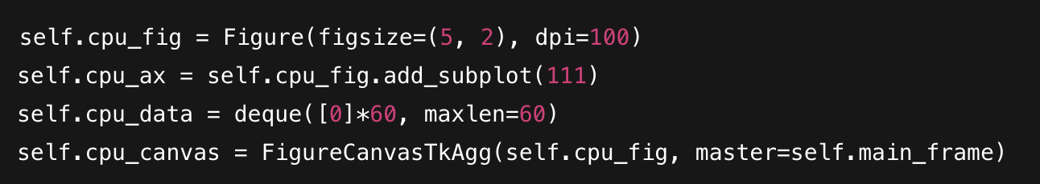
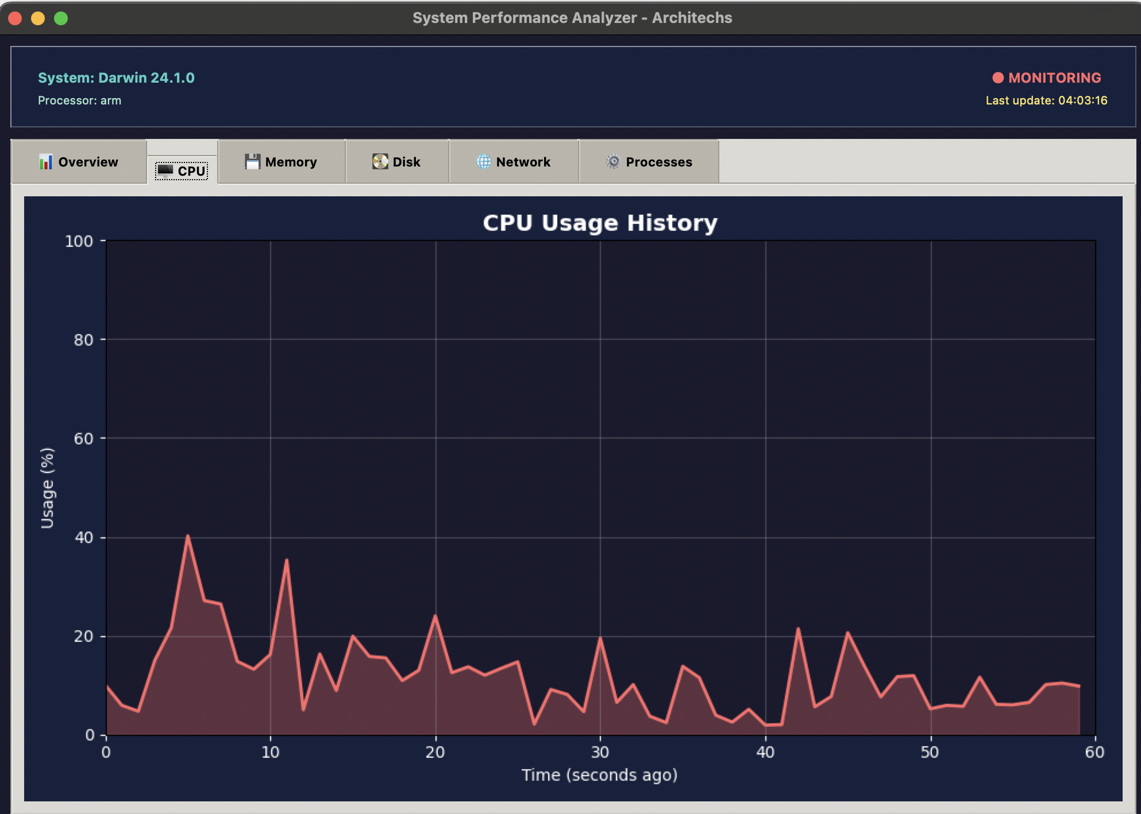
Code Snippet – CPU Graphing
Functionality:
Initializes a matplotlib figure and axis for plotting CPU usage.
Uses a deque to maintain a fixed-length rolling window of CPU data.
Embeds the chart inside the tkinter GUI frame.

Slide 9
Role-wise Contributions
Team Member | Contribution Area
Harshit Jasuja | psutil system data integration, Threading and live data updates, Add process-level tracking, Additional alert thresholds (RAM, Disk)
Yashika Dixit | GUI design and layout , Splash screen and branding integration, Theme customization (light/dark mode)
Shivendra Srivastava | Real-time graph plotting with matplotlib, Alert system for high CPU usage, Packaging tool into .app (macOS)

Slide 10
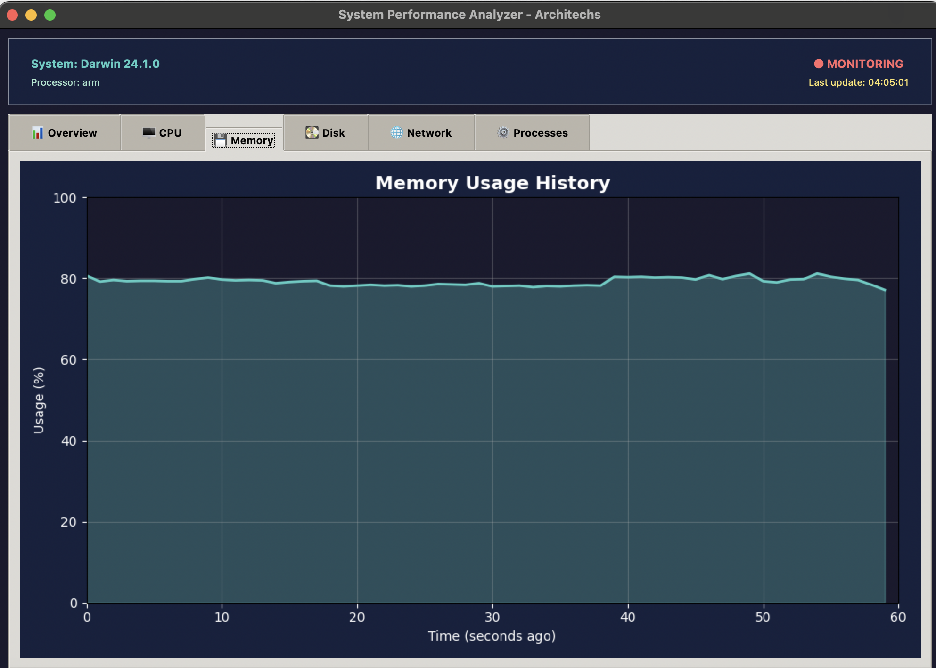
Challenges Faced & Key Learnings
Challenges:
Integrating live data updates without disrupting UI responsiveness.
Adapting the interface to macOS-specific dimensions and display scaling.
Managing background threads with tkinter's mainloop.
Key Learnings:
Efficient use of Python libraries like psutil and matplotlib.
GUI threading and synchronization concepts.
Application modularization for easier maintenance.
Coordinated teamwork and Git-based version control.

Slide 11
Future Enhancements & Scope
Process-level monitoring: Show top memory- or CPU-consuming processes.
Remote access: Allow stats syncing to a mobile or cloud dashboard.
Theme customization: Add light/dark mode toggles for accessibility.
macOS packaging: Convert Python script to native .app using py2app.
System cleanup recommendations: Suggest user actions when system slows down.

