Slide 1

Urban Harvest
Final Year Project
Submitted By:
1.Harshit Sharma(2010991265)
2.Aman Arora (2010993672)
Department of Computer Science and Engineering
Chitkara University, Punjab

Slide 2
INTRODUCTION
Welcome to Urban Harvest!
Urban Harvest was designed with a hope to emerge as a convenient and accessible way for individuals to seek the services of wide selection of restaurants and menus, place orders for delivery. The app is designed to provide a seamless and convenient ordering experience for users, while also helping restaurants to manage orders.
This app is intended to be a scalable and reliable solution for food ordering and delivery, with the ability to handle a large number of users and orders without degrading performance or availability. The app is also designed to be easy to use and maintain, with a modular architecture and well-documented codebase.

Slide 3
PROBLEM STATEMENT
Ordering food for delivery can be a time-consuming and frustrating process, involving multiple steps and interactions with different parties. Customers often have to call restaurants to place orders, wait on hold, and provide payment and delivery information. Restaurants, in turn, have to manually process orders, manage payment and delivery logistics, and handle customer inquiries and complaints. This process can be inefficient and error-prone, leading to delays, misunderstandings, and dissatisfied customers.
To address this problem, there is a need for a food delivery app that streamlines the ordering process and provides a convenient and user-friendly experience for both customers and restaurants.

Slide 4
OBJECTIVES
Here are some potential objectives for our food delivery app project:
To design and implement a user-friendly interface for browsing the menu and placing orders.
To allow customers to search for restaurants and menu items, customize their orders, and track the status of their orders.
To provide multiple payment options, including credit card, debit card, and mobile wallet, to ensure a convenient and secure checkout experience.
To ensure the app is scalable and can handle a large number of users and orders without degrading performance or availability.

Slide 5
SOFTWARE REQUIREMENTS
To run our Web(React.js) application, a system needs to meet the following tech-requirements:
Node.js: This is a JavaScript runtime that allows you to run JavaScript code outside of a web browser. You will need to install Node.js on your system.
TailwindCSS: This is a project based on a CSS framework known as TailwindCSS. For the VS Code the recognise it, you will be needed to install it using npm command:
-npm install tailwindcss –save

Slide 6
SOFTWARE REQUIREMENTS
3.React: This is a JavaScript library for building user interfaces. It allows you to create reusable UI components and manage the state of your application.
Once Node.js is installed, the Node Package Manager (npm) is used to install TailwindCSS and React.
One needs to install all the above-mentioned technologies, to run the application from their system. A user can simply use any web browser to access our website.

Slide 7
HARDWARE REQUIREMENTS
Device: Users should have access to a computer, laptop, tablet, or smartphone to access our website.
Memory (RAM): We need to ensure that the devices running our website have atleast 1GB to handle our website requirements.
Storage Space: To able to run are website properly, we need to have sufficient space for installing the environment to run our website. I would say 64 gigs.
Internet Connection: A stable internet connection is needed as our website is all about API data. It needs to fetch data from the API all the time.

Slide 8
PROJECT PLAN
Bundler : As for the the base, we have decided to go for –create-react-app that will use webpack as a bundler. It is greatly optimized and is reliable for making production builds.
Responsiveness (TailwindCSS): As for the responsiveness of the app, to ensure it adapts to different screen sizes and devices, we used responsive design techniques, such as flex and grids to create a seamless experience across desktop, tablet, and mobile devices.
Styling and Theming: For applying appropriate styles, color schemes to our components we used TailwindCSS to create a visually appealing interface.

Slide 9
PROJECT PLAN
Testing: For conducting functional and non-functional testing of the app, we have invested a lot of time identifying and fixing bugs and issues using a react testing framework known as Jest. We wrote various test cases for the proper functioning of our website.
Data: For the data of our website, we have used live swiggy’s API to get data into a json format and used it across the website.
Deployment: For deploying the app to a production environment we used Netlify. It is a free platform that helped us in deploying the website and access it anytime.

Slide 10
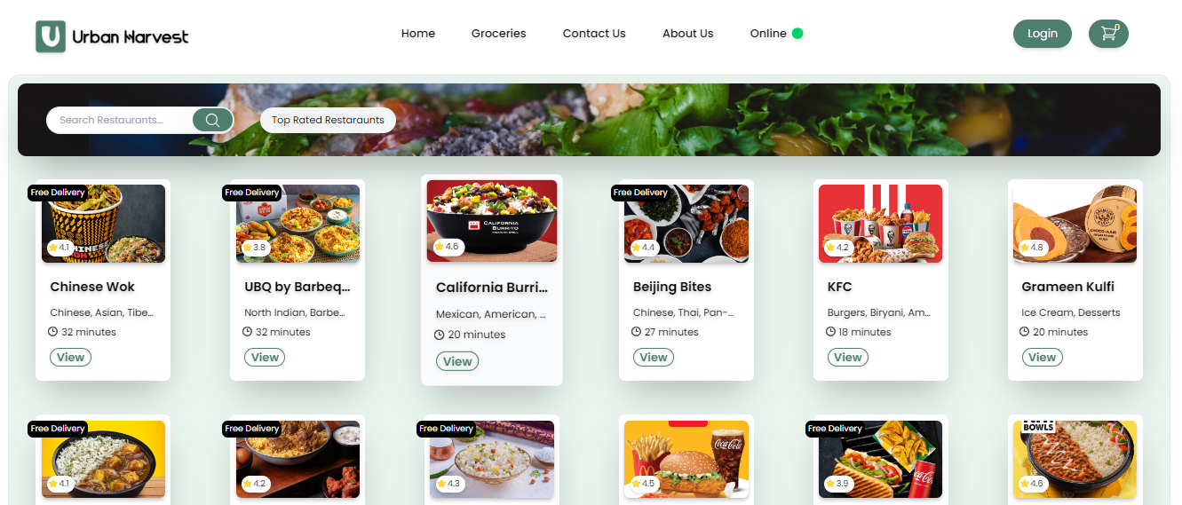
Screenshots
Homepage :

Slide 11
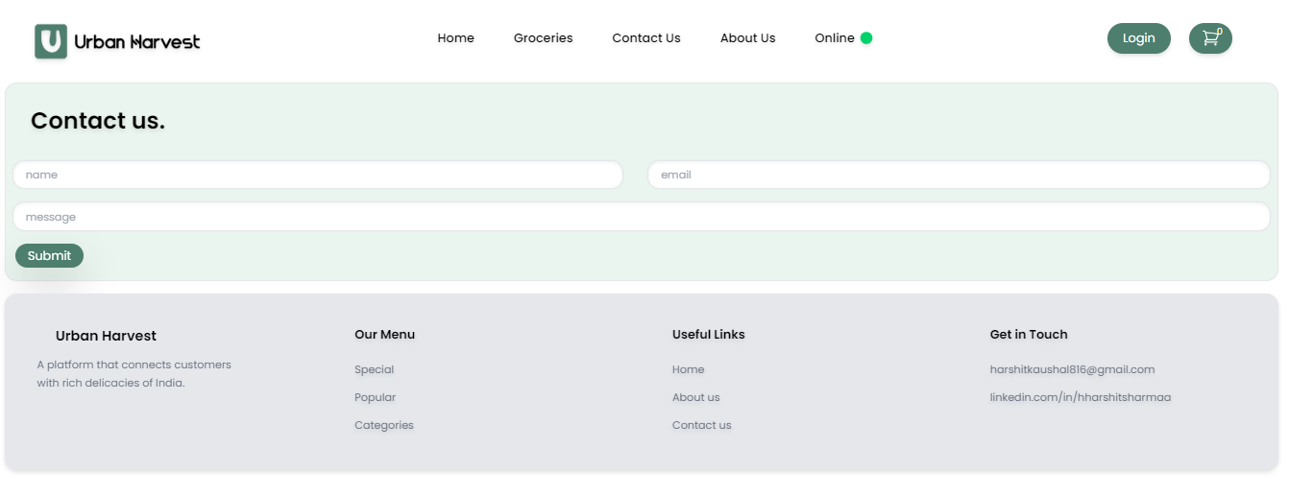
Screenshots
Contact Us :

Slide 12
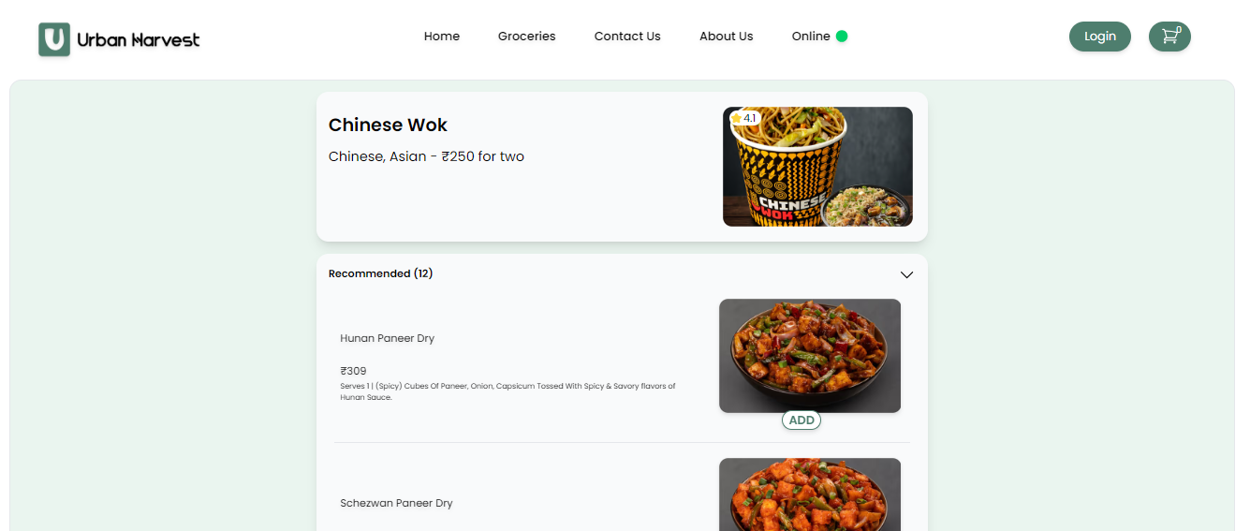
Screenshots
Menu Page :

Slide 13
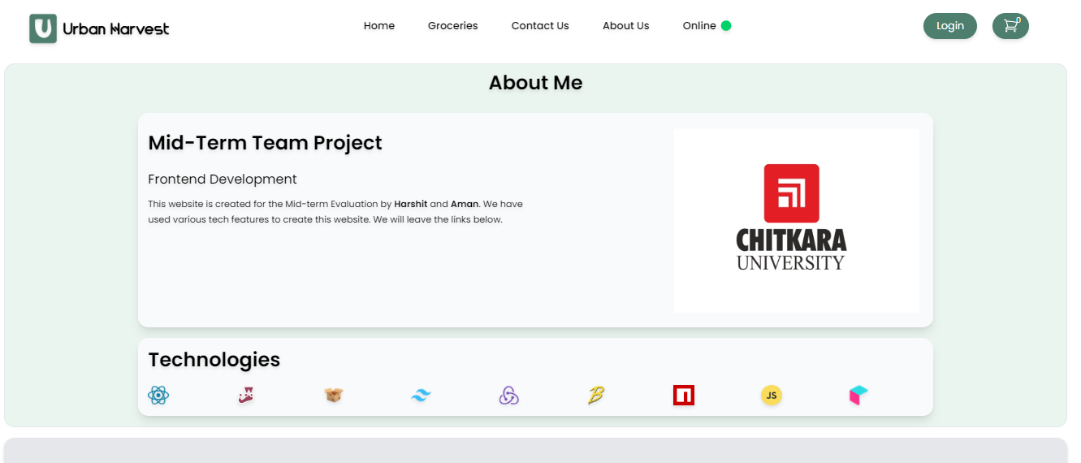
Screenshots
About Us :

Slide 14
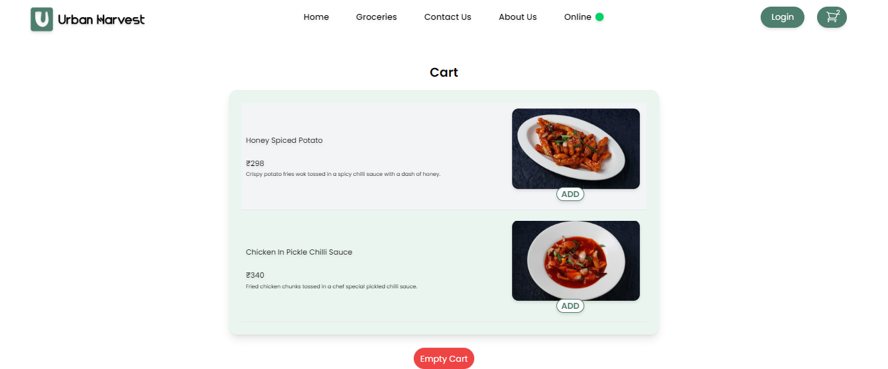
Screenshots
Cart Section :

Slide 15
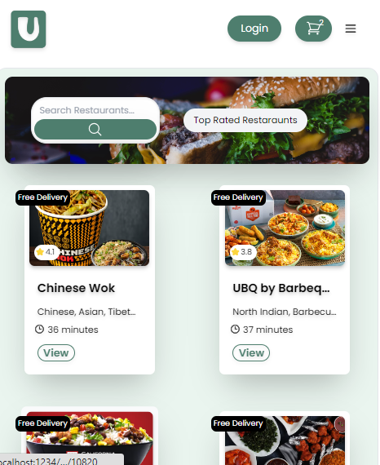
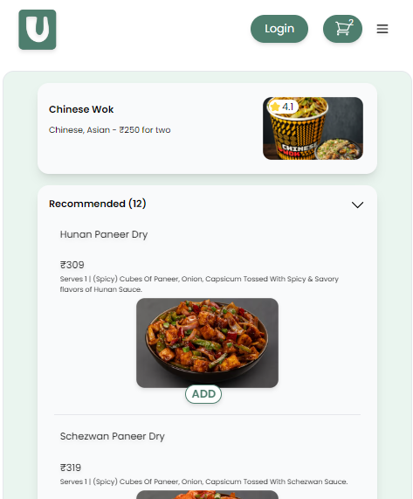
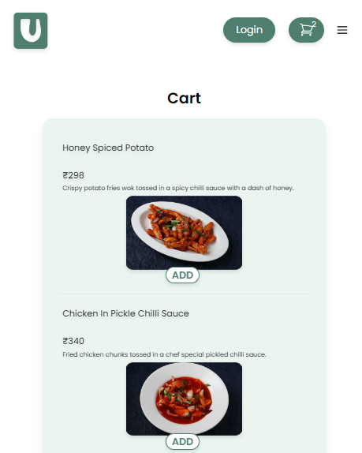
Responsiveness
Mobile-Friendly: -

Slide 16
FUTURE SCOPE
We are thinking of expanding its services to include more comprehensive services such as leaving the review of the restaurants.
To develop a mobile app for Android and iOS so that users can access our website on-the-go.
To create a google map interface so that people can see the restaurants live and can get tracking.
Add grocery section so that people get access to a vast store and make orders online.

