Slide 1

Project Presentation of Industry Oriented Hands-on Experience (IOHE) (CS-253)
on
Urban Harvest
1.Harshit Sharma(2010991265)
2.Aman Arora (2010993672)
Supervised by:
Dr. Isha Kansal
Department of Computer Science and Engineering
Chitkara University, Punjab

Slide 2
INTRODUCTION
Welcome to Urban Harvest!
Urban Harvest was designed with a hope to emerge as a convenient and accessible way for individuals to seek the services of wide selection of restaurants and menus, place orders. The app is designed to provide a seamless and convenient ordering experience for users, while also helping restaurants to manage orders.
This app is intended to be a scalable and reliable solution for food ordering, with the ability to handle a large number of users and orders without degrading performance or availability. The app is also designed to be easy to use and maintain, with a modular architecture and well-documented codebase.

Slide 3
PROBLEM STATEMENT
Ordering food for delivery can be a time-consuming and frustrating process, involving multiple steps and interactions with different parties. Customers often have to call restaurants to place orders, wait on hold, and provide information. Restaurants, in turn, have to manually process orders, manage payment, and handle customer inquiries and complaints. This process can be inefficient and error-prone, leading to delays, misunderstandings, and dissatisfied customers.
To address this problem, there is a need for a food ordering app that streamlines the ordering process and provides a convenient and user-friendly experience for both customers and restaurants.

Slide 4
OBJECTIVES
Here are some potential objectives for our food delivery app project:
To design and implement a user-friendly interface for browsing the menu and placing orders.
To allow customers to search for restaurants and menu items, customize their orders.
To allow customers to securely login into the website using personal credentials.
To ensure the app is scalable and can handle a large number of users and orders without degrading performance or availability.

Slide 5
SOFTWARE REQUIREMENTS
To run our Web(React.js) application, a system needs to meet the following tech-requirements:
Node.js: This is a JavaScript runtime that allows you to run JavaScript code outside of a web browser. You will need to install Node.js on your system.
TailwindCSS: This is a project based on a CSS framework known as TailwindCSS. For the VS Code the recognise it, you will be needed to install it using npm command:
-npm install tailwindcss –save

Slide 6
SOFTWARE REQUIREMENTS
3.React: This is a JavaScript library for building user interfaces. It allows you to create reusable UI components and manage the state of your application.
Once Node.js is installed, the Node Package Manager (npm) is used to install TailwindCSS and React.
One needs to install all the above-mentioned technologies, to run the application from their system. A user can simply use any web browser to access our website.

Slide 7
HARDWARE REQUIREMENTS
Device: Users should have access to a computer, laptop, tablet, or smartphone to access our website.
Memory (RAM): We need to ensure that the devices running our website have atleast 1GB to handle our website requirements.
Storage Space: To able to run are website properly, we need to have sufficient space for installing the environment to run our website. I would say 64 gigs.
Internet Connection: A stable internet connection is needed as our website is all about API data. It needs to fetch data from the API all the time.

Slide 8
PROJECT PLAN
The project plan outlines the systematic approach that will be followed develop the Urban Harvest using the Front End development. It details the various stages of the development process, from initial planning and requirements gathering to deployment and maintenance.
1. Requirements Gathering:
Defining the scope and goals of the our platform.
Gathering requirements by understanding user needs, preferences, and expectations.
Identify key features such as user registration, menu browsing, adding items to cart, form-submissions and more.

Slide 9
PROJECT PLAN
2. System Design:
Once the requirements are gathered, the system design phase begins. The design should prioritize user experience (UX) and accessibility while ensuring scalability, security, and maintainability of the system.
3. Front-end Development:
Using React.js, the front-end development phase involves translating the design mockups into interactive user interfaces. Components such as forms, tables, and dashboards are developed to facilitate user interactions. The front-end should be responsive, intuitive, and visually appealing, adhering to best practices in web development and accessibility standards.

Slide 10
PROJECT PLAN
4. Testing:
Throughout the development process, rigorous testing is conducted to ensure the quality and reliability of the Urban Harvest. Unit tests, integration tests, and end-to-end tests are performed to identify and fix any bugs or issues. These tests are conducted with real users to gather feedback and validate the system against the original requirements.
5. Deployment:
Once testing is complete and the Urban Harvest is deemed ready for production, it is deployed to a hosting environment using platforms such Vercel, Netlify.

Slide 11
TOOLS AND TECHNOLOGY
Bundler : As for the the base, we have decided to go for –create-react-app that will use webpack as a bundler. It is greatly optimized and is reliable for making production builds.
Responsiveness (TailwindCSS): As for the responsiveness of the app, to ensure it adapts to different screen sizes and devices, we used responsive design techniques, such as flex and grids to create a seamless experience across desktop, tablet, and mobile devices.
Styling and Theming: For applying appropriate styles, color schemes to our components we used TailwindCSS to create a visually appealing interface.

Slide 12
TOOLS AND TECHNOLOGY
Testing: For conducting functional and non-functional testing of the app, we have invested a lot of time identifying and fixing bugs and issues using a react testing framework known as Jest. We wrote various test cases for the proper functioning of our website.
Data: For the data of our website, we have used live swiggy’s API to get data into a json format and used it across the website.
Deployment: For deploying the app to a production environment we used Netlify. It is a free platform that helped us in deploying the website and access it anytime.

Slide 13
TOOLS AND TECHNOLOGY
State Management: Redux, a predictable state container for managing application state and ensuring data consistency across the frontend components.
Firebase: A standard for securely logging and signing in, used for implementing user authentication and authorization.
React-Testing-library : It provides light utility functions on top of react-dom and react-dom/test utils, in a way that encourages better testing practices.

Slide 14
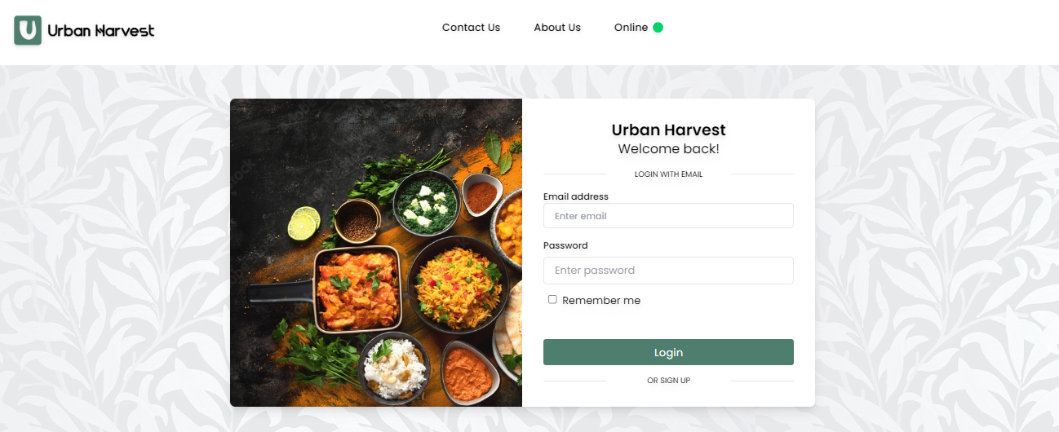
Screenshots
Login Component:

Slide 15
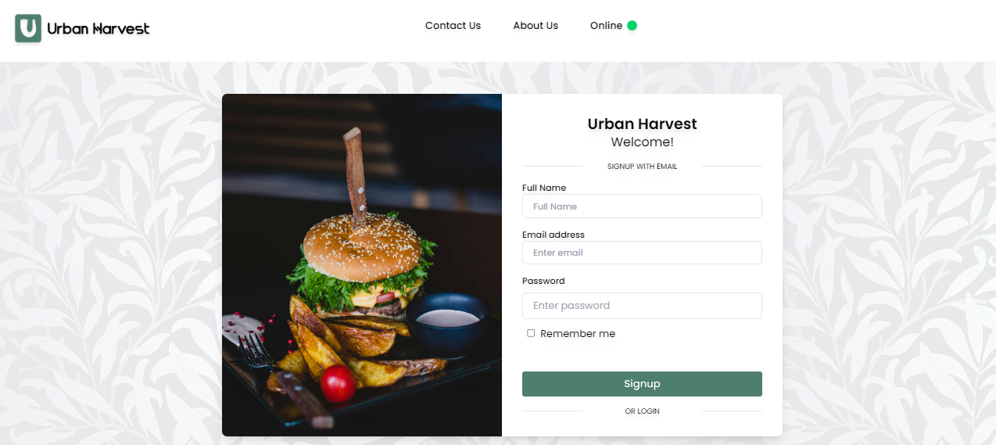
Sign Up component:

Slide 16
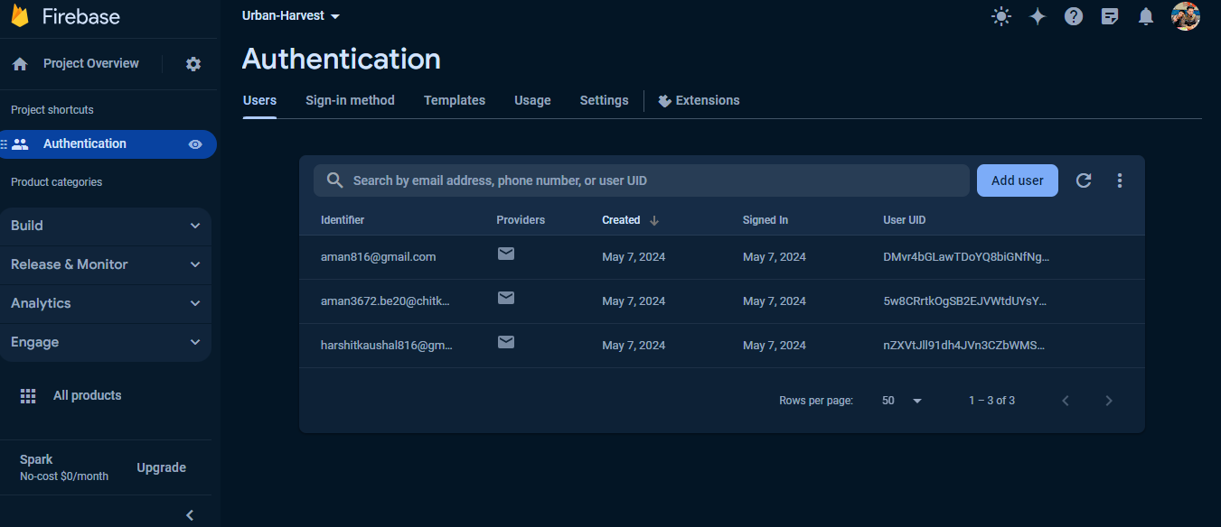
Firebase Auth:

Slide 17
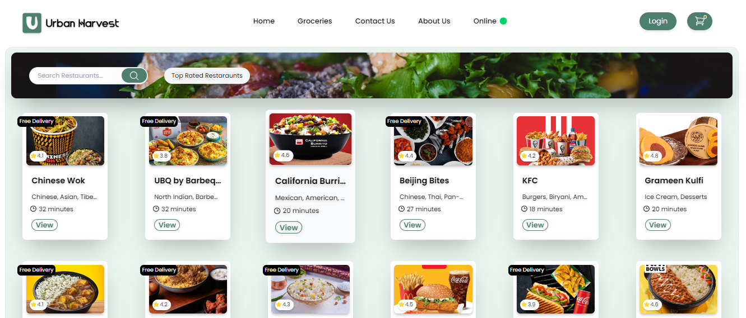
Screenshots
Homepage :

Slide 18
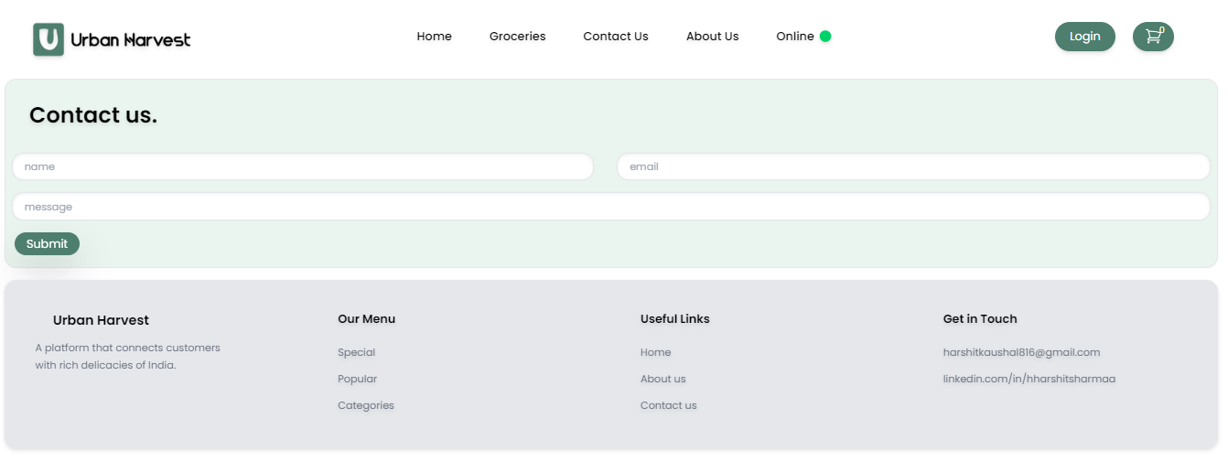
Screenshots
Contact Us :

Slide 19
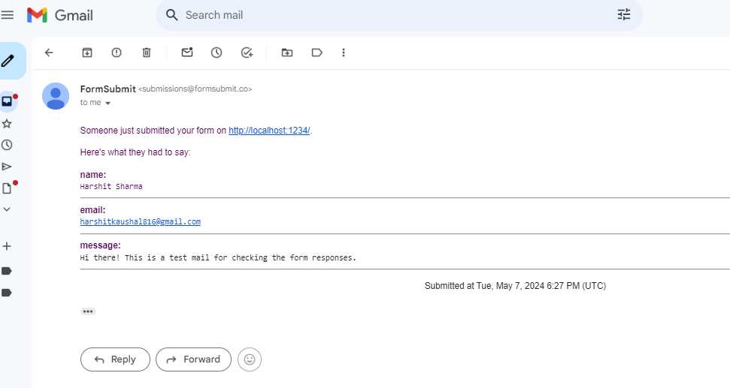
Form response :

Slide 20
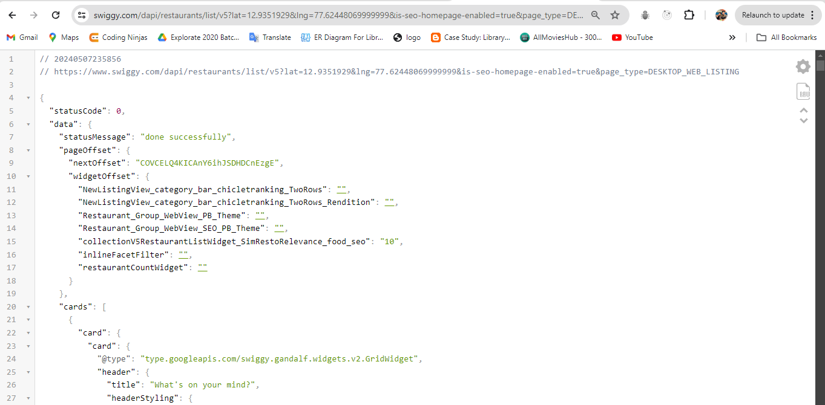
Swiggy Live API:

Slide 21
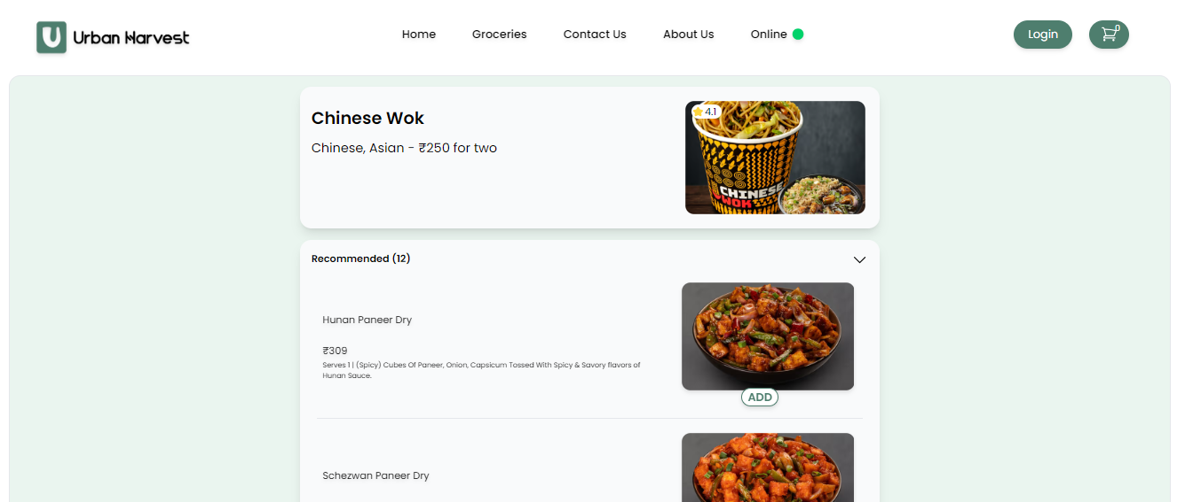
Screenshots
Menu Page :

Slide 22
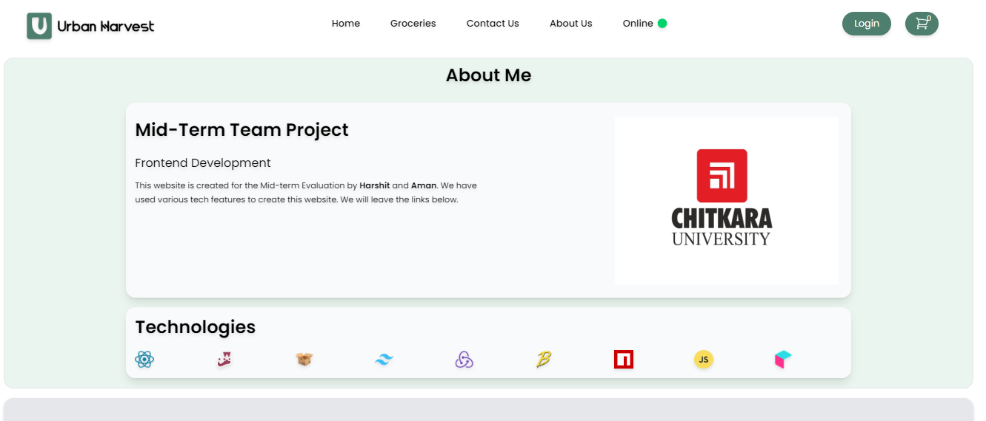
Screenshots
About Us :

Slide 23
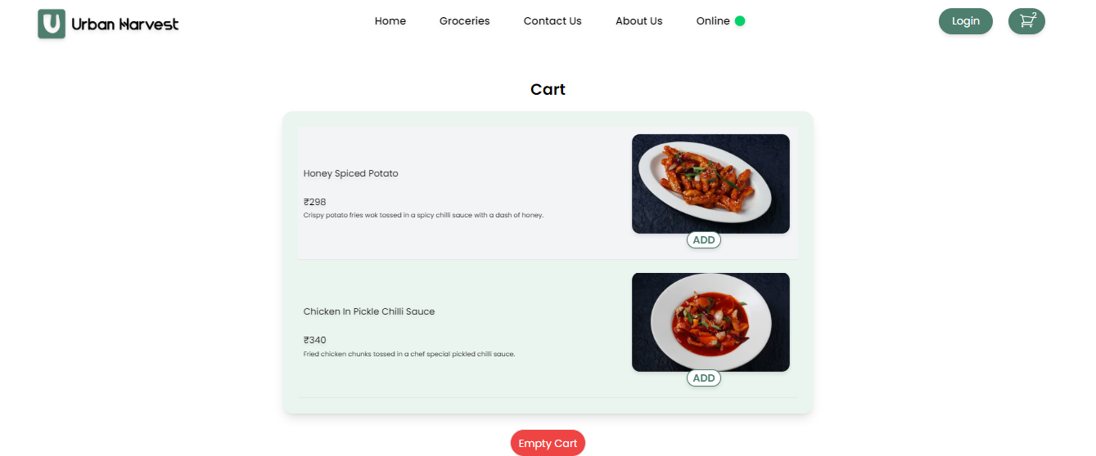
Screenshots
Cart Section :

Slide 24
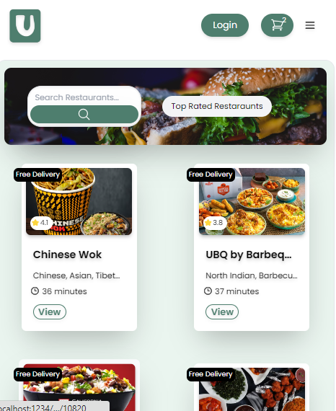
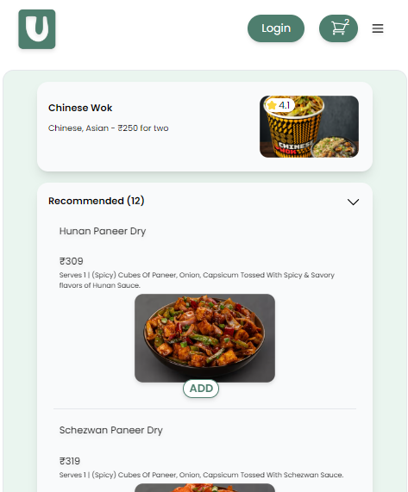
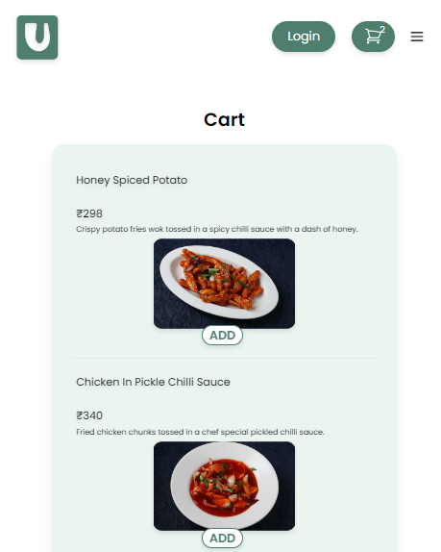
Responsiveness
Mobile-Friendly: -

Slide 25
CONCLUSION
The development and implementation of the Urban Harvest project have successfully
addressed the identified gap in the online food ordering market by providing a dedicated platform for ordering, selling food items. Through its user-friendly interface, innovative
features, and community-driven initiatives, Urban Harvest has democratized access to
various famous restaurants. The positive feedback and engagement metrics reflect the project's success in meeting user needs and expectations, underscoring its significance in
promoting good knowledge, and experiencing an overall good practice while ordering food online.

Slide 26
FUTURE SCOPE
We are thinking of expanding its services to include more comprehensive services such as leaving the review of the restaurants.
To develop a mobile app for Android and iOS so that users can access our website on-the-go.
To create a google map interface so that people can see the restaurants live and can get tracking.
Add grocery section so that people get access to a vast store and make orders online.
Continuously optimizing the performance of the platform to ensure fast load times, smooth navigation, and reliable operation.

