Slide 1

TVS CREDIT E.P.I.C 8 // IT CASE STUDY CHALLENGE
SMART LENDING
DECISION HUB
Empowering Rural Bharat with Geospatial AI, Sentinel-2 Crop Telemetry & Harvest-Aligned Dynamic Repayments
PROBLEM STATEMENT (c): Alternative Underwriting & AI Credit Risk for Rural Borrowers
🛰️ 10-Meter Sentinel-2 Satellite Multi-Spectral NDVI & Automated Cadastre Verification
📊 Explainable AI Scoring Engine with Factor Contribution SHAP Attribution Drivers
🌾 Cash-Flow Synchronized Harvest-Aligned Bullet Repayment Structuring
🚨 Real-Time Agro-Climatic Early-Warning Anomaly Radar & Default Prevention
🤖 GenAI 'TVS Sahayak' Multilingual Vernacular Voice & Text Underwriting Copilot
TEAM HANDLE: hverma0511
TEAM MEMBERS: Harshit Verma | Nandani Singh
LIVE DEPLOYED PROTOTYPE: https://tvs-pied.vercel.app/

Slide 2

TVS CREDIT E.P.I.C 8 // IT CASE STUDY // PROBLEM STATEMENT (C)
EXECUTIVE SUMMARY: THE NEXT-GEN LENDING ENGINE
THE STRATEGIC CONTEXT
• TVS Credit Heartland Presence:
A premier NBFC serving 26M+ rural & semi-urban customers across India with Tractor, Two-Wheeler, and MSME loans.
• The Smallholder Challenge:
Over 80% of farming borrowers operate in a cash economy with zero formal CIBIL credit score.
• The Paradigm Shift:
Transitioning from slow, subjective physical auditing to objective, algorithmic geospatial underwriting.
THE CORE INNOVATION
• Sentinel-2 Satellite Telemetry:
10-meter optical NDVI tracking crop canopy vigor, chlorophyll density & soil moisture without physical field visits.
• Explainable AI Scoring:
XGBoost + SHAP underwriting engine delivering instant, audit-compliant decisions in < 3 minutes.
• Harvest-Aligned EMIs:
Repayment amounts flex with crop-cutting dates — token interest in sowing, bullet post-mandi sale.
QUANTIFIED IMPACT
• Sanction Speed:
< 3 Minutes automated credit decisioning vs 14-21 days of manual revenue-patwari audits.
• Underwriting CAC:
38% decrease in customer acquisition & loan servicing costs via remote digital cadastre verification.
• Delinquency Reduction:
42% drop in 90-day overdue accounts through cash-flow aligned harvest repayment scheduling.

Slide 3
TVS CREDIT E.P.I.C 8 // IT CASE STUDY // PROBLEM STATEMENT (C)
THE PROBLEM: WHY TRADITIONAL CREDIT EXCLUDES SMALLHOLDERS
01 // ABSENCE OF FORMAL CREDIT HISTORY
• Over 80% of smallholder farmers operate in a cash-first ecosystem with zero CIBIL score.
• Lack of IT returns or audited salary slips locks viable rural borrowers out of formal NBFC banking.
• Drives farmers toward unorganized local moneylenders charging exorbitant 36%-60% interest rates.
02 // EXPENSIVE MANUAL LAND AUDITS
• Traditional physical parcel verification takes 14 to 21 days with manual revenue-patwari audits.
• Direct operational cost averages ₹3,500 per site visit, heavily inflating customer acquisition costs.
• High vulnerability to boundary disputes, falsified tenancy documents, and forged land records.
03 // RIGID FLAT MONTHLY EMIs
• Conventional banking forces identical monthly EMIs (e.g. ₹12,500 every 30 days) across all 12 months.
• During sowing seasons (July/Aug), farmer cash flow is depleted by seeds and fertilizers, causing defaults.
• Triggers artificial loan delinquency despite a guaranteed bumper harvest maturity just 90 days away.
04 // CLIMATE & MANDI PRICE CRASHES
• Localized weather shocks (monsoon deficits, pest outbreaks) trigger regional default clusters.
• Sudden wholesale APMC mandi price crashes wipe out crop profits without early risk notice.
• Lenders lack predictive surveillance to restructure loans before accounts turn into NPAs.

Slide 4
TVS CREDIT E.P.I.C 8 // IT CASE STUDY // PROBLEM STATEMENT (C)
SYSTEM ARCHITECTURE: END-TO-END DECISION FLOWCHART
STAGE 01
DATA INGESTION
▸ Sentinel-2 10m Optical
▸ State Khasra Cadastre
▸ IMD Agromet 30-Yr Weather
▸ APMC Mandi Real-time Feeds
STAGE 02
FEATURE ENGINE
▸ NDVI Chlorophyll Curve
▸ NDWI Moisture Deficit
▸ Geo-Fenced Polygon Match
▸ Drought Variance Benchmarks
STAGE 03
AI SCORING CORE
▸ XGBoost Gradient Model
▸ SHAP Factor Contributions
▸ Multi-Factor Score (0-100)
▸ Risk Tier Stratification
STAGE 04
PRODUCT STRUCTURING
▸ Dynamic Harvest EMI Engine
▸ Token Sowing Rate (₹800/mo)
▸ Bullet Mandi Principal
▸ < 3 Min Automated Sanction
STAGE 05
RISK RADAR & SHIELD
▸ Continuous Satellite Scan
▸ Automated Vernacular SMS
▸ Proactive EMI Restructuring
▸ Field Officer Dispatch
CORE ARCHITECTURAL HIGHLIGHTS // SCALABLE CLOUD PIPELINE
• Ingestion: Automated Copernicus Open Access Hub API | • Model: XGBoost Regression with Treelite low-latency C-runtime (<15ms inference) | • Database: PostGIS Spatial DB | • Security: 256-bit Cadastre Encryption with RBI Digital Lending Compliance

Slide 5
TVS CREDIT E.P.I.C 8 // IT CASE STUDY // PROBLEM STATEMENT (C)
GEOSPATIAL AI: SENTINEL-2 NDVI & CADASTRAL VERIFICATION
SATELLITE METHODOLOGY & PIPELINE
• 10-Meter Optical Multi-Spectral Resolution
Ingests Sentinel-2A and 2B constellations revisiting farm parcels every 5 days for real-time cloud-masked telemetry.
• Normalized Difference Vegetation Index (NDVI)
Calculated via (Band 8 NIR - Band 4 Red) / (Band 8 NIR + Band 4 Red). Direct indicator of chlorophyll activity and biomass density.
• 24-Month Temporal Trajectory
Compares active crop phenology against 2-year historical benchmarks to detect growth anomalies, pest damage, or delayed sowing.
• Automated Boundary Cadastre Lookup
Cross-validates claimed survey numbers against digitised State Bhulekh/Bhoomi registries, stopping ghost-plot loan fraud.
NDVI UNDERWRITING THRESHOLD MATRIX
■ NDVI > 0.65 (OPTIMAL HEALTH)
Status: High Chlorophyll Biomass
Action: Sanction Approved: Maximum 90% LTV, Preferred 11.5% interest rate, zero manual audit requirement.
■ NDVI 0.40 - 0.65 (MODERATE)
Status: Normal Crop Growth
Action: Sanction Approved: Standard 80% LTV, 12.2% rate, automated disbursement to TVS Wallet.
■ NDVI 0.20 - 0.40 (VEGETATIVE STRESS)
Status: Moisture Deficit Detected
Action: Conditional Approval: Requires irrigation validation (borewell/canal) or co-applicant guarantee.
■ NDVI < 0.20 (BARREN / FAILURE)
Status: Stunted Crop / Dry Plot
Action: Declined / Restructuring: Automatically diverted to disaster relief & crop insurance claim assistance.

Slide 6
TVS CREDIT E.P.I.C 8 // IT CASE STUDY // PROBLEM STATEMENT (C)
EXPLAINABLE AI: ALTERNATIVE MULTI-FACTOR SCORING
CROP CANOPY VIGOR (NDVI) // +35% WEIGHT
Satellite multi-spectral vegetation curve confirming active farming, chlorophyll density, and projected crop cutting yield.
PRECIPITATION & WATER ACCESS // +20% WEIGHT
30-year IMD monsoon anomaly comparison, drought frequency modeling, and tube-well/perennial canal irrigation access.
MANDI ACCESSIBILITY & CASH-IN // +15% WEIGHT
Proximity to regulated APMC wholesale mandis, historical market realization rates, and modal price volatility metrics.
SOIL QUALITY & CROP ROTATION // +15% WEIGHT
Soil texture classification (black cotton, alluvial loam) and demonstrated multi-season crop diversification track.
ASSET PROXIES & REPAYMENT TRACK // +15% WEIGHT
Utility payments, tractor telemetry ownership data, and historical micro-loan repayment discipline.

Slide 7
TVS CREDIT E.P.I.C 8 // IT CASE STUDY // PROBLEM STATEMENT (C)
PRODUCT INNOVATION: HARVEST-ALIGNED REPAYMENT LIFECYCLE
PHASE 1: SOWING
JUN - AUG (3 MONTHS)
Cash Flow: Peak Cash Outflow
(Seeds, Fertilizers, Diesel, Labor)
❌ TRADITIONAL FLAT:
EMI: ₹12,500 / mo
Impact: Severe Cash Deficit → 18.4% Default
✅ TVS HARVEST-ALIGNED:
EMI: ₹800 / mo
Impact: Token Interest Only → Zero Default Risk
PHASE 2: VEGETATIVE
SEP (1 MONTH)
Cash Flow: Maintenance Outflow
(Pesticide sprays & weeding)
❌ TRADITIONAL FLAT:
EMI: ₹12,500 / mo
Impact: Liquidity Strain → Missed Payments
✅ TVS HARVEST-ALIGNED:
EMI: ₹1,200 / mo
Impact: Low Maintenance EMI → Working Capital Intact
PHASE 3: HARVEST & MANDI
OCT - NOV (2 MONTHS)
Cash Flow: Massive Cash Inflow
(APMC wholesale crop realization)
❌ TRADITIONAL FLAT:
EMI: ₹12,500 / mo
Impact: Under-collects surplus cash liquidity
✅ TVS HARVEST-ALIGNED:
EMI: ₹68,000 Bullet
Impact: Syncs with ₹1.8L+ Mandi crop payout
PHASE 4: RABI / OFF-SEASON
DEC - MAY (6 MONTHS)
Cash Flow: Stabilized Cash Flow
(Winter crop & allied income)
❌ TRADITIONAL FLAT:
EMI: ₹12,500 / mo
Impact: Rigid burden during winter sowing
✅ TVS HARVEST-ALIGNED:
EMI: ₹1,000 / mo
Impact: Buffer cushion for Rabi field inputs

Slide 8
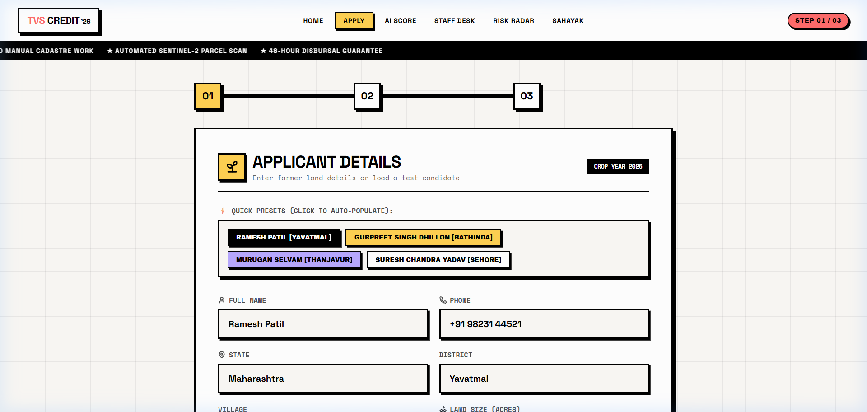
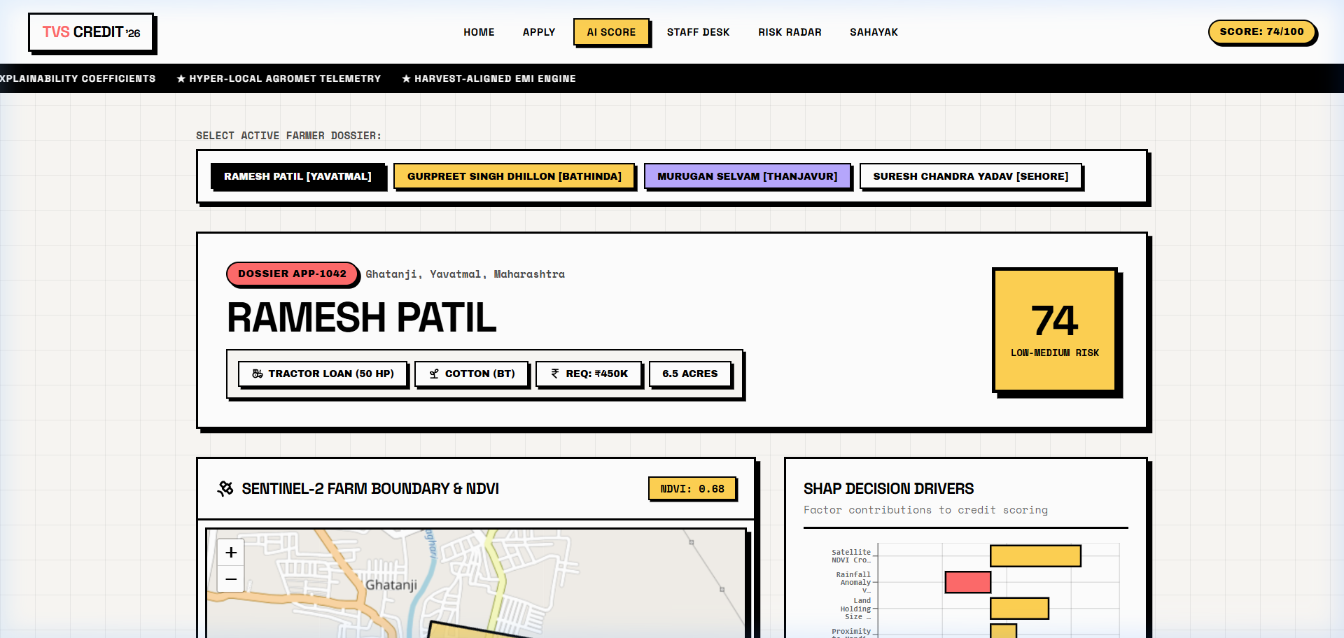
PROTOTYPE SHOWCASE // LIVE LINK: HTTPS://TVS-PIED.VERCEL.APP/
LIVE PROTOTYPE: DIGITAL ONBOARDING & SATELLITE SCORING
1. ZERO-PAPERWORK FARMER APPLICATION (/apply)
2. SATELLITE MAP & SHAP DRIVERS (/scoring)
• 3-Step Guided Flow: Quick-select presets for Ramesh Patil, Gurpreet Singh, etc.
• Automated Cadastre Match: Auto-populates State, District, Village & Survey number.
• Zero CIBIL Required: Instant alternative evaluation for unbanked smallholders.
• 48-Hour Disbursal Guarantee: Direct TVS loan sanction generation in under 3 minutes.
• Interactive Leaflet Map: Geospatial parcel boundary with active NDVI 0.68 display.
• Transparent Score Card: Instant AI Score 74/100 (Low-Medium Risk Profile).
• Explainable SHAP Drivers: Direct positive factor attribution breakdown for credit.
• Dynamic EMI Simulation: Previews token sowing installment vs harvest bullet.

Slide 9
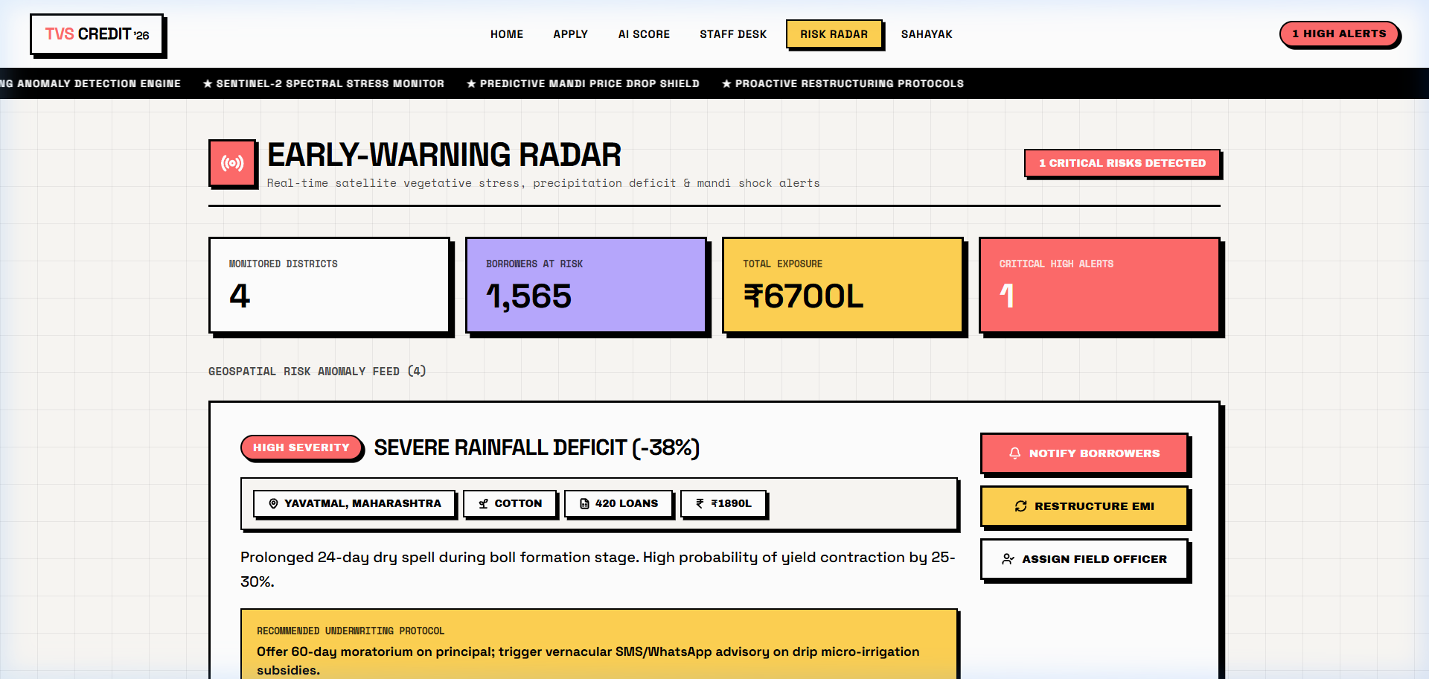
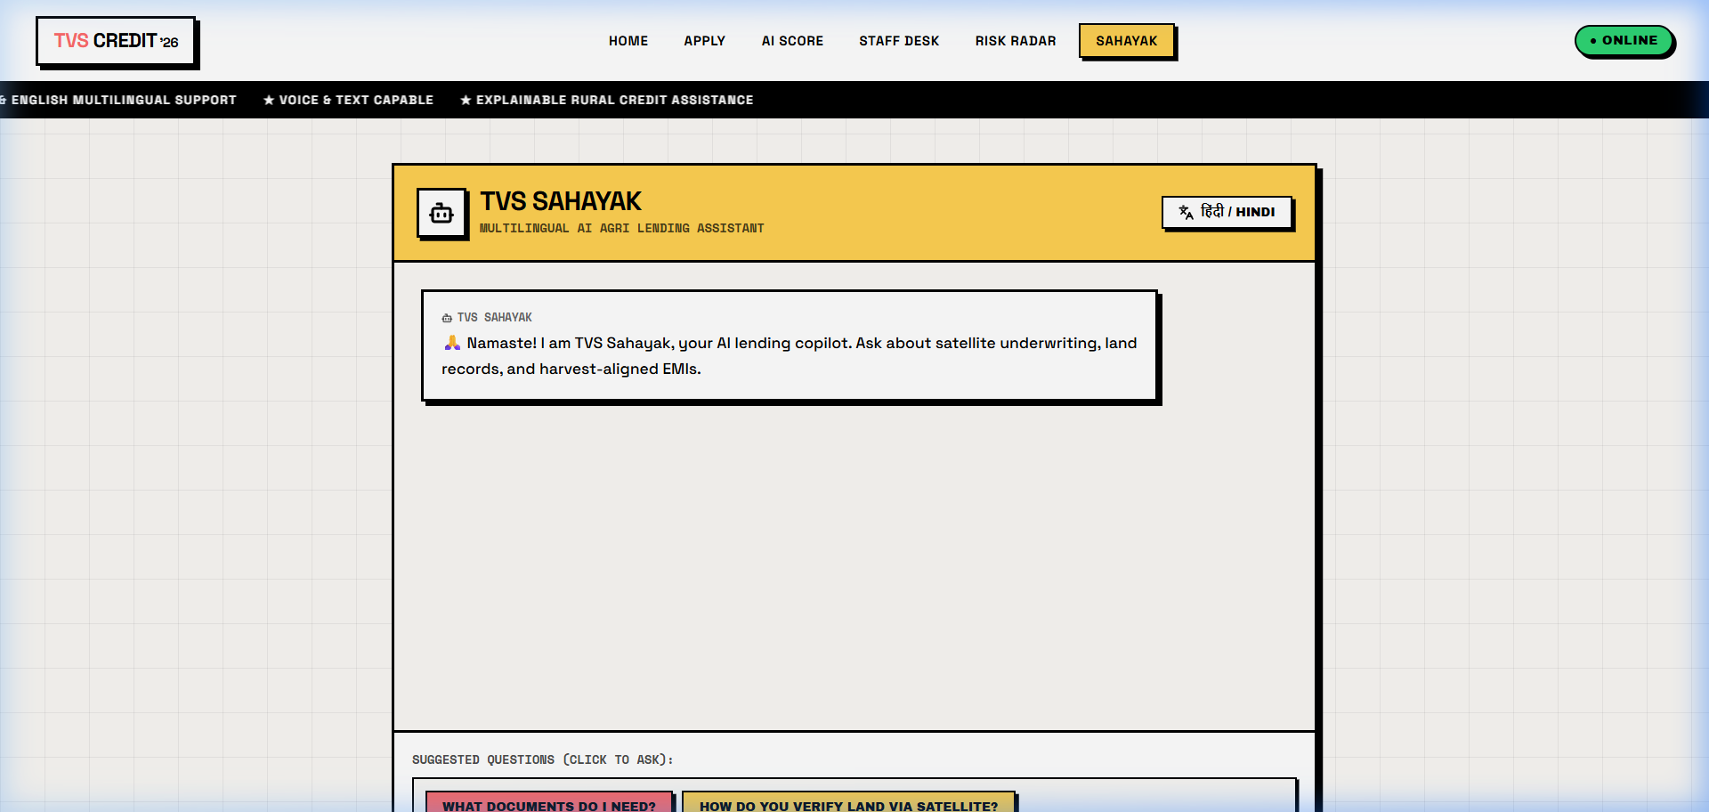
PROTOTYPE SHOWCASE // LIVE LINK: HTTPS://TVS-PIED.VERCEL.APP/
LIVE PROTOTYPE: EARLY-WARNING RADAR & TVS SAHAYAK
3. AGRO-CLIMATIC RISK RADAR (/monitoring)
4. GENAI MULTILINGUAL SAHAYAK (/assistant)
• Real-Time Portfolio Telemetry: 1,565 borrowers at risk, ₹6,700L exposure tracked.
• Drought & Anomaly Feeds: Flags severe rainfall deficits (-38%) in Yavatmal.
• One-Click Restructuring: Automated 60-day moratorium on principal repayment.
• Field Officer Dispatch: Routes local agro-officers to assist distressed farmers.
• Vernacular Dialogue: Converses fluently in Hindi, Marathi, Tamil, Telugu & English.
• Jargon Translation: Converts complex SHAP & NDVI terms into farming analogies.
• Quick Question Chips: 'How do you verify land?', 'What documents do I need?'
• Fraud Protection: Educates farmers against local predatory commission middlemen.

Slide 10
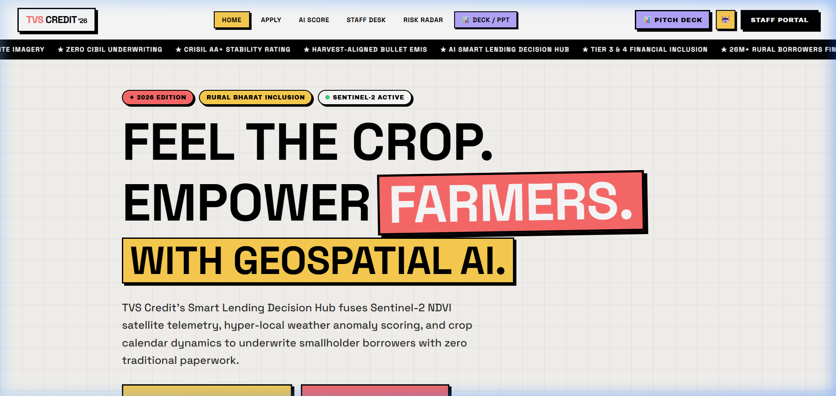
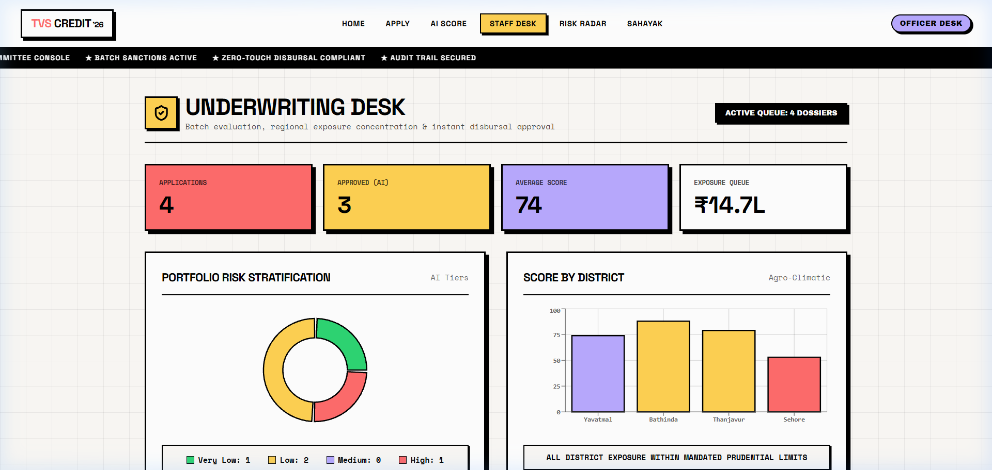
PROTOTYPE SHOWCASE // LIVE LINK: HTTPS://TVS-PIED.VERCEL.APP/
LIVE PROTOTYPE: NEO-BRUTALIST UI & CREDIT COMMITTEE DESK
5. NEO-BRUTALIST BORROWER PORTAL (/)
6. CREDIT COMMITTEE PORTFOLIO DESK (/staff)
• Sunlight-Optimized Neo-Brutalism: 3px solid ink borders and flat offset shadows.
• High Contrast: Ultra-crisp readability on low-cost mobile screens in rural fields.
• Running Ticker Tape: CRISIL AA+ stability, zero-CIBIL underwriting, Sentinel-2 feeds.
• Direct Access: Seamless navigation between application, scoring, and AI Sahayak.
• Portfolio Risk Stratification: Real-time distribution across 4 distinct risk tiers.
• Agro-Climatic Score Breakdown: District benchmarks across Yavatmal, Bathinda, etc.
• Batch Sanction Approvals: Fast-track queue management for loan officers.
• Prudential Concentration: Enforces regional exposure safety caps under RBI norms.

Slide 11
TVS CREDIT E.P.I.C 8 // IT CASE STUDY // PROBLEM STATEMENT (C)
BUSINESS IMPACT, ROI & SCALABILITY ROADMAP
< 3 MIN
SANCTION TURNAROUND
Down from 14-21 days of manual field audits.
38% DROP
UNDERWRITING CAC
Remote satellite scans eliminate physical survey travel.
42% LESS
90-DAY DELINQUENCY
Harvest EMIs eliminate artificial sowing season defaults.
90% LTV
MAXIMUM FINANCING
Increased from 70% industry average with satellite certainty.
STRATEGIC SCALING ROADMAP // 2026 - 2028
★ PHASE 1: NATIONWIDE SATELLITE EXPANSION
Scale Sentinel-2 & SAR radar cadastre to 150+ agro-climatic zones across Maharashtra, Punjab, Tamil Nadu, MP, UP, and Rajasthan.
★ PHASE 2: IOT SENSOR & E-NAM DIGITAL MANDI INTEGRATION
Integrate automated digital mandi telemetry and private IoT soil-moisture probes for automated yield insurance underwriting.
★ PHASE 3: SUSTAINABLE GREEN AGRI-FINANCING
Subsidized 0% interest credit tiers for PM-KUSUM solar water pumps, micro-drip irrigation, and zero-tillage residue management equipment.
★ PHASE 4: ONDC VALUE CHAIN EMBEDDED CREDIT
Directly disburse funds to farm input dealers, certified seed distributors, and cold storage lockers via TVS Farmer Wallet.

Slide 12
TVS CREDIT E.P.I.C 8 // IT CASE STUDY // PROBLEM STATEMENT (C)
CONCLUSION: TRANSFORMING RURAL CREDIT FOR BHARAT
TRANSFORMATIVE VALUE PROPOSITION
• For Rural Smallholders:
Dignified, rapid access to institutional NBFC credit without mortgaging ancestral gold or borrowing from 48% local moneylenders.
• For TVS Credit:
Massive expansion of qualified borrower pipeline with 38% lower CAC, automated 3-minute sanctions, and 42% lower delinquency.
• For National Financial Inclusion:
Catalyzing PM-KISAN, Digital Agriculture Mission, and AgriStack integration to formalize 120M+ unbanked Indian farmers.
• Auditable & Explainable:
100% compliant with RBI Fair Lending guidelines with transparent SHAP factor attribution for every sanction or decline.
LIVE PROTOTYPE ACCESS & TEAM
🌐 EXPLORE LIVE PROTOTYPE:
https://tvs-pied.vercel.app/
👥 COMPETITION TEAM:
Team Handle: hverma0511
👤 TEAM MEMBERS:
• Harshit Verma
• Nandani Singh
THANK YOU!

