Slide 1
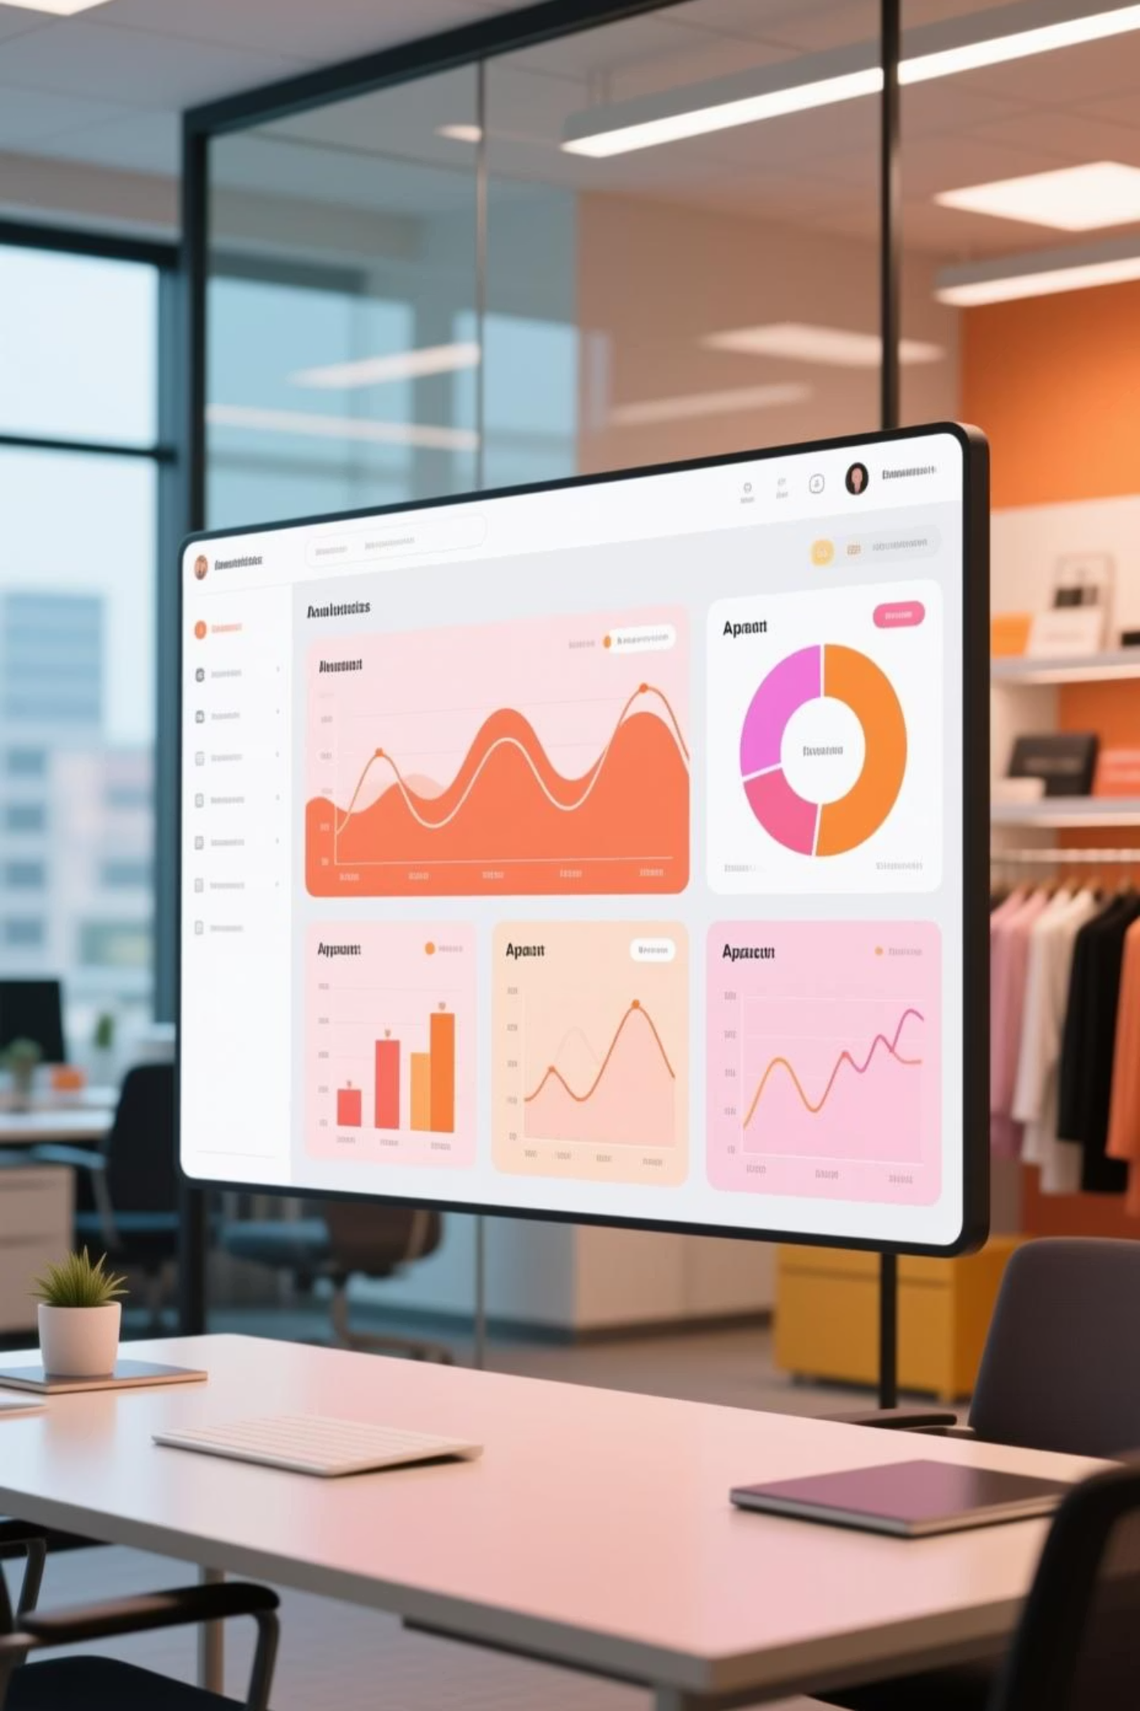
Retail Sales Performance Analysis
Analyzing retail sales performance using Python, SQL, and Power BI to uncover key insights across profitability, customer behavior, and operational efficiency from 2014-2017 Superstore data.
Created by –
Harshit Verma

Slide 2




Project Objectives
Sales & Profitability
Product Performance
Evaluate performance across categories, regions, and customer segments
Identify top and underperforming products and states
Operational Impact
Interactive Insights
Assess discount and shipping mode effects on profit
Build Power BI dashboards for data-driven decision-making

Slide 3

Tools & Dataset Overview
Technology Stack
Dataset Specifications
Python – Data cleaning, transformation, and EDA
10,000 rows across 26 columns
MySQL (XAMPP) – Deep analytical queries
Includes order details, customer segments, product categories, sales, profit, discount, quantity, and shipping information spanning 2014-2017.
Power BI – Dashboard creation and KPI tracking
Excel – Data validation and preliminary analysis

Slide 4
Python Analysis: Key Discoveries
1
2
Sales-Profit Correlation
Regional Performance
Moderate positive correlation, but high Furniture sales lead to losses due to shipping and discounts
West region most profitable; South underperforming significantly
3
4
Top Sales States
Seasonal Trends
California, New York, and Texas dominate sales volume
Sales peak October-December, reflecting holiday shopping patterns
5
6
Segment Leaders
Category Winners
Corporate customers drive most profit; Home Office performs least
Technology most profitable; Furniture often incurs losses

Slide 5


Product Performance Deep Dive
🏆 Top Performers
⚠️ Loss Makers
High-Profit Sub-Categories:
Underperforming Sub-Categories:
Phones
Tables
Accessories
Bookcases
Copiers
Supplies
Shipping efficiency remains strong with most orders delivered in 3-5 days, reflecting robust logistics operations.

Slide 6
SQL Analysis Highlights
Business KPIs
Trend Analysis
Category Breakdown
Geographic Insights
Calculated total sales, profit, and quantity for comprehensive performance tracking
Monthly sales and profit patterns identified for strategic planning
Sales and profit computed by category and sub-category for comparison
Region and state performance measured to highlight strong and weak areas

Slide 7






Advanced SQL Analytics
Product Rankings
Customer Segments
Identified top and least profitable products for strategic adjustments
Examined Consumer, Corporate, and Home Office performance patterns
Shipping Efficiency
Discount Impact
Evaluated shipping mode performance (average days vs profit)
Correlated discount levels with profitability outcomes
Order Value Analysis
RFM Summary
Calculated Average Order Value by customer segment
Created Recency, Frequency, Monetary value customer analysis

Slide 8
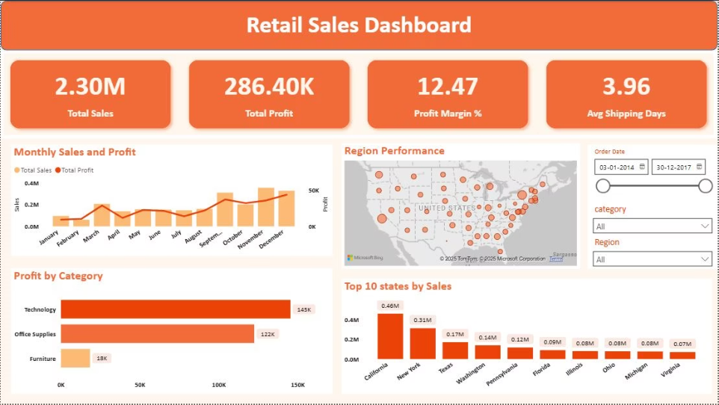
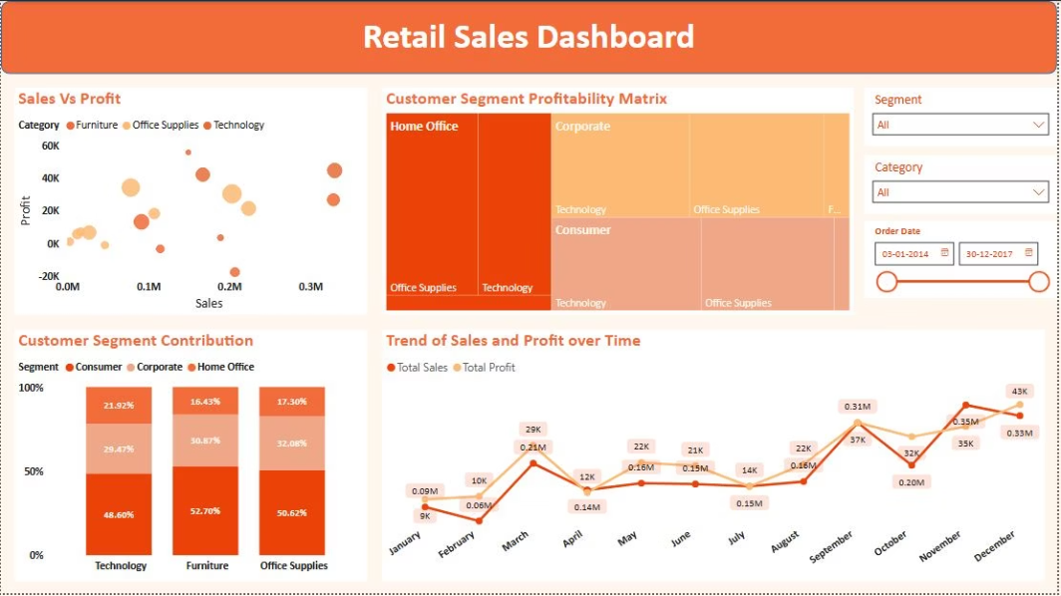
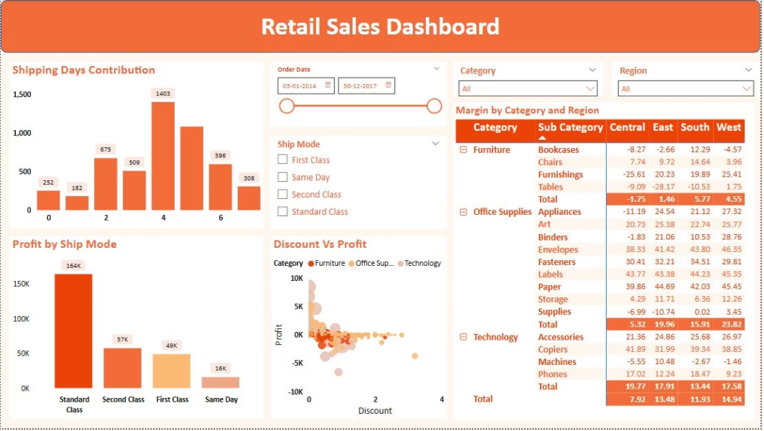



Power BI Dashboard Suite
Three interactive dashboards provide comprehensive visual insights for business decision-making:
Sales Overview
Segment Insights
Operations
KPIs, monthly trends, category profit, regional map, and top states
Scatter plots, profitability matrix, customer contribution, and trend analysis
Shipping analysis, profit by mode, discount impact, and margin matrix

Slide 9

Key Results & Insights
$2.3M
$286K
12.47%
3.96
Total Sales
Total Profit
Profit Margin
Avg Ship Days
Revenue generated across all categories
Net profitability achieved
Overall margin percentage
Average delivery time
Critical Finding: High discount levels strongly correlate with low profit. Technology leads profitability while Furniture lags. West region and California state dominate performance.

Slide 10
Strategic Recommendations
Optimize Furniture
Focus on Technology
Reduce logistics costs and review discount structure to improve margins
Invest marketing in high-profitability category with proven returns
Target Corporate Segment
Promote Winners
Prioritize highest margin customers with superior order value
Push high-margin products: Phones, Copiers, and Accessories
Enhance Delivery
Plan Seasonally
Expand 2-day shipping options to boost customer satisfaction
Prepare inventory for Q4 holiday demand surge
This complete data analytics lifecycle—from Python cleaning to SQL intelligence to Power BI visualization—delivers actionable insights for data-driven business decisions.

Slide 11
Business Recommendations
What actions I would tale If I were the Retail Manager.
Problem
Evidence
Action Recommendation
Furniture Profit very low
Only 18K profit
Reduce Discounting bundle with office supplies.
Same Day Shipping underperforms
Only 16K profit
Add Delivery fee for low-ticket orders.
Low sales in Feb/July
Monthly trend chart
Run promotions + optimize stock levels.
Margin leakage in East/Central
Region table
Partner with local distributors.

Slide 12
Thank You

