Slide 1
ARTIFICIAL INTELLIGENCE (AI)
Connect 4 AI

Slide 2
TABLE OF CONTENTS
01.
02.
03.
The Game
Algorithms used
Functions made
04.
05.
06.
Code Explanation
Code Demonstration
FUTURE Work

Slide 3
01.
About THE GAME

Slide 4
Connect 4
Connect Four is a two-player connection board game, in which the players choose a color and then take turns dropping colored tokens into a seven-column, six-row vertically suspended grid.
The pieces fall straight down, occupying the lowest available space within the column.
The objective of the game is to be the first to form a horizontal, vertical, or diagonal line of four of one's own tokens.

Slide 5
Connect 4
One measure of complexity of the Connect Four game is the number of possible games board positions.
For classic Connect Four played on a 7-column-wide, 6-row-high grid, there are 4,531,985,219,092 positions for all game boards populated with 0 to 42 pieces.

Slide 6
02.
Algorithms Used

Slide 7
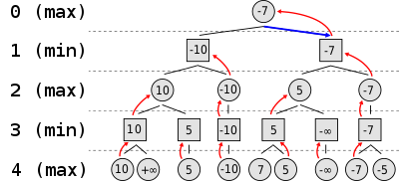
Mini-max
Properties of Mini-Max algorithm:
It will definitely find a solution (if exist), in the finite search tree.
Optimal- Min-Max algorithm is optimal if both opponents are playing optimally.

Slide 8

Mini-max
Time complexity - As it performs DFS for the game-tree, so the time complexity of Min-Max algorithm is O(bm), where b is branching factor of the game-tree, and m is the maximum depth of the tree.
Space Complexity - Space complexity of Mini-max algorithm is also similar to DFS which is O(bm)

Slide 9
03.
Functions

Slide 10
FUNCTIONS
•minimax() - Recursive function to explore various states of the game and return with the best value, alpha beta pruning is used to optimize the game with default values (alpha:-1,beta:1)
•create_board() – Creating a matrix of rows and columns
•drop_piece() – Players choosing which column to drop the piece at

Slide 11
FUNCTIONS
•is_valid_location() – If the function returns true then the players can choose to drop at that column , if its false then the column is filled to the top.
•get_next_open_row() – Checking which row is empty in the column selected by the player and returning it

Slide 12
FUNCTIONS
•printBoard() - Flipping the board over x axis to make (0,0) at the lower left
•winning_move() – Checks all the horizontal, vertical, positive and negative slope diagonal for wins
•game_start() - runs the game until either the computer or the human wins

Slide 13
THANK YOU!

