Slide 1
LANGUAGE DETECTION
USING MACHINE LEARNING

Slide 2
TABLE OF CONTENTS
01
02
03
04
ALGORITHMS USED
CODE ANALYSIS
FUTURE WORK
ABOUT THE PROJECT

Slide 3
01
ABOUT THE PROJECT

Slide 4
INTRODUCTION
There are a huge number of languages all over the world. These language scripts can make their way into our daily lives as well through digital media like emails, articles, blogs etc. But one may not be aware of which language a certain script in their junk email drawer may belong to. We have created a model which alleviates this problem.

Slide 5
02
ALGORITHMS USED

Slide 6
OUR METHODS
Linear Discriminant Analysis
Principal Component Analysis

Slide 7
LINEAR DISCRIMINANT ANALYSIS
Linear Discriminant Analysis as its name suggests is a linear model for classification and dimensionality reduction. LDA projects data from a D dimensional feature space down to a D’ (D>D’) dimensional space in a way to maximize the variability between the classes and reducing the variability within the classes.

Slide 8
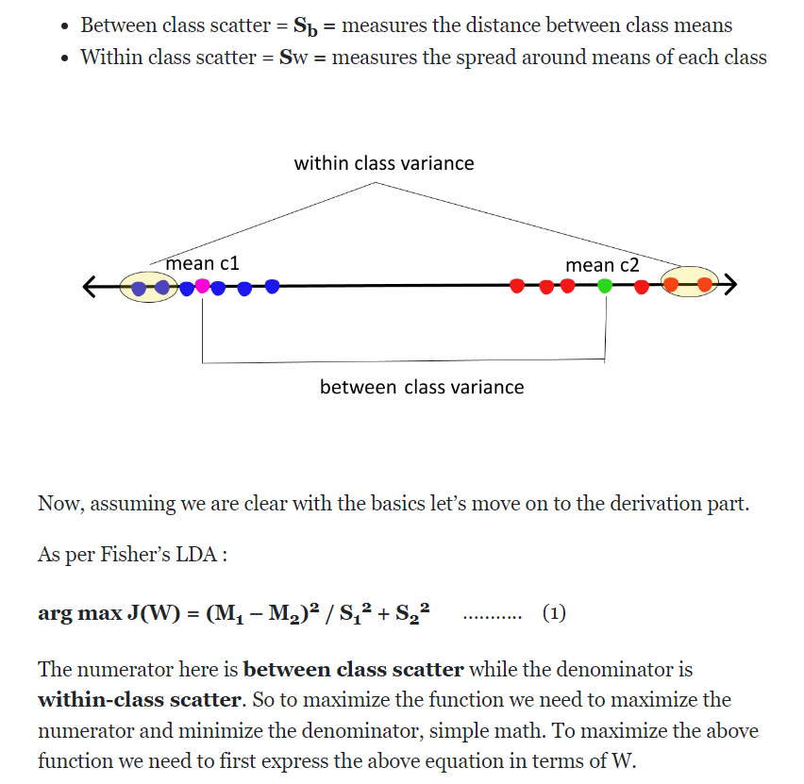
LINEAR DISCRIMINANT ANALYSIS

Slide 9
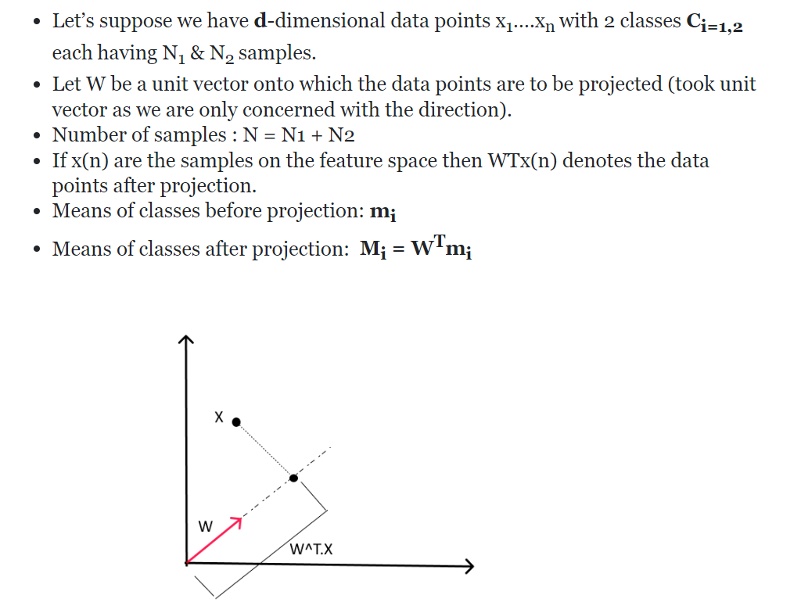
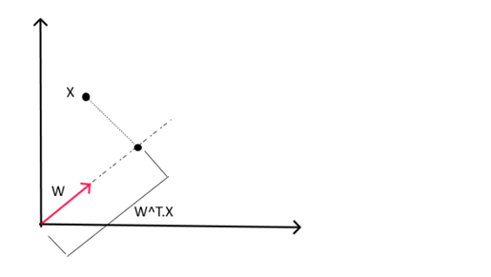
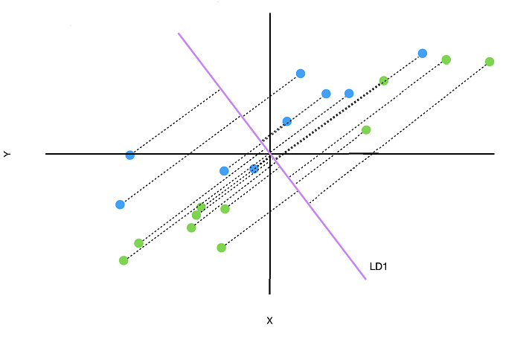
LINEAR DISCRIMINANT ANALYSIS

Slide 10
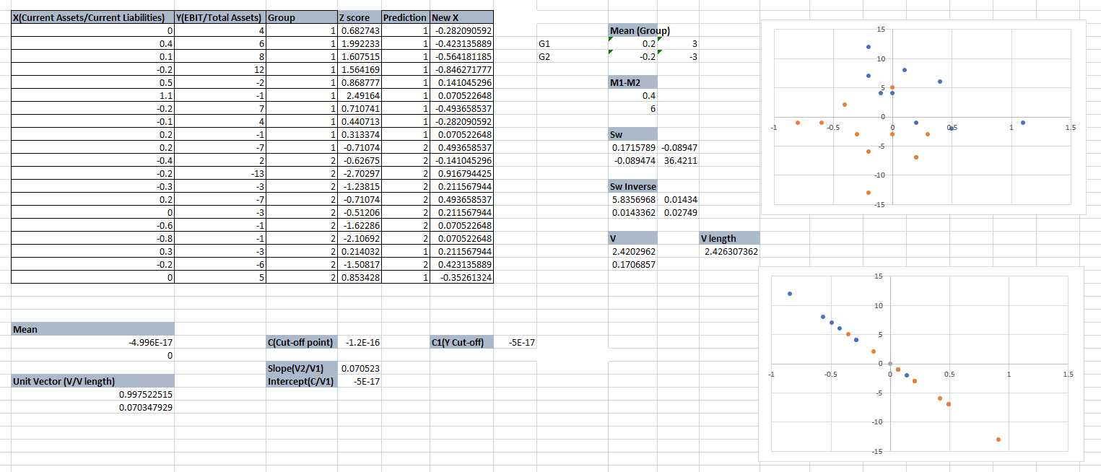
WORKING ON EXCEL

Slide 11
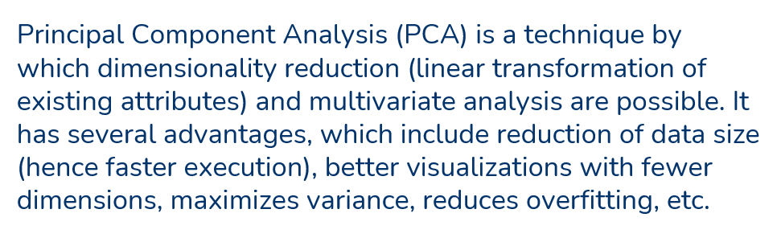
PRINCIPAL COMPONENT ANALYSIS

Slide 12
PRINCIPAL COMPONENT ANALYSIS
Now as there are numerous principal components for large data, it is primarily selected on basis of which accounts for the largest possible variance. As a result, the next components are also decided in decreasing order of variance from earlier components by ordering eigenvalues, provided that these also do not have a correlation with earlier principal components. Then we discard those components with less eigenvalue/vectors (less significant).

Slide 13
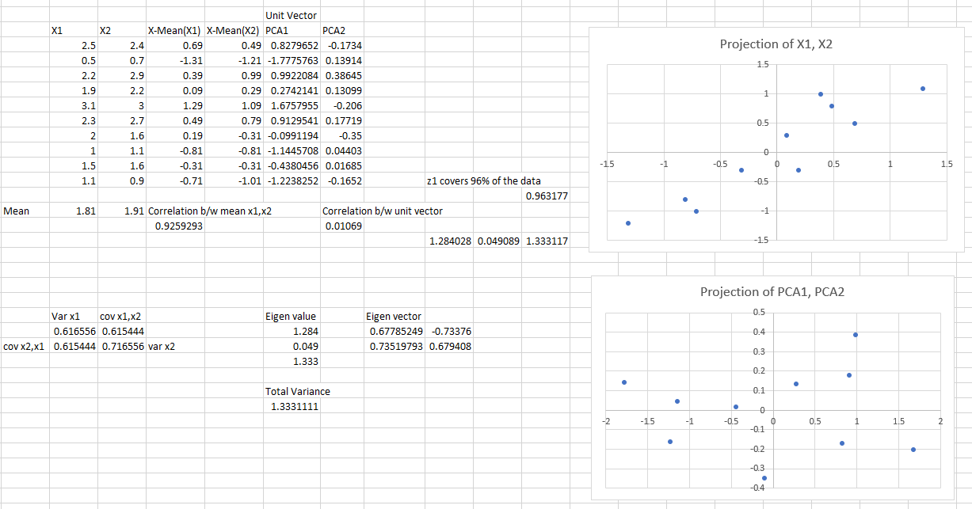
WORKING ON EXCEL

Slide 14
03
CODE ANALYSIS

Slide 15
04
FUTURE WORK

Slide 16
FUTURE WORK
1. Scalability:
We can add more languages and more images of each language to further strengthen our model and make more accurate predictions.
2. Deployment:
We can host this algorithm on a website or an app so that everyone can use it at their convenience.
3. Better algorithm:
It is well known that a Convoluted Neural Network or CNN is objectively better than LDA in images with higher resolution.
We could replace LDA with CNN for classification and improve our model considerably.

Slide 17
THANK YOU!

