Slide 1
IoT Based Smart Fish Farming System for Sustainable
Aquaculture
By
Harshkumar Bhamare

Slide 2
Project Title : IoT Based Smart Fish Farming System for Sustainable Aquaculture
Project Domain: Internet of Things

Slide 3
Motivation
Our project is driven by the desire to modernize fish farming and alleviate the struggles of aquacultural farmers. By introducing IoT-based monitoring for pH, temperature and feeding schedules, we aim to improve fish health, streamline operations, and reduce costs. This technology-driven approach not only enhances productivity but also contributes to sustainable seafood production, benefiting both farmers and the environment.

Slide 4
Problem Statement
Aquacultural farmers struggle with high costs and operations due to manually monitoring pH, temperature, and turbidity. Inadequate water quality control leads to bacterial growth, fish mortality, and infections. Fish farmers also lack precise timing for feeding, impacting fish health and growth due to irregular feeding schedules.

Slide 5
Objective
Optimize Fish Health : Implement a system to monitor water quality parameters in real-time.
Reduce Operational Costs : Minimize resource wastage and energy consumption through proposed system.
Ensure Sustainable Seafood Production : Contribute to sustainable seafood production by maintaining a healthy environment for fish farming and promoting the overall well-being of aquatic life.

Slide 6
Methodology
Sensor Deployment : Deploy IoT sensors within the fish farming area to measure crucial parameters, including water temperature, pH level
Centralized Data Transmission : Establish a central control system that aggregates data from all deployed sensors.
Accessibility and Monitoring : Provide real-time access to the collected data, allowing them to monitor water parameters remotely.

Slide 7
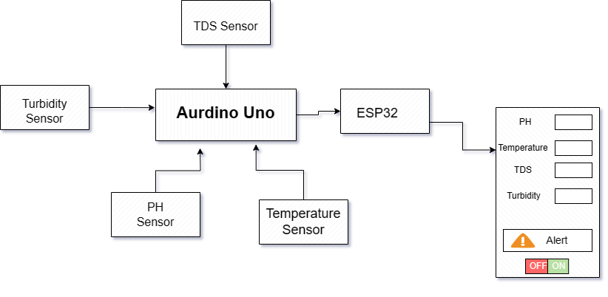
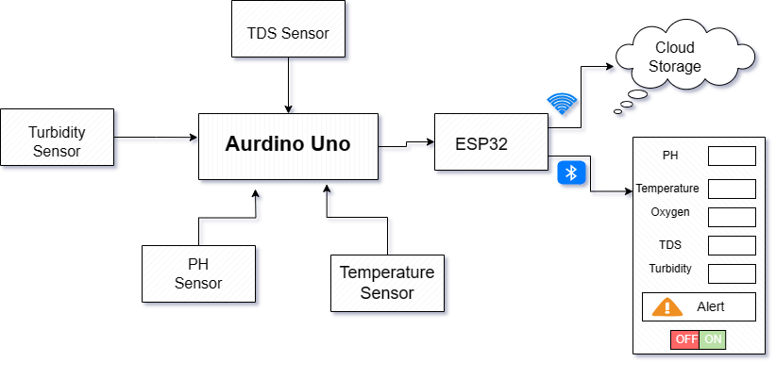
Architecture

Slide 8
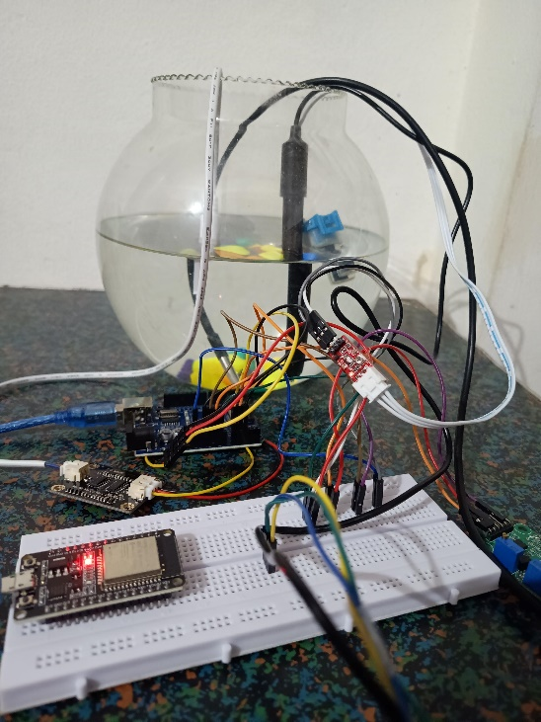
Results
The IoT-based Smart Fish Aquaculture Monitoring System proposed here represents the deployment of IoT sensors and centralized data transmission, it enables real-time monitoring of crucial water parameters. The system's user-friendly interface, accessible via computers, facilitates proactive management. Notably, its cost-effectiveness, achieved through the use of affordable sensors and minimal additional expenses, sets it apart. Compared to existing systems, it stands out for its comprehensive features, affordability, and user accessibility. In sum, this system promises to revolutionize aquaculture management, improving efficiency, productivity, and sustainability while contributing to fish Health

Slide 9
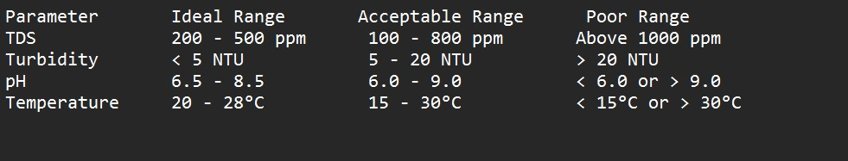
Results

Slide 10
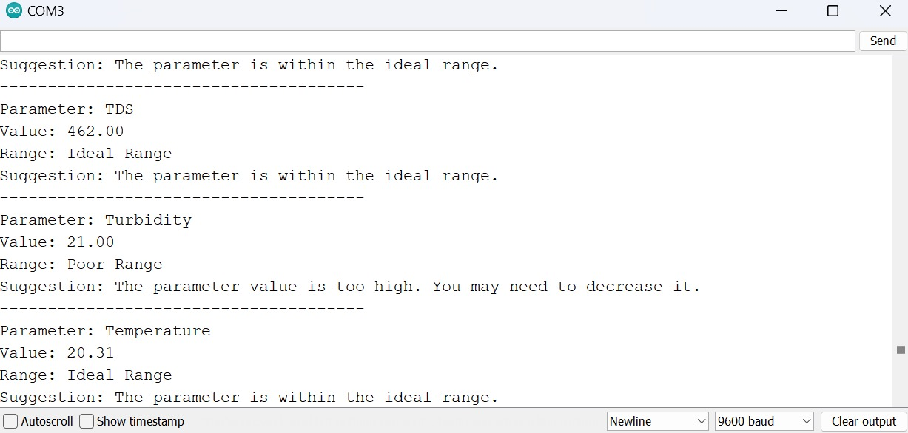
Results
Pond Water

Slide 11
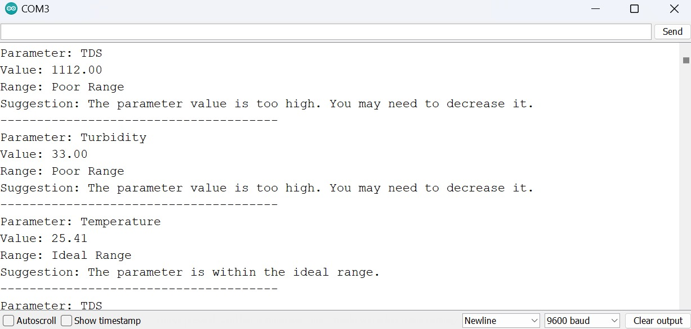
Results
Detergant Water

Slide 12
Observation
Day | Temperature (°C) | pH | TDS (ppm) | Turbidity (%)
Monday | 28 | 6.1 | 410 | 45.2%
Tuesday | 27 | 7.1 | 430 | 45.1%
Wednesday | 29 | 6.6 | 420 | 45.5%
Thursday | 26 | 6.9 | 412 | 45.9%
Friday | 30 | 5.4 | 420 | 45.3%
Saturday | 28 | 6.8 | 415 | 45.4%
Sunday | 31 | 6.7 | 405 | 45.2%

Slide 13
Conclusion
IoT-based Smart Fish Aquaculture Monitoring System provides a comprehensive solution for fish farming management. Its utilization of IoT technology allows for real-time monitoring of critical water parameters, facilitating informed decision-making and proactive intervention. With its user-friendly interface and cost-effective approach, the system ensures accessibility and affordability for fish farmers. Moreover, its scalability enables seamless integration with existing infrastructure, promising efficient operations without substantial additional costs. The system's adoption holds significant potential to enhance productivity and sustainability in the aquaculture industry, emphasizing the importance of continued research and development in this field.

Slide 14
Comparative Analysis
Parameters | Proposed System | Existing System
Integration with Existing Farm Infrastructure | Seamless Integration: Ensures compatibility with existing farm infrastructure without additional costs, minimizing implementation expenses. | Integration Expenses: Other systems may incur additional integration expenses, including customization or retrofitting costs, potentially increasing project budget and complexity.
Scalability and Adaptability | Flexible System Design: Designed to be portable and adaptable to evolving farm needs, ensuring cost-effective scalability and integration. | Limited Portability: Other systems may lack portability features, leading to additional expenses for system relocation or expansion.
Expert | No need of expert | Need Expert Assistance

Slide 15
Reference
Siqabukile Ndlovu, Sibonile Moyo, Samkeliso Dube & Sindiso Nleya,” Precision Fish Farming Systems: A Mapping Study”, Zimbabwe Conference on Information Communication & Technology (ZCICT),2022
Yi-Chen Wu., Chiung-Hsing Chen., Shao-En Kao.,” Fish Farm Management System Based on IoT”, International Symposium on Intelligent Signal Processing and Communication Systems (ISPACS),2021
S M Ravi Kumar, Thayyaba Khatoon Mohammed, Seeram Srinivasa Rao.” IoT Based Fish Pond Monitoring System to Enhance Its Productivity”, International Conference on Innovative Practices in Technology and Management (ICIPTM 2023).
D. Liu, C. Zhang, J. Wang, and K. Jiang, "An Intelligent Monitoring System for Aquaculture Water Environment Based on Internet of Things," in IEEE Access, vol. 8, pp. 55674-55686, 2022.
C. Chen, Y. Liu and H. Zhang, "Design and Implementation of a Fishery Ecological Environment Monitoring System Based on Internet of Things," in IEEE Access, vol. 8, pp. 123282-123293, 2023.
R. Agrawal, A. Bajpai and A. K. Pradhan, "Design and Implementation of Wireless Sensor Network for Monitoring Water Quality Parameters in Fish Farms," 2019 International Conference on Sustainable Energy, Electronics.

Slide 16
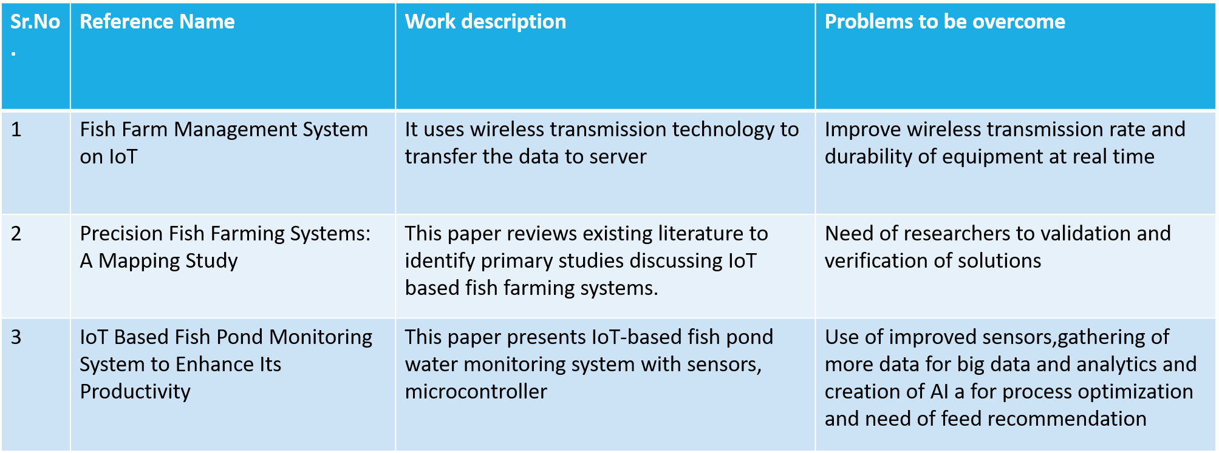
Work description & Problems to be overcome

Slide 17
Sr.No. | Reference Name | Work Description | Problems to be overcome
4. | An Intelligent Monitoring System for Aquaculture Water Environment Based on Internet of Things | Developed an intelligent monitoring system utilizing IoT for aquaculture water quality assessment. | Challenges include sensor accuracy, energy efficiency, and data processing techniques for real-time decision-making.
5. | Design and Implementation of a Fishery Ecological Environment Monitoring System Based on Internet of Things | Implemented a fishery ecological environment monitoring system integrating IoT technologies. | Overcoming issues such as sensor reliability, data transmission range, and robustness in harsh aquatic environments.
6. | Design and Implementation of Wireless Sensor Network for Monitoring Water Quality Parameters in Fish Farms | Implemented a wireless sensor network for monitoring water quality parameters in fish farms. | Overcoming limitations such as sensor battery life, data transmission range, and interference in densely populated IoT environments.

Slide 18
THANK YOU…!!

