Slide 1

Research Review on Iconography
Present by :
Harshkumar Beladiya ( 23BCE030 )
Yagnik Baldaniya ( 23BCE027 )
Guide By:
Anuja Nair
1

Slide 2
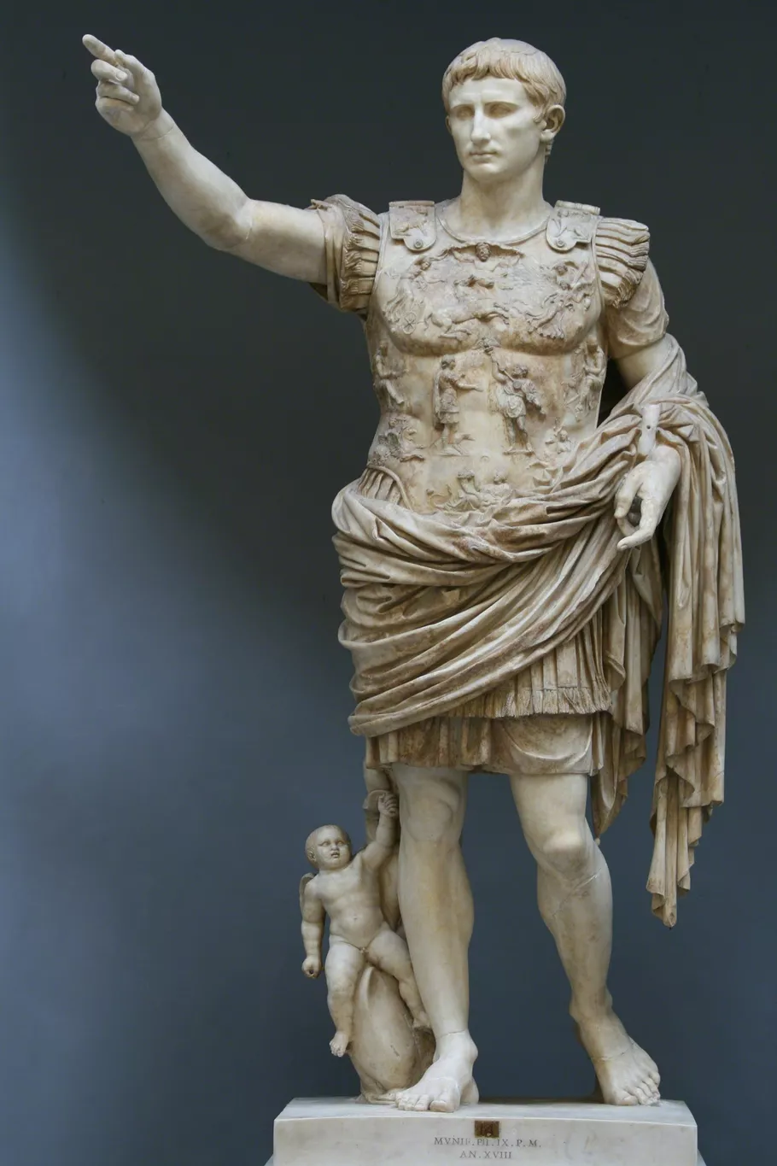
Introduction to Iconography
Iconography is the systematic study of symbols, images, motifs, and visual representations.
It examines how visual elements convey specific meanings, beliefs, and narratives.
Meaning is interpreted based on historical, cultural, religious, and social contexts.
Scope of Iconography
Interpretation of visual symbols in artworks, architecture, manuscripts, and artifacts
Analysis of religious imagery, mythological figures, and sacred symbols
Study of modern visual symbols such as logos, icons, emojis, and digital pictograms
2

Slide 3



Research Objectives
These objectives form the bedrock of this research, guiding the systematic exploration of iconographic studies.
Literature Review on Iconography
Analysis of Research Trends, Merits, and Limitations
Development of Taxonomies
To systematically study existing research papers related to iconography
To understand how iconography has been approached across different disciplines
To identify dominant themes, methodologies, and areas of focus in prior studies
To examine current research trends in iconography studies
To analyze the strengths (merits) of existing approaches and models
To identify limitations, gaps, and unexplored areas in the literature
Taxonomy for Iconography Applications
Taxonomy for Cultural and Religious Iconography

Slide 4

Methodology Adopted (So Far)
Identified and studied multiple research papers on iconography
Extracted key information from each paper
Performed comparative analysis using a structured table
Designed taxonomies based on application domains and cultural aspects

Slide 5
Literature Review – Work till now
A focused literature review was conducted, examining several key research papers related to iconography. This stage involved a meticulous examination of each paper's core components.
Literature review summarized in a comparative Excel table
Objectives of each paper
Clarifying the specific aims and goals of each paper.
Methodologies used
Understanding the research approaches and techniques used for iconography.
Strengths and weaknesses
Assessing the merits and limitations of each research contribution.
5

Slide 6
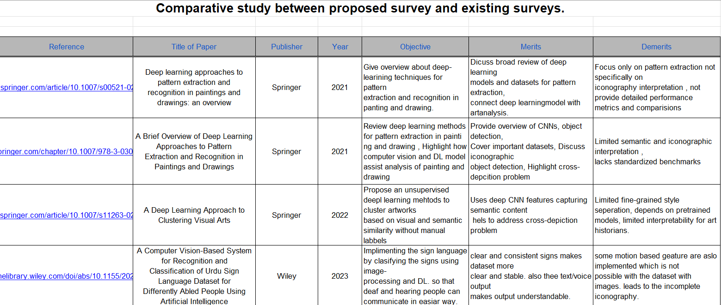
6

Slide 7
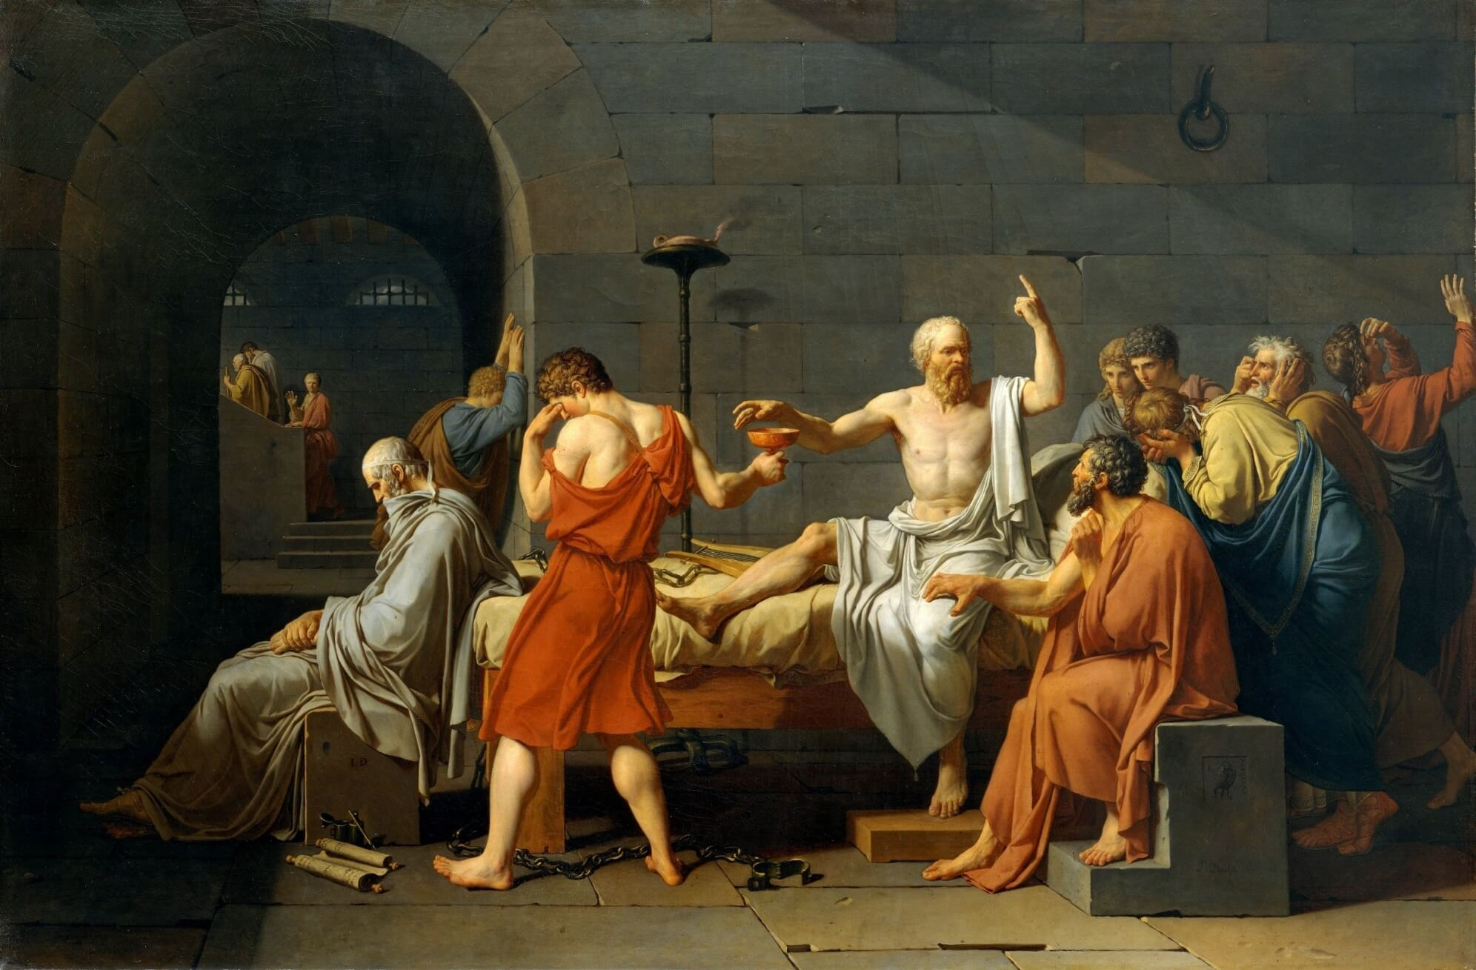
Key Observations from Literature Review
Majority of studies concentrate on traditional art forms, sculptures, paintings, and murals
Limited attention to interdisciplinary or cross-domain applications of iconography
Most research relies on manual interpretation and expert analysis
Lack of automated systems for symbol detection, classification, and interpretation
Limited availability of annotated datasets for iconographic research
Absence of a standardized or unified taxonomy for iconography
Insufficient comparative studies across cultures and traditions
Limited analysis of symbolic variations across regions and historical periods

Slide 8
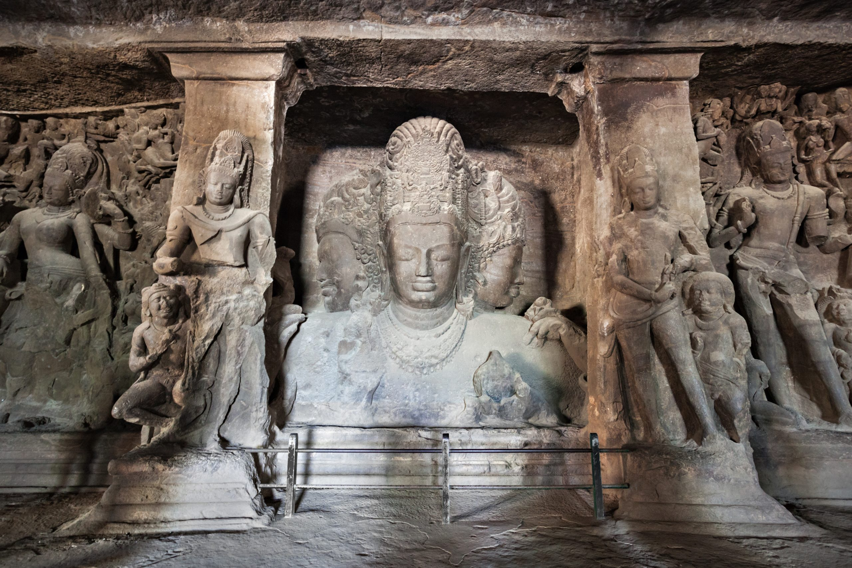
Need for Taxonomy in Iconography
Iconography research is widely scattered across multiple disciplines such as art history, religious studies, archaeology, media, and computer science
Ambiguity in defining iconographic categories and application areas
Overlapping or redundant research due to unclear domain boundaries
Provides a structured and systematic framework for classification
Bridges traditional iconography with modern technological applications
Organizes research areas into well-defined categories
Supports comparative and interdisciplinary studies

Slide 9
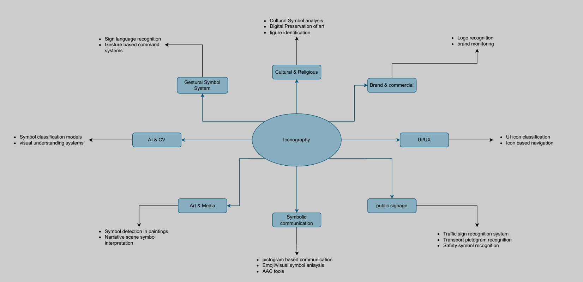
Taxonomy for Iconography Applications

Slide 10
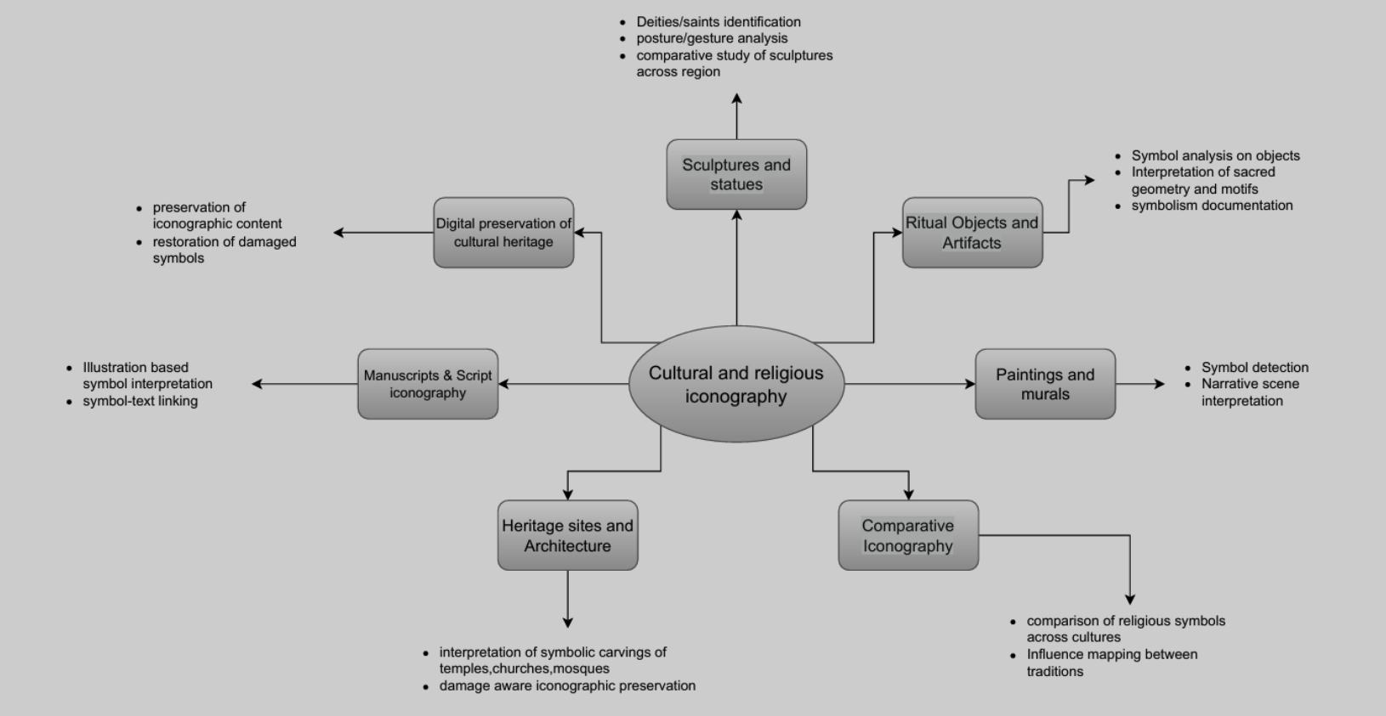
Taxonomy for Cultural & Religious Iconography

Slide 11
Conclusion
Summarizes the research work completed on iconography till date
Systematic literature review and comparative analysis were conducted
Structured taxonomies for iconography applications and cultural–religious iconography were developed
Made Excel for ,Comparative study between proposed survey and existing surveys.

Slide 12
Thank you
12

